Slide 1
Hybrid Application Development
Ionic Framework
Mobile App Development
Hybrid App
Team members:
Prathamesh Bagwe TE IT-1
Sanket Devlekar TE IT-1

Slide 2
Mobile Application Development

Slide 3

Native Applications
Downloaded directly to the device and stored locally.
Interfaces directly with the mobile OS.
It can access all the API’s that are made available by the OS.
Developer writes source code and includes images, audio files and puts in into a binary executable file.
These tools are included in the Software Development Kit(SDK).
Notes:
Add examples such as Angry Birds, Retrica(camera app).

Slide 4
Application Programming Interface(API)
It is a set of routines, protocols, and tools for building software applications.
Low-level APIs
The app can interact directly with the touch screen or keyboard, render graphics, connect to networks, process audio received from the
microphone, play sounds through the speaker or headphones, or
receive images and videos from the camera.
High-level APIs
Browsing the web, managing the calendar, contacts, photo album and, of course, the ability to make phone calls or send and receive text
messages.

Slide 5
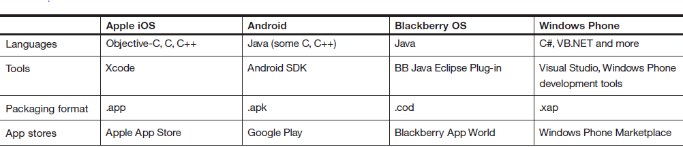
APIs for various platforms

Slide 6

Web Applications
A web application or web app is any software that runs in a web browser.
It is created in a browser-supported programming language such as the combination of JavaScript, HTML and CSS.
HTML5 provides access to rich media, geolocation services and offline availability.
To help developers build the client-side UI, a
growing number of JavaScript toolkits have been created, such as dojox.mobile,
Sencha Touch and jQuery Mobile.
Notes:
Add examples such as Google docs, icloud.

Slide 7
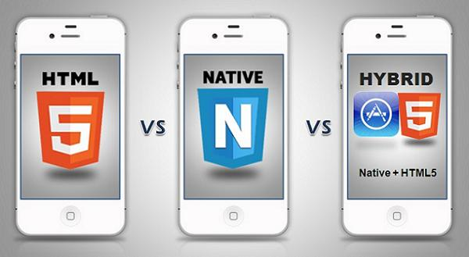
Hybrid Applications

Slide 8
Overview
The hybrid approach combines native development with web
technology.
Developers write significant portions of their application in cross-platform web technologies, while maintaining direct access to native APIs when required.
The native portion of the app can be developed independently, whereas the web portion of the app can be either a web page that resides
on a server.
Notes:
The native portion of the application uses the operating system APIs to create an embedded HTML rendering engine that serves as a bridge between the browser and the device APIs.
This bridge enables the hybrid app to take full advantage of all the features that modern devices have to offer.

Slide 9
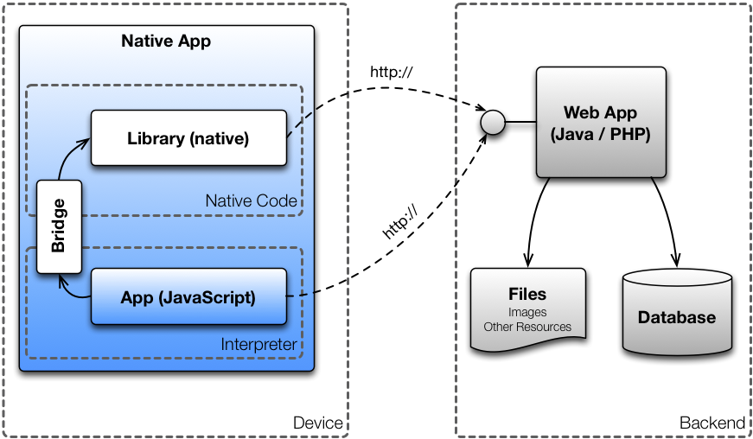
Architecture of Hybrid Apps

Slide 10
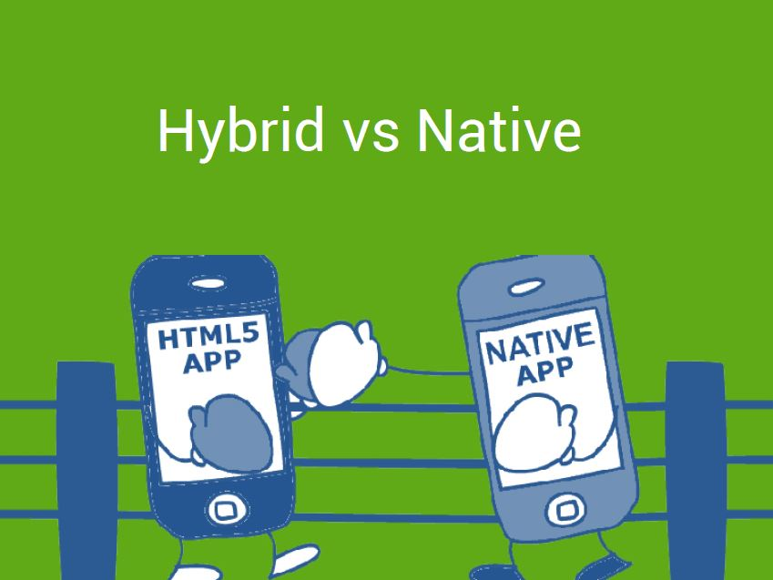

Slide 11
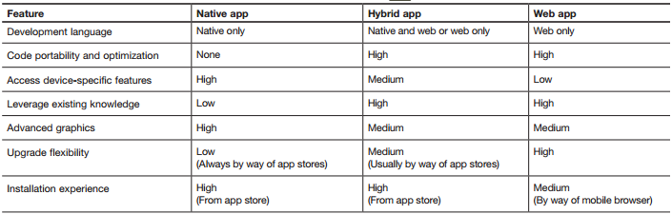

Slide 12
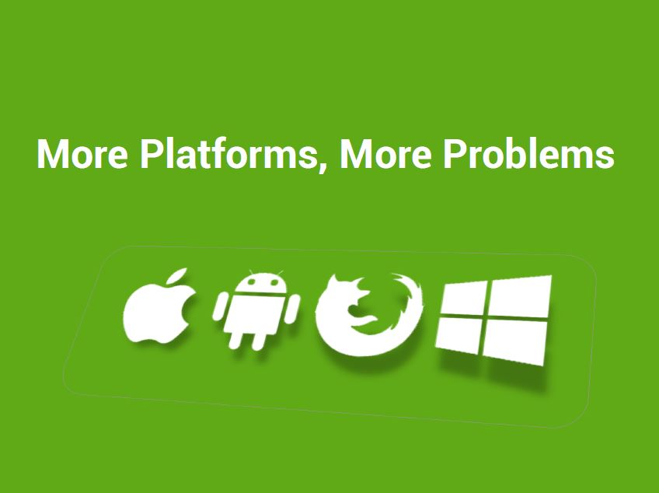

Slide 13
Hybrid App Features
Platform independent (iOS, Android etc.)
HTML5, CSS3 & JS
Quick development
Direct access to native APIs with Cordova
Hybrid Apps

Slide 14
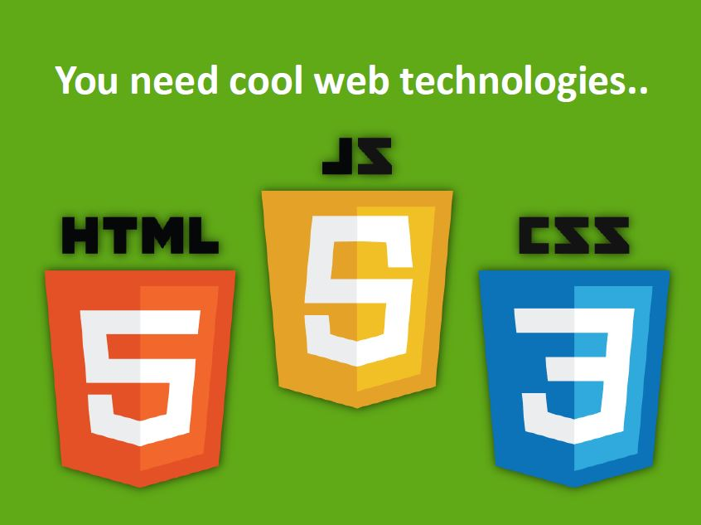

Slide 15

Cordova , Angular JS and Ionic

Slide 16
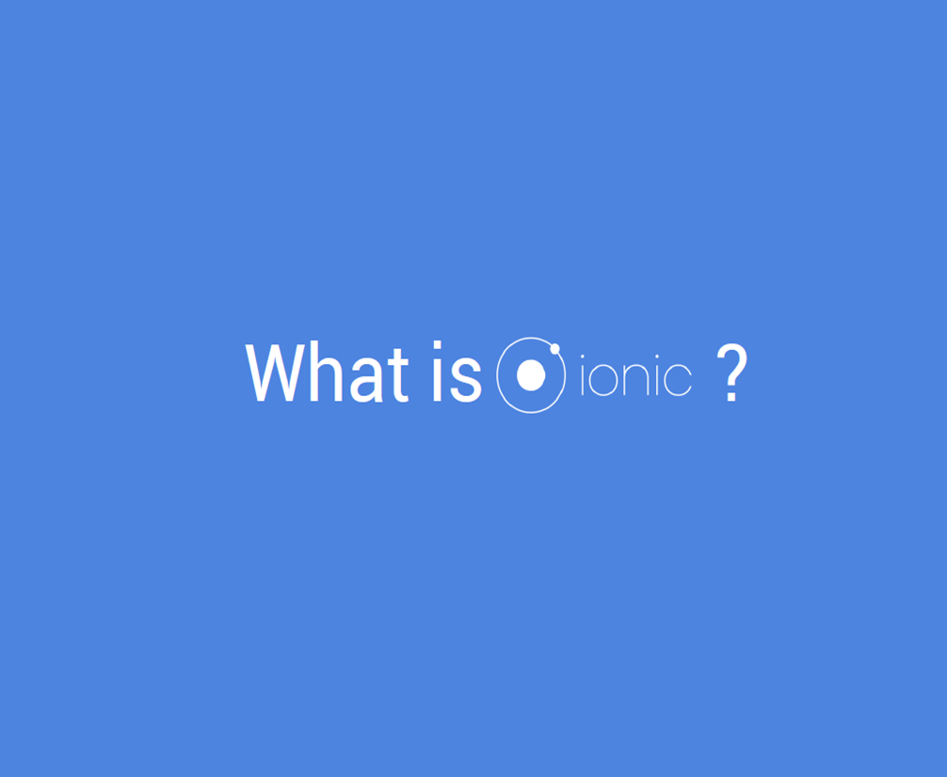

Slide 17
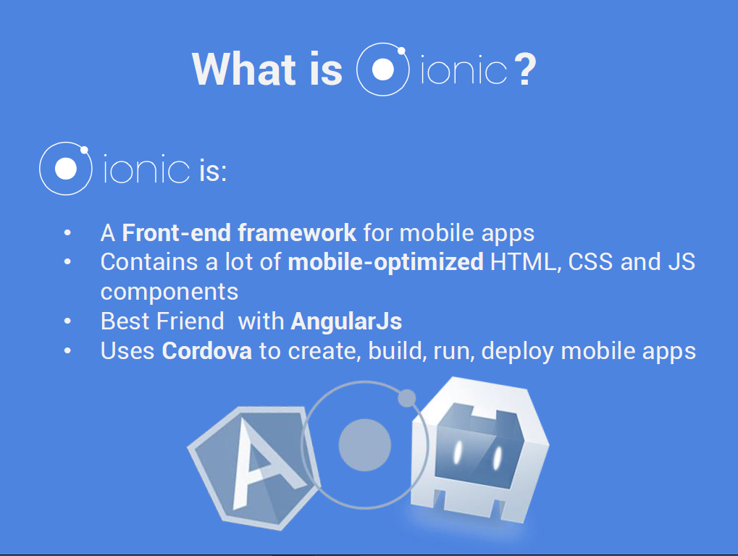

Slide 18
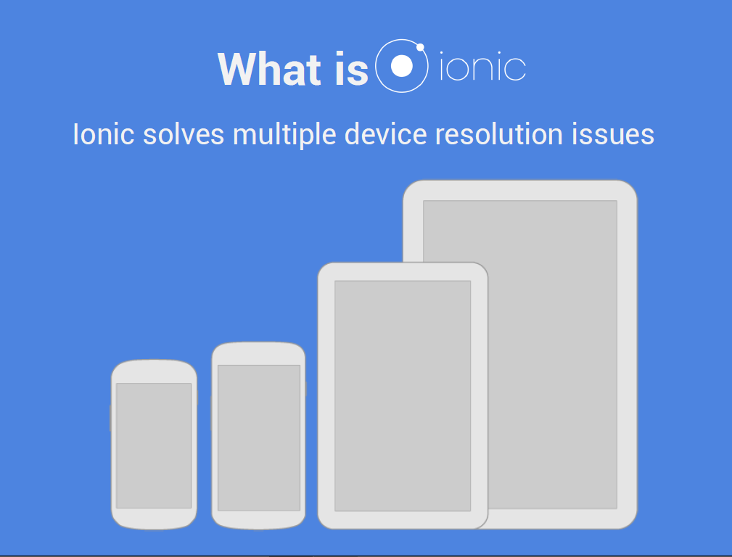

Slide 19
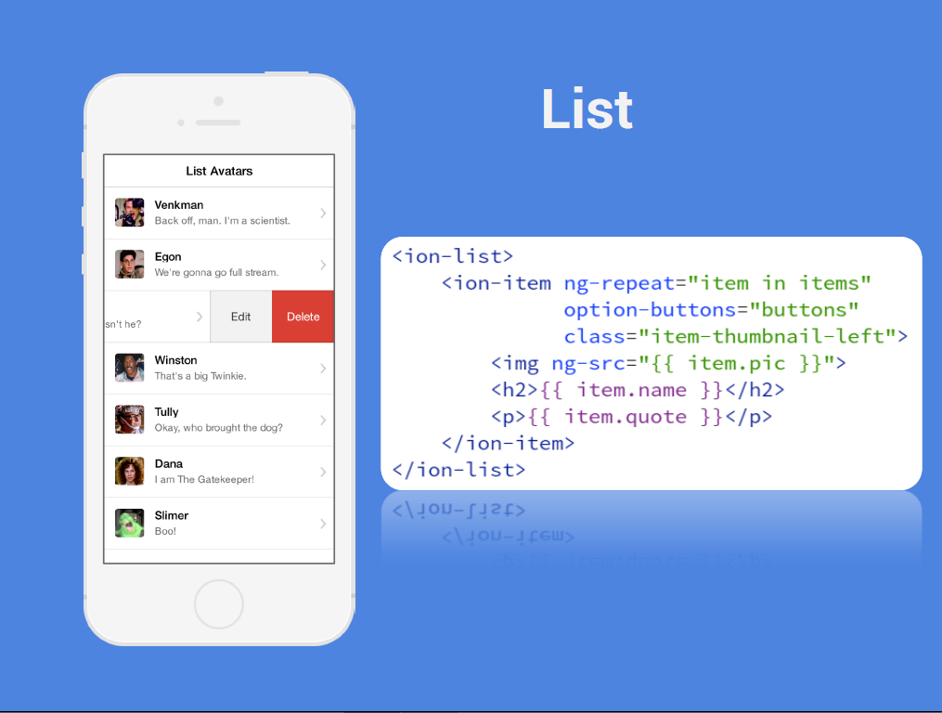

Slide 20
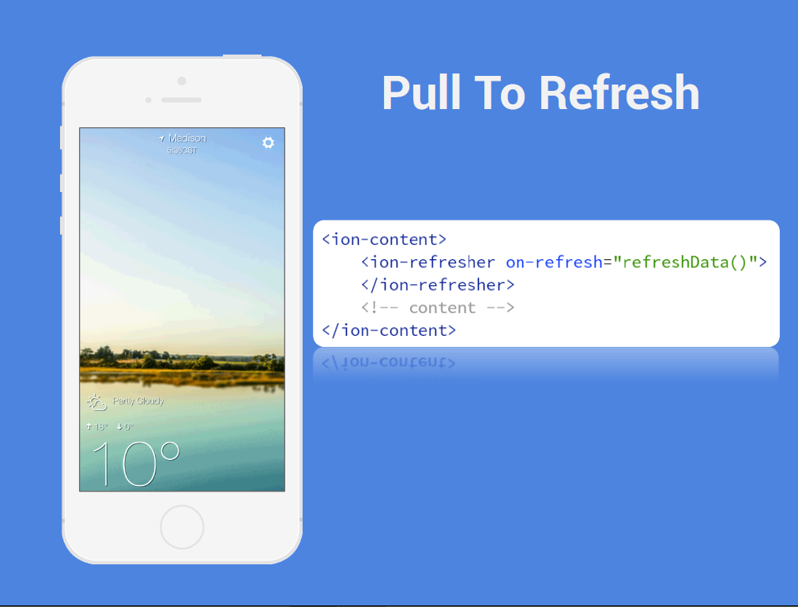

Slide 21
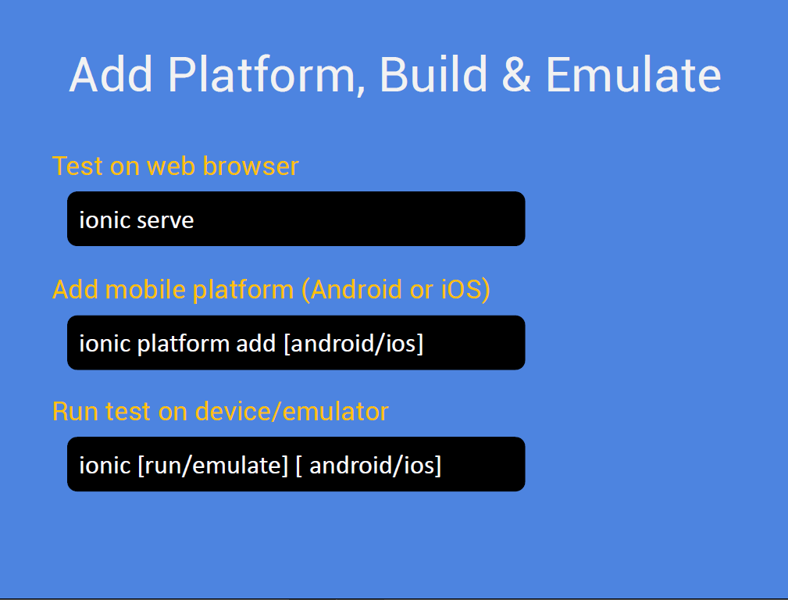

Slide 22
Thank you!
Notes:
You can remove this slide if you need. But we will strongly appreciate that you help us to spread the voice and let your colleagues and audience to download our free templates.
Here are a free resources:
Prepare your presentations: SlideHunter.com lets you download free templates for your presentations.
Share online: SlideOnline.com lets you upload presentations for free.

