Slide 1
Hybrid Application Development
Ionic Framework
Mobile App Development
Hybrid App
Team members:
Prathamesh Bagwe TE IT-1
Sanket Devlekar TE IT-1

Slide 2
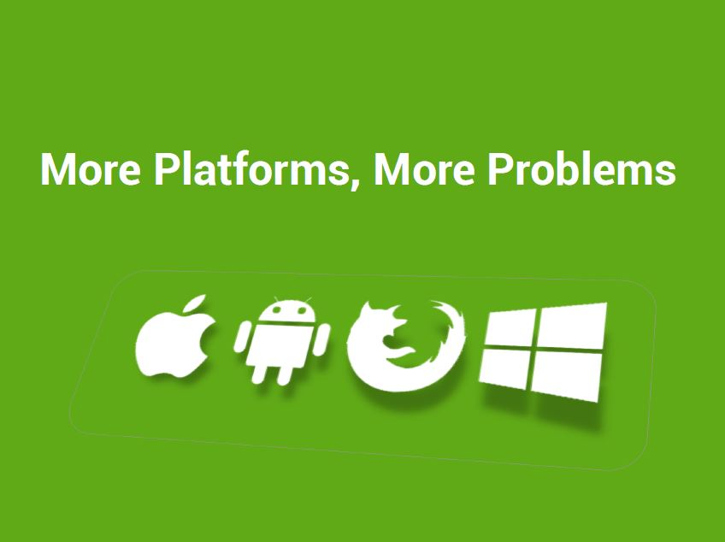

Slide 3
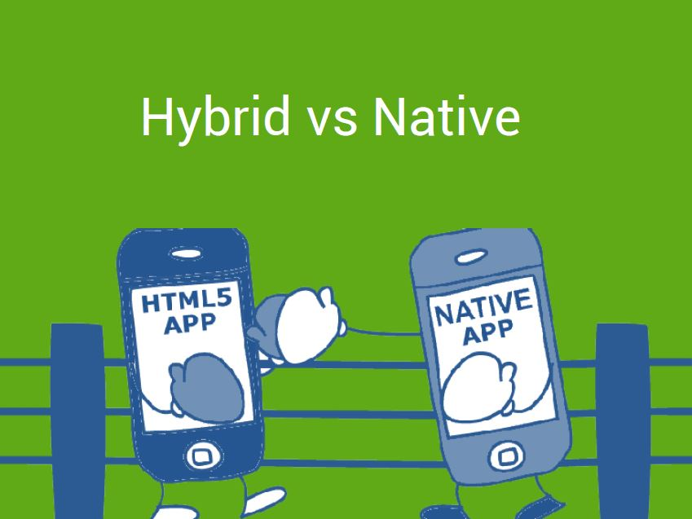

Slide 4
Hybrid VS Native
Platform independent (iOS, Android etc.)
HTML5, CSS3 & JS
Quick development
Direct access to native APIs with Cordova
Hybrid Apps

Slide 5
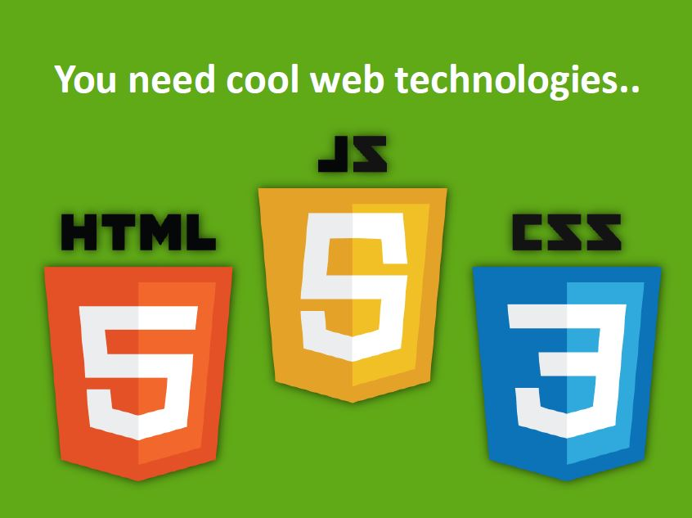

Slide 6

Cordova , Angular JS and Ionic

Slide 7
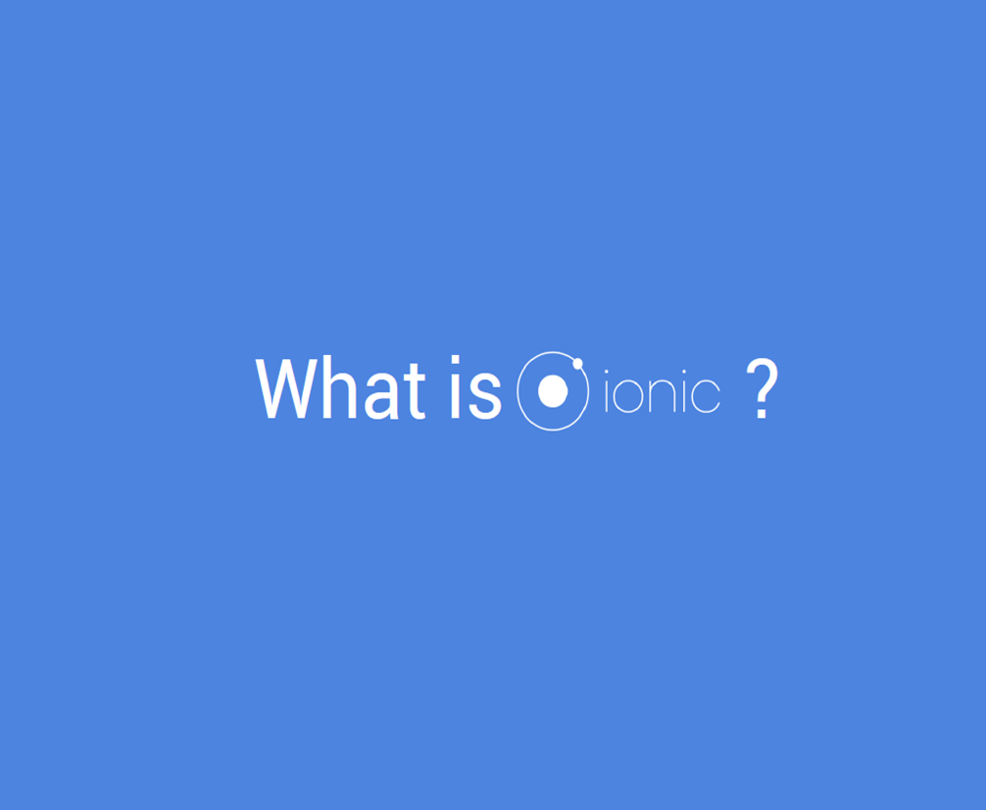

Slide 8
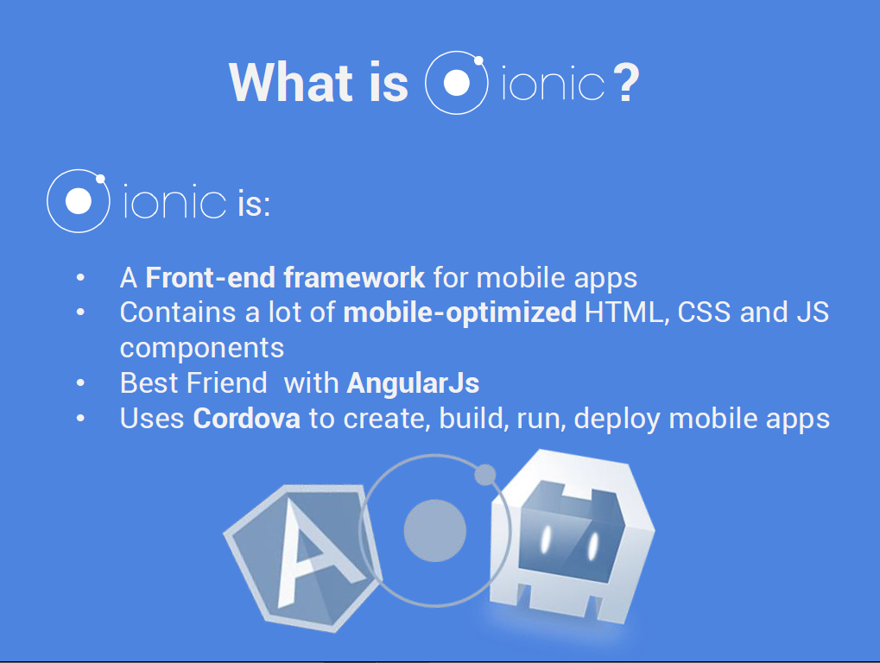

Slide 9
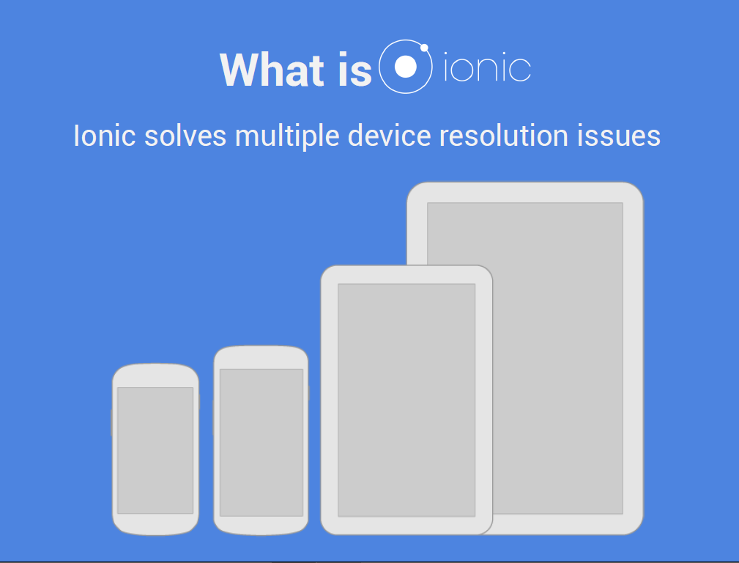

Slide 10
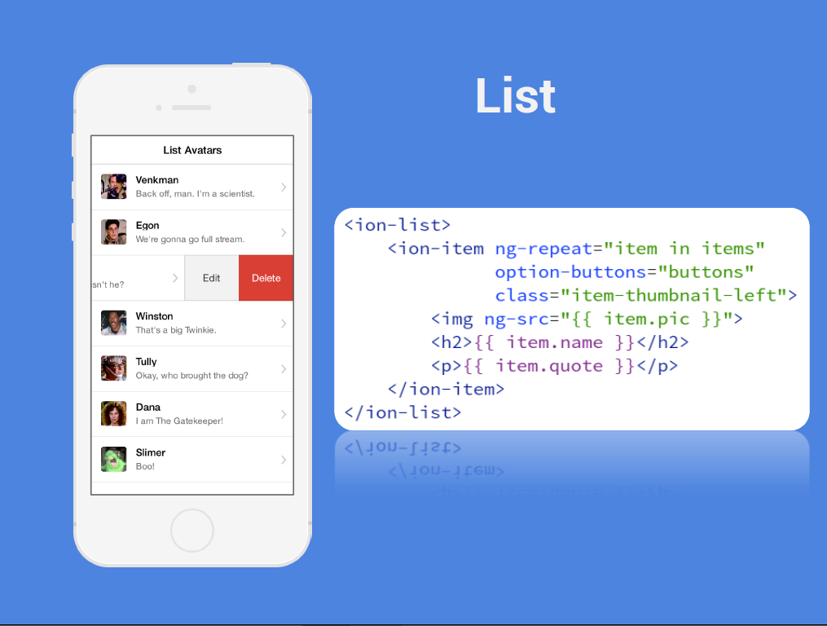

Slide 11
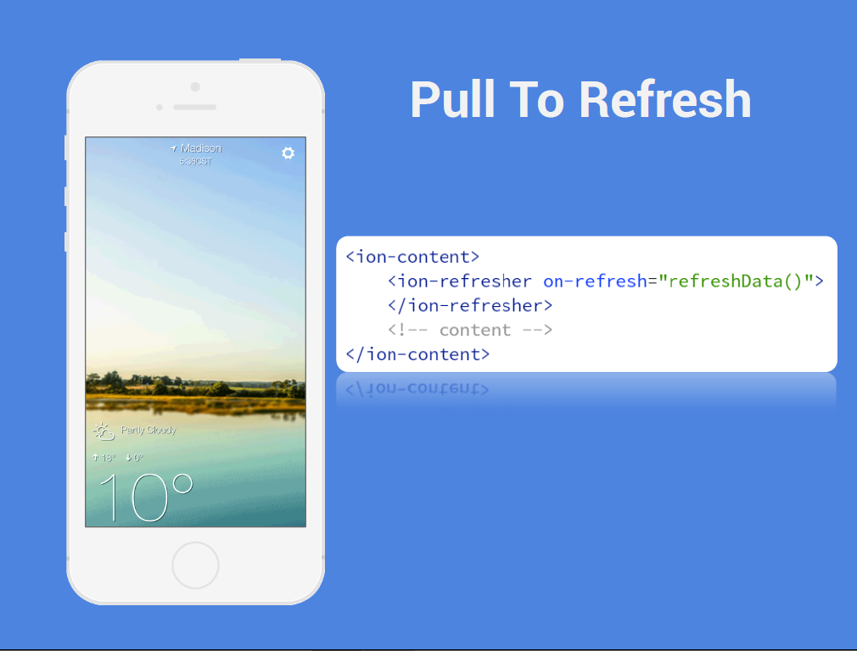

Slide 12
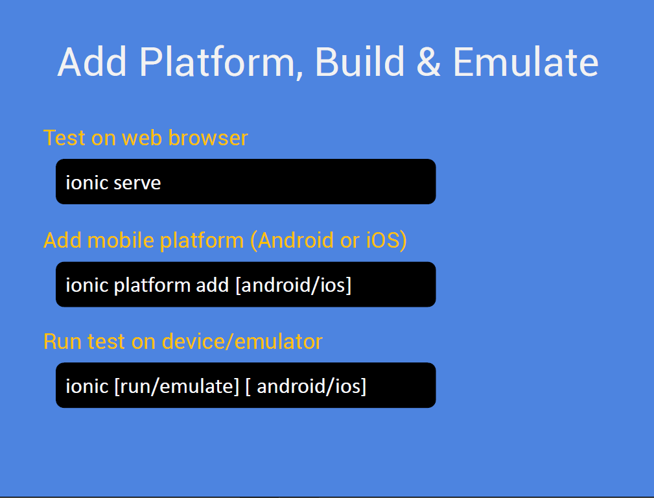

Slide 13
Thank you!
Notes:
You can remove this slide if you need. But we will strongly appreciate that you help us to spread the voice and let your colleagues and audience to download our free templates.
Here are a free resources:
Prepare your presentations: SlideHunter.com lets you download free templates for your presentations.
Share online: SlideOnline.com lets you upload presentations for free.

