Slide 1
Name: Sanket Saboo Roll No: 1911112 Batch: B3

Slide 2
Real-Time Smart Attendance System using Face Recognition Techniques
Authors:
Shreyak Sawhney, Karan Kacker ,Samyak Jain,
Shailendra Narayan Singh , Rakesh Garg.

Slide 3
Abstract

Slide 4
Abstract
The management of the attendance can be a great burden on the teachers if it is done by hand. To resolve this problem, smart and auto attendance management system is being utilized. But authentication is an important issue in this system. The smart attendance system is generally executed with the help of biometrics.
Face recognition is one of the biometric methods to improve this system. Being a prime feature of biometric verification, facial recognition is being used enormously in several such applications, like video monitoring and CCTV footage system, an interaction between computer & humans and access systems present indoors and network security.
By utilizing this framework, the problem of proxies and students being marked present even though they are not physically present can easily be solved. The main implementation steps used in this type of system are face detection and recognizing the detected face.

Slide 5
Abstract
This paper proposes a model for implementing an automated attendance management system for students of a class by making use of face recognition technique.
After these, the connection of recognized faces ought to be conceivable by comparing with the database containing student's faces.
This model will be a successful technique to manage the attendance and records of students.

Slide 6
Introduction

Slide 7
Introduction
By and large, there are two kinds of student attendance framework, i.e. Manual Attendance System (MAS) and Automated Attendance System (AAS). Practically in MAS, the staff may experience difficulty in both approving and keeping up every student's record in a classroom all the time.
AAS may decrease the managerial work of its staff. Especially, for an attendance system which embraces Human Face Recognition (HFR), it normally includes the students' facial images captured at the time he/she is entering the classroom, or when everyone is seated in the classroom to mark the attendance
Generally, there are two known methodologies to deal with HFR, one is the feature-based methodology and the other is the brightness-based methodology.
The feature based methodology utilizes key point features present on the face, called landmarks, of the face, for example, eyes, nose, mouth, edges or some other unique attributes. In this way, out of the picture that has been extricated beforehand, just some part is covered during the calculation process. Then again, the brightness-based methodology consolidates and computes all parts of the given picture .
It is also called holistic-based or image-based methodology. Since the overall picture must be considered, the brightness based methodology takes longer handling time and is likewise more complicated

Slide 8
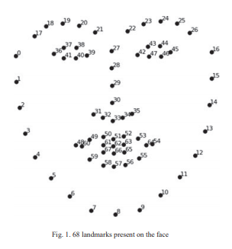
Introduction
Firstly, to mark the attendance, the images of students' faces will be required. This image can be captured from the camera, which will be installed in the classroom at a position from where the entire classroom is visible.
This image will be considered as an input to the system. For efficient face identification, the picture should be upgraded by utilizing some image processing methods like grayscale conversion and histogram equalization.
After image quality upgrade, the image will be passed to perform face detection. The face identification process is trailed by face recognition process.

Slide 9
PROPOSED METHODOLOGY
Consists of Architecture, Methodology, Algorithm

Slide 10
Architecture
The automated attendance management system has a very simple and easy to implement the architecture. The system consists of two databases, a student database, and an attendance database. The student database is for storing the details of the student in a particular class.
On the other hand, the attendance database, as the name suggests, is for marking and maintaining the attendance records of students attending a particular lecture. For the accomplishment of marking attendance, this system will have a high-definition camera installed outside the classroom.
Students will avail the access to enter the classroom, by scanning their faces in that camera. Another camera will be installed inside the classroom in such a way that every student in the class will be visible to the lens of the camera.
Facial detection and recognition algorithms will be applied to both the cameras to analyze the faces and mark their attendance accordingly.

Slide 11
Methodology
To develop the smart attendance management system, some steps are required to be followed for accomplishing this task successfully.
The steps can be defined in the following ways:
Enrollment
Face Detection
Face Recognition
Confirmation by the class camera
Attendance Marking

Slide 12
Methodology
1.Enrollment:
In this step, the student is enrolled in the student database. General information like Name, Enrolment Number, Class, and Section is stored in the database. Along with all this information, pictures of the student's face appearing in the camera window are also stored in the student database. With the help of all the images stored in the student database, facial recognition can be performed for all the students are coming to attend a lecture.
2.Face Detection:
For detecting the faces, we will be referring to the above mentioned 68 landmarks present on a person’s face. Based on these landmarks of the face, the Viola and Jones algorithm will be used for face bounding box detection and constrained Local Model-based face tracking and face landmark identification algorithm. Once the detection part is successfully completed, we will be moving on to the next phase. The next phase in this system is Face Recognition

Slide 13
Methodology
3.Face Recognition:
To implement the facial recognition in this model, we will make use of the face recognition libraries. The students, appearing on the camera present outside the class, will have their face recognized in order to get access to enter the classroom. If the student's face is present in the respective database, then he is allowed the access to enter the class, else if his face image is not present in the database then the system will ask the student to enroll himself in the student database before gaining access in the classroom.

Slide 14
Methodology
4.Confirmation by the classroom camera:
After the face of a student is recognized successfully and the student is allowed access to the classroom, in order to confirm that the student is present in the class for the lecture, a second camera installed inside the classroom will be set up in such a way that all the students are visible. This will help in cancelling out the proxies.
5.Attendance Marking:
At the end of the lectures, the camera inside the classroom will be used to provide the list of students present in the classroom. With the help of this, attendance for that lecture will be marked in the attendance database.

Slide 15
Algorithm
INPUTS: Faces of students at Entrance, Inside Classroom.
OUTPUT: Automatic Marking of the attendance.
PROBLEM DESCRIPTION: Recognition of faces and marking attendance accordingly.
Step I: Commence
Step II: Enrolment of students’ details in the student database.
Step III: Setup a camera outside the classroom. Students’ face will appear in the camera.
Step IV: Face Detection
Step V: Face Recognition by comparing the students’ face with images in the student database.
Step VI: IF: student is present in database. Grant access to the classroom ELSE: Go back to Step 2. Step VII: Camera installed in the class is used to check the presence of the student in the class. IF: Faces recognized in step 6 are present, Mark them present. ELSE: Mark absent.
Step VIII: Mark the attendance in the attendance database.
Step IX: End

Slide 16
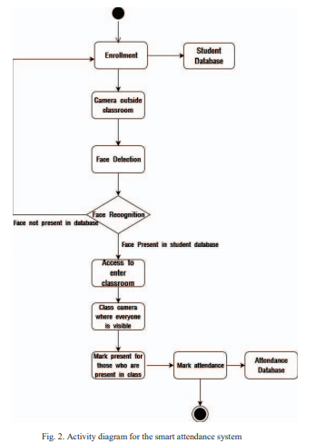
Flow Diagram

Slide 17
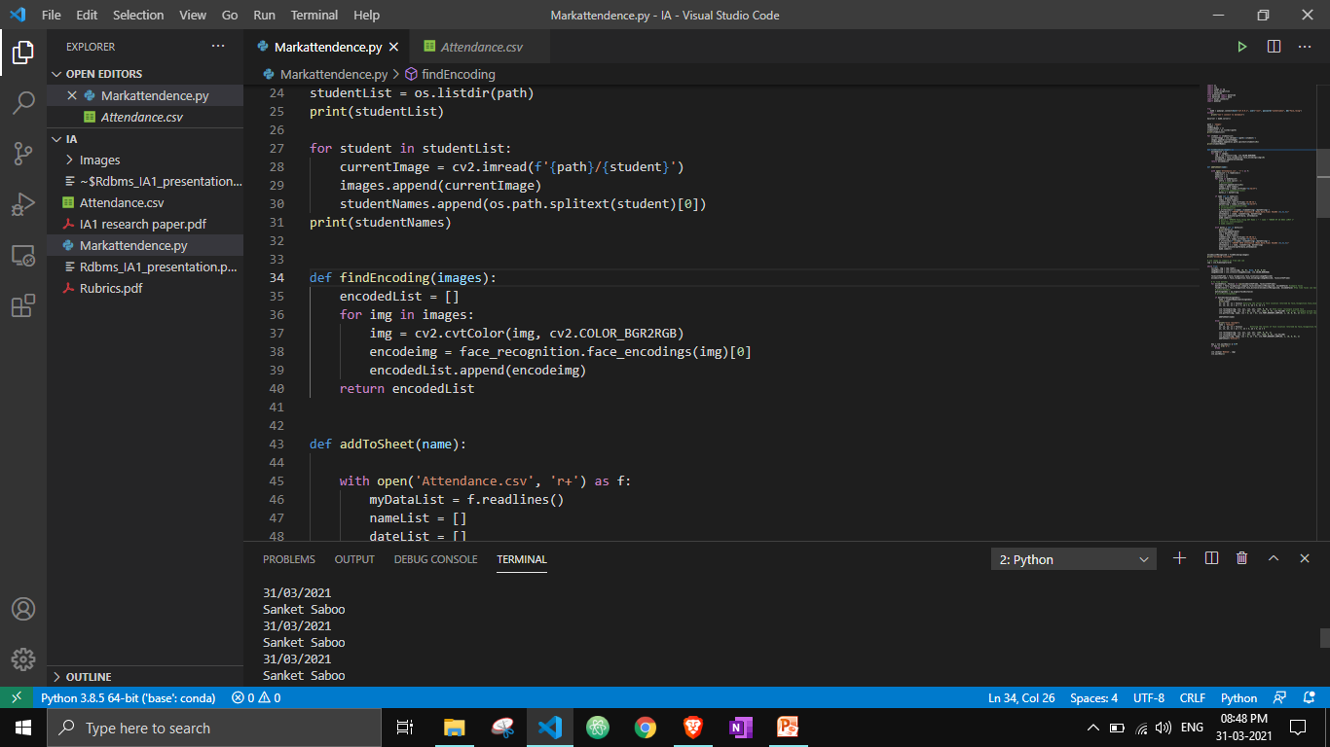
Place your screenshot here
Implementation Strategy

Slide 18
Implementation Strategy
Firstly I would make a folder named Images where I’ll store images of all the students as name.jpg/png etc.
Using face recognition package we would get all the necessary information regarding encoders, locations and we would also be able to compare the image from video feed with our images.
Now let’s append the name of all the students present in the live video feed into database and also into a csv file.
I would either use pymysql or mysql.connector packages in the code to link the results to database.
The result will consist of Name, Time, Date.

Slide 19
Conclusion

Slide 20
Conclusion
The proposed automated attendance system using face recognition is a great model for marking the attendance of students in a classroom. This system also assists in overcoming the chances of proxies and fake attendance. In the modern world, a large number of systems using biometrics are available. However, the facial recognition turns out to be a viable option because of its high accuracy along with minimum human intervention.
This system is aimed at providing a significant level of security. Hence, a highly pro-efficient attendance system for classroom attendance needs to be developed which can perform recognition on multiple faces at one instance. Also, there is no requirement of any special hardware for its implementation. A camera, a PC and database servers are sufficient for constructing the smart attendance system

Slide 21
Future Scope

Slide 22
Future Scope
The proposed system here is only used for classroom attendance for students. However, this system can be improved and enhanced in a way that it can also be used in multi-national companies for maintaining the surveillance of a much larger database, filled with huge amount of entries of the employees working in a particular organization.
This will be able to help in maintaining security and also the company will able to keep a track on its workers whether they are completing the desired working hours in a day or not.

Slide 23
Bibliography

Slide 24
Bibliography
[1] S. Lukas, A. R. Mitra, R. I. Desanti and D. Krisnadi, "Student Attendance System in Classroom Using Face Recognition Technique," in ICTC 2016, Karawaci, 2016.
[2] P. Wagh, S. Patil, J. Chaudhari and R. Thakare, "Attendance System based on Face Recognition using Eigen face and PCA Algorithms," in 2015 International Conference on Green Computing and Internet of Things (ICGCloT), 2015.
[3] N. M. Ara, N. S. Simul and M. S. Islam, "Convolutional Neural Network Approach for Vision Based Student Recognition System," in 2017 20th International Conference of Computer and Information Technology (ICCIT), 22-24 December, 2017, Sylhet, 2017.
[4] N. Khan and Balcoh, "Algorithm for efficient attendance management: Face recognition based approach," in JCSI International Journal of Computer Science Issues 9.4, 2012.
[5] KAWAGUCHI and Yohei, "Face Recognition-based Lecture Attendance System.," in The 3rd AEARU Workshop on Network Education. 2005., 2005.
[6] MuthuKalyani.K, "Smart Application For AMS using Face Recognition," in CSEIJ 2013, 2013

Slide 25
Bibliography
[7] M. Arsenovic, S. Skadojevic and A. Anderla, "FaceTime- Deep Learning Based Face Recognition Attendamce system.," in IEEE 15th International Symposium on Intelligent Systems and Informatics, Serbia, 2017.
[8] K. Goyal, K. Agarwal and R. Kumar, "Face Detection and tracking using OpenCV," in International Conference on Electronics, Communication and Aerospace Technology, ICECA 2017, 2017.
[9] Viola, M. J. Jones and Paul, "Robust real-time face detection.," in International journal of computer vision 57.2 (2004), 2004.
[10] A. Jha, ""Class Room Attendance System Using Facial Recognition System."," in International journal of Mathematical science technology and management 2(3). 2007, 2007.

Slide 26
THANK YOU!
Any questions?

