Slide 1
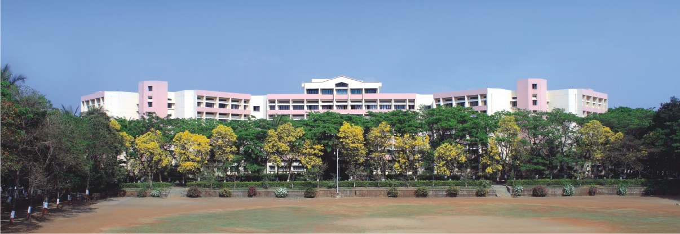

An Automated Framework for Migrating Java Applications to Ethereum Solidity Applications
Presented by:
Shirsath Sanket Dilip
TE_B_69
Guided by:
Prof.J.R Mankar
Notes:
NOTE:
To change the image on this slide, select the picture and delete it. Then click the Pictures icon in the placeholder to insert your own image.

Slide 2

Contents
Introduction
Literature Review
System Architecture /Working Model /Methodology
Algorithm
Applications
Summary
References

Slide 3
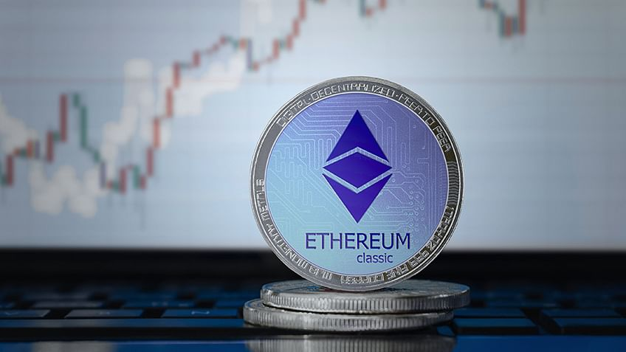
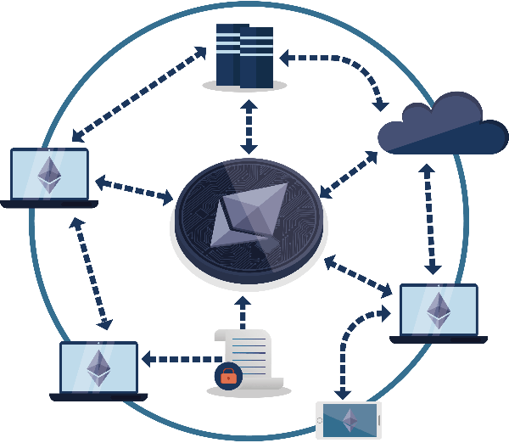
Introduction
Ethereum
Second-largest public blockchain network
Popular blockchain for distributed applications.
Ethereum Virtual Machine (EVM)
Solidity
Most actively developed
Maintained language on the Ethereum blockchain
Few blockchain platforms
support mainstream languages, such as Java , C++,Golang
Proven to be unfit
Presence of non-determinism and language vulnerabilities

Slide 4

Introduction
Challenge :
Transitioning from existing technology to blockchain technology
Solution:
Develop the blockchain solution from scratch.
Most expensive due to the time and money invested.
A dedicated team of developers with domain expertise in target languages
Migrate the existing codebase to blockchain solution.
Dedicated team of developers with domain expertise in both source and target languages
Less expensive and time consuming than the first
Adopt any similar off-the-shelf blockchain solution
Requires extensive customization and can become quite costly.

Slide 5
Literature Review
Author | Title | Review
F. Casino, T. K. Dasaklis, and C. Patsakis | A systematic literature review of blockchain-based applications: Current status, classification and open issues, | This work provides a systematic literature review of blockchain-based applications across multiple domains.
S. Nakamoto. (2008) | Bitcoin: A peer-to-peer electronic cash system | This work provides purely peer-to-peer version of electronic cash would allow online payments to be sent directly from one party to another without going through a financial institution.
G. Wood | Ethereum: A secure decentralised generalised transaction ledger | This work provides blockchain paradigm when coupled with cryptographically-secured transactions has demonstrated its utility through a number of projects, not the least being Bitcoin. Each such project can be seen as a simple application on a decentralised, but singleton, compute resource.

Slide 6
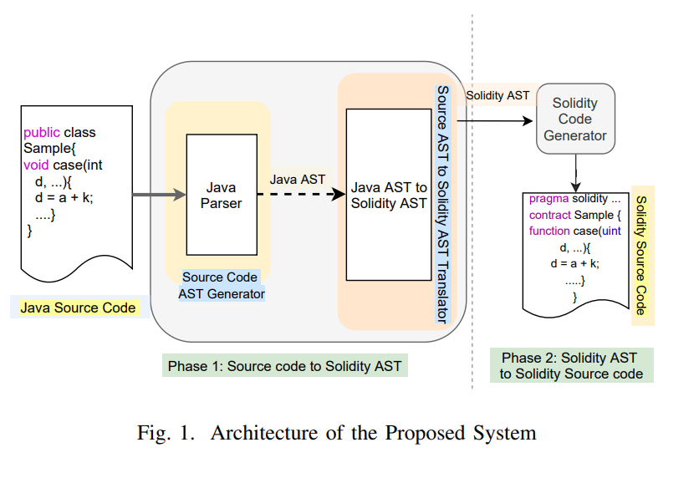
System Architecture
The proposed system’s
architecture is depicted in
Figure 1, which consists of the
following phases:
Phase 1: Source code to Solidity AST
generation
Phase 2: Solidity AST to Solidity code
generation

Slide 8
Phase 1: Source code to Solidity AST generation
Two Functional Components:
First Component :
Checks the syntactic correctness of given source program.
It uses source language-specific parser and generates AST module.
Other Component :
Preform post-order traversal of the source code AST and generates its equivalent Solidity AST recursively
It uses the mapping library included in the Source AST to Solidity AST translator module

Slide 9
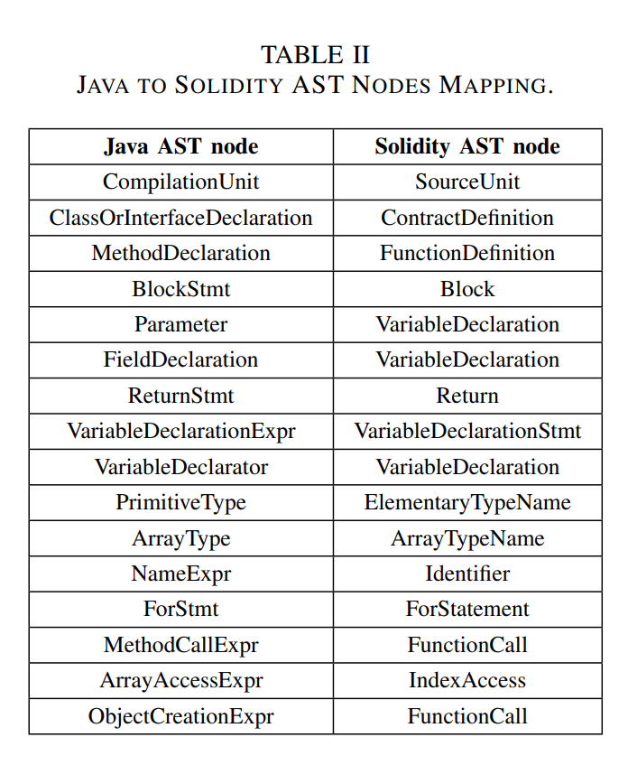
Phase 1: Source code to Solidity AST generation
Two Functional Components:
First Component :
Checks the syntactic correctness of given source program.
It uses source language-specific parser and generates AST module.
Other Component :
Preform post-order traversal of the source code AST and generates its equivalent Solidity AST recursively
It uses the mapping library included in the Source AST to Solidity AST translator module

Slide 11
Phase 2: Solidity AST to Solidity code generation
The Solidity code generator has a node processing method for each node in the Solidity AST.
It generates Solidity source code from the specification of the Solidity AST.
It traverses the Solidity AST and uses a functional interface to generate Solidity source code, which is then recursively embedded in the appropriate location in the source code file.

Slide 13
Summary
We propose the architecture of an automated source code translator from Java to Solidity. This approach performs the translation at the abstract syntax tree (AST) level.
We develop a working prototype of a Java-to-Solidity Translator. Additionally, this package includes a Solidity AST to Solidity code generation tool
We conduct extensive testing on various large-scale standard Java programs and provide statistics and analytics on Java code parsing time, AST-to-AST translation time, Solidity code generation time, and memory usage.

Slide 14
Conclusion
We develop a working prototype for Java-to-Solidity translation, which is capable of translating either a single Java file or an entire Java codebase in a single run.
Our proposal can easily be extended to other programming languages or specifications by simply adding a source-specific parser module and a Solidity AST translator module in phase 1.
In the future, we plan to conduct safety and security analyses while generating the Solidity source code.
We also plan to analyze the semantic equivalence of the source language programs and the translated Solidity code.

Slide 15
References
F. Casino, T. K. Dasaklis and C. Patsakis, "A systematic literature review of blockchain-based applications: Current status classification and open issues", Telematics and Informatics, vol. 36, pp. 55-81, 2019.
S. Nakamoto, Bitcoin: A peer-to-peer electronic cash system, 2008, [online] Available: https://bitcoin.orgibitcoin.pdf.
G. Wood, Ethereum: A secure decentralised generalised transaction ledger, 2014, [online] Available.
Solidity documentation - release 0.8.4, [online] Available: http://solidity.readthedocs.io/.
F. Spoto, "A java framework for smart contracts", Proceedings of the Financial Cryptography and Data Security Workshop on Trusted Smart Contracts (WTSC‘19), vol. LNCS 11599, pp. 122-137, February 18–22 2019.
Eosio official portal, [online] Available: https://eos.io/.
E. Androulaki et al., "Hyperledger fabric: A distributed operating system for permissioned blockchains", Proceedings of the Thirteenth EuroSys Conference (EuroSys‘18), pp. 30:1-30:15, April 23–26 2018

Slide 16
THANK YOU !!
Name of Student: Shirsath Sanket Dilip
Email: sanketshirsath226@gmail.com
Department of Computer Engineering
K. K. Wagh Institute of Engineering Education & Research, Nashik

