Slide 1



Predicting Stock Market Share Prices
Team Members: Vekariya sanket k.
Ayush Akabari K.
Guide: Jay Rathod
Disclaimer: The content is curated for educational purposes only.

Slide 2
OUTLINE
Abstract
Problem Statement
Aims, Objective & Proposed System/Solution
System Design/Architecture
System Development Approach (Technology Used)
Algorithm & Deployment
Conclusion
Future Scope
References
Video of the Project
Notes:
These are the list of chapters that we are going to cover in these foundation codes. Those are chapter one what are AI and ML? chapter 2 applied Python programming in AI, and chapter 3 is exploratory data analysis for ML.

Slide 3
Abstract This project aims to predict the closing prices of Apple Inc. (AAPL) stock using historical price data and Long Short-Term Memory (LSTM) neural networks. Stock price prediction is a complex task due to market volatility and various influencing factors. The LSTM model is well-suited for time series forecasting and has been employed to capture historical patterns and trends in the stock data from 2010 to 2023. The project involves data collection, exploration, preprocessing, model building, evaluation, and potential improvements for future work. Results indicate that while the LSTM model provides reasonable predictions, further enhancements can improve accuracy.

Slide 4
Problem Statement The stock market is a complex and dynamic system influenced by a myriad of factors, making the prediction of stock prices a highly challenging task. Accurate predictions of stock market prices can provide significant benefits for investors, financial analysts, and economic strategists by guiding informed decision-making and optimizing investment strategies. The primary objective of this project is to develop a predictive model that can forecast the closing prices of Apple Inc. (AAPL) stock using historical price data. Given the inherent volatility and numerous influencing factors in the stock market, traditional linear models often fall short in capturing the intricate patterns and temporal dependencies present in stock price movements.

Slide 5
Aim and Objective The aim of this project is to develop a predictive model that accurately forecasts the closing prices of Apple Inc. (AAPL) stock using historical price data, leveraging the capabilities of Long Short-Term Memory (LSTM) neural networks. The ultimate goal is to demonstrate the feasibility and effectiveness of LSTM models in predicting stock prices, providing valuable insights for investors and financial analysts. The primary objectives of this project are to collect and preprocess historical stock price data for Apple Inc. (AAPL) from 2010 to 2023, develop an LSTM neural network model to predict the stock's closing prices, and evaluate the model's performance. This involves visualizing the data to identify trends and patterns, building and training the LSTM model, and assessing its accuracy using metrics like Root Mean Squared Error (RMSE). Additionally, the project aims to explore potential improvements through hyperparameter tuning and incorporating additional features, ultimately providing a comprehensive framework for stock price prediction and insights for further enhancement.

Slide 6
Proposed Solution To predict the closing prices of Apple Inc. (AAPL) stock, we implemented a Long Short-Term Memory (LSTM) neural network solution. Historical stock price data from 2010 to 2023 was collected and normalized to a range of 0 to 1. Sequences of 100 time steps were prepared for the LSTM model, which was trained on 80% of the data and tested on the remaining 20%. The LSTM model, comprising two LSTM layers and two Dense layers, was compiled with the Adam optimizer and mean squared error loss function. Model performance was evaluated using Root Mean Squared Error (RMSE) and visualized through actual versus predicted price plots. Future enhancements could involve hyperparameter tuning, additional features, and advanced models to further refine prediction accuracy.

Slide 7
System Architecture The system architecture for predicting Apple Inc. (AAPL) stock prices using an LSTM neural network consists of several key components. The process begins with data collection, where historical stock price data is retrieved via the yfinance library. This data is then preprocessed, including normalization with MinMaxScaler and sequence generation of 100 time steps. The preprocessed data is split into training and testing sets. The core of the system is the LSTM model, designed with two LSTM layers followed by two Dense layers, which learns temporal patterns from the training data. The model is compiled with the Adam optimizer and mean squared error loss function. After training, the model's performance is evaluated using Root Mean Squared Error (RMSE), and results are visualized by comparing actual versus predicted prices. Future improvements are considered for optimizing model accuracy and incorporating additional features.

Slide 8
Conclusion The LSTM model demonstrated a reasonable ability to predict stock prices, but there is room for improvement. Model performance could be enhanced by tuning hyperparameters, incorporating additional features, or experimenting with more advanced models like GRU or attention-based mechanisms. Given the volatile nature of stock markets, predictions should be approached with caution.

Slide 9
Future Scope 1.Hyperparameter Tuning: Experiment with different numbers of layers, units, batch sizes, and epochs to optimize model performance. 2. Feature Engineering: Incorporate additional features such as trading volume, technical indicators, and macroeconomic variables to provide the model with more context. 3. Advanced Models: Explore more sophisticated models, including GRU, Transformer, or hybrid models that combine CNN and LSTM to capture both spatial and temporal patterns in the data.

Slide 10
Reference
http://www.oreilly.com/data/free/the-new-artificial-intelligence-market.csp
Notes:
Reference
These are the references for this session.
10

Slide 11
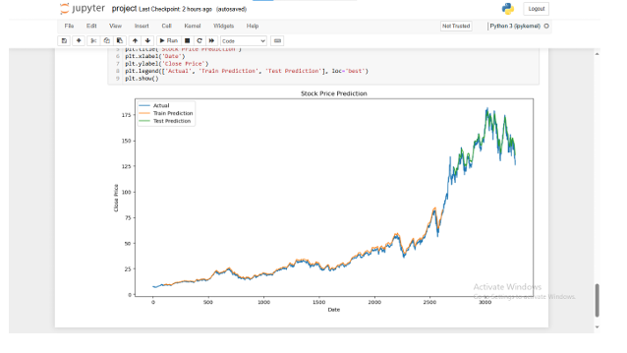

Slide 12
Thank you!
Notes:
thank you very much for joining this PPT, keep learning.
12

