Slide 1
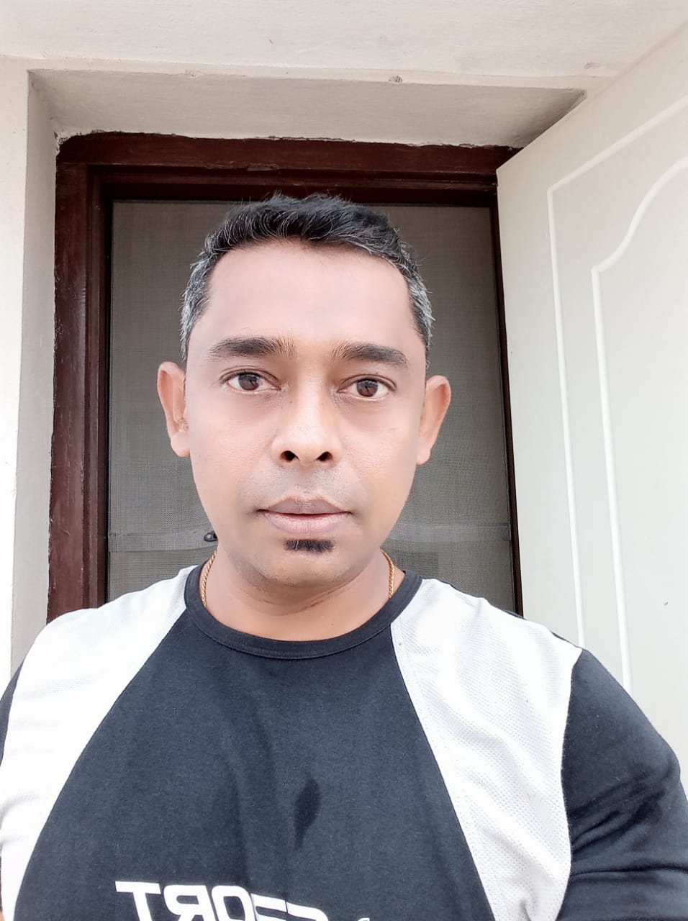
Hemant Kumar Panda
I think, “The Fit VALLEY” group created by Saptarshi is fantastic ! I think he has a great pedagogy of dynamic training variation to suite everyone’s need. I love the positive message that comes through in the group. The encouragement to aim for balance than non-realistic ideals is the key thing which Saptarshi brings into his sessions. I love his commitment to responsible and sustainable training with a strong sense of a duty of care, towards his clients. I really like the inclusiveness which he has brought, in his “FIT VALLEY’ family.
Saptarshi, you definitely have my vote for another industry award !!

Slide 2
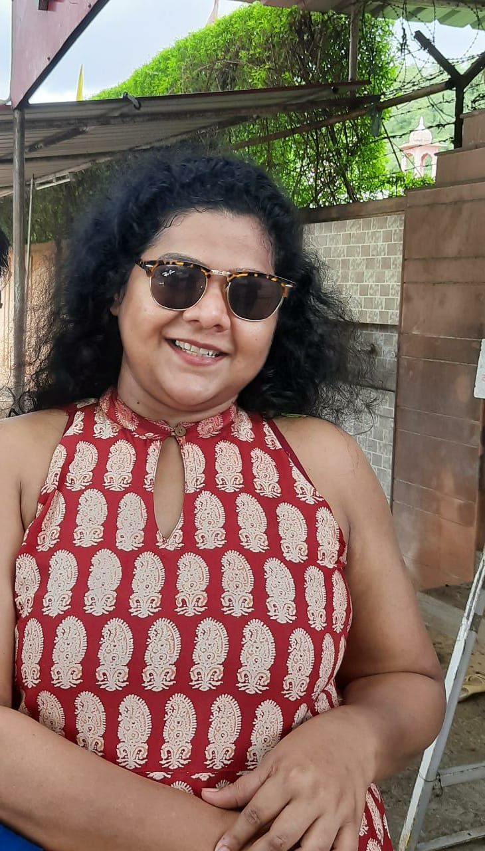
Babita Singh
Workouts under Rishi’s guidance is a great experience ...he monitors closely with personal attention and gives hands on instant feedback and adjustments during the workouts and gives the right amount of encouragement throughout the session. The best part is ...all his sessions are absolutely on time with no cancellations, even if there is 1 person present, he is there to conduct the session with same passion and enthusiasm as he does in other group sessions.

Slide 3
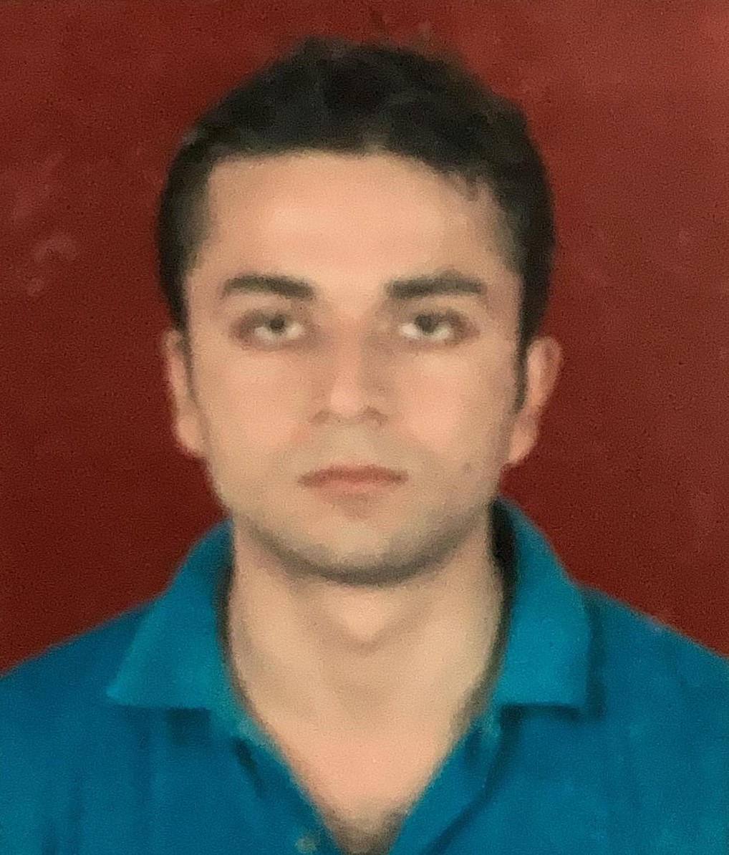
Adhiraj
Saptarshi is my Fitness trainer at FIT VALLEY (online fitness program). I know him for a very long time, we are childhood friends.
However that’s not compelling me to say anything good for him now ! He has always been enthusiastic about fitness and sports, and that love for fitness shows up in the enthusiasm with which he conducts his fitness classes.
I have been exercising under his guidance since 6 months now and it has helped me build up my fitness and stamina to a great extent. Saptarshi pays great attention to an individual’s posture during the sessions. I am looking forward to continuing my fitness journey with him.

Slide 4
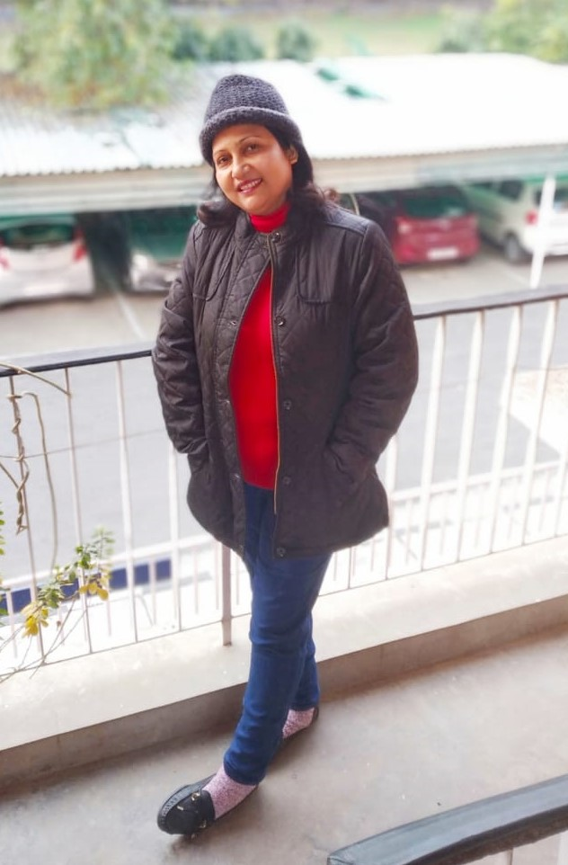
Murchana Sharma
Hi I am Murchana, and have been a part of this exercise group for a few months now. Doing these series of exercises has really improved my physical stamina, my body feel lighter and tighter, my mental health has improved and moreover I really enjoy exercising with Saptarshi. The mode of instruction is easy to follow as the instructor explain each movement thoroughly with visual demonstration as well.
Overall being a part of this exercise group, it has been a rewarding and enjoying experience !

Slide 5
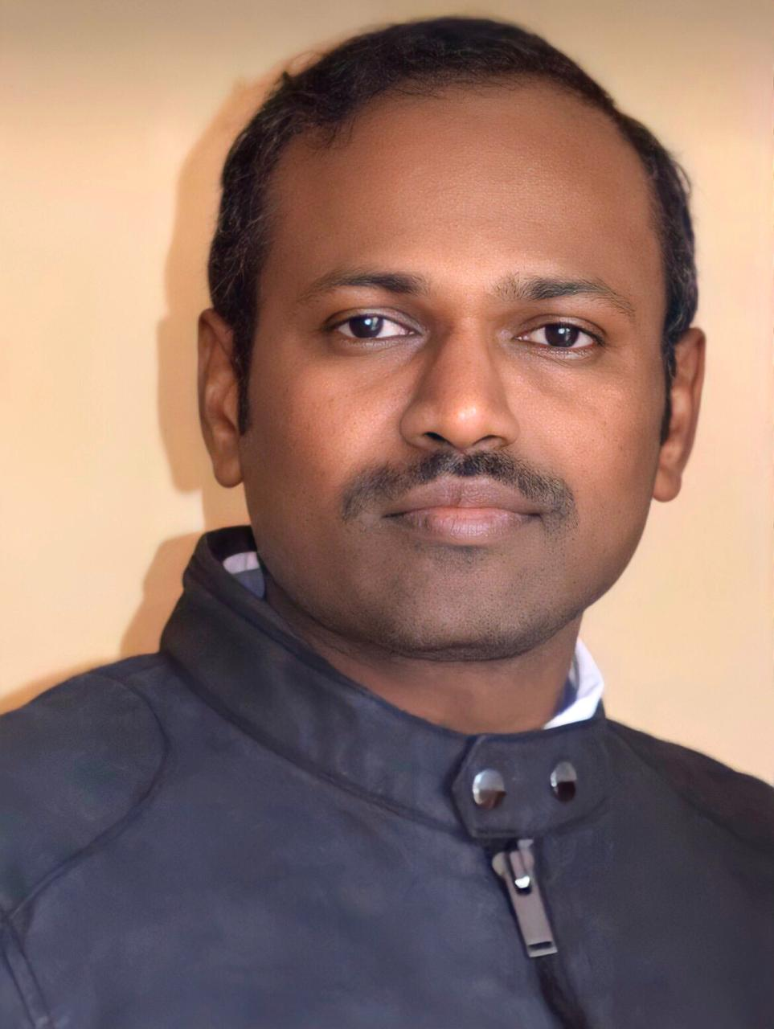
Pavan Medisetty
5 months of HIIT brought lot of changes in me. More stamina, confidence, and health. Stopped worrying about not going outside in COVID. Thanks to FIT VALLEY & Saptarshi for his live online workouts.

Slide 6
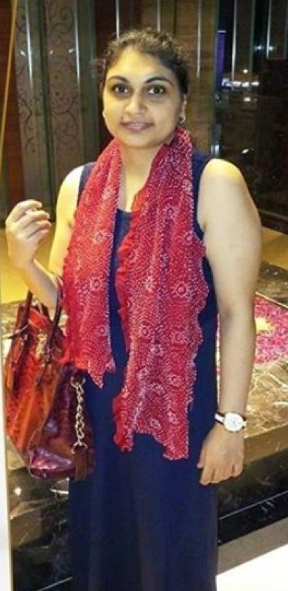
Saganjit Kaur
I started my Fitness journey 2 months back with Saptarshi. He is very knowledgeable and passionate coach. I have started seeing improvements in my stamina and lost a few inches. Working towards my goal of fit before 40 and I am sure Saptarshi will lead me to my goal.

Slide 7
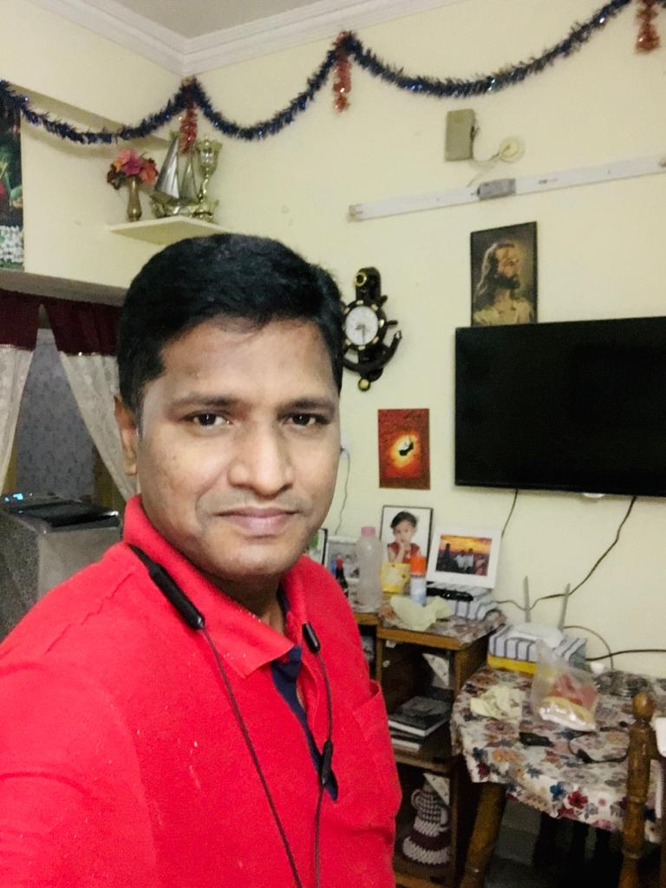
Naveen
It has been 5 + months, me and my sister have joined this beautiful fitness sessions with FIT Valley. In this COVID pandemic, these workout sessions have definitely helped us to stay fit. Before joining these sessions, every morning I used to jog and my sister used to do diet for weight loss, but after joining these online sessions, my sister almost lost 5 kgs and I lost 4 kgs with minimum dieting, within a month. Truly, we appreciate Saptarshi’s encouragement that helped us to stay on track. We enjoy every session and these fitness sessions has now become a part of our daily routine.
Thanks for these great workouts...!

