Slide 1
Allowing exceptions in knowledge base: Defeasible Reasoning
Sankhya Singh (u6737668)
Supervisor : Mr Dirk Pattinson
The Australian National university

Slide 2
Overview
Problem
Motivation
Defeasible reasoning
Example explanation using SPINDLE¹
Application
Conclusion

Slide 3
Problem and Motivation
Applying defeasible logic in real world scenario problems and checking for soundness and scalability of these methods, more specifically is the formalization strong enough to accept large number of exceptions or how can we know that which problem is suited for defeasible theory?
But why defeasible reasoning or what is defeasible reasoning ?
In order to answer this let us consider an small example that will motivate us towards our goal
Consider the simple example of statement such as “All birds can fly”

Slide 4
Now if we want to formalize this above statement is classical logic then there would be seemingly have an open list of exceptions such as ostriches, penguins ,Peking ducks, etc. etc.
If we try to write this an axiom, then we get
Now in order to compensate the fact there are so many exceptions we introduce a new implication know as defeasible implication in our domain (which aligns with our common sense reasoning)
bird(x) ⇒ flies(x)
The idea is that if we know that something is a bird, then we may conclude that it flies, unless there is other, not inferior, evidence suggesting that it may not fly.

Slide 5
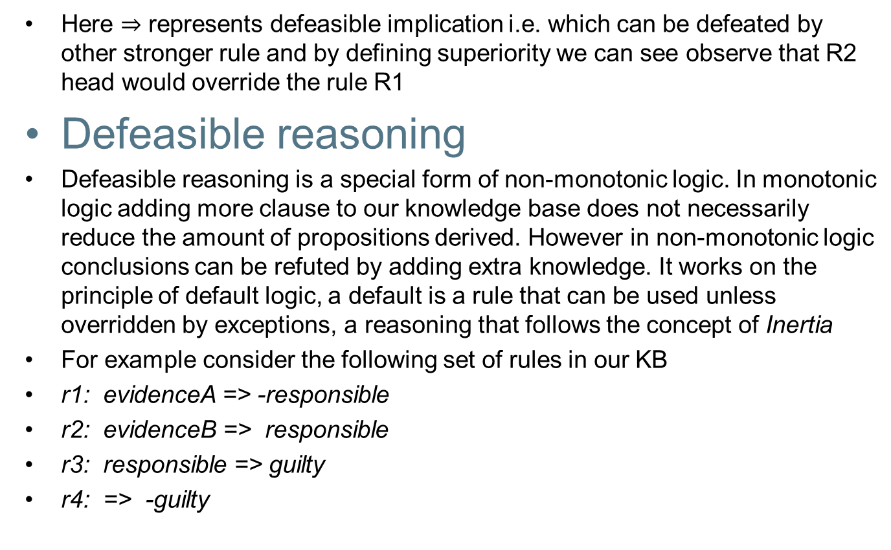
Here $⇒$ represents defeasible implication i.e. which can be defeated by other stronger rule and by defining superiority we can see observe that R2 head would override the rule R1
Defeasible reasoning
Defeasible reasoning is a special form of non-monotonic logic. In monotonic logic adding more clause to our knowledge base does not necessarily reduce the amount of propositions derived. However in non-monotonic logic conclusions can be refuted by adding extra knowledge. It works on the principle of default logic, a default is a rule that can be used unless overridden by exceptions, a reasoning that follows the concept of Inertia
For example consider the following set of rules in our KB
r1: evidenceA => -responsible
r2: evidenceB => responsible
r3: responsible => guilty
r4: => -guilty

Slide 6
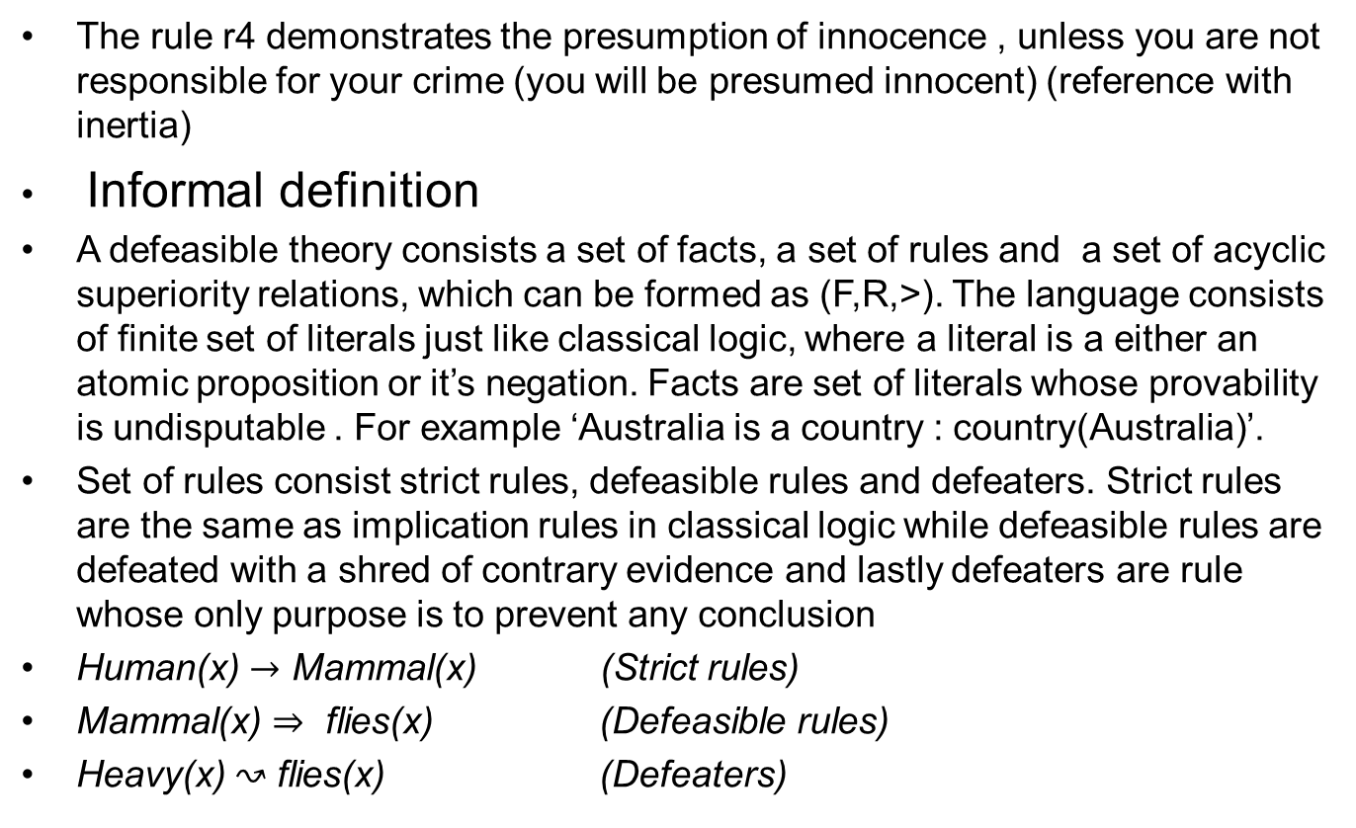
The rule r4 demonstrates the presumption of innocence , unless you are not responsible for your crime (you will be presumed innocent) (reference with inertia)
Informal definition
A defeasible theory consists a set of facts, a set of rules and a set of acyclic superiority relations, which can be formed as (F,R,>). The language consists of finite set of literals just like classical logic, where a literal is a either an atomic proposition or it’s negation. Facts are set of literals whose provability is undisputable . For example ‘Australia is a country : country(Australia)’.
Set of rules consist strict rules, defeasible rules and defeaters. Strict rules are the same as implication rules in classical logic while defeasible rules are defeated with a shred of contrary evidence and lastly defeaters are rule whose only purpose is to prevent any conclusion
Human(x) $→$ Mammal(x) (Strict rules)
Mammal(x) $⇒$ flies(x) (Defeasible rules)
Heavy(x) ↝ flies(x) (Defeaters)

Slide 7
Formal definition
Definition 1.1. Let Lab be a set of arbitrary labels. Rules have form “r : A(r) ↪️ C(r)”:
1. r ∈ Lab is a unique name.
2. A(r) is the antecedent, or body, of the rule. A(r) can either have the form A(r) = a₁, .,a_{n} to denote a multi-set, or A(r) = a₁, .,a_{n} to denote a sequence.
3. ↪️∈ {→,⇒, ↝} denotes a strict rule, a defeasible rule, and a defeater, respectively.
4. C(r) is the consequent, or head, of the rule. For the head, we consider three options: (a) The head is a single literal ‘p’, (b) The head is a multi-set ‘p₁, . . ., p_{m}’, and (c) The head is a sequence ‘p₁;. . .; p_{m}’.
Three different types of rule in defeasible logic is as follows, strict rules use →, defeasible rules use ⇒, while defeaters use ↝.
The rule notation for these different kinds of rules can be denoted as follows, R_{s} denotes all the strict rules, the set of all defeasible rule is R_{d}, while set of all strict and defeasible rule is R_{sd}; and name R[q] with set of all rules R with head q.

Slide 8
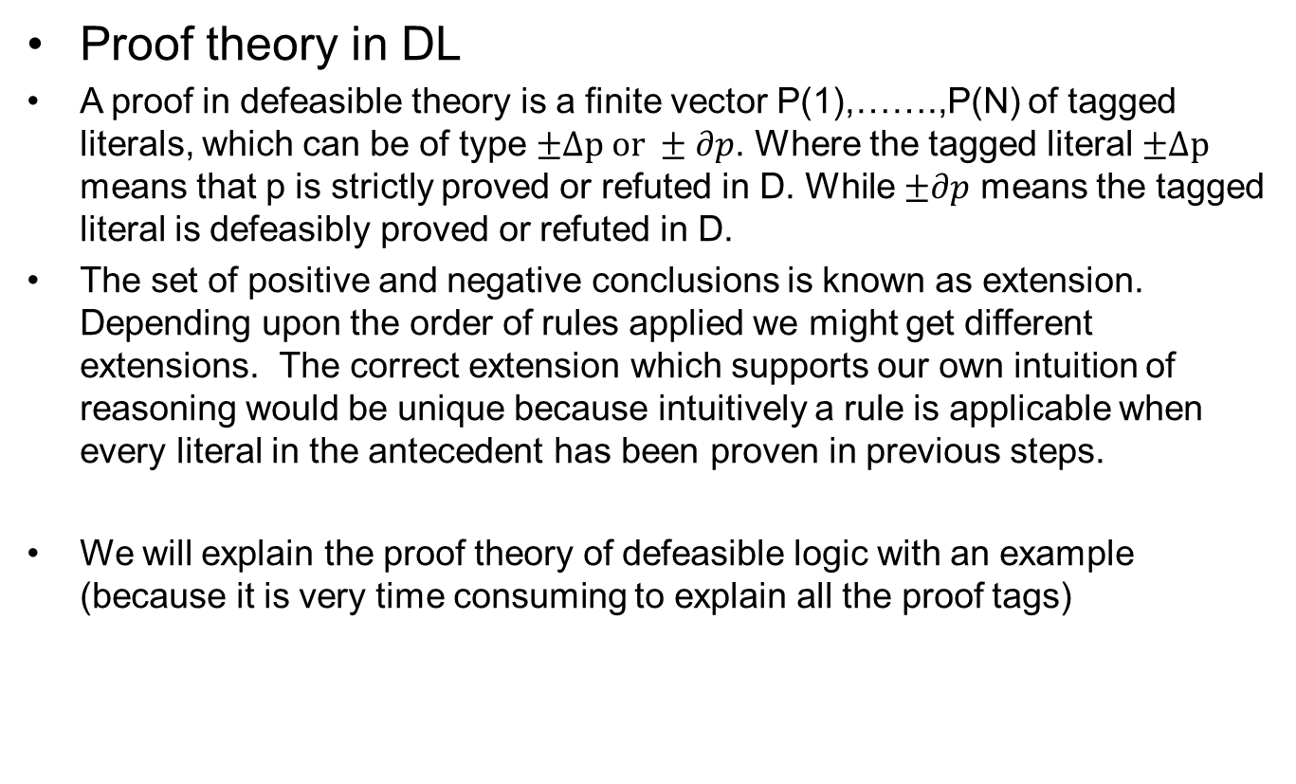
Proof theory in DL
A proof in defeasible theory is a finite vector P(1),…….,P(N) of tagged literals, which can be of type $±Δp or ±∂p$. Where the tagged literal $±Δp$ means that p is strictly proved or refuted in D. While $±∂p$ means the tagged literal is defeasibly proved or refuted in D.
The set of positive and negative conclusions is known as extension. Depending upon the order of rules applied we might get different extensions. The correct extension which supports our own intuition of reasoning would be unique because intuitively a rule is applicable when every literal in the antecedent has been proven in previous steps.
We will explain the proof theory of defeasible logic with an example (because it is very time consuming to explain all the proof tags)

Slide 9
Example explanation using SPINDLE¹
The SPINDLE¹ is state of the art reasoner which aligns with the proof theory of the defeasible logic. We will explain an example of defeasible theory by providing the rules in xml format to the reasoner.
The example which we are trying to deal is of an overseas student .The goal of formalization is to allow exceptions in the domain of knowledge base and one’s intuition result must match with inference result.
– r1: student(X), overseas(X) ⇒ payFPOS(X)
– r2: student(X), overseas(X), exchange(X) ⇒ ∼ payFPOS(X)
– r3: student(X) ⇒ payHECS(X)
– r4: student(X), payFPOS(X) ⇒ ∼payHECS(X)
– r4 > r3

Slide 10
The rule r4 is more specific than rule r3 hence it gains precedence in this case. Because a student giving overseas fees is more specific than an ordinary student.
Now Sofia is an overseas student and we ant to argue that she ha to pay HECs fees or not. Moreover, by looking at example we don’t know that she is an exchange student , so our intuition is that it must be the case that she does not have to pay HECS. (student(Sofia),overseas(Sofia) are facts)
We get the following conclusions from the reasoner
1)+D | overseas(X)
2)+D | student(X)
3)-D | exchange(X)
4)-D | payFPOS(X)
5)-D | -payFPOS(X)
6)-D | payHECS(X)
7)-D | -payHECS(X)
8)+d | overseas(X)
9)+d | payFPOS(X)
10)+d | -payHECS(X)
11)+d | student(X)
12)-d | exchange(X)
13)-d | -payFPOS(X)
14)-d | payHECS(X)

Slide 11
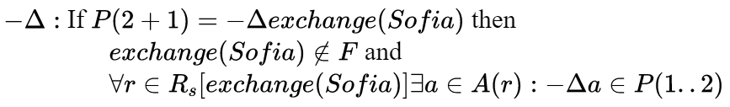
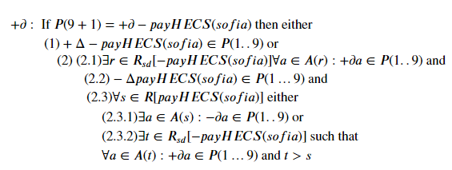
Due to time constraints we won’t be going into detail proof of every literal but the important ones,
3) –D exchange(Sofia)
10) +d -payHECS(Sofia)

Slide 12
Application
We will test defeasible theory on various scenarios, specially we will focus subsections of Legislative acts . This will allow us to argue in which situations the formalization best fits to our intuition of reasoning. Mainly we could see that how to allow exceptions on various domains
Australian capital territory health act 1993
Subdivision abortion.
The goal of the formalization is to capture any inconsistency in the set of laws, and we know that one can capture those inconsistencies by allowing them in our current knowledge base and argue it’s provability by processing them in our inference engine.
Just a couple of terms to get familiar with, Abortifacient means a medicine or a drug that causes pregnancy to end prematurely and abortion means a medical abortion or surgical abortion

Slide 13
If we formulate the rules with defeasible logic, we get
r1: personsupply, purposeendingpregnancy, -doctor => abortion(offence)
r2: assistingpharmacist => -abortion(offence)
r3 : pharmacistsupply => -abortion(offence)
r4: abortion(offence) => guilty
r5: =>-guilty
The rule r1,r2 and r3 can be understood as a set of evidences indicating a offence or not, if offence is proven then the person is guilty (rule r4) and the rule r5 indicates the presumption of innocence.
Suppose that if we check our formal system for any exception say what would happen if a person was doctor and his/her sole purpose was to end the pregnancy , if we formulate this we get
r6: doctor, purposeendingpregnancy, assistingpharmacist => abortion(offence)
The r6 is not reliable piece of evidence, hence we can not just use superiority case over here

Slide 14
If we put all these rules in our reasoner we get the result +d –abortion(offence), which does not seem obvious because we have an extra set of evidence which should propagate the head abortion(offence). Moreover, our intuition result was that we should defeasibly prove the abortion(offence). Hence the reasoning seems inconsistent with this current domain of example why? Because there were not any specified superiority rules as we wanted to test our formalization with (not a reliable) piece of exception.
The problem result is as such because of the ambiguity propagation in defeasible logic (the discussion is outside the scope of this project).Hence the main conclusion obtained with this exercise is that even after allowing exception in domain of our formalization, if we don’t really know which set of evidences (or rules) are more specific than other than we can obtain ambiguous results.

Slide 15
Stronger Futures in the Northern Territory Act 2012
The example will showcase that simple defeasible logic is not enough for rules and regulations with compulsion and it’s very hard to formalize large number of exceptions if there is no interplay between them.
The license regime for a community store plays an important role in all the prescribed area of northern territory. Mainly we will cover the stores which play an important role in assisting the food security of Aboriginal people
Following are the set of rules that we obtain after formalization
R1: financialstability(x) => determination(license)
R2:sourceoffood(x),sourceofgrocery(x) => determination(license)
R3: Notice(owner),Notice(manager)=> determination(license)
R4:reason(x),writtensummary(x)=>Notice(owner)
R5:reason(x),writtensummary(x)=> Notice(manager)

Slide 16

Here the predicate financialstability(x) or sourceoffood(x) denotes the literal and x can be replaced by any ground atom i.e. name of any aboriginal store. The above set of rules seems reasonable for defeasible rules perspective, but you cannot formulate the rules which have compulsion or obligation. For example, if the notice is not submitted within a given time frame then one cannot get the license. Similarly, if all these conditions are not fulfilled then as a result the license would not be obtained.
In order to fulfilled the need of obligation we must look at the modal extension of defeasible logic. There is a lot of study under this this area, but we only subject ourselves to Obligation and reparation.
Here the above example illustrates that, ”The purchaser shall follow the Supplier price lists”. The primitive symbol O is defined as ‘it is obligatory that’. Now we can reformulate the above laws as extension with modal logic

Slide 17

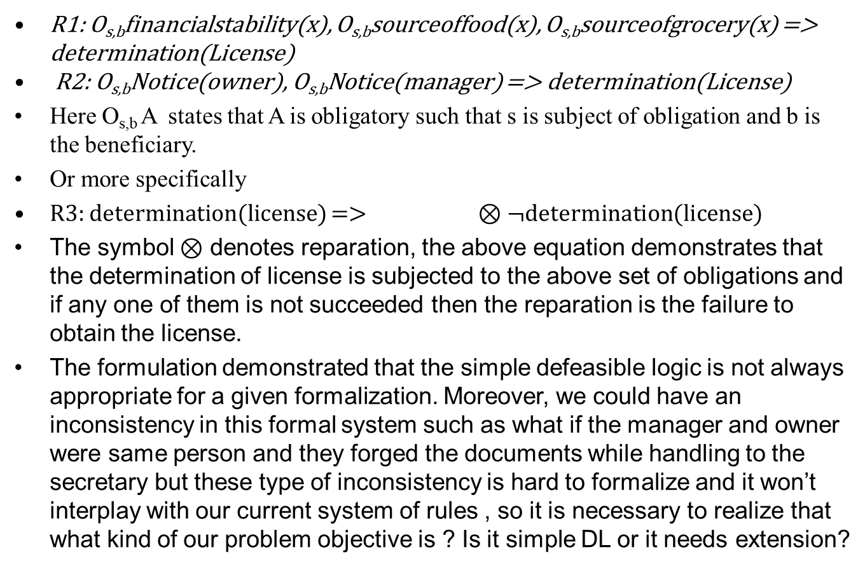
R1: O_{s,b}financialstability(x), O_{s,b}sourceoffood(x), O_{s,b}sourceofgrocery(x) => determination(License)
R2: O_{s,b}Notice(owner), O_{s,b}Notice(manager) => determination(License)
Here O_{s,b} A states that A is obligatory such that s is subject of obligation and b is the beneficiary.
Or more specifically
R3: determination(license) => $⊗$¬determination(license)
The symbol $⊗$ denotes reparation, the above equation demonstrates that the determination of license is subjected to the above set of obligations and if any one of them is not succeeded then the reparation is the failure to obtain the license.
The formulation demonstrated that the simple defeasible logic is not always appropriate for a given formalization. Moreover, we could have an inconsistency in this formal system such as what if the manager and owner were same person and they forged the documents while handling to the secretary but these type of inconsistency is hard to formalize and it won’t interplay with our current system of rules , so it is necessary to realize that what kind of our problem objective is ? Is it simple DL or it needs extension?

Slide 18
Or does the current formalization support any inconsistent rule.
Final exam timetabling of a university
The final example will help in understanding on how one can mold superiority relations in order to support your own intuition answers. Moreover, depending upon the assumption that one supports during initial stages greatly effects the results.
Let us see the rules of our problem
R1: finalcontent(x),oneweekduration => commencementexam(x)
R2: finalexampercentagelessthan40 => ¬oneweekduration
R3: oneweekduration => week13
R4: finalexampercentagemorethan40 => oneweekduration
R5: continousassesment(x) => ¬commencementexam(x)
R6: oneweekduration, continousassesment(x) => ¬week13
R7: lectureragreesonextension(x) => ¬commencementexam(x)

Slide 19
The rule R7 is superior then rule R1 because it has hierarchical advantage over these rules. It is clearer in introspection than any other rule. Furthermore, let us simply examine the above set of rules with a course (example comp 4450) this course is a continuous assessment.
The rule R5 would be as follows
continousassesment(comp4450) => ¬commencement(comp4450) and
The rule R6 is as follows
Oneweekduration, continousassesment(comp4450) => ¬week12
This is where the hierarchy of the superiority rule takes place. If we process these rules in SPINDLE with R5 > R1 we would obtain the result as +d ¬commencementexam(comp4450). The implicit constraints about the course comp 4450 would be that it is indeed a continuous assessment and it is a fact. Hence, the provability is indisputable. Furthermore, these implicit constraints can sometimes help us in facilitating the superiority between the rules. Moreover if we had another example course such as comp 3620 which is not a continuous assessment course and which is indeed a fact, then the rule R1 would override other rules such as R5, and derive the proof tagged literal as +d commencementexam(comp3620).

Slide 20
Conclusions
The implementation of defeasible logic on the above examples have showcased that the theory is only scalable to a domain of problem, in which the effect on one rule readily effects all the rules in our knowledge base. For example in the timetabling model a change in assumption of the course in the beginning could change the results in specific. Moreover, there is a interplay between the rules because of high number on conflicting heads. However, for these problems there is a issue for soundness as seen with the abortion example we can get ambiguous result. Moreover before applying defeasible theory to any problem with exceptions we must ensure that it must align to the definition i.e. it must contain (F,R,>) . Furthermore, simple defeasible logic is not suited for all scenarios, specifically when there is obligation and reparation.

