Slide 1

Fitly Customer Engagement & Churn Analysis
Overview of Project business goals
Understanding churn drivers using engagement and support data

Slide 2
Project Overview & Business Goals
Analyzing customer engagement, support, and churn.
Identifying early churn indicators.
Implement leadership KPIs to support data-driven, proactive retention strategies.

Slide 3
Business Problem
Customer Churn impacts recurring revenue
Churn Identified too late to intervene
Business Need early behavioral and operational signals

Slide 4
Work Undertaken
Cleaned and validated multiple datasets.
Standardized identifiers and durations.
Integrated data at user level.
Built engagement segments.
Performed exploratory analysis

Slide 5
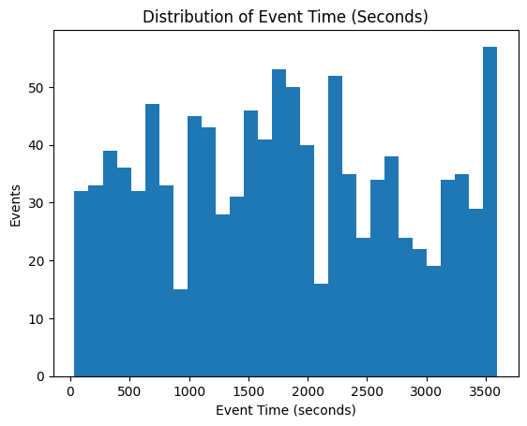
Analysis: Distribution of Event Time Single-Variable (Engagement)
The histogram displays the distribution of event durations (in seconds), illustrating how long individual user activities last.
Key Findings: Most activity durations are concentrated in a mid-range, with a noticeable right-skewed tail. This indicates that the majority of users engage in moderate-length sessions, while a smaller subset of users exhibits significantly longer activity durations representing highly engaged or “power” users.
Business Insight / Implication: This pattern suggests a healthy baseline level of engagement across the user base, with opportunities to further analyze long-session users to understand behaviors that drive deeper engagement. These insights can inform targeted retention strategies, feature optimization, and personalized experiences aimed at increasing average session duration.

Slide 6
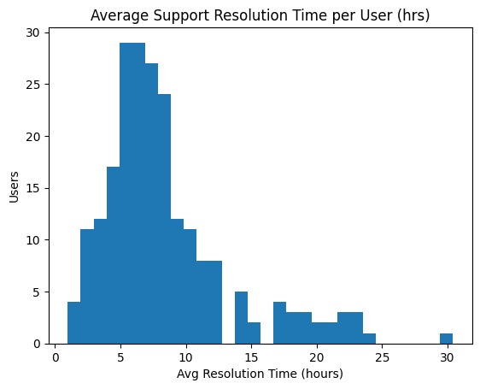
Single-Variable Analysis: Average support resolution time per user in HRS
The distribution of average support resolution time per user, measured in hours.
Key Findings: Most users have average resolution times clustered between 4 to 9 hours, indicating that the majority receive support within a reasonable timeframe. However, the distribution is right-skewed, with a long tail extending beyond 15–30 hours, representing a small subset of users who consistently experience significantly slower support resolution.
Business Insight / Implication: While overall support performance appears stable for most users, the long-tail group signals systematic delays rather than one-off incidents. These users are at higher risk of dissatisfaction and churn and should be investigated separately to identify root causes such as repeated escalations, complex issues, or support capacity constraints.

Slide 7
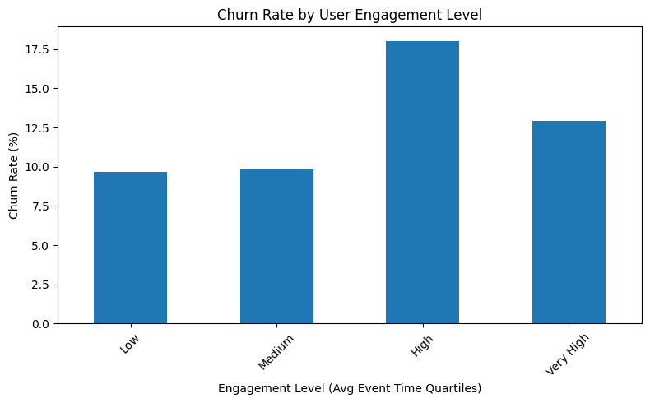
Multivariable graph of two variables Churn rate by engagement segment
The distribution of average support resolution time per user, measured in hours.
Key Findings: Churn rates are lowest for Low and Medium engagement users 10%, increase sharply for High engagement users 18%, and then decline for Very High engagement users 13%. This non-linear pattern suggests that churn risk does not decrease monotonically with engagement.
Business Insight / Implication: Users in the High engagement segment may represent customers who are actively using the platform but experiencing friction, unmet expectations, or product limitations—leading to elevated churn risk. In contrast, Very High engagement users appear more loyal, possibly due to stronger product fit or habit formation.

Slide 8
Key Findings: Engagement
Key Findings: Customer Support
Typical resolution times are reasonable
Long tail of slow resolutions exists
Long-tail cases increase churn risk
Most users show medium engagement
Small group of power users exists
Engagement varies significantly across users
Key Findings: Engagement
Key Findings: Customer Support
Higher churn observed among low-engagement users
Engagement acts as leading churn indicator
Churn Rate (8–9%)
Engagement Health (avg event time)
Support SLA (median & P90 resolution time)

Slide 9
Business Recommendations
Target low-engagement users with onboarding & nudges
Reduce support long-tail delays
Monitor churn by engagement & plan
Final Takeaway
Churn driven by engagement and support experience.
Engagement is the most actionable lever.
Focused KPIs enable proactive decision-making.

