Slide 1
InsurAI – Corporate Policy Automation and Intelligence System
AI-Driven Insurance Process Automation

Slide 2

Introduction: Navigating the Future of Insurance
The insurance industry faces unprecedented challenges, from escalating operational costs to complex regulatory environments. Manual processes and legacy systems often hinder agility and customer satisfaction. Automation, driven by artificial intelligence, is no longer a luxury but a necessity for modern enterprises to thrive and innovate.
Industry Challenges
Complexities in a rapidly evolving
market landscape.
Automation Imperative
Streamlining operations for efficiency
and speed.
AI's Strategic Role
Empowering intelligent decision-
making and growth.

Slide 3
Problem Statement: The Bottlenecks in Traditional Insurance
Current insurance practices are plagued by inefficiencies that impact both profitability and customer experience. These systemic issues demand a transformative solution.
Manual Processing Delays
Slow policy processing and claim settlements due to human intervention.
High Operational Costs
Significant expenses associated with labor-intensive tasks and error correction.
Human Error Susceptibility
Inconsistencies and mistakes in underwriting and claims leading to financial losses.
Limited Fraud Detection
Ineffective systems for identifying
and preventing fraudulent claims.
Lack of Real-time Insights
Inability to access immediate analytics for strategic business decisions.

Slide 4

The Urgent Need for Transformative Systems
Traditional systems, built on outdated paradigms, can no longer keep pace with modern demands. The competitive landscape mandates a shift towards intelligent, proactive solutions.
Limitations of Traditional Systems
Why AI-Based Automation is Critical
Fragmented data silos
Inflexible workflows
Reactive rather than proactive
High maintenance and upgrade costs
Enhanced efficiency and speed
Reduced human error
Superior risk management
Competitive market advantage

Slide 5


Introducing InsurAI: The Future of Insurance Automation
InsurAI is an AI-powered corporate policy automation system designed to revolutionize the insurance lifecycle. It moves beyond simple automation to provide intelligent decision-making capabilities across all operations.
Policy Request
InsurAI Processing
Automated Decision
Policy Issuance
This end-to-end automation platform streamlines processes, enhances accuracy, and empowers insurance providers with smart insights for growth.

Slide 6
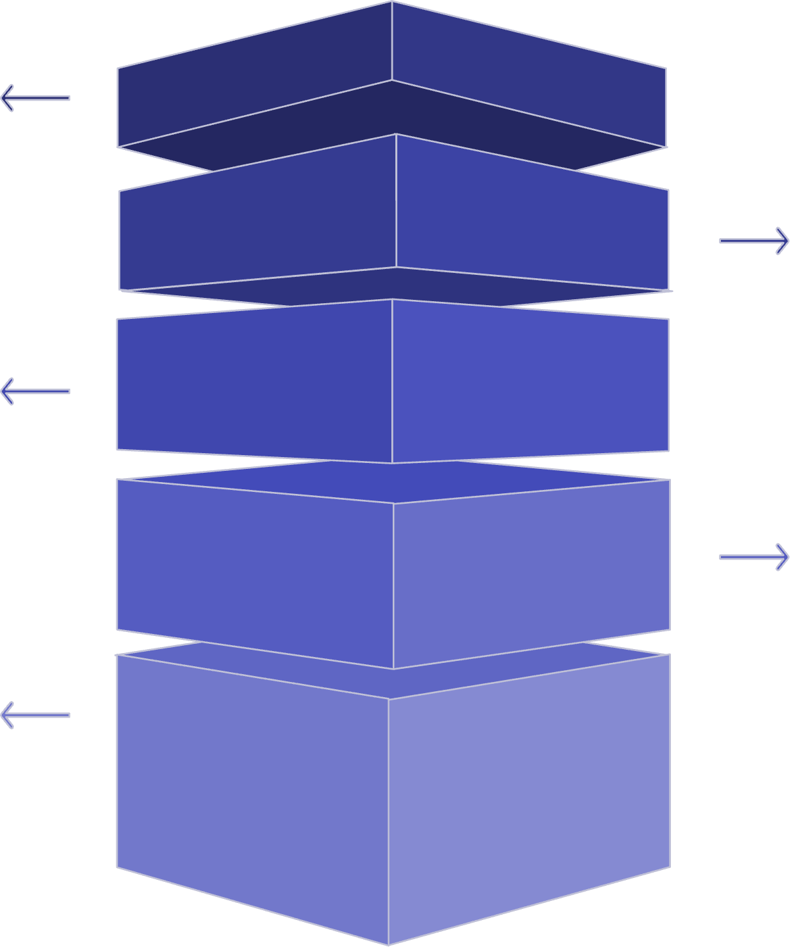
InsurAI System Architecture
Our robust system architecture ensures seamless integration, scalability, and optimal performance across all modules.
Users
Clients and external
systems accessing
services.
Web/App Interface
Frontend portals and mobile applications.
API Layer
REST/gRPC gateways and
authentication.
Core Modules
Business logic, policy, and
claims processing.
AI/ML Engine
Model inference, training,
and feature store.
This modular design allows for flexible deployment and future enhancements, ensuring a future-proof solution for corporate insurance needs.

Slide 7
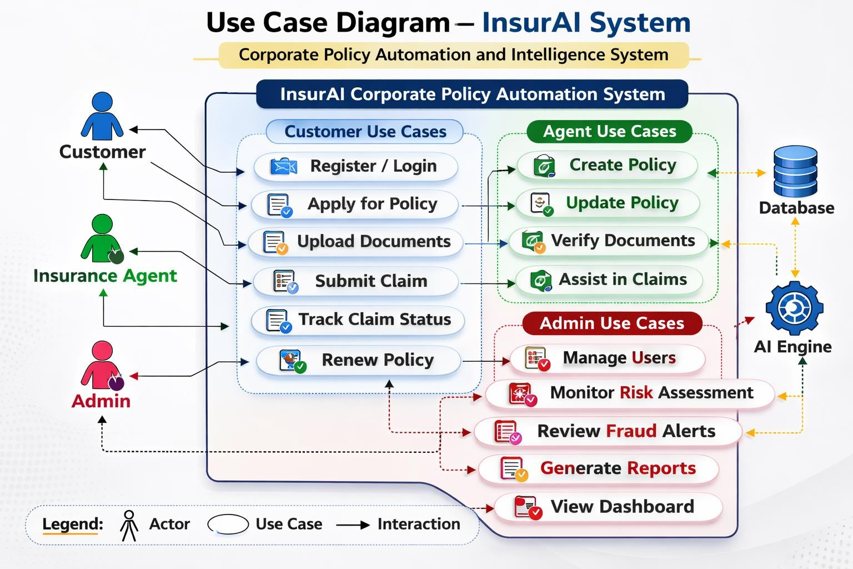

Slide 8



Core Modules Overview
InsurAI comprises three interconnected core modules, each engineered to automate and intellectualize a critical aspect of
insurance operations.
Policy Management
Automated creation, renewal, and cancellation.
Risk Assessment
ML-driven underwriting and risk scoring.
Fraud Detection
Anomaly detection and predictive analytics.

Slide 9



Policy Management Module
The Policy Management Module streamlines the entire policy lifecycle, from issuance to termination, ensuring accuracy and efficiency.
Policy Creation
Automated Tracking
Renewal Decision
Renew or Cancel
This automation reduces administrative burden, improves processing times, and minimizes errors associated with manual data en try.

Slide 10




Risk Assessment Engine
Leveraging advanced Machine Learning, the Risk Assessment Engine provides precise underwriting and dynamic risk scoring, transforming complex decisions into automated insights.
ML-Based Underwriting
Automated analysis of vast datasets to determine risk
profiles.
Dynamic Risk Scoring
Real-time evaluation and adjustment of policy risk scores.
Automated Decision Support
Instant recommendations for policy acceptance or rejection.

Slide 11




Fraud Detection System
Our Fraud Detection System employs cutting-edge AI to identify suspicious patterns and anomalies, safeguarding against financial losses due to fraudulent activities.
Data Ingestion
Anomaly Detection
Predictive Analytics
Human Review
Fraud Alert
This proactive approach significantly reduces exposure to fraud and enhances the integrity of the claims process.

