Slide 1

Reliance Stock Price Prediction

Slide 2
PROJECT NO: P377
GROUP NO:- 2
SANKIT SHIRSALE

Slide 3



EDA
Model Building
Deployment

Slide 4
EDA :
In this data analysis, I have focused on exploratory data analysis of reliance stock prices forecast. The data set contains Date, Adj Close and Volume. The removal of null values, duplicates, correlation analysis and different visualization has done in this part of EDA which provides valuable insights into the data, and the visualization helps to communicate these insights effectively.

Slide 5
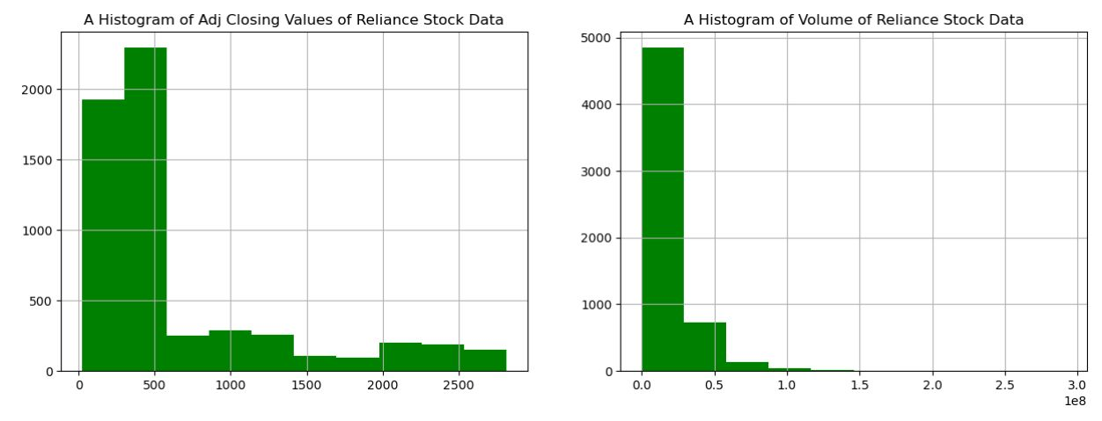
Histogram

Slide 6
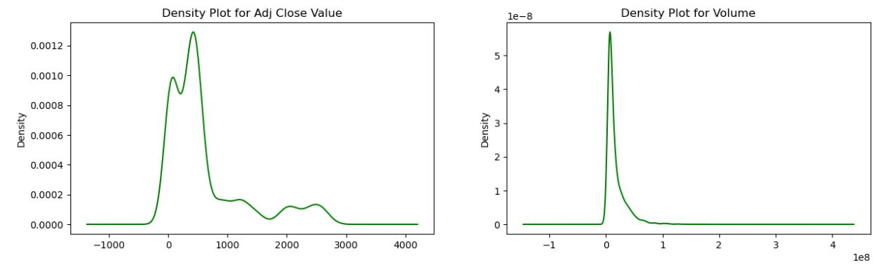
Density plots

Slide 7
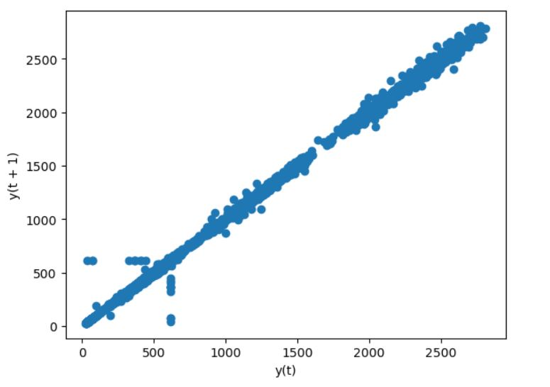
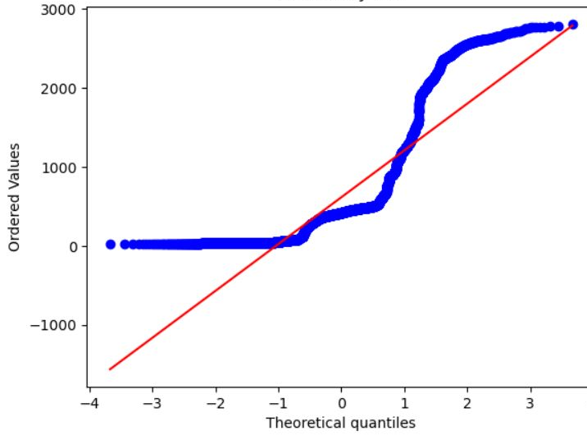
Lag plot
Q-Q plot of Adj_Close

Slide 8
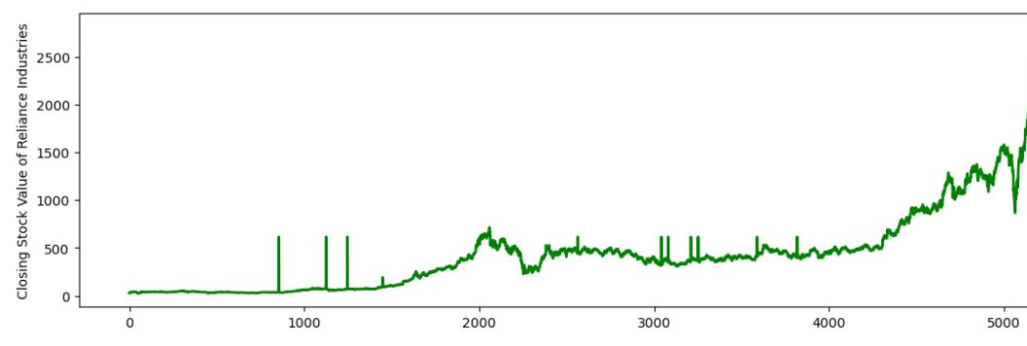
Line plot

Slide 9
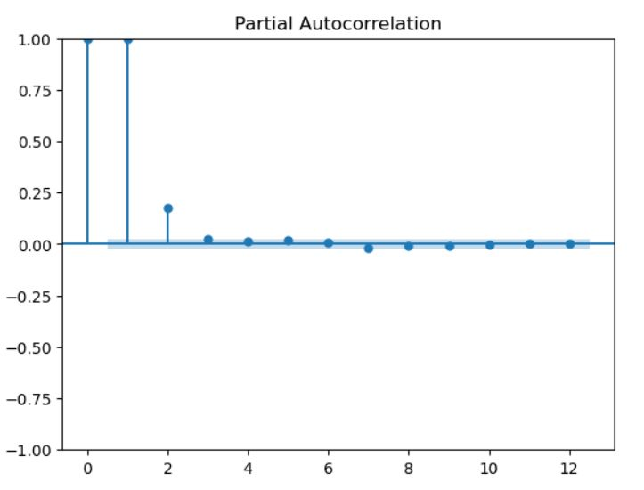
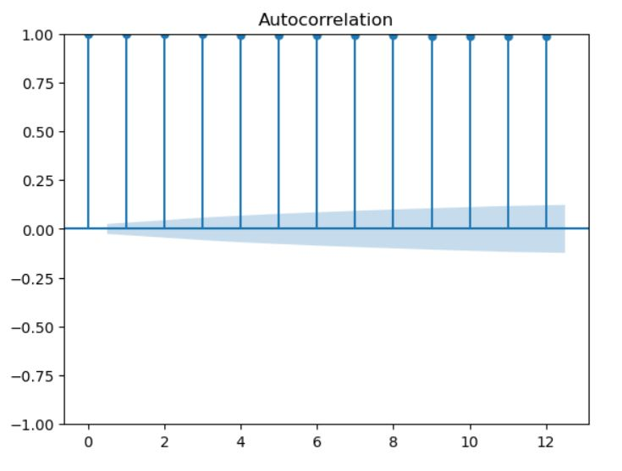
ACF plots and PACF plots

Slide 10

MODEL BUILDING :
Model building for stock market prediction involves leveraging advanced techniques such as machine learning algorithms, time series modeling, and fundamental analysis to develop robust predictive models. Through rigorous testing and validation, model building enhances the accuracy and reliability of stock price predictions.

Slide 11
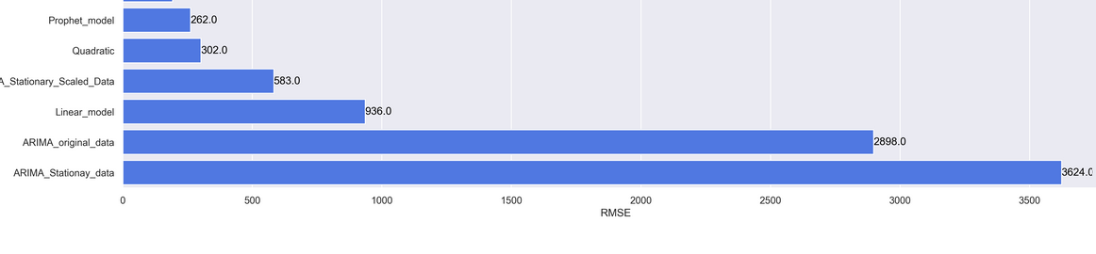
Feature Extraction:
:
Arima_model 6.279060
Holtw_add_add_model 13.64221
Holtw_mult_add_model. 19.492931
Holt_model. 15.675039
Holt_winter_moel. 44.174789
Linear_ model 55.542131
Quadratic_model. 58.370974
Ses_model. 57.412700
Addictive_seasonality_model. 80.311374

Slide 12
From the above results Prophet model.
Model give the least RMSE and MAPE
values so, we are taking Prophet model.
Model for forecasting.

Slide 13
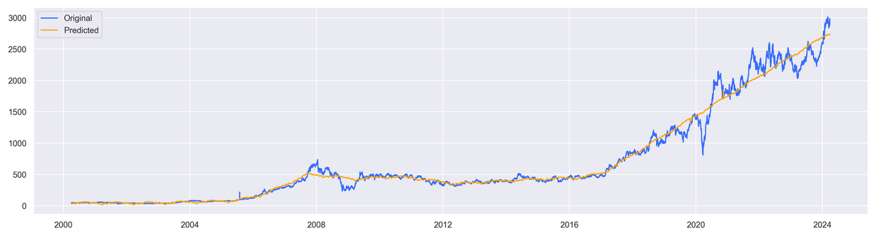
PROPHET MODEL

Slide 14
. PROPHET MODEL:
Prophet is an open-source time series forecasting tool developed by Facebook.
It is based on an additive model where non-linear trends are fit with yearly, weekly, and daily seasonality, plus holiday effects.
Prophet handles missing data and outliers, and provides intuitive parameters for adjusting the forecast.

Slide 15
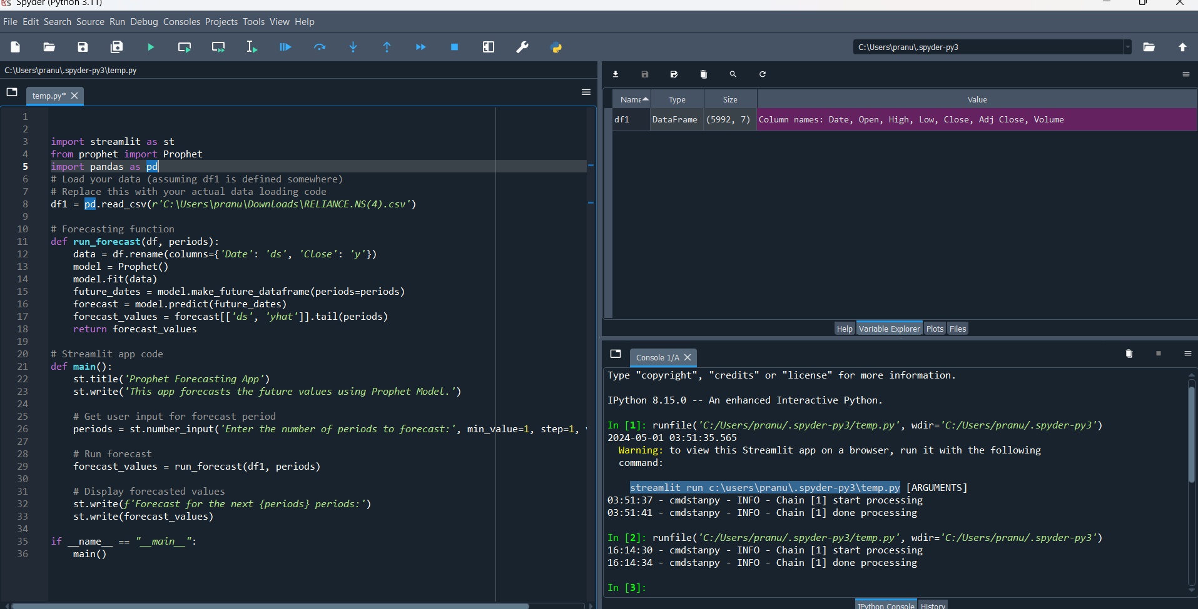
DEPLOYMENT :
Performing model deployment using streamlit by loading the required files and by writing the python code in Spyder.
We are going to see the dashboard be like :

Slide 16
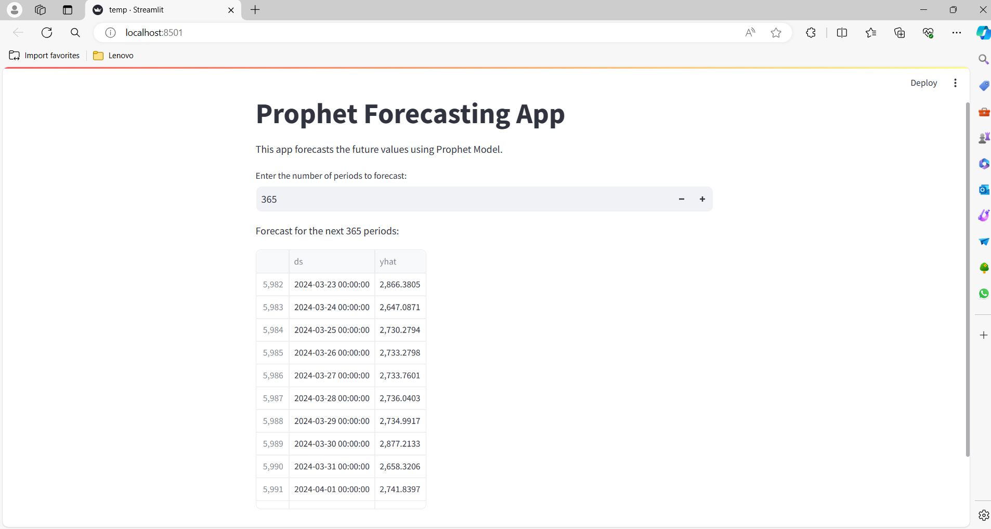
Visualization

Slide 17


