Slide 1
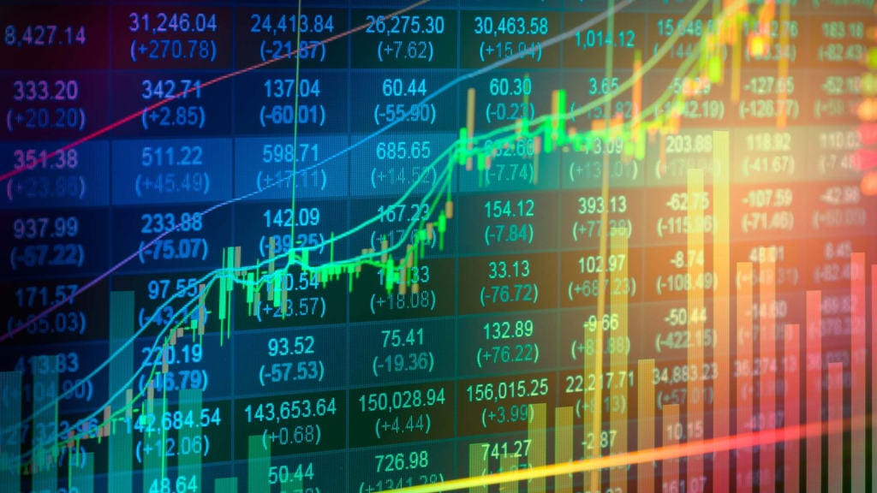
Reliance Stock Price Prediction

Slide 2

PROJECT NO: P377
GROUP NO:- 2
SANKIT SHIRSALE

Slide 3
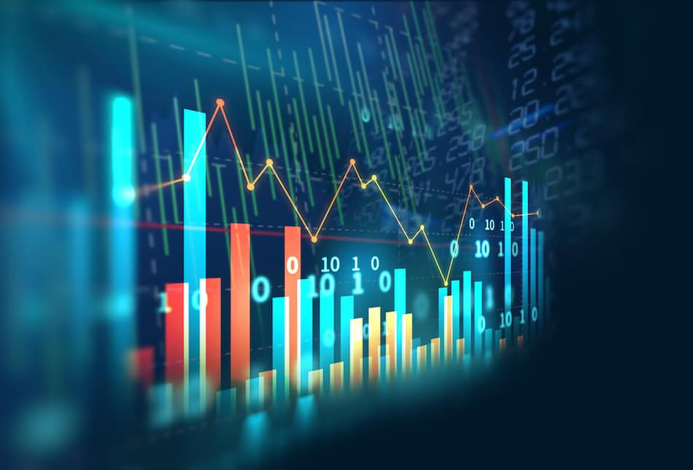


EDA
Model Building
Deployment

Slide 4
EDA :
In this data analysis, I have focused on exploratory data analysis of reliance stock prices forecast. The data set contains Date, Adj Close and Volume. The removal of null values, duplicates, correlation analysis and different visualization has done in this part of EDA which provides valuable insights into the data, and the visualization helps to communicate these insights effectively.

Slide 5
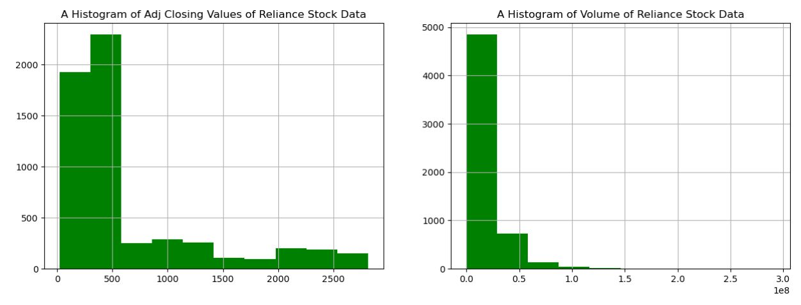
Histogram

Slide 6
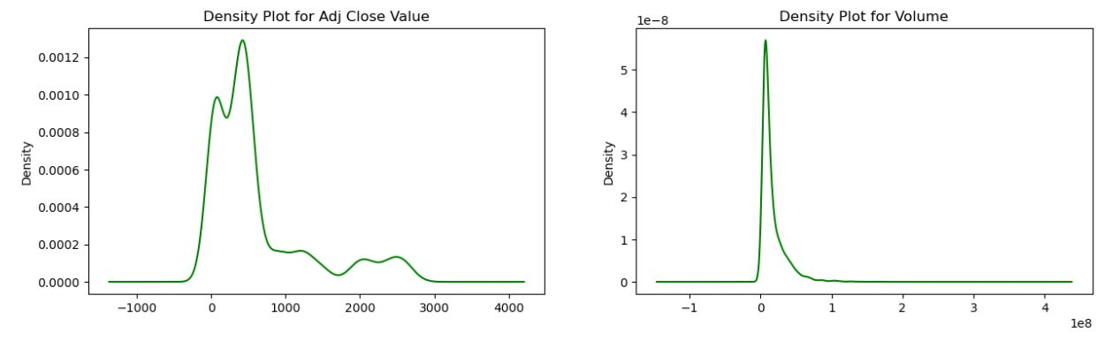
Density plots

Slide 7
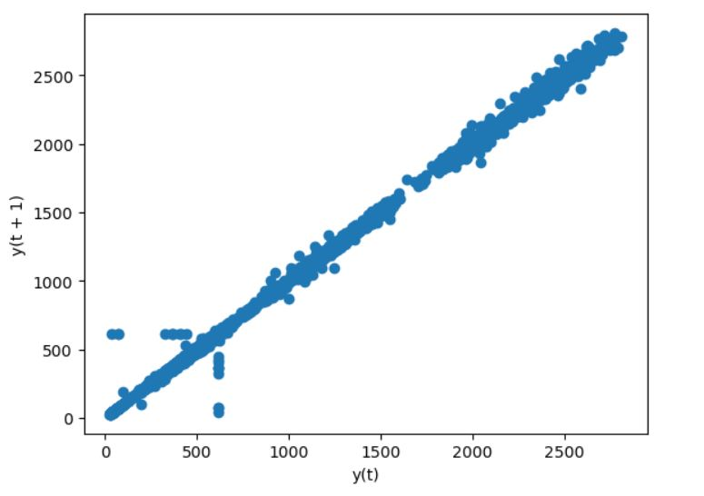
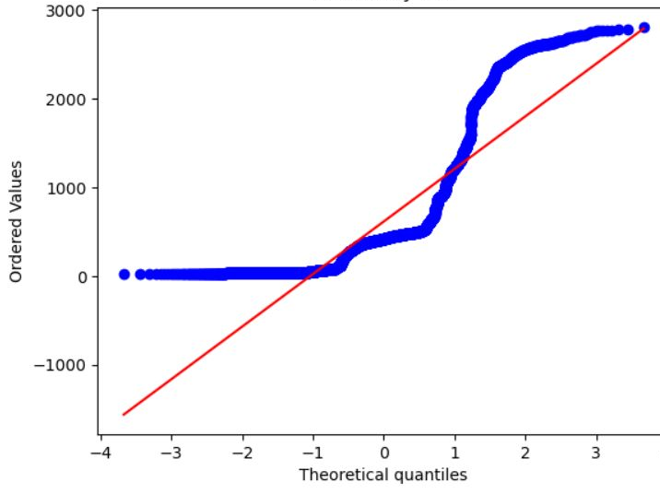
Lag plot
Q-Q plot of Adj_Close

Slide 8
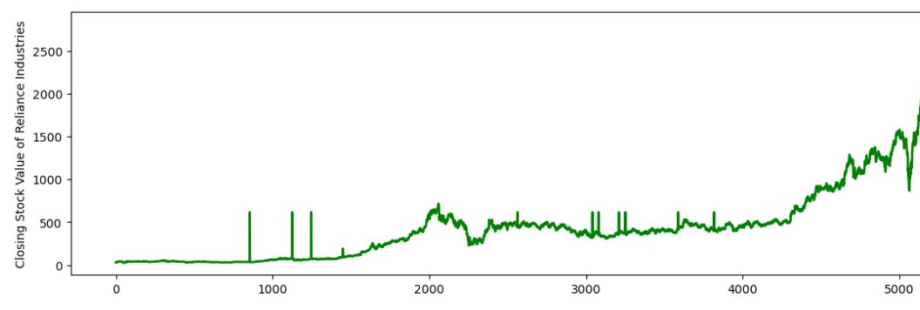
Line plot

Slide 9
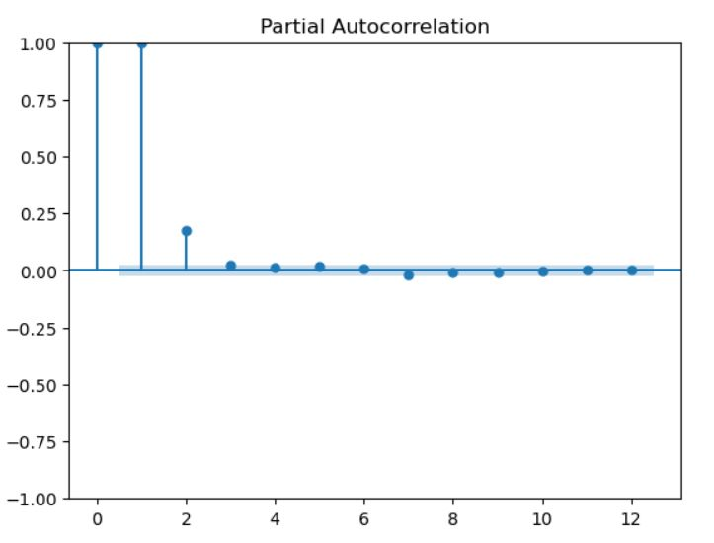
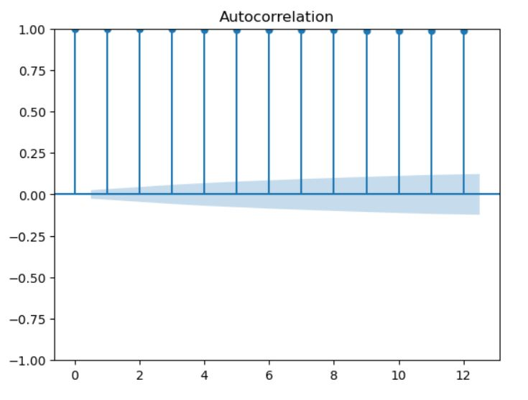
ACF plots and PACF plots

Slide 10

MODEL BUILDING :
Model building for stock market prediction involves leveraging advanced techniques such as machine learning algorithms, time series modeling, and fundamental analysis to develop robust predictive models. Through rigorous testing and validation, model building enhances the accuracy and reliability of stock price predictions.

Slide 11
Feature Extraction:
MODELS: MAPE_Values: RMSE_Values
148.8434
364.3326
383.3751
428.6003
1059.7971
1182.3001
1233.6891
1244.6083
1579.9963
Arima_model 6.279060
Holtw_add_add_model 13.640221
Holtw_mult_add_model. 19.492931
Holt_model. 15.675039
Holt_winter_model. 44.174789
Linear_ model 55.542131
Quadratic_model. 58.370974
Ses_model. 57.412700
Addictive_seasonality_model. 80.311374

Slide 12
From the above results ARIMA Model give the least RMSE and MAPE
values so, we are taking ARIMA Model for forecasting
-

Slide 13
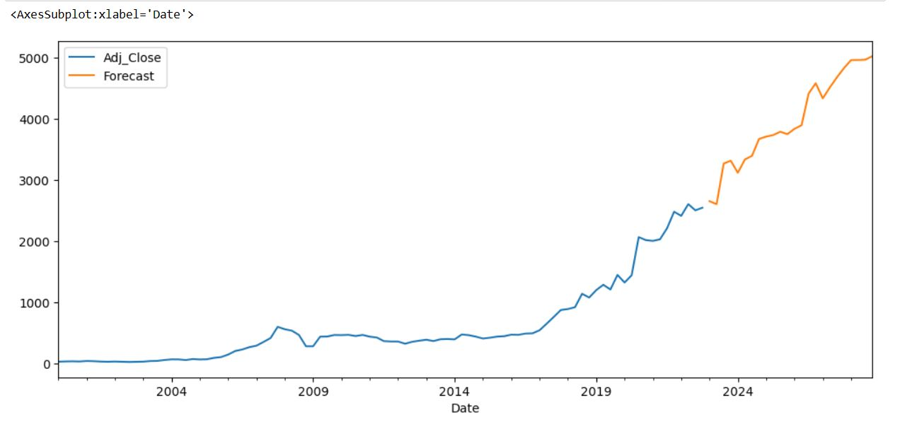
ARIMA MODEL

Slide 14
. ARIMA MODEL:
Autoregressive integrated moving average, or ARIMA.
It is a statistical analysis model that uses time series data to either better understand the data set or to predict future trends.
A statistical model is autoregressive if it predicts future values based on past values.

Slide 15
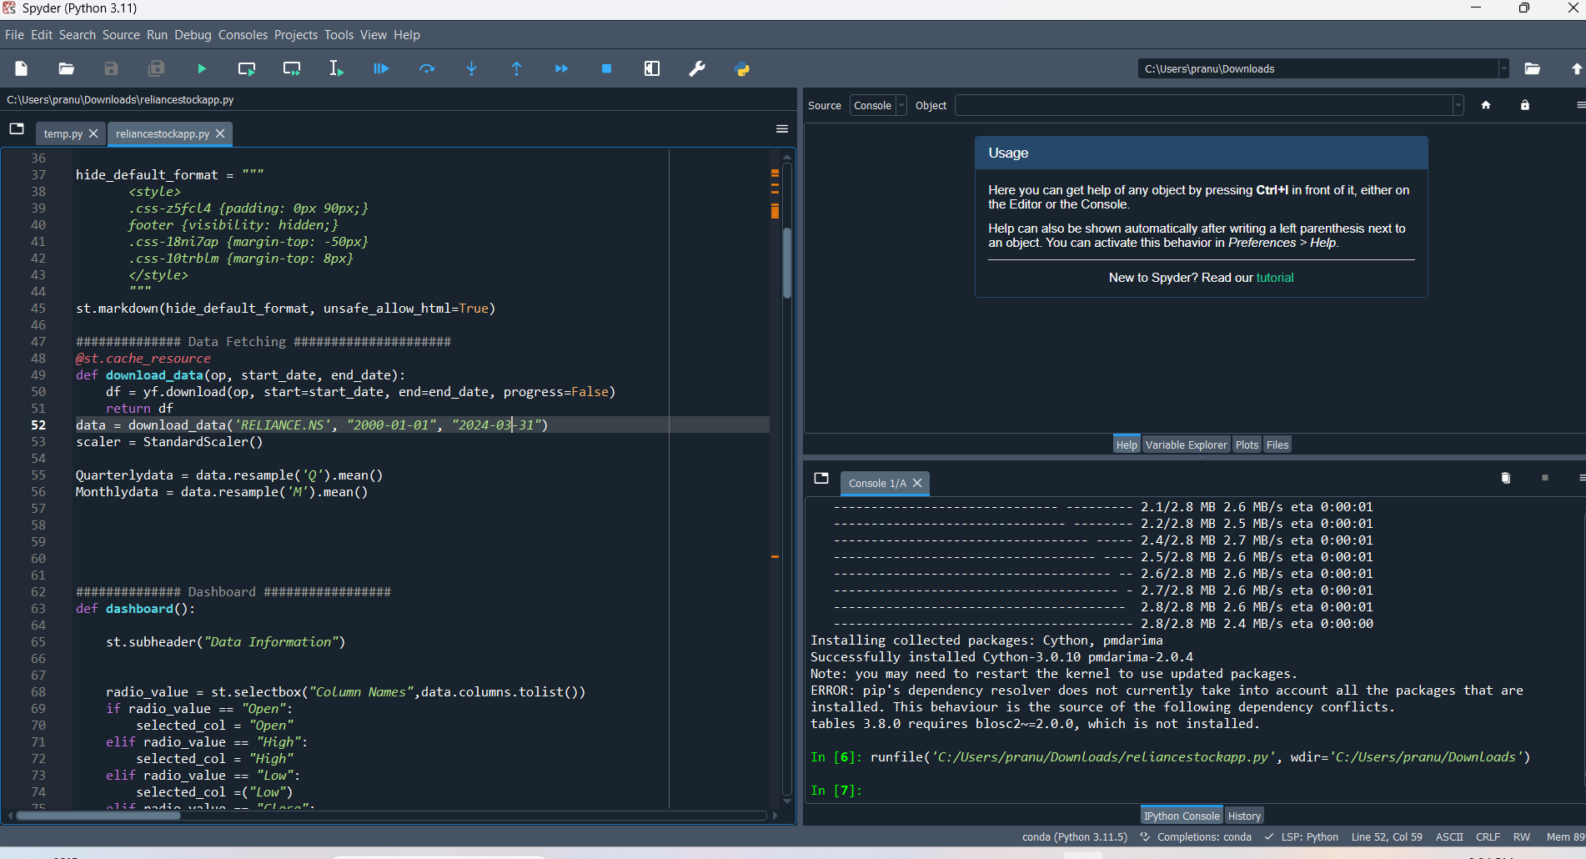
DEPLOYMENT :
Performing model deployment using streamlit by loading the required files and by writing the python code in Spyder.
We are going to see the dashboard be like :

Slide 16
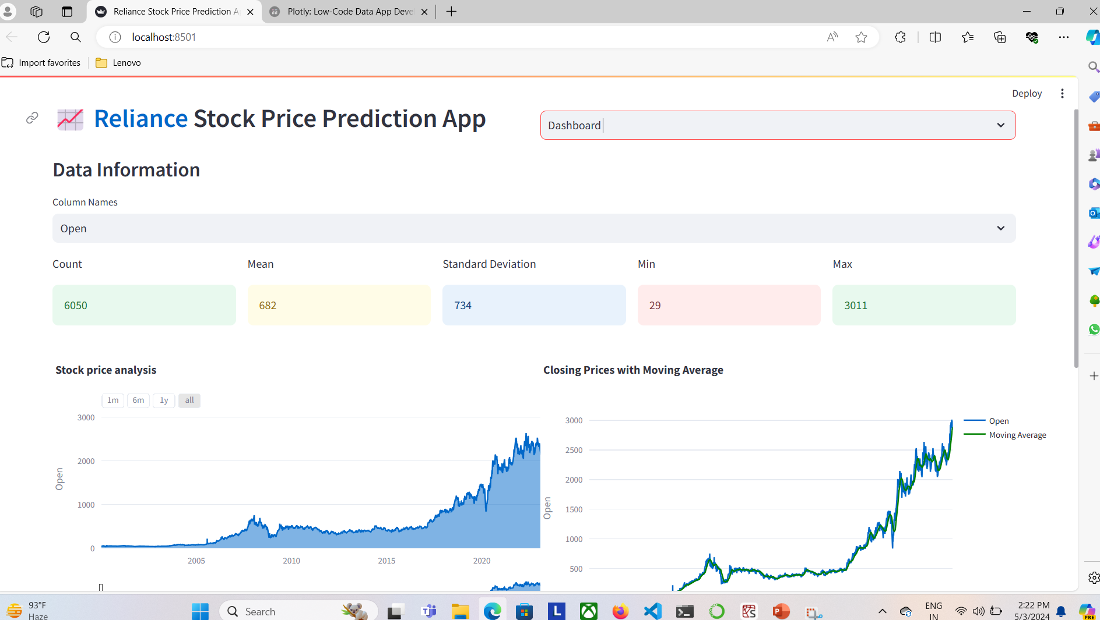
Visualization

Slide 17
THANK YOU

