Slide 1
Quick Access

Slide 2
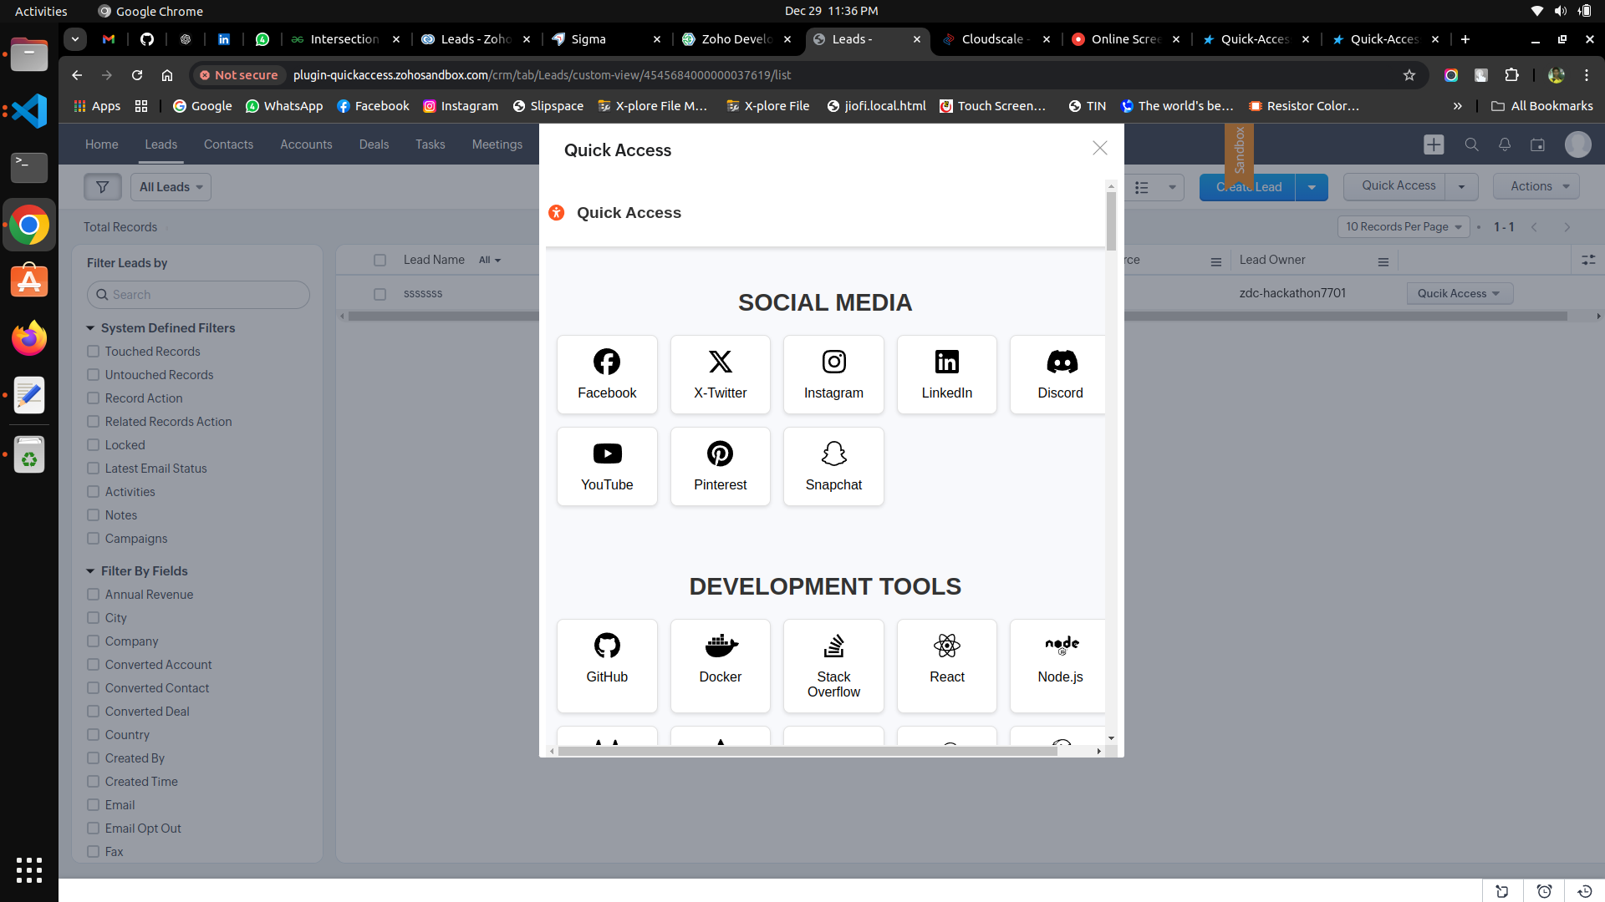

Slide 3

This work is licensed under a Creative Commons Attribution-ShareAlike 3.0 Unported License.
It makes use of the works of Mateus Machado Luna.

Slide 4
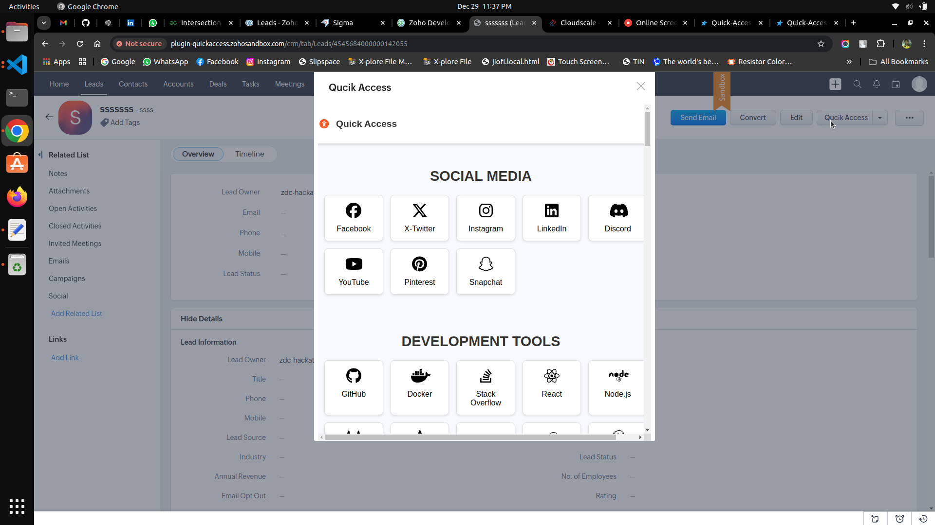
This work is licensed under a Creative Commons Attribution-ShareAlike 3.0 Unported License.
It makes use of the works of Mateus Machado Luna.

Slide 5
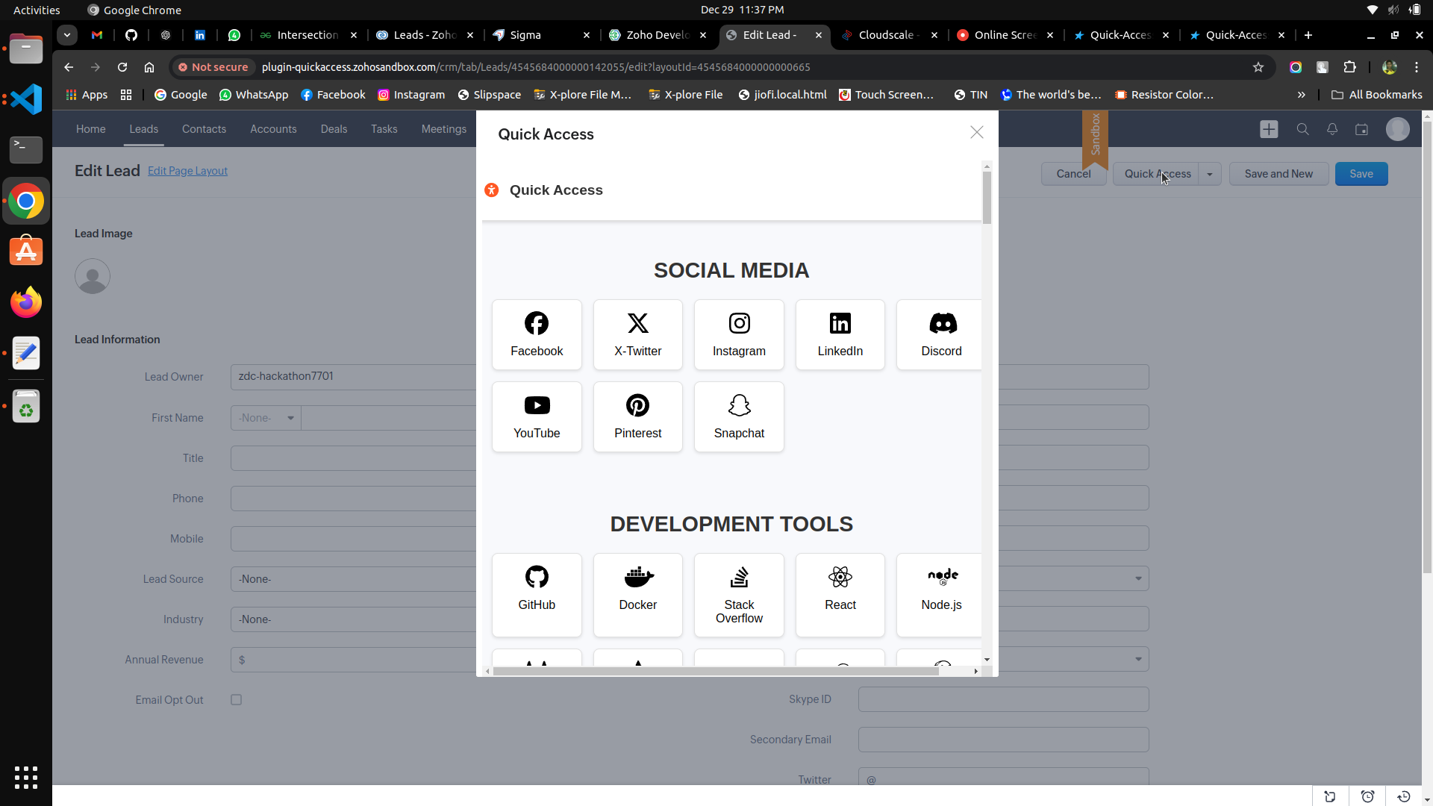
This work is licensed under a Creative Commons Attribution-ShareAlike 3.0 Unported License.
It makes use of the works of Mateus Machado Luna.

Slide 6

This work is licensed under a Creative Commons Attribution-ShareAlike 3.0 Unported License.
It makes use of the works of Mateus Machado Luna.

Slide 7
The end

