Slide 1
INTERNSHIP REPORT
AI&ML

Slide 2
CONTENT:
Company profile
Organization structure
Vision and mission
Roles & responsibilities of personal in organization
Product & market performance

Slide 3
Company Profile
AgileMinds was incorporated in July 1 2020 by Mr. Suhas Shetty.
It is a group of enthusiastic software professionals driving towards a common goal of developing software products through the cutting-edge technologies.
They aim for professional quality products and they ensure that the products developed at Agile Tech meet the customer requirements at its best.
Agile Tech have a group of professionals who have a strong technical background and have experience in MNCs including Microsoft GTSC, Intel, Mind Tree, Tech Mahindra, NRT, Unisys, and UBQ Technologies.
This has enabled them to carry forward the learning and experience of handling critical projects/ products at Agile Tech.
Agile Tech also have a group of budding engineers with creative ideas and ways of getting the work done to it for the modern era of technology.

Slide 4
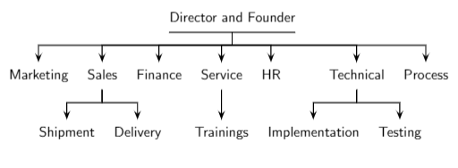
Organization Structure:
Founder of AgileTEC is Mr. Suhas Shetty and Director is Mr. Krishna Rao
They follow agile methodology for the faster and efficient development of project.
To ensure that the quality is not compromised, they have a rigorous training module developed before any new software developer is included in the project.

Slide 5
Mission:
Mission is to deliver quality knowledge transfer through innovative delivery
mechanism and technologies.
Vision:
To develop world-class products to satisfy customers through continuous improvement
driven by the integrity, teamwork and creativity.

Slide 6
Roles & Responsibilities of personal in organization:
AI/ML Researcher: AI/ML researchers are responsible for conducting research and developing new algorithms, models, and techniques in the field of AI and ML. They explore new ideas, conduct experiments, analyze data, and publish their findings in academic or industry conferences and journals.
Data Scientist: Data scientists are responsible for collecting, analyzing, and interpreting large volumes of data to extract insights and support decision-making. They develop and implement ML models, algorithms, and statistical techniques to solve business problems and optimize processes.
Machine Learning Engineer: ML engineers focus on designing and implementing ML systems and infrastructure. They build and deploy ML models, optimize performance, and integrate them into production systems. They work closely with data scientists and software engineers to develop scalable and efficient ML solutions.
AI/ML Project Manager: Project managers in AI/ML oversee the planning, coordination, and execution of AI/ML projects within the organization. They collaborate with stakeholders, define project goals and requirements, allocate resources, manage timelines, and ensure successful project delivery.

Slide 7
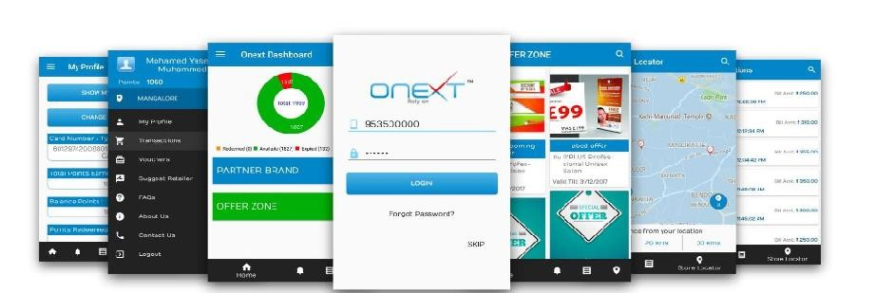
Products
Onext:
Onext is a loyalty program. It represents many advantages over traditional, customer loyalty schemes for across 58 categories of retailers in different cities. The power of Onext stems from pooling loyalty benefits from many attractive partners across 58 categories. Using one single card, members earn loyalty points when they shop at a wide range of different merchants and brands at retail outlets and online.

Slide 8
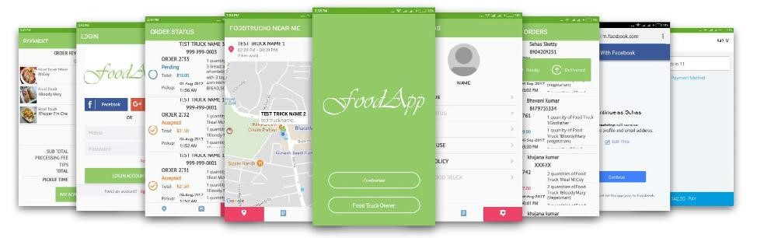
Food App:
This application finds the food trucks faster and ordering food from trucks easier. Customer can view food trucks closets to them and order from their menu without the hassle of finding the truck and ordering from them. Food trucks can transmit their location to get more customers and customize their wait times.

Slide 9
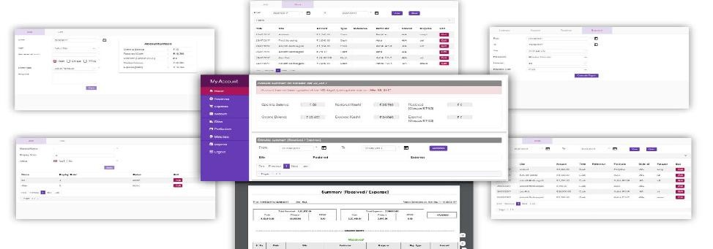
My Account:
Simple yet powerful accounting solution for managing personal accounts / daily in-come/expense. Dashboard contains overall summery about Income /Expense and includes analysis about income/expense. Latest SPA technology (Angular 4) is used with high performing rest enabled back-end (Spring) with proper security measures. Reports in different formats can be easily generated with single click with a help of powerful Jasper Reporting Engine.

Slide 10
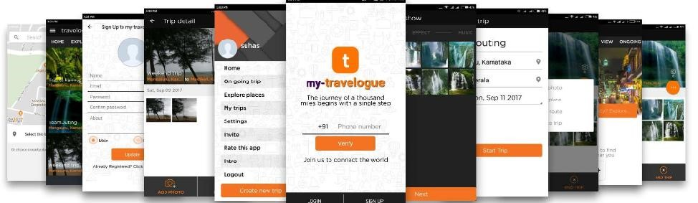
Travelogue:
Created with an idea of saving those special moments and experiences during the travel to a new place while actually in travel. With this app now you can save all your special moments during the journey, highlights the place you visited, various attraction, some out of way tourists sports, cultural background of place and some really good food.

Slide 11
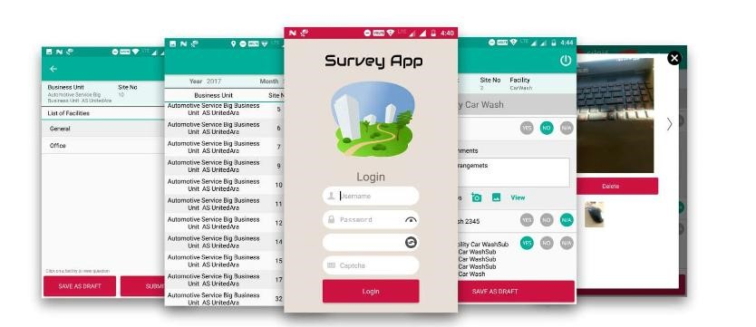
Survey App:
Intuitive Android application to get quick survey about services/infrastructure of an organization. App will make sure that survey is completed within a set of periods at specified location. GPS tracker will not let the assessor to submit the fake survey report without visiting the location. Allows assessors to upload the images if required. Works well in offline mode as well, data sync will take place in background whenever mobile device connects to data network or Wi-Fi.

Slide 12
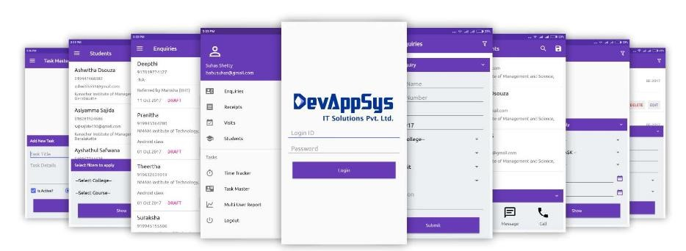
IMS:
Institute Management System, comprehensive solution to manage all the activities of training institute. IMS provides App and Web based functionalities to manage enquiries, students, registrations, course/batch management, staff management, time tracker, staff report, accounts, income/expense, fee installment etc. IMS allows communicating with enquires/students using quick links to WhatsApp/messaging services from App.

Slide 13
Services
Mobile Application Development:
The team of mobile app developers is creative and knowledgeable to accomplish individual demands as well as business needs. With advanced tools and technology Agile Tech mobile apps developers can create highly customized mobile applications for consumer needs and enterprises.
Web Application Development:
With the help of recent updates on technology (Angular 2), Agile Tech can provide the high performing dynamic web applications by using single page application (SPA) architecture on web. This will help the business to switch between high performing backend platforms based on the growth of users without vendor lock in. This helps in serving the customers without any delay and gives the desktop application like feel to the customer while using the web.

Slide 14
Enterprise Resource Planning Development:
With the help of experienced developers and latest technologies, Agile Tech team can develop complete software solution for any kind of business.
Platform Migrations and Code Porting:
Agile Tech team will help the business to migrate their old technology solution to recent one, which can be easily customizable and maintainable in the future.

Slide 15
Customers:
Carl Zeiss
Carrefour
ENOC-Emirates National Oil Company
Care Consulting
Varthabharathi
Potters Cottage Industrial Co-Operative Society Ltd,Perdoor

