Slide 1
Aug 2026
Infrastructure & Operations:
Enterprise Database Services Roadmap

Slide 2
Document Status (Work in-progress / Draft)
Document Status:
Author:
Date:
Status:
Santhosh Kumar Chandrashekar, Enterprise Architecture
Contributors:
Awareness:
Glen Loewen, Infrastructure & Operations
John-Paul Vassart, Infrastructure & Operations
Rakesh Nair, Enterprise Architecture
TTO Roadmap Program Leadership
I&O Roadmap Leadership
Approval L1:
Approval L2:
Hani Mousa
Goran Zugic
Charles Lewis
Joe Kitchen
Kaushik Venkatadri

Slide 3
Table of Contents
Topic | Page
Vision
Database Services Value Chain
Guiding Principles
Strategic Focus Areas & Transformation Opportunities
Alignment with the NORTH Data Platform
Capability Mapping
Current State
Target State
Work Packages / Initiatives Identification and Sequencing
Appendix

Slide 4

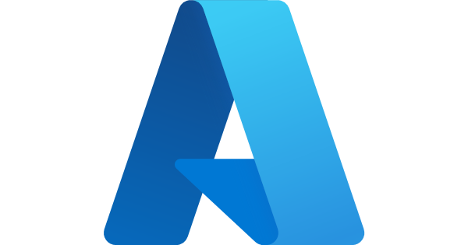


Advancing Enterprise Database Maturity
Vision Statement : Advance a modern, resilient, and secure database enterprise that enables scalable growth, strengthens regulatory compliance, and accelerates innovation across the organization. Through strategic adoption of cloud-native and vendor-supported technologies, we will simplify operations, enhance service reliability, and unlock AI-enabled data capabilities that drive business value
Business Outcomes
Accelerate Time-to-Market
Increase Service Resilience
Strengthen Security Posture
Modernized Features like AI
Reduce Operational Effort
Agility
Resilience
Compliance & Security
Consumable Features
Reduced Operations
Enterprise
Database Value
Pillars
“Delivering Secure, Intelligent, and Resilient Data Platforms for the Future of Financial Services”

Slide 5
Database Services Value Chain
The end-to-end journey from planning to optimization — standardized, secure, and efficient database operations that enable faster delivery and compliance.
Plan
Provision
Secure
Operate
Optimize
Retire
Assess workload needs
Define engine strategy
Plan cloud vs. on-prem
Automated builds
CMDB/tag registration
Backup & monitoring setup
Encryption & RBAC
Vulnerability baselines
Principle of Least Privilege (PoLP)
24/7 monitoring & incident mgmt
Patch & lifecycle mgmt
Change management
Capacity & performance tuning
License & cost optimization
DR testing
Decommission
Data archival
License reclamation
Key constituents:
Database Product Owner • EA Data Portfolio Architect • DBA/Engineering Teams (HCL) • Application Owners • Security • FinOps • Compliance • Vendors
Enterprise Architecture Engagement: contributes to database strategy & planning, ensures governance alignment across the full lifecycle, and keeps this roadmap connected to the dependent roadmaps.

Slide 6
I&O Guiding Principles
Guiding Principles
Cloud
Appropriate
Cloud first, cloud appropriate. Leverage pattern-based decision frameworks to inform multi-cloud solution deployment.​
Buy before
Build
Whenever possible, choose solutions that abstract management and operations. SaaS are our first choice, followed by PaaS, followed by IaaS.​
Responsible Autonomy
Practitioners are trusted to act in the best interest of the company and our customers. Flexibility at the edge governed by a strong foundation.​
Automation Everywhere
Solutions are deployed through automated provisioning, configuration, integration, deployment and management.
Experientially Focused
Putting the customer at the center of everything we do. This means placing a high value on the experience.
Value
Oriented
Outcomes are connected to value where velocity, frequency, experience, resilience and total cost of ownership are weighted considerations.
E2E
Observability
Prioritize unified, real-time visibility and insights into the health, performance and behaviour of services.​
Secure
by Design
Solutions are governed by a multi-layer security architecture, policy-driven enforcement, data protection and incident detection and handling.
Continuous Optimization
Programmatic measurement and feedback loops to promote efficient use of technology and processes.​

Slide 7
Six Strategic Domains
This roadmap organizes database services into six strategic domains the Cloud Foundations Roadmap uses, so the two roadmaps share one structural language – each domain below is grounded in confirmed technology direction.
F
Foundation
S
Security
G
Governance
Platform architecture & standards; provisioning & onboarding.
Security engineering; access management.
Data movement & integration governance; change & lifecycle management.
P
Platform & Services
C
Cost & Optimization
A
Automation
Modernization & cloud engineering; capacity & performance engineering.
Infrastructure and Operational cost optimization & license governance.
Platform engineering, automation & tooling; self-service.

Slide 8
Strategic Focus Areas & Transformation Opportunities
These focus areas translate database platform priorities into measurable opportunities that advance standardization, modernization, resilience, and operational efficiency by 2028.
Strategic Focus Areas
Transformation Opportunities
P
Platform Standardization & Consolidation
1
Standardize & Consolidate the Estate
Standardize MS SQL on Azure SQL MI / AWS RDS
Retire DB2 to Oracle Exadata or SaaS Applications
✓ Fewer patterns to operate; removes the clearest cost outlier (~10x MS SQL rate)
M
Modernization & AI-Readiness
2
Modernize for AI-Readiness
Migrate Oracle 19c → 26ai with Autonomous ops
One placement policy for NoSQL / Postgres / graph-vector
✓ AI-ready platform without a separate NoSQL buildout; lower ops burden
»
R
Resilience & DR Modernization
3
Strengthen Resilience & Recovery
Extend Exa@Azure tiered SLA + multi-region model
Bring the wider estate to parity
✓ Faster recovery; parity with cloud infrastructure maturity targets
O
Operating Model Evolution
4
Streamline the Operating Model
Shift HCL ticket-driven model toward self-service
Lower priority — low technical debt today
✓ Faster provisioning; reduced operational friction

Slide 9
Alignment with the NORTH Data Platform / Data Strategy
NORTH (Next-Gen Organizational Repository for Trusted and High-Value Data) is Canada Life's enterprise data/AI platform — a downstream consumer of our databases, not a competing scope. It sets new demand signals this roadmap should plan for.
How the two fit together
New demand signals for this roadmap
This roadmap owns the source-of-record databases (Oracle, MS SQL, DB2, MongoDB, PostgreSQL) — provisioning, resilience, security, licensing.
NORTH owns ingestion, governance, and consumption of data drawn FROM those databases into its Lakehouse, ODS, MDM, Graph and Vector repositories.
NORTH is Azure-first by design — consistent with the Exa@Azure direction — with select AWS use for resiliency, latency, or specific functionality.
NORTH's Data Integration layer requires Batch, Streaming (Kafka), API, and CDC (Change Data Capture) access to our source systems.
Graph database readiness — Neo4j is NORTH's named target for knowledge graphs and relationship data.
Vector database readiness — an “Extended” NORTH pattern for RAG/semantic search; vendor not yet named.
CDC support — confirm which source engines (Oracle, MS SQL, DB2) support low-latency CDC today, and where gaps exist.
MDM hosting — NORTH's Master Data Management hub needs a technology home; confirm whether that's in this roadmap's scope or owned by the NORTH/Data team.
Governance alignment — NORTH's Authoritative Sources / Book of Record model should map cleanly onto this roadmap's Governance domain rather than creating a second standard.

Slide 10
Current State​

Slide 11
Enterprise Database Landscape
MS SQL Server — the Estate's Largest Footprint
Oracle — Medium–Large Critical Workloads
On-prem + Exadata Cloud @ Customer, migrating to Exa@Azure — workload wave Q4 2026 (CONFIRMED).
All licensing included in Exa@Azure; 19c supported to 2033 — no forced move.
On-Prem (dedicated VM clusters)
Unpreferred but persists beyond this roadmap's horizon — not a retirement target.
IBM DB2 — In Containment
AWS
On-prem, AIX/Linux; ~10 years in containment. One non-standard AWS EC2 exception (FileNet replacement) — not an enterprise pattern.
Clearest cost outlier in the estate — roughly 10x the MS SQL rate.
Cloud IaaS (self-installed on EC2) — retiring. Target: AWS RDS (managed).
Azure
Cloud IaaS across three flavours (VM, SQL Database, SQL Logical Server) — retiring. Target: Azure SQL Managed Instance (PaaS).
MongoDB & PostgreSQL — NoSQL / Open-Source Relational
MongoDB Atlas — active, self-service across AWS, Azure & GCP.
PostgreSQL on AWS RDS — active, self-service (Canada Central only).
Target version: SQL Server 2025 (max general support + AI-compatible datatypes).
Placement direction still to be unified across Atlas / RDS / 26ai-native / graph-vector.
Operating Model & Cost Snapshot: HCL-managed, 24/7 L1–L3 · Oracle ≈$150/instance/mo · MS SQL ≈$55/CPU/mo · DB2 ≈$555/CPU/mo (outlier) · Exadata C@C ≈$1/GB/mo
· SLA 99.5%, RPO/RTO ≤24h–96h

Slide 12
Database Maturity Model – 8 Dimensions
Baselined on the Enterprise Cloud Maturity Model (1-5 Scale, INITIAL → OPTIMIZED)
Maturity Dimension | What It Assesses
Platform Standardization & Rationalization | Consolidation onto confirmed target platforms (MS SQL MI/RDS, Oracle Exadata) vs. fragmented/legacy patterns.
Lifecycle & Technical Debt | Version currency, end-of-life exposure, containment status of legacy platforms — DB2 is the clearest current gap.
Cloud & Managed-Service Adoption | Share of estate on managed/DBaaS (Managed Instance, RDS, Exa@Azure, Autonomous DB) vs. self-managed IaaS.
Automation & Self-Service | Automated provisioning/patching and self-service enablement vs. ticket-driven, manual operations.
Resilience & DR | RPO/RTO tiering by workload criticality, multi-region posture, DR testing cadence.
Security & Compliance | RBAC/PAM maturity, encryption, regulatory alignment (OSFI) — excludes masking, which is App Owner-led.
Observability & Operations | Real-time visibility into performance, health, capacity; incident response maturity.
Cost / FinOps | License governance, consumption transparency, cost optimization discipline across platforms.
Enterprise Cloud Maturity Model — Scale
Level | Name
1 | Initial
2 | Managed
3 | Defined
4 | Measured
5 | Optimized
People · Process · Technology
Current estate clusters around Level 3 - Defined) today
These 8 dimensions are the team-agreed axes for both the maturity table and the current-vs-target radar (next slide).

Slide 13
Database Capability Maturity: Current vs. Target
Key Insight
Lifecycle & Technical Debt is scored lowest today, driven almost entirely by DB2 — the one dimension where the estate's broader low-technical-debt position doesn't yet apply.
Cloud & Managed-Service Adoption has the clearest, fastest-moving path to target given confirmed direction: Exa@Azure, MS SQL MI/RDS, and Oracle Autonomous Database.
Automation & Self-Service shows the widest gap if the roadmap pursues more self-service, mirroring the cloud roadmap's automation ambitions.

Slide 14
Evolving From Current-State Insights to Future-Ready Focus Areas
CURRENT-STATE INSIGHT
DRIVES FOCUS AREA
MS SQL
Sprawl across on-prem VM clusters, IaaS SQL-on-VM in both clouds, and three Azure flavours — too many patterns to operate and secure.
▸
Standardize & Consolidate
1
IBM DB2
Legacy AIX/Linux estate plus a non-endorsed EC2 FileNet one-off; the clearest cost outlier at ~10x the MS SQL rate.
▸
Standardize & Consolidate
1
Oracle
Exadata Cloud @ Customer exits 2026, and a large 19c estate is ready to unlock AI — without a support-cliff forcing the move.
▸
2
Modernize & AI-Ready
3
Strengthen Resilience
Mongo / Postgres
Both sit on AWS RDS today, with NoSQL/graph/vector direction unresolved — teams lack a single placement rule.
▸
Modernize & AI-Ready
2
Operating Model Evolution — cross-cutting
HCL-managed, ticket-driven ops shift toward self-service; lower priority given generally low technical debt.
▸
4
Evolve Operating Model

Slide 15
Target State​

Slide 16
Design Principles for Target State & Expected Business Outcomes
Key Design Principles
Expected Business Outcomes
Right Engine for the Job:
MS SQL (Managed Instance/RDS) for small–medium workloads, Oracle Exadata for medium–large (critical) — a confirmed sizing rule, not case-by-case debate.
Cost Efficiency: contain licensing and infrastructure spend while supporting business growth.
1
1
Resilient, Tiered Architecture:
DR and recovery targets matched to workload criticality, not one-size-fits-all.
Speed to Value: faster provisioning for application teams via self-service.
2
2
Security & Governance by Design:
Policy-driven guardrails, automated compliance — masking stays an Application Owner responsibility.
Risk & Compliance: reduced operational risk via unified database governance.
3
3
Cost-Transparent Operations:
unified licensing and consumption visibility for FinOps-style traceability.
Strategic Focus: simplify the estate by exiting deprecated, high-cost platforms.
4
4
Progressive Retirement of Legacy Platforms:
DB2 exit to Oracle Exadata completed on a committed timeline.
Maturity Uplift: target Level 4+ across all assessed database capabilities.
5
5

Slide 17
Enterprise Database Landscape – Target State
MS SQL Server
Oracle
On-Prem: persists beyond this roadmap's horizon — unpreferred pattern, not a retirement target.
AWS RDS (managed instance): preferred cloud target, replacing self-installed IaaS on EC2.
Azure SQL Managed Instance (PaaS): preferred cloud target, replacing VM / SQL Database / SQL Logical Server IaaS patterns.
Version: SQL Server 2025 — maximum general support window, plus enhanced AI-compatible datatypes.
Exa@Azure: sole Oracle landing zone; all database licensing included.
19c stays supported to 2033 — no support-cliff forcing the move.
26ai unlocks AI out of the box: native AI vector search, native MongoDB-compatible storage, unified JSON-or-SQL access.
Autonomous Database: self-manage, self-patch, self-heal — targeted operating-model uplift.
DB2 · MongoDB · PostgreSQL — Target Resolution
IBM DB2: retired — consolidated onto Oracle Exadata.
MongoDB: Atlas or 26ai-native Mongo, per placement policy.
PostgreSQL: AWS RDS PostgreSQL, per placement policy.

Slide 18
High-Level Target Operating Model
The target model gives every workload a governed path to the right engine, sized by workload demand, with automation and observability wrapped around all of it.
Consumers
Application Teams • Analytics & BI • AI / ML Workloads
Database Service Layer
Relational: MS SQL 2025 MI/RDS (small–medium) + Oracle Exadata/26ai/Autonomous DB (medium–large, critical) • NoSQL: MongoDB Atlas + Oracle 26ai-native • Graph/Vector (NORTH-driven, future)
Automation, Security & Governance
Policy-as-code • RBAC/PAM • Automated backup, patch & DR • Cost & license governance • Masking = App Owner-led, Oracle-enabled
Foundation
Oracle Exadata @ Azure (sole Oracle landing zone) • Azure SQL MI • AWS RDS • On-Prem MS SQL (persists beyond roadmap horizon, unpreferred) • On-Prem DB2 (retiring to Exadata)

Slide 19
Work Packages / Sequencing

Slide 20
Roadmap Priorities Summary
Priority Name | Rank | Opportunity / Pain Point | Business Impact | Domain
 | High |  |  | Platform & Services
 | High |  |  | Platform & Services
 | High |  |  | Cost & Optimization
 | Medium |  |  | Platform & Services
 | Medium |  |  | Automation
 | Medium |  |  | Governance
 | Medium |  |  | Platform & Services
 | Low |  |  | Automation

Slide 21
Strategic Work Packages / Initiatives & Objectives

Slide 22
Work Packages / Initiatives Sequencing (2027–2028)
2027
2028
Initiative | Q1 | Q2 | Q3 | Q4 | Q1 | Q2 | Q3 | Q4

Slide 25
Appendix

Slide 26
Capability Mapping
For Capability Mapping, I&O roadmaps are mapped to the Canada Life Technology Capability model.
The Canada Life Technology Capability model is based on the Technology Business Management (TBM) taxonomy.
Level 1 - 3 are standardized TBM taxonomy names, Level 4 are Canada Life specific modifications.
Technology categorization with descriptions:​
L1 Capability L2 Capability L3 Capability L4 Service Category Description
Technology Infrastructure
Data Platform Services
Database Services
Relational Database Services
Managed relational database platforms supporting transactional and analytical workloads, including availability, backup/recovery, patching, upgrades and lifecycle management.
Non-Relational Database Services
Managed document, key-value, NoSQL and caching platforms for workloads requiring flexible schemas, low latency and scale.
Database Resilience & Recovery
Standardized high availability, backup, restore, replication, disaster recovery, RPO/RTO and recovery-testing capabilities.
Database Automation & Lifecycle
Automated provisioning, configuration, patching, upgrades, decommissioning and infrastructure-as-code patterns across database platforms.
Database Security & Protection
Platform capabilities supporting encryption, access control, auditing, secrets management and approved masking/security controls.
Database Observability & Performance
Monitoring, capacity management, performance optimization, health checks and operational telemetry.

Slide 27
Enterprise Database Landscape – Current State
MS SQL Server
  On-Prem (unpreferred target):
    Dedicated VM clusters to optimize licensing at the dedicated physical core level
    All physical stand-alone instances have been converted to VMs for cost optimization
    Both Single Instances and Always-On HA Instances available depending on Application Owner’s needs
      All environments lower than UAT are hosted on Single Instances for cost optimization
  AWS:
    IaaS builds with MS SQL installed on top of provided VMs
    RDS managed instances (target state)
  Azure:
    IaaS builds with MS SQL installed on top of provided VMs
    Azure SQL Database
    SQL Logical Server
    Azure SQL Managed Instance - PaaS (preferred target state)

Slide 28
Enterprise Database Landscape – Current State
IBM DB2
  On-Prem
    Hosted on either AIX or Linux
  AWS
    Hosted on EC2 VM (this is a one-off FileNet stack replacement and *not* intended to be an Enterprise endorsed pattern for Database)
Oracle
  On-Prem
    Exadata Cloud at Customer (expected departure in 2026 as migrations to Azure complete)
  Azure
    Exadata@Azure (target state)
MongoDB
  AWS RDS
PostgreSQL
  AWS RDS

Slide 29
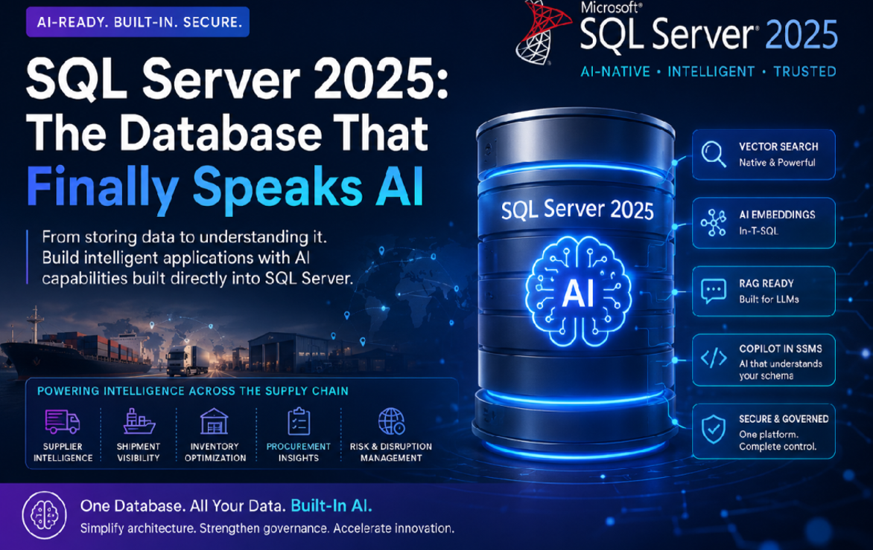
Enterprise Database Landscape – Target State
MS SQL Server
Targeting small to medium database sizes and corresponding workloads
  On-Prem (will still exist beyond the timeframe of this Roadmap):
    Dedicated VM clusters to optimize licensing at the dedicated physical core level
    Both Single Instances and Always-On HA Instances available depending on Application Owner’s needs
      All environments lower than UAT are hosted on Single Instances for cost optimization
  AWS:
    RDS managed instances
  Azure:
    Azure SQL Managed Instance - PaaS (Preferred Target)
      Reduction of Operational Costs with vendor managed environments
  Target moving our versions to MS SQL Server 2025 for maximum general support and enhanced AI compatibilities/datatypes

Slide 30
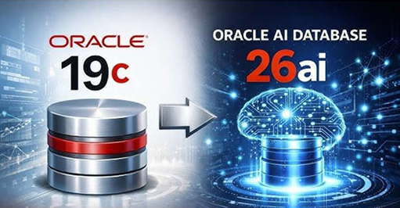
Enterprise Database Landscape – Target State
Oracle
Targeting medium to large (critical) database sizes and corresponding workloads
  Azure
    Exadata@Azure
      Licensing of all DB versions/features are included in this service
      Oracle 19c is on support until 2033
      Oracle 26ai can unlock AI capabilities and datatypes out of the box by upgrading from 19c
        Able to natively consume MongoDB
        It is the latest major database release that deeply integrates AI and machine learning into every layer of the Oracle Database stack
        It brings AI to your data with the addition of AI Vector search to Oracle's relational database
        Instead of using two separated databases (relational and non-relational databases), developers can operate on the same underlying data as either JSON documents, using standard document APIs, or as relational, using standard SQL
      Autonomous environments available for self management, patching, and healing for Operational reductions

