Slide 1

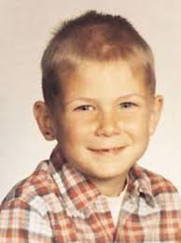
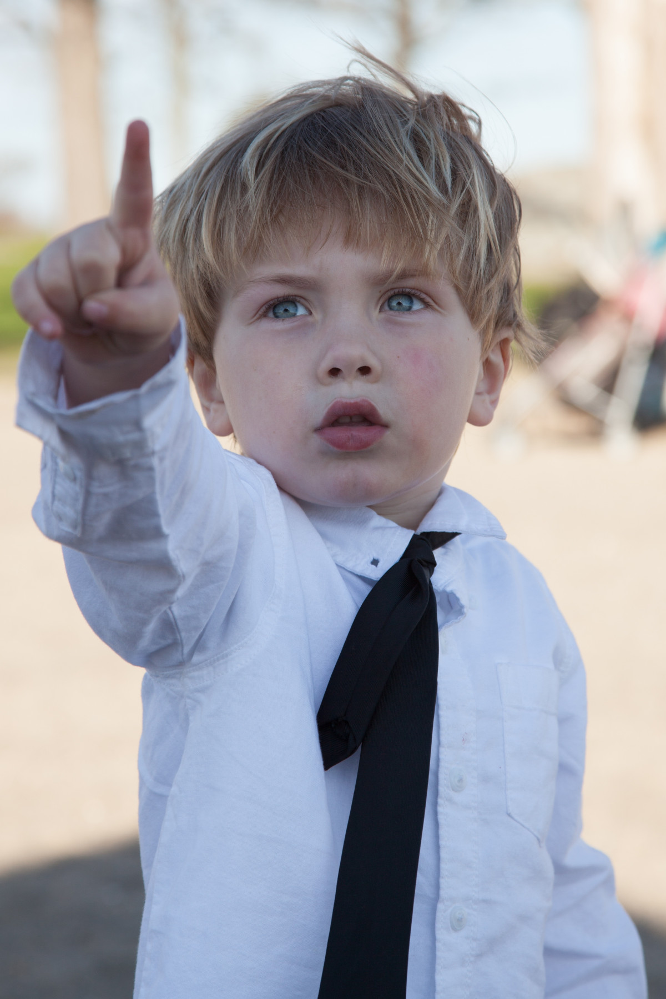
“The Power of Resilience”
Launch
Launch
Review of Book: “ A Child Called IT “ by Dave Pelzer’s

Slide 2
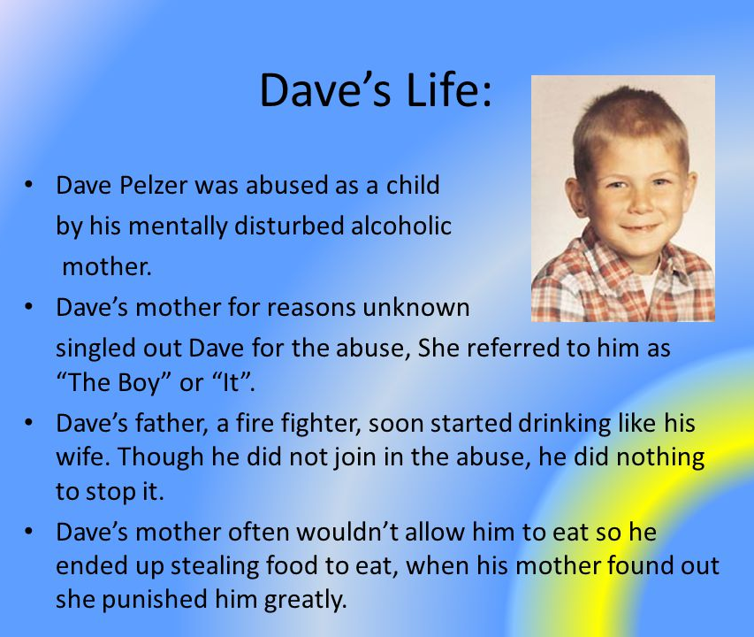
DAVE PELZER
“Breaking the Cycle of Abuse”

Slide 3
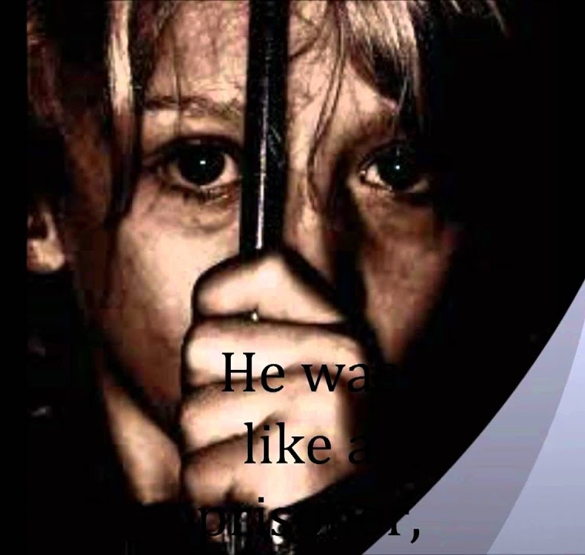
Summary
"Surviving the Unthinkable"
"A Child Called It" is a memoir by Dave Pelzer that tells the story of his childhood abuse at the hands of his mother. The book is divided into chapters that chronicle different stages of Pelzer's life, from his early years as a happy child to his eventual rescue from his mother's abuse.
The book has been described as a very moving and unbelievable journey of a young boy who manages to somehow survive his mother’s unpredictable and torturous games.

Slide 4
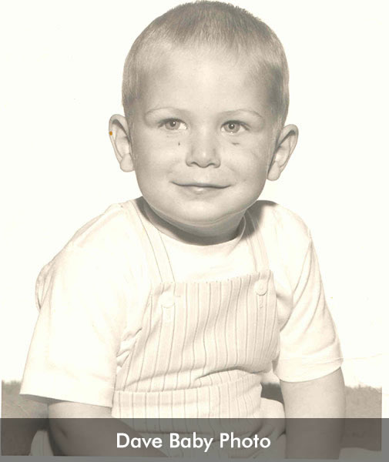
“The Power of Resilience”
Title that I wish to have for the book
Reason: Pelzer became determined to survive and fight back against his mother's abuse.

Slide 5

Large image slide
REVIEW
The book begins with Pelzer as a twelve-year-old boy living in Daly City, California. He is late for school and rushes to finish his chores before leaving for school. His mother hits him in the face and he falls to the floor.
In 2nd chapter, Pelzer describes his early years as a happy child who loved spending time with his family. He talks about how his mother was once loving and caring towards him. He’s mother begins to abuse him physically and emotionally. She forces him to eat dog faeces and vomit, and she locks him in the bathroom for hours on end.
Pelzer's mother begins to withhold food from him as a form of punishment. He becomes malnourished and weak. Pelzer's mother stabs him in the stomach with a knife. He’s father is away on business trips frequently, leaving Pelzer alone with his mother. She continues to abuse him. Pelzer finds solace in religion and begins to pray for help.
Pelzer's teachers begin to notice that something is wrong at home and report their concerns to Child Protective Services. Pelzer becomes determined to survive and fight back against his mother's abuse. Child Protective Services finally intervenes and rescues Pelzer from his mother's abuse.

Slide 6

Large image slide
Key takeaways:
1. "A Child Called It" is a powerful memoir that sheds light on the issue of child abuse.
2. The book highlights the importance of resilience and determination in overcoming adversity.
3. It also emphasizes the role that teachers and other adults can play in identifying and reporting child abuse.
4. The book can be difficult to read due to its graphic descriptions of abuse, but it ultimately offers hope and inspiration for survivors of trauma.

Slide 7


Large image slide
LearningS:
The learning from this book can be applied in many ways such as:
1. Understanding the importance of reporting child abuse if you suspect it.
2. Learning how to recognize signs of child abuse.
3. Understanding how resilience can help people overcome adversity.
4. Learning how survivors of trauma can find hope and inspiration in their experiences.

Slide 8

Thank You
FUNKY TUNES
Launch
Launch
Feedback is the breakfast of champions
RAMAVATH SANTHOSH
22MCF1R40
Any Feedback

