Slide 1
PHASE 2
DETECTING AVALANCHES
IN SAR IMAGERY
A small D4-equivariant CNN, and an honest look at the metric
GUILLERMO SAN MARCO
April 2026
Notes:
Avalanche debris segmentation on bi-temporal Sentinel-1 SAR. Two findings worth
leaving with: (1) a small equivariant CNN matches state-of-the-art on pixel F1
at 4× fewer params; (2) the standard benchmark metric hides a real operational
gap — our model finds more actual avalanches. ~15 minutes.

Slide 2
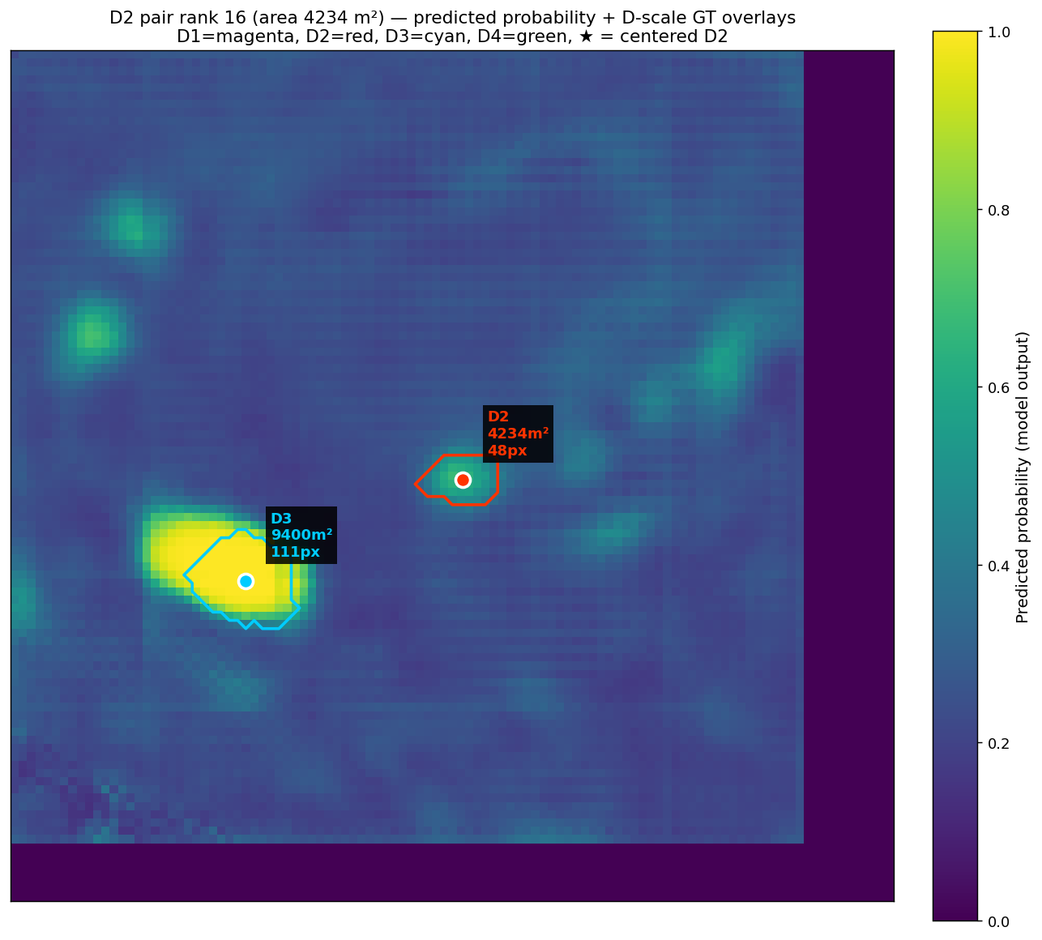
WHY THIS MATTERS
Avalanche rescue and road management depend on knowing where debris fell
— Avalanches kill ~150 people a year in Europe alone
— Optical imagery is useless under clouds — avalanches happen in storms
— SAR sees through cloud / night — the only reliable sensor at scale
— Key signal: the DIFFERENCE between a pre-storm and post-storm acquisition
— Goal: automatic, pixel-accurate deposit maps from free Sentinel-1 data
02
Notes:
Why care. Avalanches kill ~150 people per year in Europe. They happen during
storms, when optical satellites see only clouds. Sentinel-1 SAR is free,
all-weather, and sees through cloud and night. Its downside: the imagery is
noisy and deposits only show up as a difference between pre-storm and
post-storm acquisitions. The goal is an automatic pipeline: hand it two SAR
scenes, get back a deposit map. The example on the right shows raw VH
backscatter with a deposit polygon overlaid.

Slide 3
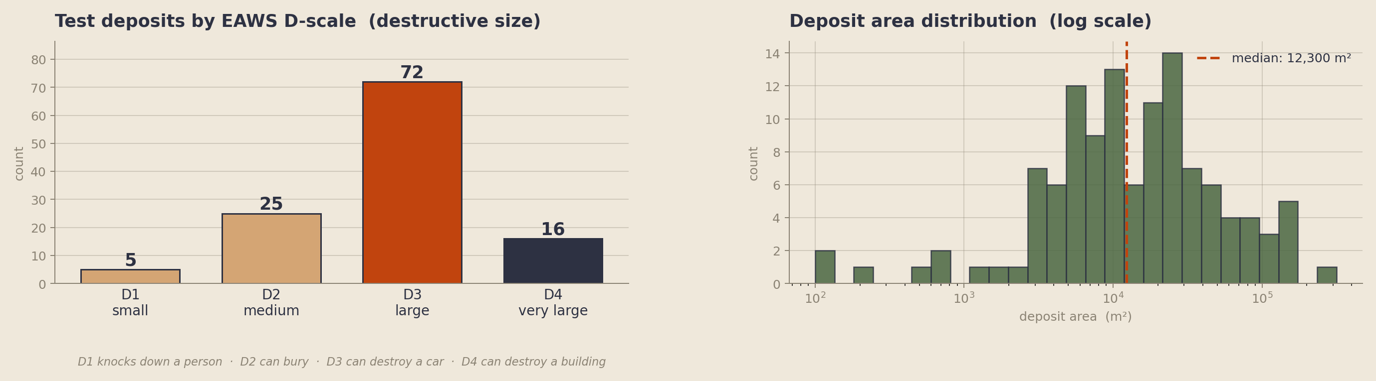
THE DATASET
AvalCD (Gatti et al.) · 117 polygons on the held-out Tromsø OOD test scene
TRAIN
VAL
TEST
5 scenes · ~34 k deposit pixels
Livigno 2025-03-18
Tromsø 2024-12-20 (OOD)
Livigno ×2, Nuuk ×2, Pish ×1
threshold & calibration tuning
117 polygons · 0.5 % pixels positive
03
Notes:
AvalCD public benchmark from Gatti et al. Five training scenes (Italy,
Greenland, Pakistan), one validation scene, and one out-of-distribution test
scene — Tromsø, 117 polygons, 0.5% of pixels positive. Deposits labeled with
EAWS D-scale: D1 knocks down a person, D2 can bury, D3 can destroy a car, D4
can destroy a building. Test scene is D3-dominated (n=72). Median deposit is
~12 000 m² — roughly a small parking lot.

Slide 4
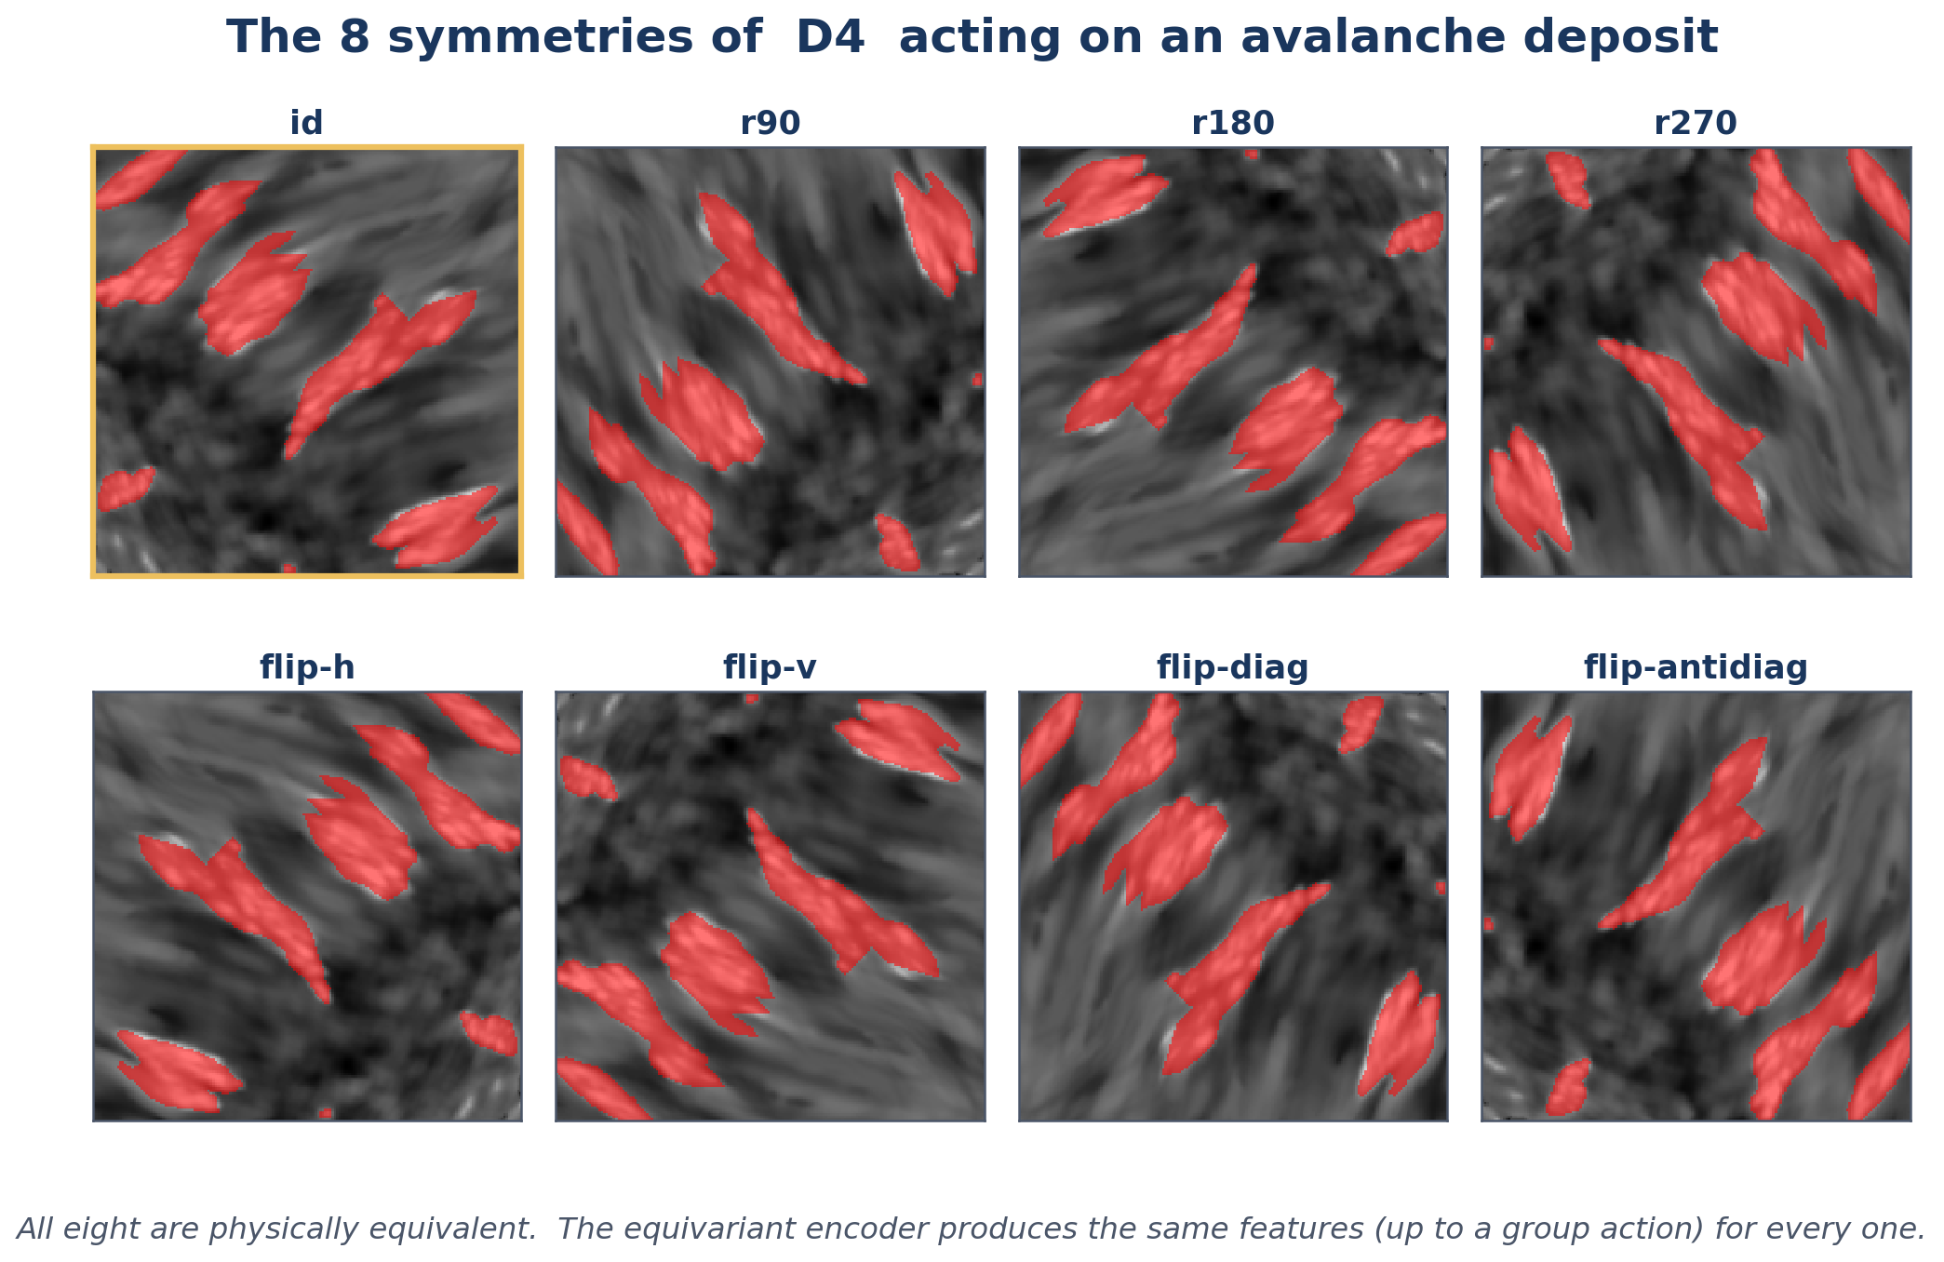
ORIENTATION DOESN'T MATTER
A rotated avalanche is still the same avalanche — the satellite just flew a different path
A standard CNN must LEARN this from 8× augmented data. A D4-equivariant CNN gets it for free, by construction.
04
Notes:
The physical insight. All 8 panels are the same real avalanche patch under the
4 rotations and 4 reflections that make up D4 — the symmetry group of the
square. Physically equivalent: the avalanche doesn't know which way the
satellite flew. Standard CNN has to learn this from augmented data.
D4-equivariant CNN encodes the symmetry into the convolutions. Rotation in →
rotation out, guaranteed.

Slide 5
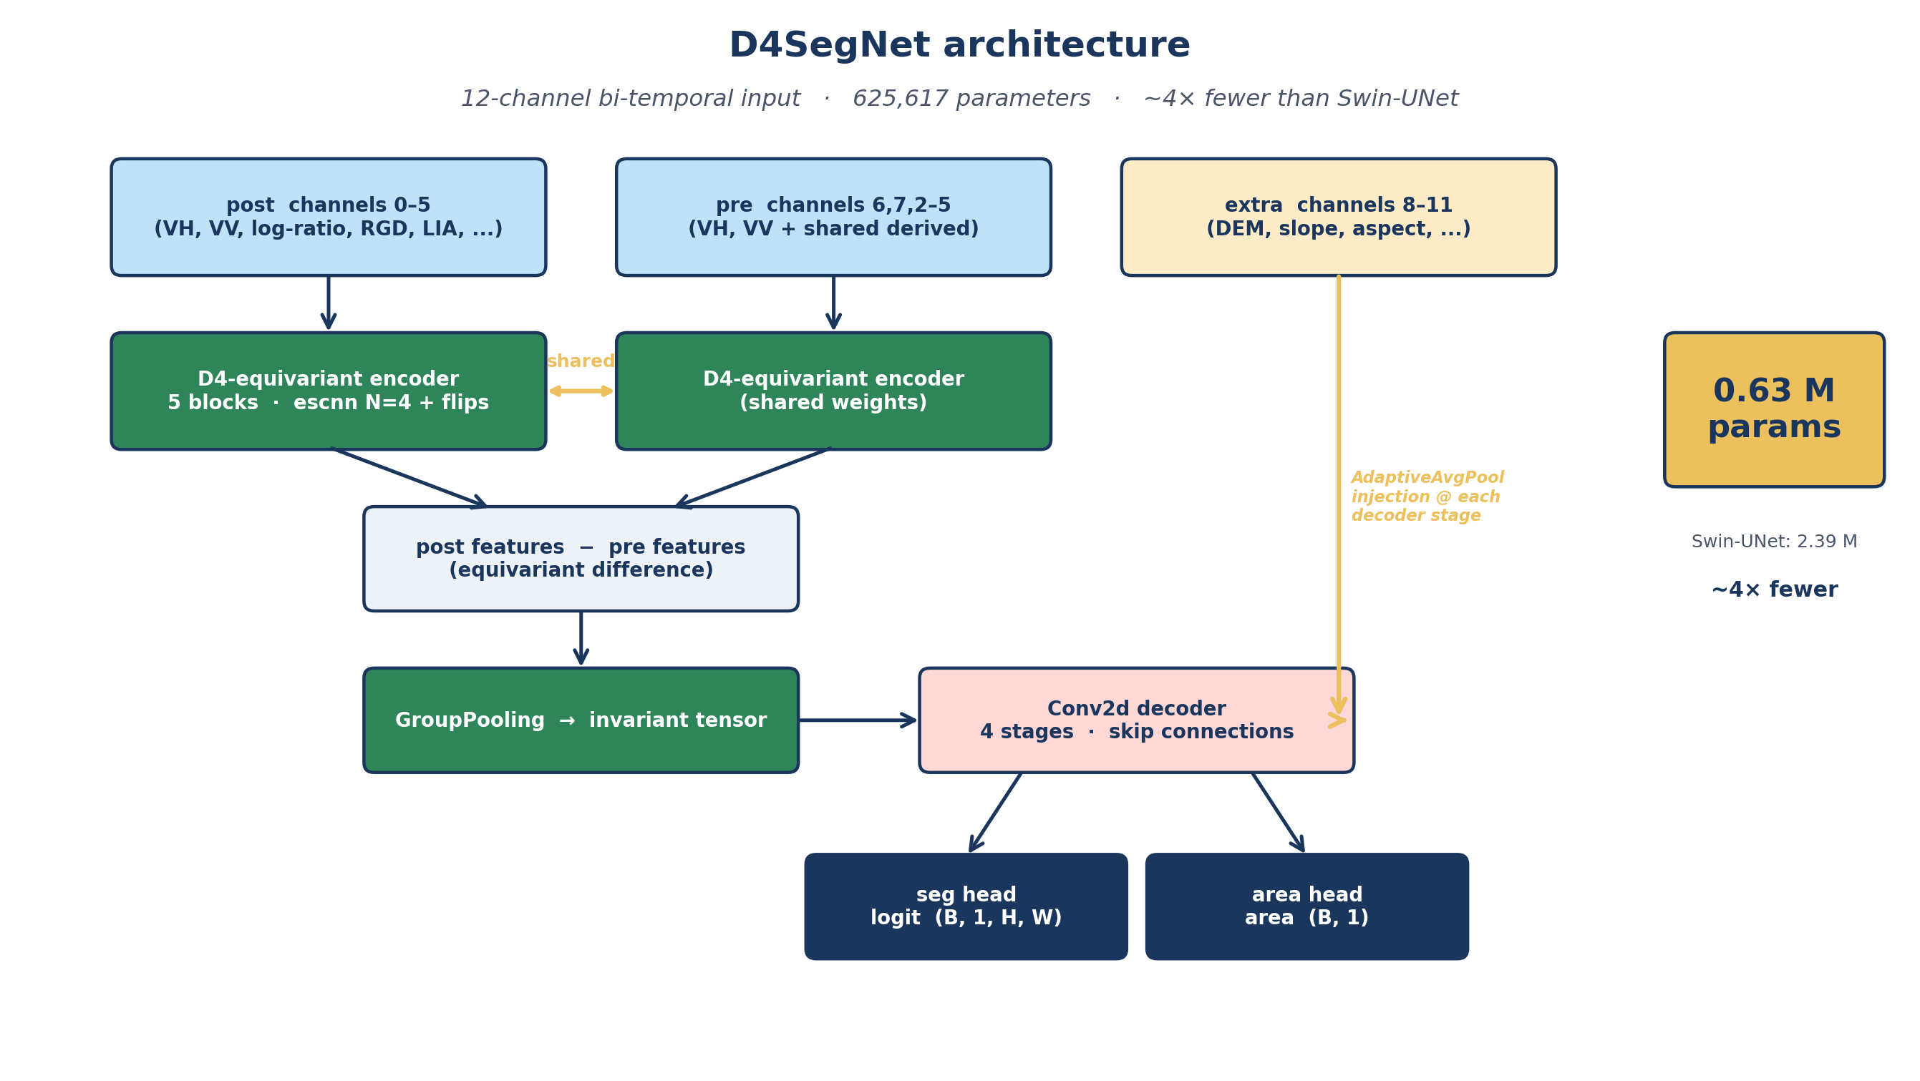
OUR APPROACH
A small equivariant encoder compares pre and post scenes
05
Notes:
12-channel input (pre, post, plus derived features). Two encoder branches with
SHARED weights — both D4-equivariant. Subtract pre features from post features
(the change). GroupPool to an invariant tensor. Small Conv2d decoder turns
that into a pixel-level prediction, with DEM and slope injected at each
decoder stage. Two outputs: mask and deposit area. Total: 625,617 parameters.
Gatti's Swin-UNet: 2.39 million.

Slide 6
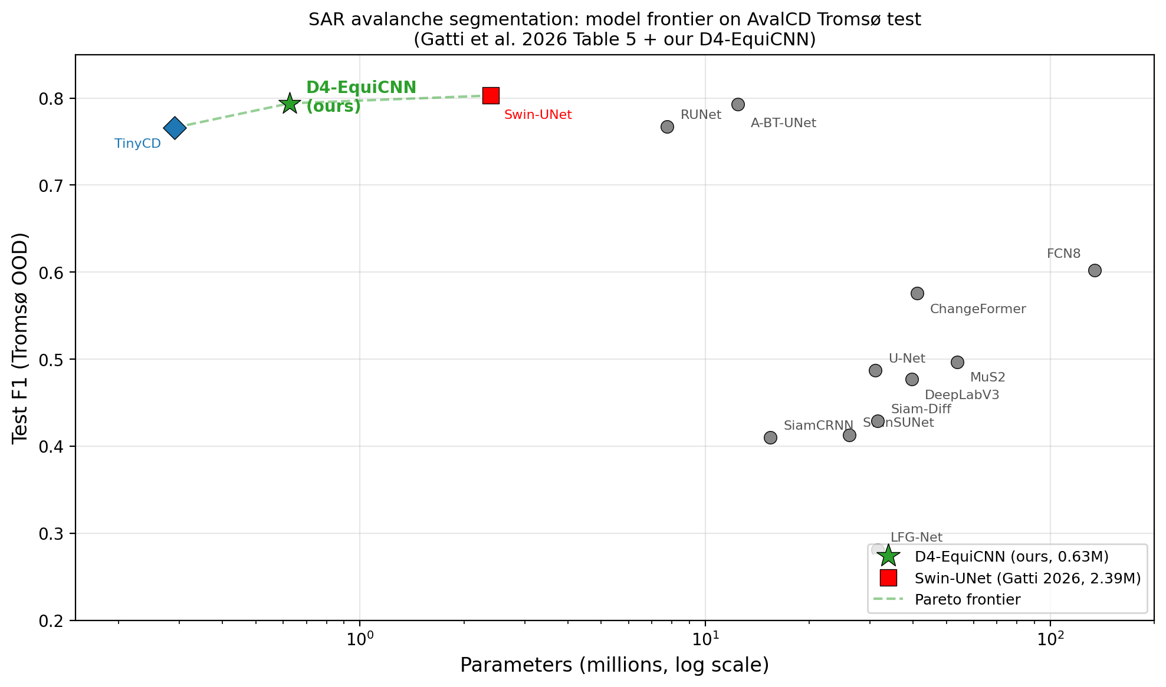
PIXEL-LEVEL RESULTS
AvalCD Table 5 (Gatti et al.) with our model added · Pareto frontier on params × F1
MODEL
PARAMS
F1
U-Net
31.0 M
0.487
FCN8
134.3 M
0.602
TinyCD
0.29 M
0.766
RUNet
7.76 M
0.767
A-BT-UNet
12.4 M
0.793
D4-EquiCNN (ours)
0.63 M
0.794
Swin-UNet (Gatti)
2.39 M
0.803
6 TH OF 7 ON TABLE 5 · WITHIN 1 PP OF THE LEADER · 4× FEWER PARAMETERS
Pareto-dominant bottom-right of the frontier.
06
Notes:
Table 5 from Gatti's paper with our model inserted, paired with the Pareto plot
on the right. U-Net and FCN8 are the old guard: 30-130M params, weak F1.
TinyCD, RUNet, A-BT-UNet — more recent. At the top: Swin-UNet at 2.39M
params, F1 0.803. Ours: 0.63M params, F1 0.794. Within 1pp of Swin-UNet at
4× fewer params — and as the Pareto plot on the right makes visually clear,
we sit alone in the bottom-right of the frontier (high F1, low params).

Slide 7
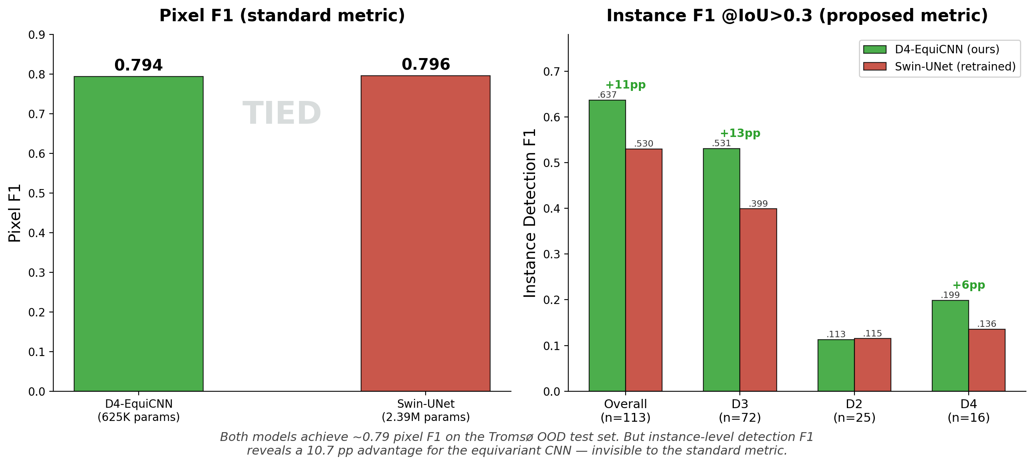
PIXEL F1 VS INSTANCE F1
Same predictions, different metric, different ranking · Tromsø test scene
INSTANCE F1 BREAKDOWN BY D-SCALE (IOU > 0.3)
D-SCALE
OURS
GATTI
Δ
N
D2 small
0.113
0.115
−0.002
25
D3 medium
0.531
0.399
+0.132
72
D4 large
0.199
0.136
+0.063
16
all excl D1
0.637
0.530
+0.107
113
D3 is where the gap is largest — and D3 is what practitioners act on.
Robust across IoU thresholds 0.1–0.5 · center-point matching confirms the ranking
PIXEL F1 SAYS TIE · INSTANCE F1 SAYS +10.7 PP
07
Pixel F1 treats every pixel independently. It does not ask "which avalanches did you find?"
Notes:
Two views of the same predictions. Left: pixel F1 vs instance F1 bar chart —
same model pair, same ground truth. The pixel bars are nearly identical; the
instance bars split wide open. Right: D-scale breakdown of the instance F1.
D2 (small) — tie. D3 (medium, car-destroying) — +13 points on n=72,
well-powered. D4 (large) — +6 points. Overall +10.7 pp. This gap is robust
across IoU thresholds and under center-point matching.

Slide 8
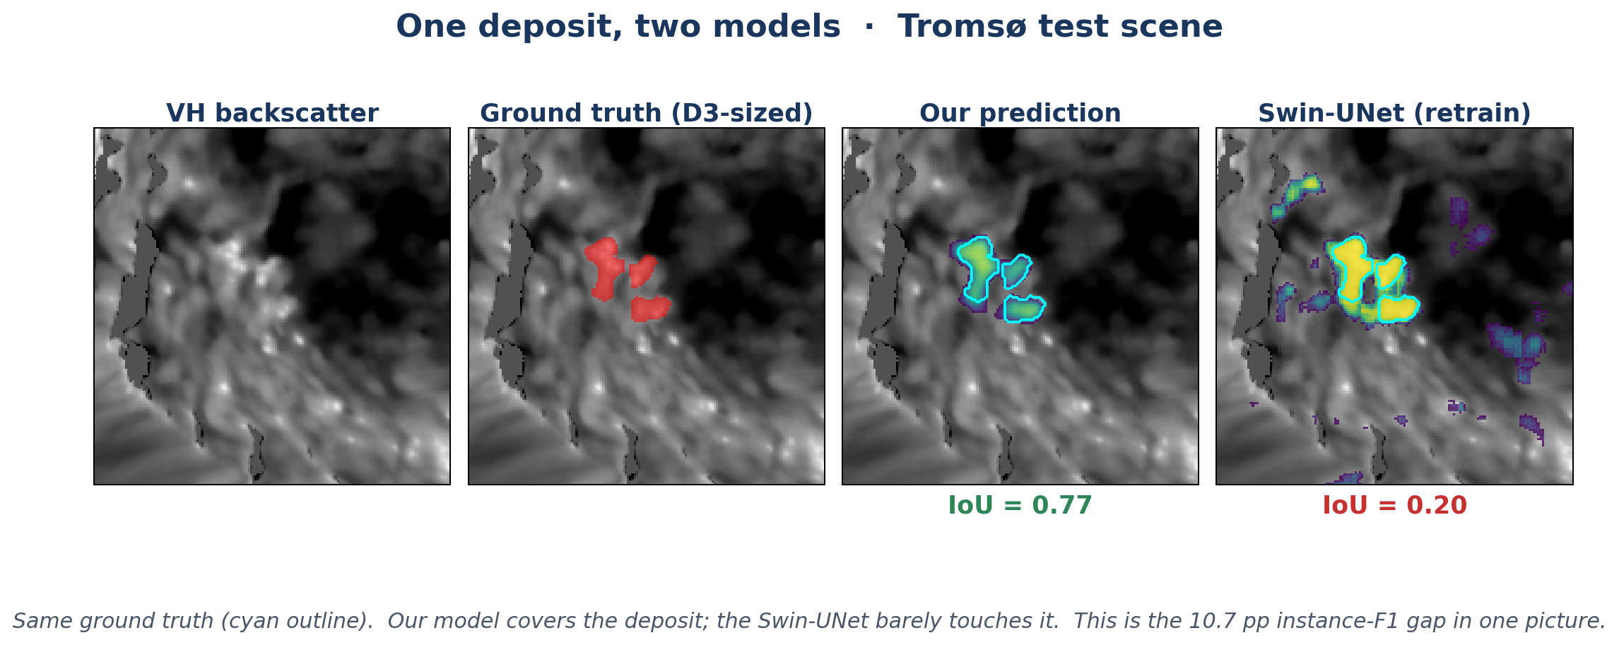
ONE DEPOSIT, TWO MODELS
Same ground-truth outline · same inference pipeline · different architectures
08
Notes:
One real example from Tromsø. Left to right: VH backscatter, ground truth,
our probability, Gatti's probability. Same cyan outline. Our model locks onto
the actual deposit — IoU 0.77. Swin-UNet spills probability all over — IoU
0.20. This is the 10-point gap in one frame.

Slide 9
CAN WE BOLT ON AN INSTANCE HEAD?
Phase 1 of this project · what we tried · what happened
MOTIVATION
DETECT → PROPOSE → REFINE
— Maybe the instance-F1 gap can be fixed with pipeline engineering
— Mask R-CNN decomposes detect → segment; we can try the same
Phase 1 proposes regions. Refiner segments each crop.
Refine crops (fine-tune)
F1 = 0.555
150 TP crops vs 30 k patches
WHAT IS PHASE 1?
Refine crops (encoder frozen)
— Same D4-equivariant backbone, classification head
— Slides 64 × 64 patches across the scene → dense avalanche-probability heatmap
— Transfers to Tromsø OOD with 100 % proposal recall
F1 = 0.551
bottleneck is data, not forgetting
Heatmap as Phase-2 channel
F1 = 0.773
Phase 1 info already captured internally
The instance-F1 advantage is architectural. It cannot be bolted on after the fact.
09
Notes:
DPR = Detect-Propose-Refine. Motivation: Mask R-CNN decomposes instance
segmentation — so maybe we could too. Phase 1 (separate repo) is a classifier
with the same D4-equivariant backbone but a classification head — patches in,
Y/N out. Transfers to Tromsø OOD with 100% recall of real deposits.
Three variants:
1. Fine-tune a conditional segmenter on crops where Phase 1 fires → F1 0.555.
Cause: 150 TP crops vs 30k pixel patches. Data scarcity.
2. Freeze the encoder during retraining → F1 0.551. Almost identical — so it's
not catastrophic forgetting, it's data volume.
3. Add Phase 1's heatmap as an extra Phase 2 channel, train on all 30k
patches → F1 0.773. Below our 0.794 baseline. Phase 1 output is redundant
with Phase 2's internal features.
Conclusion: instance advantage is architectural, not glueable.

Slide 10
OTHER NEGATIVE RESULTS WORTH REPORTING
Λ SWEEP OF COMPONENT-IOU LOSS
Trained with L = BCE + λ · component-IoU for λ ∈ {0, 0.25, 0.5, 1, 2}
No setting kept both pixel F1 ≥ 0.78 AND D2 detection ≥ 65 %
BIGGER / DEEPER MODELS
More capacity consistently HURT
Inductive bias is doing the work, not scale
HEAVY REGULARIZATION, WARM RESTARTS
Both hurt
Equivariance is already regularizing the model
CALIBRATION ASYMMETRY
Our F1-optimal threshold 0.225, Gatti's 0.775
Same F1, completely different probability distributions
10
Notes:
Four negatives worth the slide. Lambda sweep: we trained the component-IoU
loss at five lambda values. Never found a setting that kept both pixel F1 high
AND D2 detection up. Bigger/deeper models hurt — evidence for bias, not scale.
Heavy regularization hurt — equivariance is already regularizing. Calibration
asymmetry: both hit F1 ~0.79 at very different thresholds — 0.225 vs 0.775.
Interesting for practitioners; doesn't change the ranking.

Slide 11
WHAT WE CONTRIBUTED
Four things worth taking away
01
A METRIC THAT MATCHES WHAT OPERATORS CARE ABOUT
Instance-level F1 reveals detection gaps that pixel F1 hides. Should become standard reporting on AvalCD.
02
D4-EQUIVARIANCE WINS OVER SCALE HERE
625 k params match or exceed a 2.39 M Swin-UNet on pixel F1, and outperform it by +10.7 pp on instance F1.
03
THE GAP MATTERS MOST WHERE IT COUNTS — D3
+13 pp on the deposits that drive real decisions (road closures, rescue dispatch). n = 72, well-powered.
04
HONEST NEGATIVES RULE OUT THE EASY ALTERNATIVES
DPR, loss engineering, and scale all failed. The advantage is architectural.
11
Notes:
Four contributions. 01 METHOD: instance-level F1 with IoU matching should
become standard reporting on AvalCD — pixel F1 is demonstrably blind to
operational behavior. 02 MODEL: 625k params beats 2.39M on instance F1,
matches on pixel F1. 03 OPS: gap is largest where it matters — D3, with n=72
and well-powered. 04 RIGOR: DPR, loss engineering, scale — all failed.
Advantage is architectural.

Slide 12
CONCLUSION / WHAT COMES NEXT
CONCLUSION
WHAT COMES NEXT
Symmetry-aware inductive bias beats scale for this problem.
More OOD test scenes
One held-out scene is thin evidence for generalization · need curated multi-scene OOD benchmarks
Seed-level variance on headline
0.7938 is seed 1 only; ablations used 3 seeds
— Matched pixel F1 at 4× fewer parameters
— +10.7 pp instance F1, +13 pp on D3
— Pixel F1 is an insufficient benchmark
— The advantage is architectural, not bolt-on
D2 detection floor
Physics-limited or architecture-limited?
Operational integration
Sentinel-1 ingest → deposit map in minutes
Other SAR missions
SAOCOM, NISAR, TerraSAR-X — same symmetry, different geometry
12
Notes:
Conclusion: for a problem with known symmetry, a small equivariant network
beats a larger transformer that has to LEARN the symmetry — on the standard
metric (tied) AND on the metric that matters for operations (+10.7 pp).
Advantage is architectural — we tried the alternatives, they failed.
Next: cross-scene validation, seed variance, D2 floor analysis, operational
pipeline, other SAR missions.

Slide 13
END
THANKS.
Questions welcome.
github.com/gsanmarco/Equivariant-SAR-Segmentation
Phase 1: github.com/sanmarcog/Equivariant-CNN-SAR
Notes:
Happy to go deeper on: escnn regular representations, the instance-matching
rule, SAR log-ratio channels, Phase 1 architecture, or any of the negative
results.

