Slide 1
Common Middlebox Function : RFC 3234
SANMAT SANJAYAKUMAR PAYAGOUDAR
SRN : PES1UG20CS385
SECTION : G

Slide 2
What is a Middlebox ?
A middlebox is defined as any intermediary “box” performing functions apart from the normal , standard functions of a router, on the datagrams between a source and destination.
Middle box is a device that terminates one IP packet flow and originates another, or a device that transforms or diverts an IP packet flow in some way, or a combination. In any case it is never the ultimate end-system of an applications session

Slide 3
Range of functions of the Middlebox
Middleboxes operate on any of the 5 layers of computer networks.
They can manipulate or use the header data of the datagram, or the data itself.
They can store the data that goes through them.
They can behave as an end system.

Slide 4
Taxonomy of middleboxes
Middleboxes have no obvious way of being classified but can be classified based on some facets:
The protocol layer they act on:
Explicit vs Implicit: weather the middlebox is a part of a protocol (E.g.: SMTP) or an add-on (E.g.: NAT).
Single hop vs Multi-Hop: Is there only one box in the path or several.
In-Line vs Call out: Executed inline or calls out to another box.

Slide 5
Functional vs Optimising: does it add functionality or improve performance.
Routing vs Processing: Does it route the packets or process them in some way.
Failover vs Restart: If there is a redundancy set up for the system or if it has to restart.

Slide 6
PURPOSE OF THE PROTOCOL
To identify harmful and harmless practices
To suggest architectural guidelines for application protocol and middlebox design
To identify requirements and dependencies for common functions in the middlebox environment
To derive a system design for standardisation of these functions
To identify additional work that should be done in the IETF and IRTF.

Slide 7
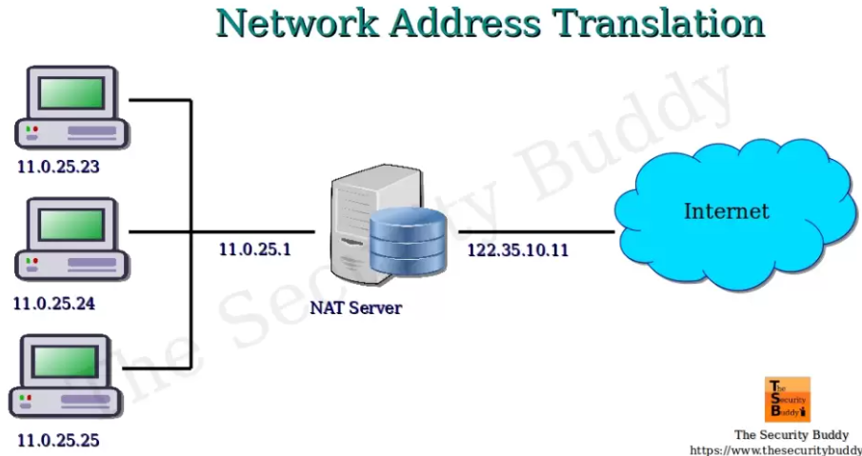
Architecture: Middlebox for NAT
Network Address Translation.
To assign a globally unique address to a host without the hosts knowledge or anyone else’s. Therefore there is a requirement to translate the address in real-time.
This acts on Network layer. Meaning that it has more functionality over a standard 2 layer IP router.
Middlebox
Middlebox comes here

Slide 8
Architecture: Application Firewalls
An Application Firewall acts as an end-system (E.g.: SMTP server)
They may be used to implement a firewall that improves protection for the application.
Perform protocol validity checks.
Add functionality to reduce possibility of bugs.
Create a safe environment.

Slide 9
Problems with Middleboxes.
Middleboxes limit the choice of transport protocols as they can drop traffic that does not follow expected behaviour, hindering the introduction of new protocols.
Middleboxes add a new point of failure in the network.
Middleboxes invalidate the end-to-end models of some communication protocols.

Slide 10
Conclusion
Middleboxes increase the functionality of the internet in many ways by operating on data in any layer.
They can behave as edge systems or intermediate communication systems with extra functionality.
Middleboxes can hinder some processes and reduce flexibility of the networks using it.

Slide 11
THANK YOU
SANMAT SANJAYAKUMAR PAYAGOUDAR
SRN : PES1UG20CS385
SECTION : G

