Slide 1
SENTIMENT ANALYSIS FOR MARKETING

Slide 2
ABTRACT:
Sentiment analysis is a marketing tool that helps you examine the way people interact with a brand online.
This method is more comprehensive than traditional online marketing tracking, which measures the number of online interactions that customers have with a brand, like comments and shares.

Slide 3
INTRODUCTION
Sentiment analysis is an automated process that attaches an emotional label or subjective opinion to text.
For example, sentiment analysis may examine a social media post and determine that it carries a positive, negative or neutral opinion.

Slide 4
Data collection :
This is one of the most important steps in the sentiment analysis process. Everything from here on will be dependent on the quality of the data that has been gathered and how it has been annotated or labelled.
API Data - Data can be uploaded through Live APIs for social media. A news API can help you glean information from all kinds of news publishers, while a Facebook API can allow you to take all the publicly available data you need from its platform. You can also use open source repositories like Kaggle
Manual - If you have data that you already have from a CRM tool, you can manually upload that onto the sentiment analysis API as a .csv file.

Slide 5
Data cleaning and pre-processing
Step 1: Delete duplicate data.
Step 2: Remove irrelevant items.
Step 3: Check for outlier data.
Step 4: Correct typos and structural mistakes.
Step 5: Check for missing data.
Step 6: Validate your data.
Discover More: Complete Sentiment Analysis Process.
The data preprocessing techniques includes five activities such as Data Cleaning, Data Optimization, Data Transformation, Data Integration and Data Conversion.

Slide 6
Sentiment analysis techniques
NLP model :A rule-based system uses a set of human-crafted rules to help identify subjectivity, polarity, or the subject of an opinion.
These rules may include various NLP techniques developed in computational linguistics, such as: Stemming, tokenization, part-of-speech tagging and parsing.
bag-of-words model in sentiment analysis: bag-of-words model is a way of extracting features from text so the text input can be used with machine learning algorithms like neural networks.
Each document, in this case a review, is converted into a vector representation.

Slide 7
Feature extraction
One Hot Encoding. One hot encoding means converting the words of your document into a V-dimension vector.
Bag of Words. It is one of the most used text vectorization techniques.
Bag of n-grams.
Tf-Idf — Term Frequency and Inverse Document Frequency.
Custom Features.
Word2vec.

Slide 8
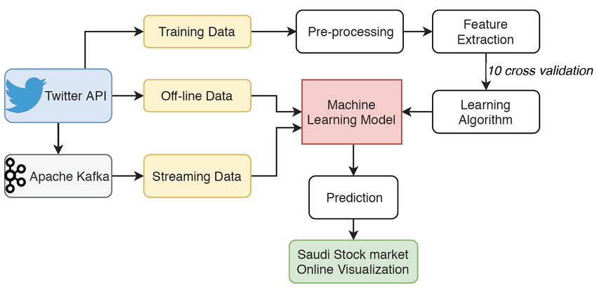
Sentiment analysis for marketing

Slide 9
Visualization
Text visualization involves creating graphical representations, such as charts, graphs, maps, word clouds, or network diagrams, to show the patterns, trends, and relationships in your text data.
These visualizations can help you highlight the key points, compare the results, and attract the attention of your audience.
You can use various tools and libraries, such as Python, matplotlib, seaborn, plotly, or word cloud, to visualize your text data.

