Slide 1

Jenkins Tutorial
www.zensar.com | © Zensar Technologies 2018
1
Notes:
1

Slide 2
Agenda - Day 1
Introduction and Getting Started
How to setup Jenkins on Tomcat
How to change Home Directory
How to use CLI - command line interface
How to create Users + Manage + Assign Roles
Basic Configurations
www.zensar.com | © Zensar Technologies 2019
2

Slide 3
Agenda - Day 2
Getting started with JOBS
Jenkins integration with GIT (SCM)
CATLIGHT
Continuous Integration and Deployment Pipeline
Jenkins Notifications
Blue Ocean
www.zensar.com | © Zensar Technologies 2019
3

Slide 4
Problems with Traditional approach and Need...
www.zensar.com | © Zensar Technologies 2019
4

Slide 5

What is CI-CD?
www.zensar.com | © Zensar Technologies 2019
5

Slide 6
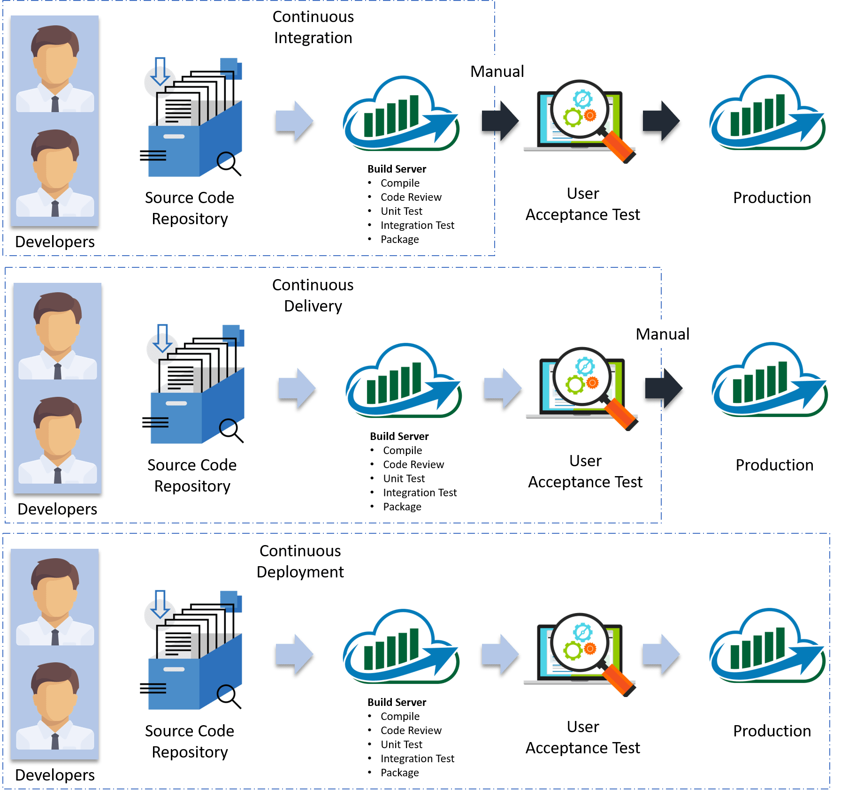
www.zensar.com | © Zensar Technologies 2019
6

Slide 7
CI and Benefits
Continuous Integration is a development practice in which developers are required to commit changes to source code in a shared repository several times a day. Every commit is then build and this allows the teams to detect problems early.
It then bring following benefits to software development:
Catch issues fast and nip them in the bud.
Everyone can see what’s happening.
Automate the build.
Continuous Integration leads to Continuous Deployment allowing us to deliver software more rapidly.
www.zensar.com | © Zensar Technologies 2019
7

Slide 8
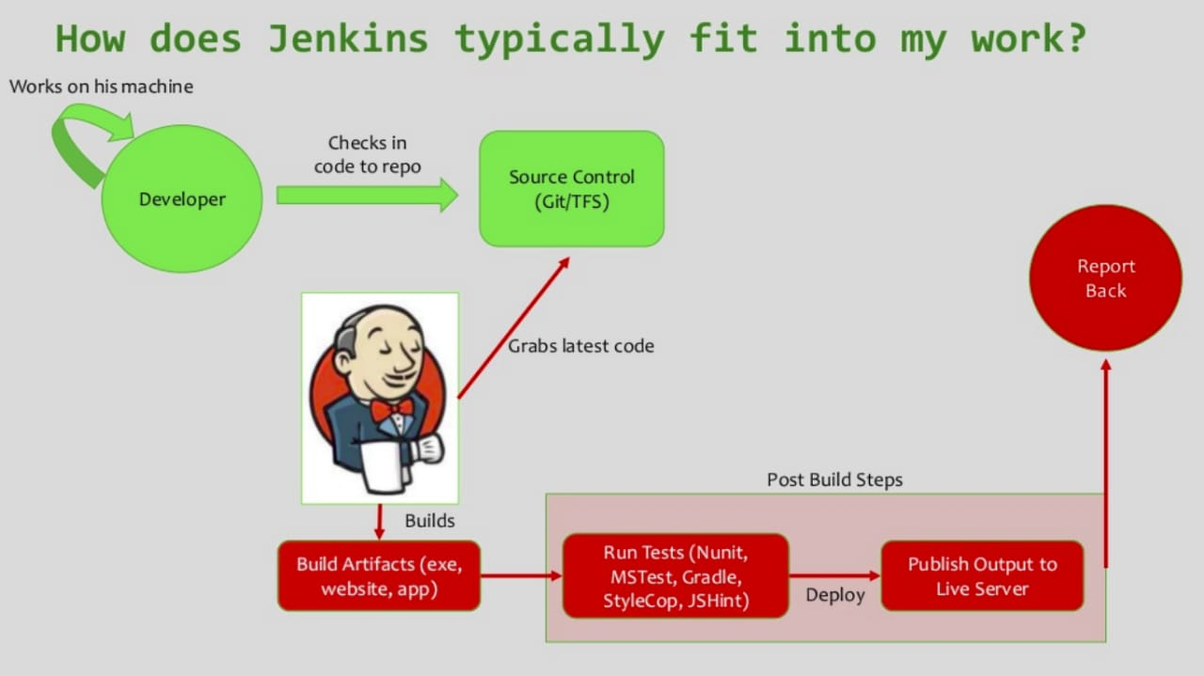
www.zensar.com | © Zensar Technologies 2019
8

Slide 9
What is Jenkins - History
Jenkins was originally developed as the Hudson project. Hudson's creation started in summer of 2004 at Sun Microsystems. In November 2010, an issue arose in the Hudson community with respect to the infrastructure used. Negotiations were held between the principal project contributors and Oracle; a key sticking point was the control of the name "Hudson" itself, which Oracle claimed, and on January 11, 2011, a proposal was made to change the project name from "Hudson" to "Jenkins".
www.zensar.com | © Zensar Technologies 2019
9

Slide 10
What is Jenkins - an Introduction
On February 1, 2011, Oracle said that they intended to continue development of Hudson, and considered Jenkins a fork rather than a rename. As of Sept 2019, the Jenkins organization on https://github.com/jenkinsci 673 project members and around 2200 public repositories, compared with Hudson's 32 project members and 17 public repositories.
Hudson is not maintained anymore, Jenkins is the replacement for it.
Jenkins builds and tests our software continuously and monitors the execution and status of remote jobs, making it easier for team members and users to regularly obtain the latest stable code.
www.zensar.com | © Zensar Technologies 2019
10

Slide 11
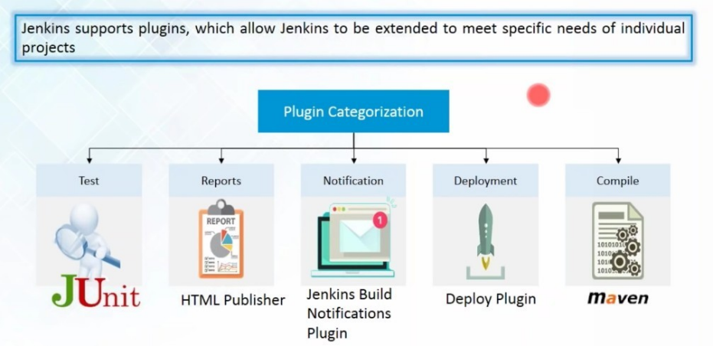
11
Notes:
11

Slide 12
Jenkins
Jenkins – open source continuous integration server
Jenkins (http://jenkins-ci.org/) is
Easy to install
Easy to use
Multi-technology
Multi-platform
Widely used
Extensible
Free
www.zensar.com | © Zensar Technologies 2019
12

Slide 13
Jenkins for Developer
Easy to install
Download one file – jenkins.war
Run one command – java –jar jenkins.war
Easy to use
Create a new job – checkout and build a small project
Checkin a change – watch it build
Create a test – watch it build and run
Fix a test – checkin and watch it pass
Multi-technology
Build C, Java, C#, Python, Perl, SQL, etc.
Test with Junit, Nunit, MSTest, etc.
www.zensar.com | © Zensar Technologies 2019
13

Slide 14
Installing Jenkins
Step 1 : Download Jenkins war file - https://jenkins.io/
Step 2 : Place the war file into any location on your system
Step 3 : goto command prompt
- goto folder where jenkins.war is
- java -jar jenkins.war
Step 4 : goto browser - http://localhost:8080 (- -httpPort=9090)
Step 5 : install required plugins
Step 6 : get started with Jenkins
www.zensar.com | © Zensar Technologies 2019
14

Slide 15
Setting up Jenkins on Tomcat
Why?
Running Jenkins standalone (jetty/winstone) vs Running Jenkins on Tomcat
https://wiki.jenkins.io/display/JENKINS/Containers
Pre-requisite***Tomcat 5 or above******java(7 or above) should be available***
Step 1 : Download Tomcat
Step 2 : Unzip and place tomcat folder at any location
Step 3 : Copy/Place the jenkins.war file inside tomcat/webapps folder
www.zensar.com | © Zensar Technologies 2019
15

Slide 16
Setting up Jenkins on Tomcat
Step 4 : Goto commandpromt (cmd) - windows | terminal - mac
- goto tomcat/bin directory
- make all files executable : chmod +x *.sh
In case of windows this command will not work. This step might not be needed if you are on windows. Else you can right click on the file/folder goto security tab and change the permissions.
Step 5 : Start Tomcat : ./startup.sh
(to shutdown tomcat : ./shutdown.sh)
www.zensar.com | © Zensar Technologies 2019
16

Slide 17
Setting up Jenkins on Tomcat
Step 6 : verify if tomcat started : browser - http://localhost:8080
Step 7 : verify if jenkins is running on tomcat : http://localhost:8080/jenkins
How to Stop, Restart Jenkins – Common URL options
URL’s to stop or restart Jenkins
http://[jenkins-server]/[command] where [command] can be
exit - shutdown jenkins
restart - restart jenkins
reload - to reload the configuration
systeminfo - to get all system properties
www.zensar.com | © Zensar Technologies 2019
17

Slide 18
Changing Home Directory
Jenkins Home Directory contains:
All configurations
Plugins
Jobs details
Logs
Why:
-To move jenkins home dir to a location that has enough disk space
-Project requirements
How:
http://tech.nitoyon.com/en/blog/2014/02/25/jenkins-home-win/
www.zensar.com | © Zensar Technologies 2019
18

Slide 19
How to use CLI - Command Line Interface
Why:
easier
faster
memory management (efficient)
Continuous Integration
www.zensar.com | © Zensar Technologies 2019
19

Slide 20
How to use CLI - Command Line Interface
Step 1 : start Jenkins
Step 2 : goto Manage Jenkins - Configure Global Security - enable security
Step 3 : goto - http://localhost:8080/cli/
Step 4 : download jerkins-cli jar. Place at any location.
Step 5 : test the jenkins command line is working
java -jar jenkins-cli.jar -s http://localhost:8080/ -auth username:pwd list-jobs
www.zensar.com | © Zensar Technologies 2019
20

Slide 21
How to create Users + Manage + Assign Roles
Step 1 : Create new users
Step 2 : Configure users
Step 3 : Create and manage user roles Roles Strategy Plugin - download - restart jenkins
Step 4 : Manage Jenkins - Configure Global Security - Authorisation - Role Based Strategy
Step 5 : Create Roles and Assign roles to users
Step 6 : Validate authorization and authentication are working properly
www.zensar.com | © Zensar Technologies 2019
21

Slide 22
Basic Configurations
Step 1 : Goto Manage Jenkins - Configure System
Step 2 : Get a basic understanding of common/basic configurations
www.zensar.com | © Zensar Technologies 2019
22

Slide 23
Getting Started with Jobs
1. How to create a basic JOB in Jenkins
2. Basic job configurations
2. How to run the Job remotely
4. How to chain Job Execution
www.zensar.com | © Zensar Technologies 2019
23

Slide 24
Jenkins integration with GIT (SCM)
1. Create a java program and run it through command line
2. Create a Jenkins job to run the java program
3. Add this program/project to Git
4. Jenkins - add git plugin
5. Configure Jenkins job to trigger the execution when a change is pushed to GitHub
www.zensar.com | © Zensar Technologies 2019
24

Slide 25
Jenkins integration with GIT (SCM)
git status
git add .
git status
git commit -m “message”
git remote add origin “url”
git push -u origin master
www.zensar.com | © Zensar Technologies 2019
25

Slide 26
Catlight
REFERENCES:
Catlight website:
https://catlight.io/
Downloads link:
https://catlight.io/downloads
Support link:
http://catlight.helprace.com/
Blog link:
http://blog.catlight.io/
www.zensar.com | © Zensar Technologies 2019
26

Slide 27
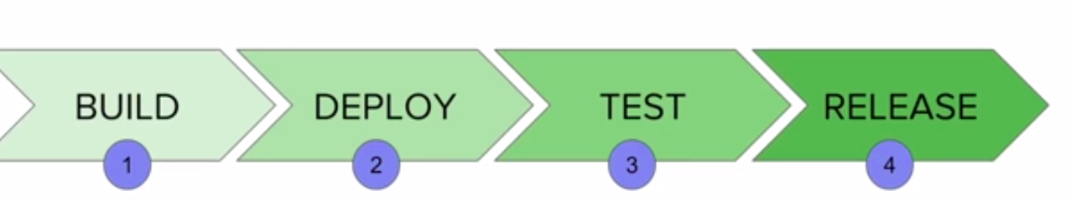
Stages of Automated Deployment
www.zensar.com | © Zensar Technologies 2019
27

Slide 28
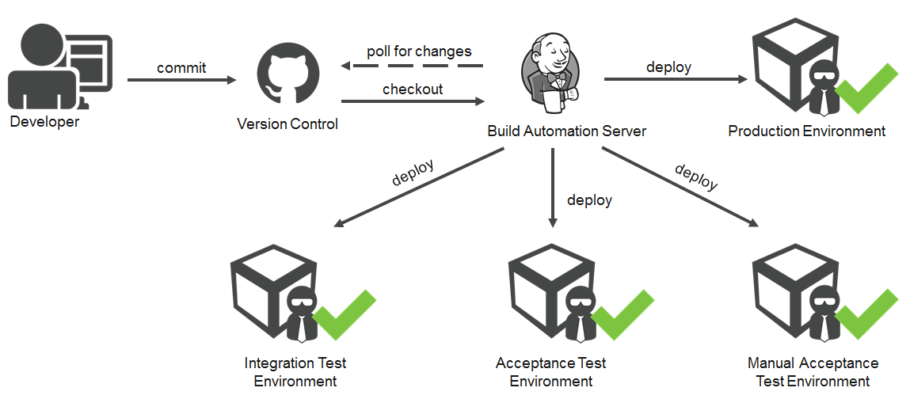
Stages of Automated Deployment
www.zensar.com | © Zensar Technologies 2019
28

Slide 29
What is Automated Deployment ?
Main stages in Continuous delivery and deployment pipeline
A real world Project SetUp
Automated Deployment is the process of Automating the deployment process in a Continuous Delivery system
Build - Deploy - Test - Release
www.zensar.com | © Zensar Technologies 2019
29

Slide 30
How to do Automated Deployments with Jenkins ?
Install (Deploy to container Plugin)
Create a Build JOB in Jenkins
Add Post-build Action Deploy war/ear to container
(add values to the fields)
sample war file downloaded - https://tomcat.apache.org/tomcat-6.0-doc/appdev/sample/
In tomcat-users.xml add user for DEPLOYMENT
user username="deployer" password="deployer" roles="manager-script" /
www.zensar.com | © Zensar Technologies 2019
30

Slide 31
Email Notification
Manage Jenkins - Configure System - Email Notifications
To find your smtp server and port details
https://www.arclab.com/en/kb/email/list-of-smtp-and-pop3-servers-mailserver-list.html
Notification Plugins
https://wiki.jenkins.io/display/JENKINS/Notification+Plugin
https://wiki.jenkins.io/display/JENKINS/Extreme+Notification+Plugin
https://wiki.jenkins.io/display/JENKINS/Email-ext+plugin
www.zensar.com | © Zensar Technologies 2019
31

Slide 32

www.zensar.com | © Zensar Technologies 2019
32

