Slide 1







Survey
Sanmay Dattatray Kotkar
08-03-24

Slide 2



OUTLINE
Executive Summary
Introduction
Methodology
Results
Visualization – Charts
Dashboard
Discussion
Findings & Implications
Conclusion
Appendix

Slide 3

EXECUTIVE SUMMARY
JavaScript is most used language. In future also it will be a trending language.
In current technology usage
SQL is top language use for databased work
Linux is most used OS for platform work
React.Js is most used language for webframe work
In future also this trend will continue
In demographics Men contribute more than women
The most active age group is 20-30

Slide 4

INTRODUCTION
Current technology usage
Future technology trend
Demographics

Slide 5

METHODOLOGY
This survey data is taken from 2019 stack overflow developer survey
The blog was created of this survey
From there the demographical survey data and survey data of technology was taken

Slide 6
RESULTS
JavaScript is most used language. In future also it will be a trending language.
In current technology usage
SQL is top language use for databased work
Linux is most used OS for platform work
React.Js is most used language for webframe work
In future also this trend will continue
In demographics Men contribute more than women
The most active age group is 20-30

Slide 7
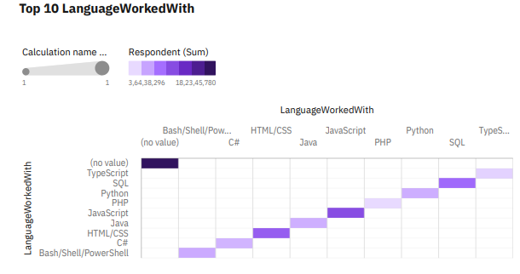
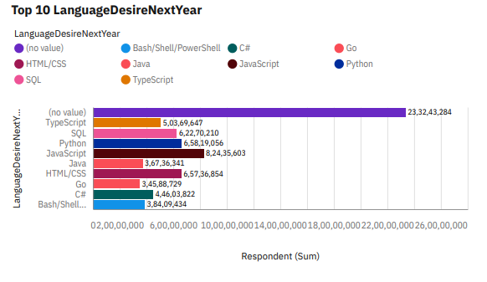
PROGRAMMING LANGUAGE TRENDS
Current Year
Next Year
<Bar chart of top 10 programming languages for the current year goes here.>

Slide 8
PROGRAMMING LANGUAGE TRENDS - FINDINGS & IMPLICATIONS
Findings
Javascript is most used language
With the help of survey javascript will be continue in trend for next year
Implications
By seeing graphs javascript will be in demand for next year
There is much gap between trending 1 and top 2 language

Slide 9
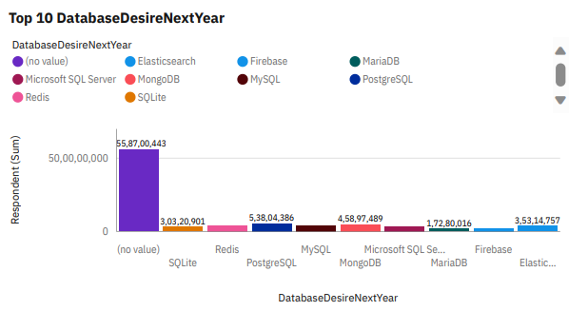
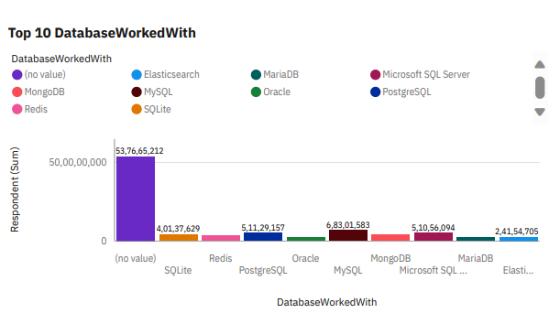
DATABASE TRENDS
Current Year
Next Year

Slide 10
DATABASE TRENDS - FINDINGS & IMPLICATIONS
Findings
In current year use SQL is most
But will the help of survey it is seen that the use of SQL will reduce by great major
Implications
By seeing it let assume that it will be trending for next year
Looking to it it can be decrease more

Slide 11

DASHBOARD
Dashboard/Project.pdf at main · sanmaydk696/Dashboard (github.com)

Slide 12
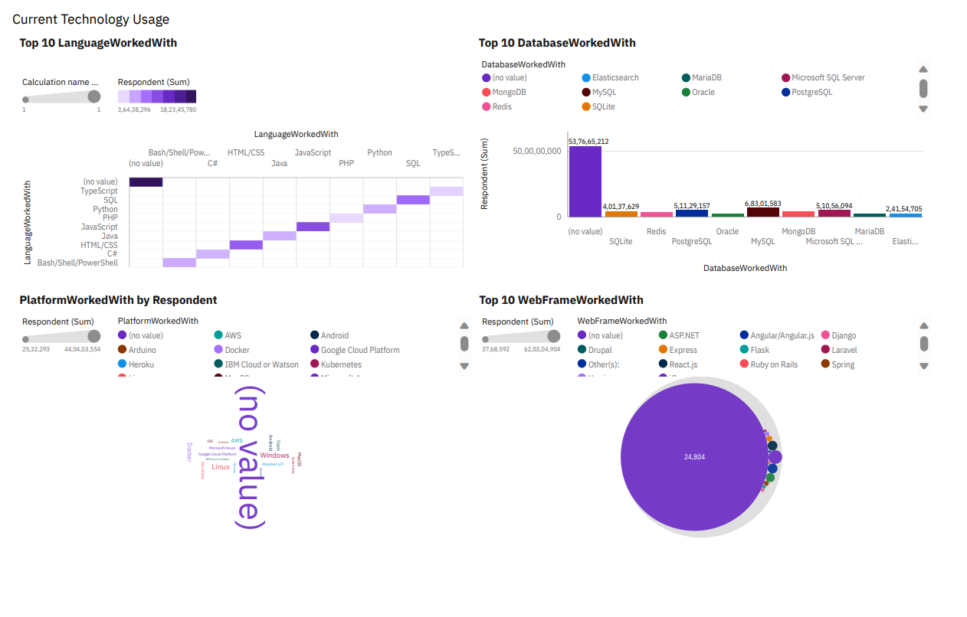
DASHBOARD TAB 1

Slide 13
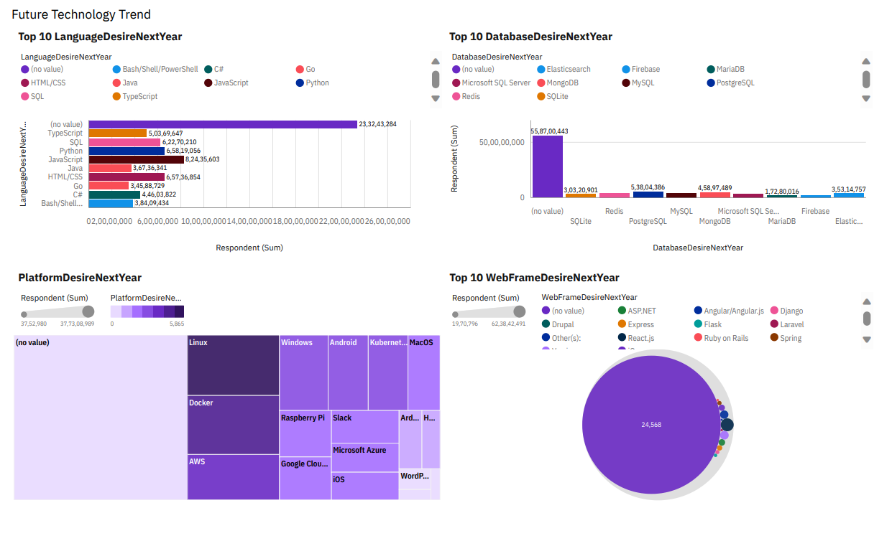
DASHBOARD TAB 2

Slide 14
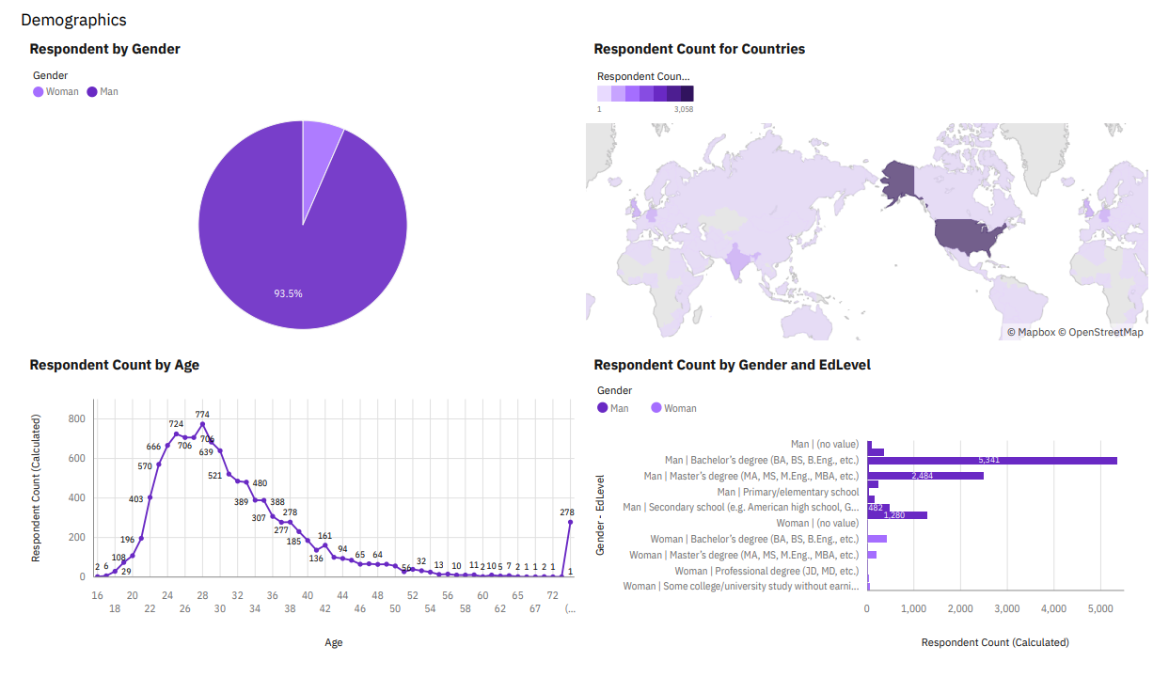
DASHBOARD TAB 3
Screenshot of dashboard tab 3 goes here

Slide 15
DISCUSSION
What you think which language use will be increase in coming years?

Slide 16
OVERALL FINDINGS & IMPLICATIONS
Findings
Working of Men is great
There is not much change in tread of technology
Implications
It will continue as per seeing graph

Slide 17

CONCLUSION
There is not change in use of language
There is reduction in use of SQL
Linux is and will be most used OS

Slide 18

APPENDIX

Slide 19
JOB POSTINGS

Slide 20
POPULAR LANGUAGES

