Slide 1





Sparse-sensing state estimation of vortex-gust airfoil interactions
Toward model-based flow control
A. Solera-Rico, A. Miró, O. Lehmkuhl, C. Sanmiguel Vila
csanvil@inta.es
EUROMECH Colloquium · Data-driven active control in flows: from model-based to reinforcement learning
Notes:
Frame: extreme gust control needs a fast, faithful forward model. Our work asks which reduced state is worth planning against, and shows a predictive (JEPA) latent captures the wake physics that reconstructive and linear baselines lose. Audience is new to JEPA, so I will spend a slide on what it is.

Slide 2
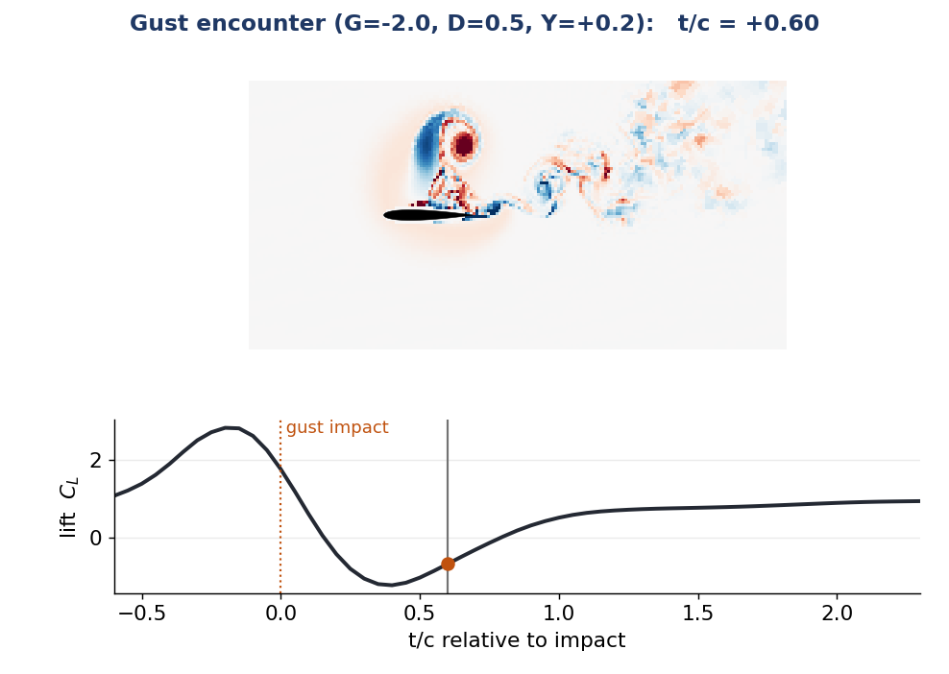
MOTIVATION
The control problem: gusts are fast, strong, nonlinear
• Small and micro air vehicles increasingly fly where the gust speed is comparable to or above the flight speed (urban canyons, building and ship wakes): gust ratio G > 1 brings large, fast load transients classical models miss
• A vortex strikes the wing: a leading-edge vortex forms and sheds, and the lift swings strongly (right: DNS, a moderate G = -2 gust, C_L from about -1 to +3)
• Active control, model-based or RL, needs a fast, faithful forward model it can trust under rollout
• This talk: what reduced state is worth planning against?
Sparse-sensing state estimation, vortex-gust interactions · EUROMECH colloquium
2
Notes:
Pure DNS, no model yet: motivate the difficulty. A moderate in-envelope gust (G = -2, D = 0.5, train set) on Fukami's canonical core; the lift swings by about 4 in C_L, in his recognisable range (baseline C_L 0.73 matches Fukami's 0.73). Pitch to a control audience: the bottleneck for model-based control / RL is a reduced dynamics model trustworthy under rollout.

Slide 3
OBJECTIVE
Objective: a reduced state that keeps the wake
• The load transient is built by the leading-edge vortex (LEV) and the wake it leaves: the discriminating information is in the wake, not the integrated forces C_L, C_D
• We quantify it by the large-scale wake enstrophy: a Gaussian scale split (Motoori & Goto 2019) at σ/c = 0.05 isolates the load-bearing large-scale vorticity (LEV + shear layer) from fine turbulence, then integrates ω_L² over the wake
• Objective: find a reduced state that faithfully encodes the wake (the part reconstruction loses), not just the forces, and that is recoverable from sparse sensors
• And compare candidate states, predictive vs reconstructive vs linear, under one matched protocol
Sparse-sensing state estimation, vortex-gust interactions · EUROMECH colloquium
3
Notes:
Objective slide (no results yet): the wake challenge, the large-scale wake enstrophy definition (Gaussian split), and the goal: a reduced state that ENCODES the wake (which reconstruction loses) and is recoverable from sensors. The predictive-vs-reconstructive Gaussian-split result comes later, in Results.

Slide 4
LITERATURE AND IDEA
The opening for JEPA
• Most flow ROMs, POD/DMD, autoencoders, are trained to reconstruct the field
– reconstruction fixes the latent only up to a diffeomorphism, so its geometry is not constrained to be predictable
• Alternative: learn a state that is predictive by construction, and plan against it
Which reduced state faithfully encodes the wake that reconstruction loses, and is recoverable from sparse sensors?
Sparse-sensing state estimation, vortex-gust interactions · EUROMECH colloquium
4
Notes:
Set up the central question. The state should ENCODE the wake (which reconstruction-only states lose) and be recoverable from sensors. This is exactly the property a planner or RL agent needs to consume.

Slide 5
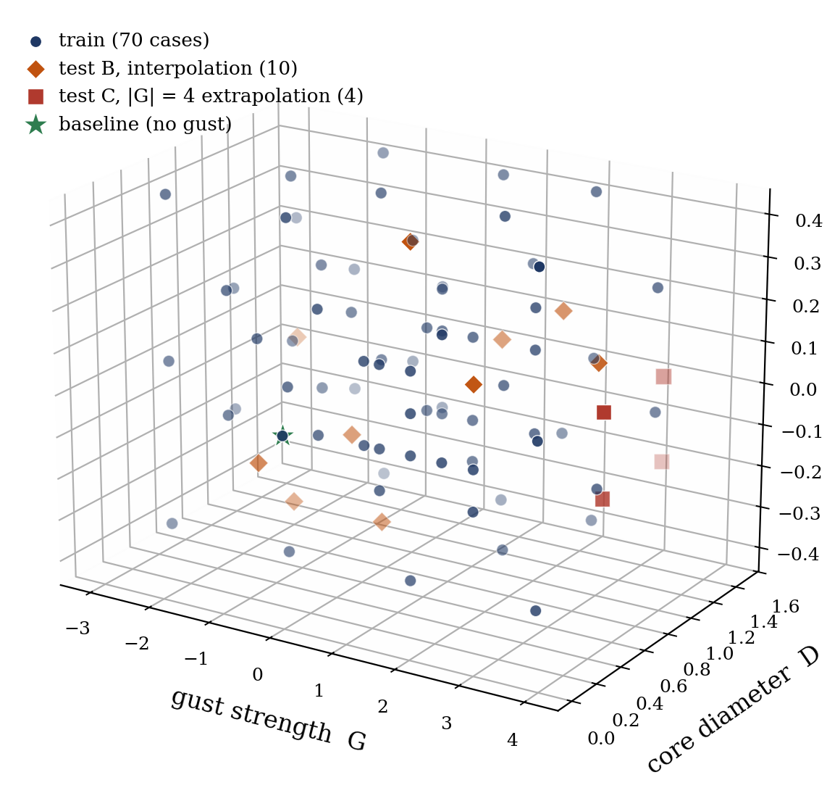
DATA
Data
• DNS (SOD2D, no subgrid-scale model), NACA 0012, α = 14°, Re = 5000
• Taylor-vortex gusts parametrised by strength G, core diameter D, wall-normal offset Y (right: the 84-case envelope, isometric)
• Impact-centred encounters; five observables: C_L, C_D, wake enstrophy, ±circulation
• Held-out test_b (interpolation) and test_c (|G| = 4 extrapolation)
Training envelope in (G, D, Y): train, test_b interpolation, test_c |G| = 4 extrapolation, baseline.
Sparse-sensing state estimation, vortex-gust interactions · EUROMECH colloquium
5
Notes:
Keep the DNS claim bounded (solver-resolution metadata pending). Emphasise the six observables, wake enstrophy being the one that separates the methods; the 3D envelope shows test_c (|G|=4) sitting far outside the training cloud.

Slide 6
METHOD, PRIMER
What is a JEPA? (1 / 2)
Autoencoder (most flow ROMs): reconstruct the field
field ω(t)
Encoder
latent z
Decoder
reconstructed field
loss compares the reconstruction to the input in PIXEL space
JEPA: predict the next latent, no decoder
field ω(t)
Encoder
latent z(t)
Predictor
predicted z(t+1)
loss compares predicted z(t+1) to z(t+1) = Encoder(next frame) in LATENT space; an anti-collapse term replaces the decoder
Reconstruction ties the latent to pixels; prediction makes it forecastable, which is what a controller needs.
Sparse-sensing state estimation, vortex-gust interactions · EUROMECH colloquium
6
Notes:
Pedagogic core for a non-ML audience. Same first three boxes; the only change is Decoder -> Predictor and where the loss lives: pixels (AE) vs latent space (JEPA). No decoder in JEPA; the anti-collapse term stops the encoder collapsing.

Slide 7
METHOD, PRIMER
What is a JEPA? (2 / 2): the recipe and why for control
• Training, in one line: minimise the latent prediction error plus an anti-collapse term so the encoder cannot cheat by mapping everything to a constant (no decoder, no pixel loss)
• So the encoder keeps only what predicts the future (the control-relevant dynamics), and the predictor gets no pixel-level shortcuts
• Cheap to roll out: planning happens in the d = 32-64 latent, two to three orders of magnitude cheaper than evolving the full field
• Lineage: I-JEPA / V-JEPA (image, video); from-pixels LeWM, LeJEPA, PLDM, so far only gridworld and toy visual tasks
• Why for control: a learned world-model that is observable from sensors; to our knowledge the first end-to-end JEPA on a parametric flow
Sparse-sensing state estimation, vortex-gust interactions · EUROMECH colloquium
7
Notes:
Second JEPA slide: recipe (latent loss + anti-collapse, no decoder), cheap latent rollout, lineage, and the control framing.

Slide 8
METHOD
Our architecture for gust encounters
mid-plane
vorticity ω(t)
Encoder
(CNN + ViT)
latent z(t)
d = 32 / 64
Predictor
(AR transformer)
predicted
z(t+1)
• The encoder maps the field to a latent: a pure state map ω(t) → z
• The predictor advances the latent z(t) → z(t+1) from the latent history; it is the latent dynamics model you plan or learn against
• A visualisation decoder is trained on the frozen encoder, never in the loss (figures only)
• Compared at matched latent dimension against a reconstructive AE (Fukami) and POD
Sparse-sensing state estimation, vortex-gust interactions · EUROMECH colloquium
8
Notes:
Encoder is a pure state map; the predictor advances the latent. For control, an actuation channel is the natural next input.

Slide 9
METHOD
The visualisation decoder (figures only, never in the loss)
latent z
d = 64
LapFiLM decoder
5-level Laplacian pyramid + FiLM
pixelshuffle upsampling · ~0.9M params
vorticity field
ω (192 × 96)
• Trained on the frozen encoder, never in the JEPA loss: it only renders a latent as a field so we can look at it
• Why not a plain CNN or ViT decoder? A transposed-conv CNN under a pixel objective blurs the wake and leaves checkerboard artefacts; a ViT decoder is heavier and patch-blocky. The Laplacian pyramid builds the field coarse-to-fine (large-scale wake first), FiLM lets the 64-D latent steer every scale at just ~0.9M params, and pixelshuffle upsamples without checkerboards
• Loss = region + Laplacian-pyramid + gradient + spectral-amplitude (small enstrophy / circulation terms): it matches structure across scales and in the Fourier spectrum, not pixelwise
• Why SSIM, not MSE? MSE is pointwise and rewards blur (a smoothed field scores well but loses the vortices); SSIM compares local contrast and structure, crediting a correct wake *pattern*. Held-out SSIM ≈ 0.73
Sparse-sensing state estimation, vortex-gust interactions · EUROMECH colloquium
9
Notes:
The visualisation decoder is a SEPARATE stage on the frozen encoder, never in the JEPA objective. LapFiLM = 5-level Laplacian pyramid + FiLM modulation + pixelshuffle upsampling, ~0.9M params. Why this and not a plain CNN/ViT decoder: a transposed-conv CNN under pixel MSE blurs the wake and adds checkerboard artefacts, and a ViT decoder is heavier and patch-blocky; the pyramid synthesises coarse-to-fine (large-scale wake first), FiLM lets the 64-D latent modulate every scale cheaply, and pixelshuffle (sub-pixel conv) upsamples without checkerboards. Loss is a multi-term region + Laplacian-pyramid + gradient + spectral-amplitude objective (plus small enstrophy/circulation terms). Why SSIM not MSE: MSE is pointwise and rewards a blurred mean field, whereas SSIM scores local luminance/contrast/structure, so it tracks whether the wake PATTERN is right. Held-out SSIM ~0.73. Used only to visualise latents as fields in the rollout / recovery figures.

Slide 10
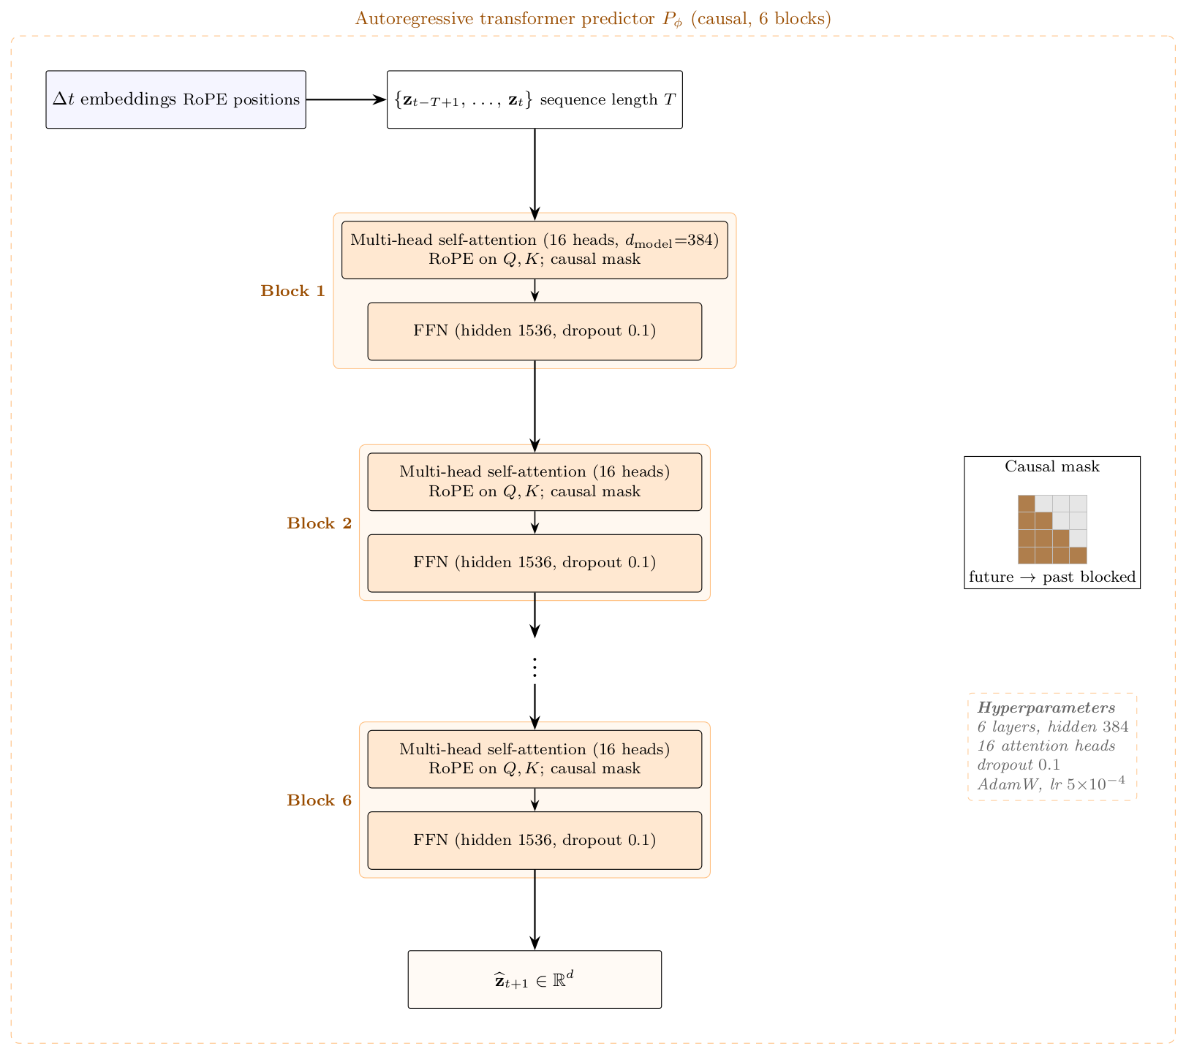
METHOD
Model detail: encoder and predictor
• Encoder = a CNN stem (3 down-sampling stages) + a 6-layer Vision Transformer; the field becomes 288 patch tokens, and a learned [CLS] token is mapped by a small MLP (with BatchNorm) to the latent z (d = 32 / 64)
• Predictor = a 6-layer autoregressive transformer (hidden 384, 16 heads, dropout 0.1): it reads z(t) and emits the next latent z(t+1). Unconditioned: no gust parameters enter the predictor
• Causal mask: each step sees only past steps, never the future; RoPE encodes the frame ordering so the transformer knows what is earlier or later
• Training: match the next latent (teacher forcing) + scheduled sampling (feed the model its own predictions over an 8-step rollout, so it tolerates its own errors) + SIGReg anti-collapse (keeps z informative without a decoder); AdamW, bf16, 20k steps
• Architecture inspired by the JEPA world-model line: I-JEPA / V-JEPA, and the from-pixels LeWM (Maes et al. 2026) and LeJEPA (Balestriero and LeCun 2025)
Sparse-sensing state estimation, vortex-gust interactions · EUROMECH colloquium
10
Notes:
Moved from backup into the architecture block (after the decoder slide). Encoder = CNN stem + 6-layer ViT, [CLS]->MLP(BatchNorm)->z. Predictor = 6-layer AR transformer, unconditioned (no gust parameters). Causal mask + RoPE. Trained with teacher forcing + scheduled sampling (8-step) + SIGReg. Lineage: I-JEPA/V-JEPA, LeWM, LeJEPA.

Slide 11
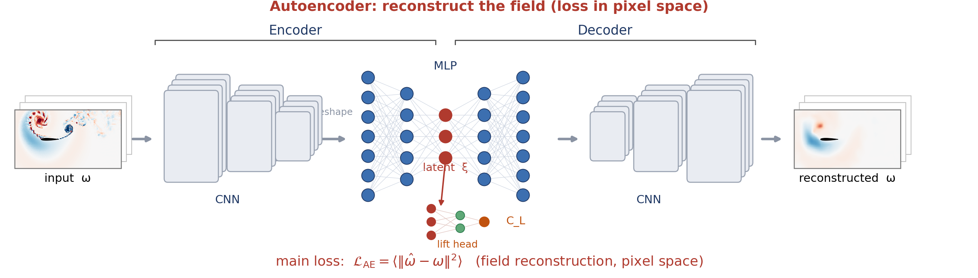
METHOD, ALTERNATIVE
Illustrated alternative: the autoencoder route
• Reconstructive route (Fukami-Taira lineage): a CNN encoder, an MLP latent ξ (which also feeds a lift head to C_L), and a CNN decoder; the loss compares the reconstructed field to the input in pixel space
An autoencoder reconstructs the field; the latent is shaped by pixel reconstruction.
Sparse-sensing state estimation, vortex-gust interactions · EUROMECH colloquium
11
Notes:
Illustrated alternative to the box diagram (slide 6); keep whichever style you prefer.

Slide 12
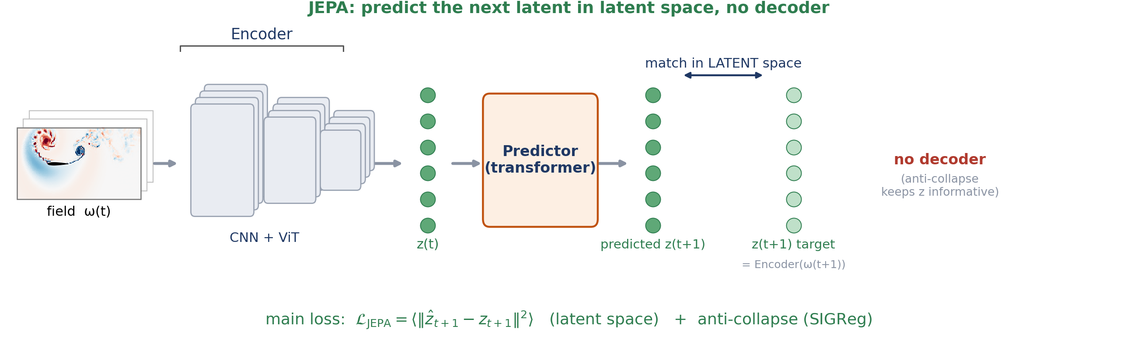
METHOD, ALTERNATIVE
Illustrated alternative: the JEPA route
• Same encoder, but a predictor advances the latent and the loss lives in latent space, with no decoder (an anti-collapse term keeps z informative)
JEPA predicts the next latent in latent space, with no field reconstruction.
Sparse-sensing state estimation, vortex-gust interactions · EUROMECH colloquium
12
Notes:
Illustrated alternative to the box architecture (slide 8); keep whichever style you prefer.

Slide 13
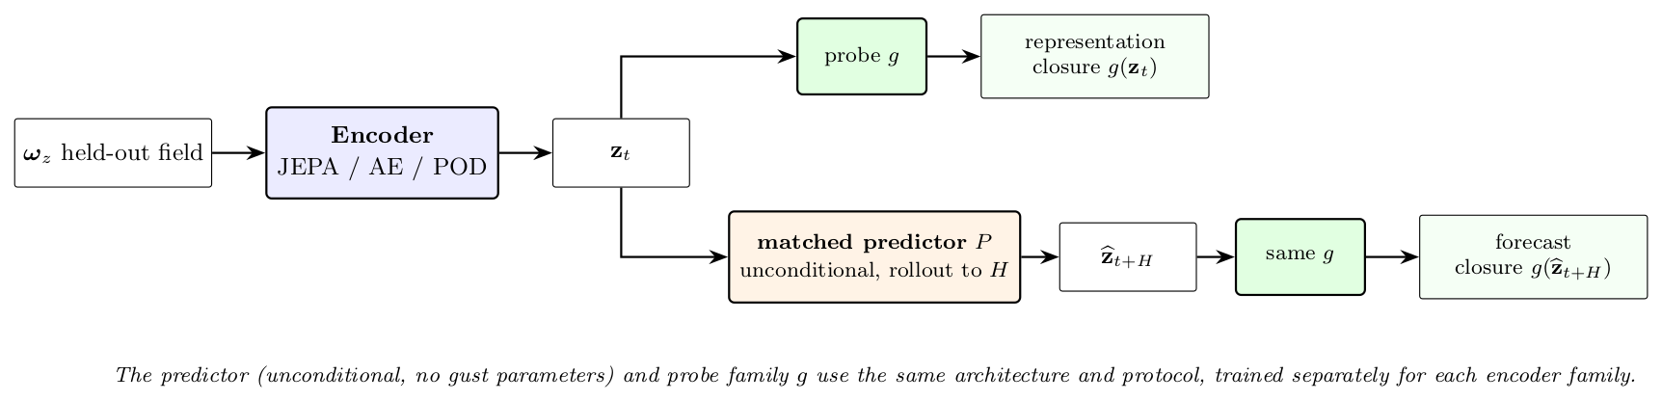
EVALUATION
Closure protocol
• Representational closure (the headline): probe each observable from the encoded latent at impact + 16, what the state *carries*, no rollout
• Forward (rollout) mode: roll the predictor recursively to H = 16 and probe the predicted latent; here we use it qualitatively (does the rolled latent track the wake?)
• Matched protocol: same predictor architecture and same probe family, trained / fitted separately per latent, so differences are the encoder's
• Parameter-only floor: can the three gust numbers (G, D, Y) alone predict each observable (a kernel-ridge fit)? Beating the floor proves the latent carries flow state beyond the parameters
Same probe family maps every encoder (JEPA / AE / POD) to the observables. Representational mode (encoded latent) is the headline; forward rollout is shown qualitatively.
Sparse-sensing state estimation, vortex-gust interactions · EUROMECH colloquium
13
Notes:
Fairness is the whole point: only the encoder changes. Headline is REPRESENTATIONAL closure (probe the encoded latent); the forward rollout is shown qualitatively only. The parameter-only floor rules out 'the parameters did it'. Reported with bootstrap CIs, 3 encoder seeds, 5-fold probe CV; held-out test_b / test_c.

Slide 14
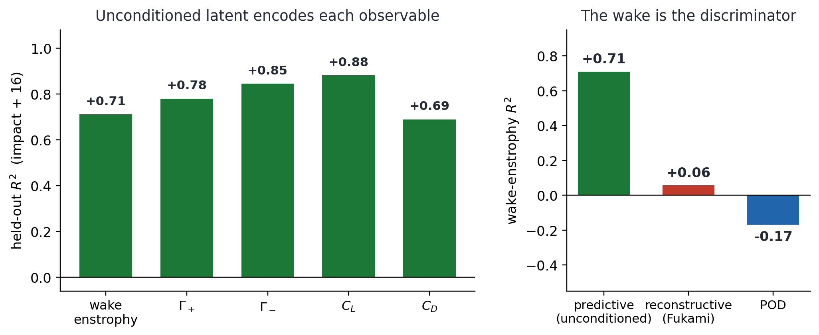
RESULT
Main result: the latent keeps the wake
• Representational closure: probe the encoded latent (no rollout) for each observable at impact + 16; the question is what the unconditioned state *carries*
• Wake enstrophy is the discriminator: tf-no-c R² = 0.71 (the conditioned model 0.75; reconstructive and POD far lower, 0.06 and below)
• So the unconditioned latent (no gust parameters anywhere) encodes the wake that reconstruction smooths away
• Forces and circulations are read off cleanly too (C_L 0.88, Γ± 0.85 / 0.78, C_D 0.69)
• Wake enstrophy E_w = ∫ ω_z² over the wake (x/c ∈ [0.5, 4], |y/c| ≤ 1): the intensity of the wake's rotational structures (LEV + shed vortices) that set the future load, the part reconstruction-only states lose
Held-out representational R² at impact + 16 from the encoded latent (test_b). Left: per observable (tf-no-c). Right: wake-enstrophy R² across families.
Sparse-sensing state estimation, vortex-gust interactions · EUROMECH colloquium
14
Notes:
Headline, reframed to REPRESENTATIONAL closure of the unconditioned tf-no-c latent. Probe the ENCODED latent (z_dns), no rollout: wake-enstrophy R^2 = 0.71 (conditioned 0.75), vs Fukami 0.06 / POD negative. I_y is excluded (the latent does not encode it; not comparable to the others). No 'rolled-out 0.84/0.93' claim; the rollout is shown only qualitatively on the next slides.

Slide 15
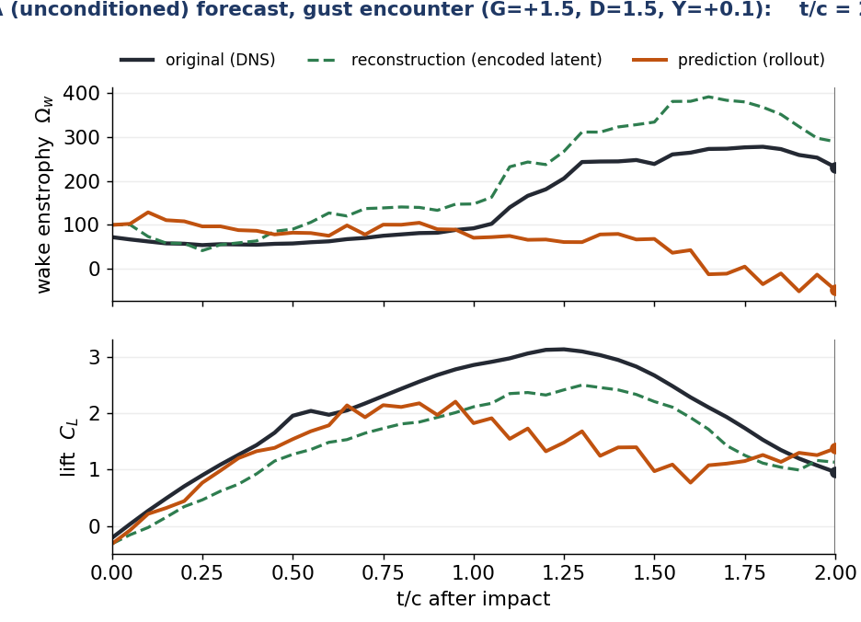
RESULT, QUALITATIVE
The rolled latent qualitatively tracks the wake
• The predictor rolls the latent forward from impact; each scalar is read off the rolled latent by a fixed linear probe
• Wake enstrophy and lift qualitatively track the DNS truth (black) through impact and the lift dip
• Green = reconstruction = the model's own encoded latent decoded with NO rollout (encode-then-decode of the true frame, the representational ceiling); it is not a separate reconstructive autoencoder
• Orange = prediction = the rolled latent (the predictor advanced forward, then decoded)
• A representative low-error encounter (G = +1.5), not the hardest case; shown qualitatively, no closure R² claimed here
Sparse-sensing state estimation, vortex-gust interactions · EUROMECH colloquium
15
Notes:
Embedded MP4 (plays in PowerPoint; a still shows otherwise). Two observables (wake enstrophy and lift). GREEN reconstruction = the model's OWN encoded latent decoded with NO rollout (encode-then-decode of the true frame), i.e. the representational ceiling, NOT a separate reconstructive autoencoder. ORANGE prediction = the rolled latent (predictor advanced forward, then decoded). Representative low-error gust encounter (G = +1.5, the unconditioned tf-no-c rollout). Qualitative: the rolled latent tracks the wake; no closure R^2 is claimed.

Slide 16
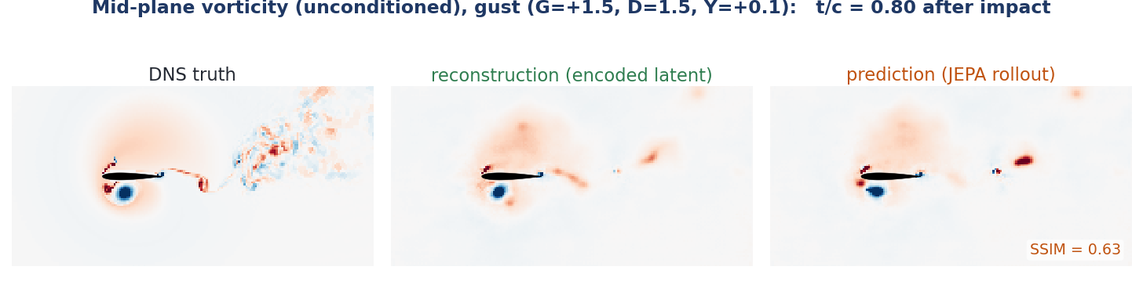
RESULT, PHYSICAL SPACE
The same rollout in physical space
Decode the rolled latent every frame: the rolled latent qualitatively tracks the wake as full vorticity fields, not just scalars.
DNS truth vs reconstruction (JEPA encode→decode of the latent) vs prediction (rolled latent), G = +1.5. At impact (H = 0) prediction = reconstruction; they diverge with horizon. SSIM(prediction) 0.75 at impact, 0.63 at H = 16. The latent keeps the LEV and shear layer; fine-scale wake is not retained at d = 64.
Sparse-sensing state estimation, vortex-gust interactions · EUROMECH colloquium
16
Notes:
Physical-space companion to the scalar rollout: same encounter (G = +1.5, unconditioned tf-no-c), decoded with the frozen LapFiLM visualisation decoder (never part of the JEPA loss). Reconstruction is the representational ceiling; prediction is the rolled latent decoded. Qualitative: the rolled latent tracks the wake.

Slide 17
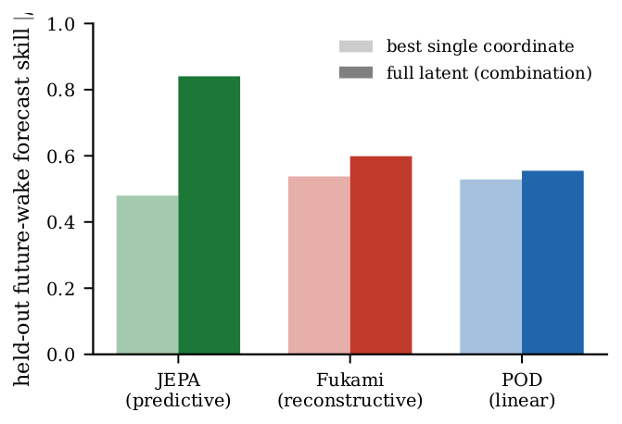
RESULT
It is the wake, not the forces
• Each bar is how well the future wake is forecast: dark = the full latent (all 64 coordinates together), light = the single best coordinate
• Predictive JEPA: the full latent (0.84) far exceeds the best single coordinate (0.48) → the wake is a distributed code spread across many coordinates
• Reconstructive / POD: the best single coordinate is already as good as the whole latent → there is no distributed / collective wake code to find
• Forces (C_L, C_D), by contrast, are carried redundantly by every family, in a single coordinate
• And it clears the parameter-only floor → the latent, not the parameters, does the work
Future-wake skill: full latent (dark, all 64 coordinates) vs the single best coordinate (light). Predictive = distributed code; reconstructive / POD = one coordinate suffices.
Sparse-sensing state estimation, vortex-gust interactions · EUROMECH colloquium
17
Notes:
Mechanistic reading of the main result. Each bar = how well the FUTURE WAKE is forecast; dark = the full latent (all 64 coordinates together), light = the single best coordinate. For the predictive JEPA the full latent (0.84) far exceeds the best single coordinate (0.48): the wake is a DISTRIBUTED code. For reconstructive / POD the best single coordinate is already as good as the whole latent, so there is NO distributed/collective wake code to find. Forces are carried redundantly by every family.

Slide 18
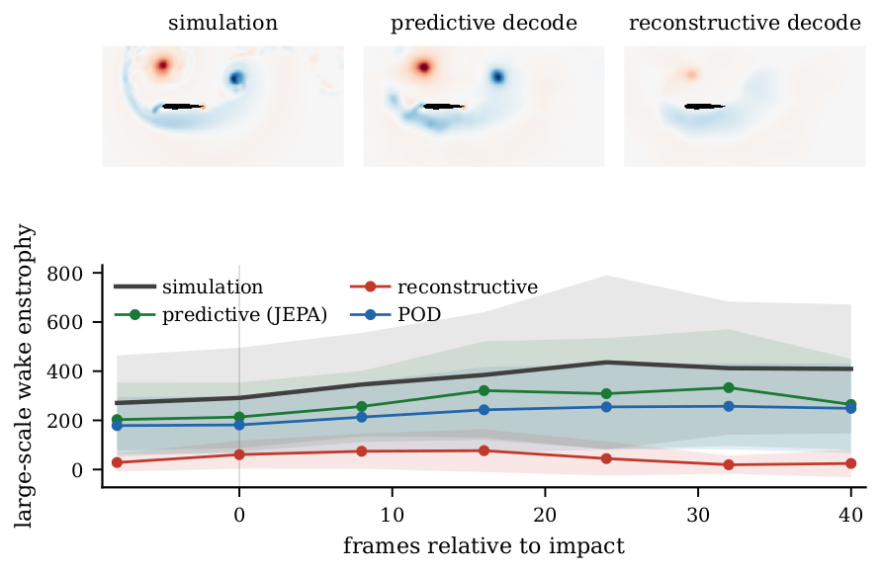
RESULT
The wake in physical space: the Gaussian scale split
• Gaussian scale split (Motoori & Goto 2019): low-pass the vorticity at σ/c = 0.05 into a large-scale part (LEV + shear layer, carries the lift) and a fine part
• Top: large-scale vorticity at impact+16 for the strongest test gust (G = -3, D = 1.5, Y = -0.1), simulation vs the predictive and reconstructive encode-then-decode reconstructions: predictive keeps the LEV/wake, reconstructive smooths it
• Bottom: the large-scale wake enstrophy through the encounter; bands = mean ± 1 s.d. across test_b encounters
• So 'it is the wake' is visible in physical space, not only in the scalar closure
Large-scale (σ/c = 0.05) wake vorticity at impact+16 (top) and large-scale wake enstrophy vs frame (bottom), by family.
Sparse-sensing state estimation, vortex-gust interactions · EUROMECH colloquium
18
Notes:
Physical-space version of 'it is the wake': the predictive reconstruction keeps the large-scale wake, the reconstructive one smooths it. These are encode-then-decode reconstructions; bands are mean +/- 1 s.d. over test_b. Moved here from the opening so results follow the method.

Slide 19
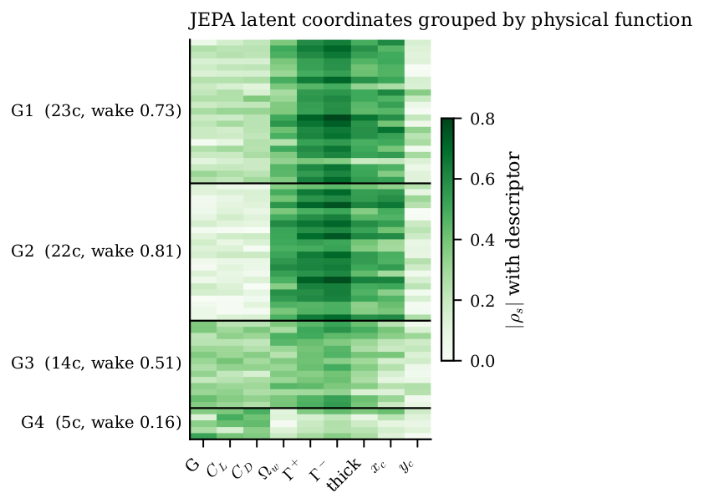
RESULT
Latent coordinates group by physical function
• Profile each of the 64 unconditioned-latent coordinates by its |Spearman| correlation with nine descriptors (gust G, forces, wake enstrophy, circulations Γ±, wake thickness, centroid)
• Clustering the profiles recovers functional groups: 59 wake-vorticity coordinates (three wake-dominated clusters) and 5 gust-forcing coordinates (one force cluster)
• Alone, the wake groups carry the wake at ≈ 0.5-0.8, the forcing group at 0.16 (all 64 together: 0.84), the collective wake code seen earlier
• Read descriptively, not as a causal claim
Per-coordinate |ρ| with each descriptor; rows grouped into functional clusters (G1-G4), labelled with coord count and held-out wake skill.
Sparse-sensing state estimation, vortex-gust interactions · EUROMECH colloquium
19
Notes:
Backs the 'it is the wake' story: the unconditioned latent organises coordinates by physical function (three wake-dominated clusters + one force cluster; full latent 0.84). Descriptive correlation only; the causal (SURD) part of this analysis is not in the paper.

Slide 20
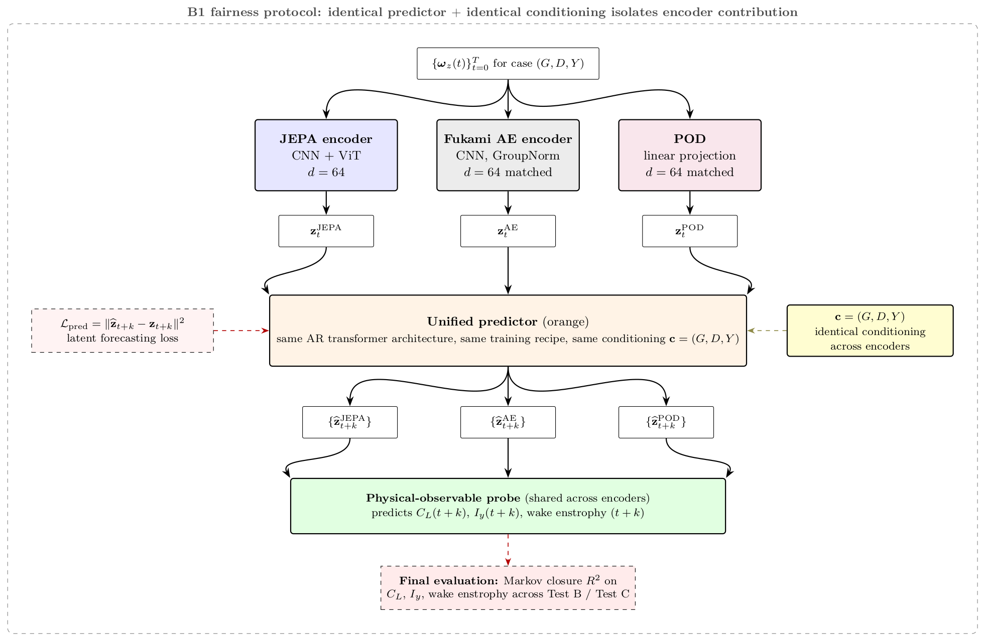
RESULT, CONTROLS (CONDITIONED-MODEL CONTROL)
Controls: objective and supervision, not architecture
• (Conditioned-model control; no unconditioned variant run.) 2 × 2: objective {predictive, reconstructive} × architecture {CNN, CNN+ViT}, auxiliary heads matched
• Fair comparison: every cell is rolled with the same temporal predictor (the matched closure predictor: same architecture and protocol, trained separately per family), so the only thing that varies is the encoder's objective / architecture
• The predictive objective wins at both architectures (wake R² 0.46 / 0.45 vs 0.16 / 0.29) → it is the objective, not the ViT
• And the wake-observable head is a necessary ingredient: removing it removes the gain
• → the gain needs the predictive objective and wake supervision together
Objective × architecture controls, three seeds per cell; every cell rolled with the same matched closure predictor, so only the encoder's objective / architecture varies.
Sparse-sensing state estimation, vortex-gust interactions · EUROMECH colloquium
20
Notes:
Pre-empt the skeptic: isolate the cause before the mechanism. Fair-comparison setup: every cell is rolled with the SAME temporal predictor (the matched closure predictor, same architecture and protocol, trained separately per family), so the only thing that varies is the encoder's objective/architecture. The predictive objective wins at both architectures (it is the objective, not the ViT), and the wake-observable head is a necessary ingredient.

Slide 21
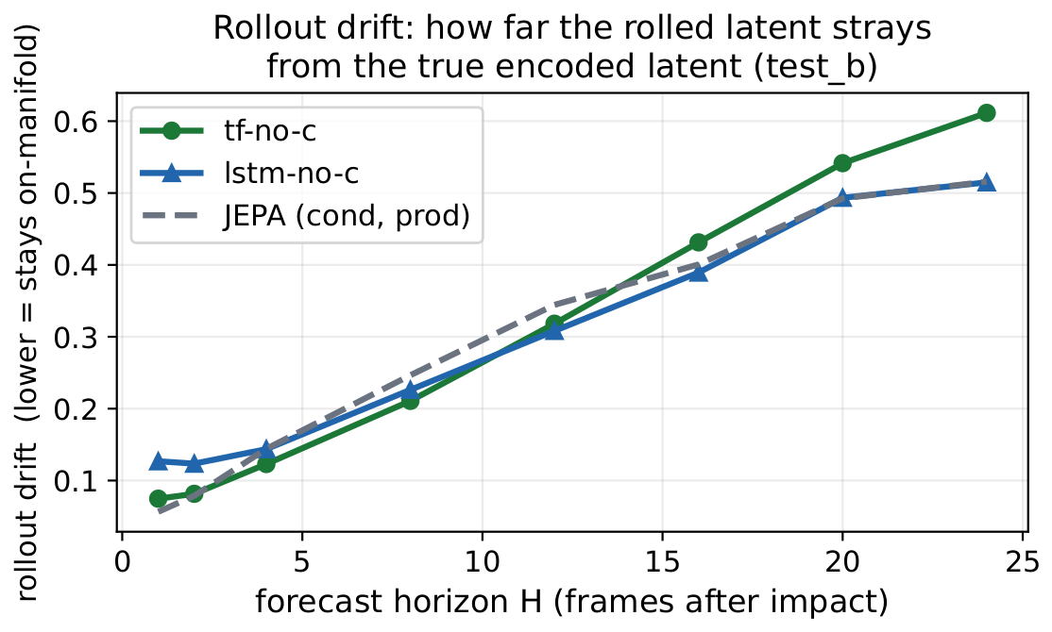
MECHANISM
Diagnostic 1: latent drift
• Why this question: a planner / RL agent queries the model at states reached by its own rollout, one-step error is not enough
• z_dns = the latent encoded directly from the simulation field (ground truth); z_markov = the latent produced by rolling the predictor forward
• The curve is their relative distance vs horizon (‖z_markov − z_dns‖ / ‖z_dns‖); lower / flatter is better (the rollout stays on the data manifold)
• Result: removing the gust parameters does not destabilise the rollout. Through the +16 horizon we forecast, the unconditioned latents drift on the same trajectory as the conditioned model (≈ 0.4, within 0.04); lstm-no-c stays matched to +24 (0.51 vs 0.52), while tf-no-c drifts a little more at the long tail (0.61)
Rollout drift vs horizon (test_b): relative distance ‖z_markov − z_dns‖ / ‖z_dns‖. The drift grows steadily; the unconditioned families track the conditioned model through the +16 forecast horizon.
Sparse-sensing state estimation, vortex-gust interactions · EUROMECH colloquium
21
Notes:
Define the terms for the audience. z_dns = the latent encoded directly from the simulation field (ground truth); z_markov = the latent produced by rolling the predictor forward. The curve is their relative distance vs horizon, LOWER/flatter is better. The drift grows steadily (not a blow-up): all three families track each other through the +16 horizon we forecast (~0.4, within 0.04); lstm-no-c stays matched to the conditioned model out to +24 (0.51 vs 0.52), tf-no-c drifts a little more at the long tail (0.61). So removing c does not destabilise the rollout. Figure plots tf-no-c (green), lstm-no-c (blue), conditioned production JEPA (grey dashed); Fukami dropped (its smooth latent gives a misleadingly low drift).

Slide 22
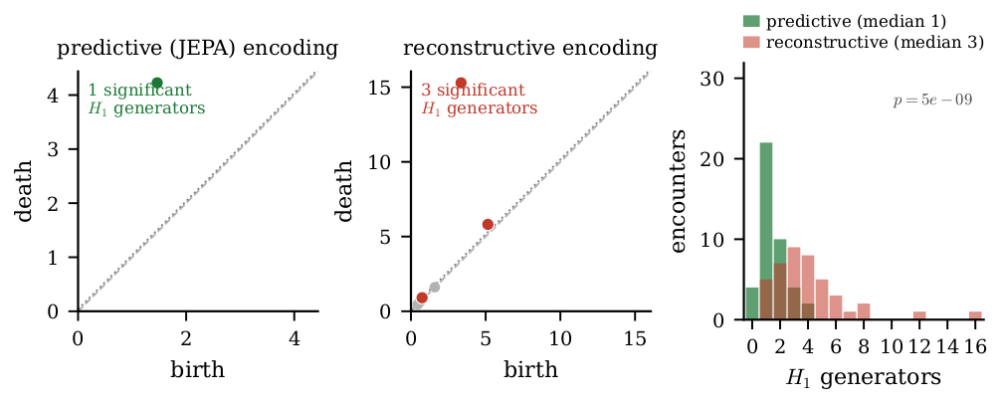
MECHANISM
Diagnostic 2: topology of the encounter
• A gust encounter is a cycle: the flow loops and roughly returns to where it started
• We ask whether the latent traces one clean loop or a tangle of many
• Persistent homology is just a principled loop-counter on the latent path (it counts the loops that genuinely persist, not noise)
• Result: the unconditioned JEPA latent makes one loop (median 1); the reconstructive latent fragments into many (median ~4); p ≈ 5×10⁻⁹
• So the predictive state captures the encounter as a single coherent cycle (count of persistent H1 generators; Mann-Whitney test)
The latent path of an encounter: the predictive latent traces one loop (median 1), the reconstructive latent many (median ~4). Persistent homology counts the loops.
Sparse-sensing state estimation, vortex-gust interactions · EUROMECH colloquium
22
Notes:
Plain-language framing for a non-expert audience. A gust encounter is a cycle (the flow loops and roughly returns). We ask whether the latent traces ONE clean loop or a tangle of many. Persistent homology is a principled loop-counter on the latent path. Result: the unconditioned JEPA latent makes one loop (median 1); the reconstructive latent fragments into many (median ~4); p ~ 5e-9. So the predictive state captures the encounter as a single coherent cycle. (Technically: count of persistent H1 generators on z_dns over 42 test_b encounters; encounter-level Mann-Whitney p ~ 5e-9. The PCA panels are encode->decode, no predictor; the orbit need not visually close in the 120-frame window.)

Slide 23
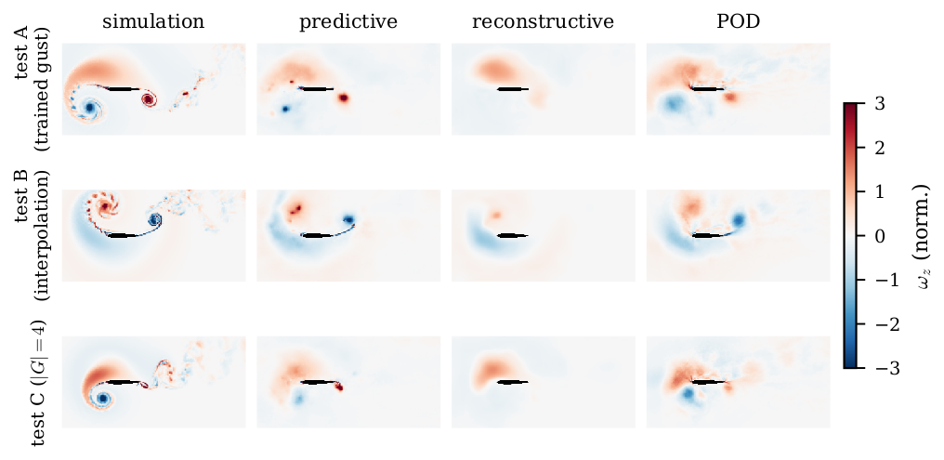
RESULT, PHYSICAL SPACE
Decoded reconstructions
• Decoded fields: predictive vs reconstructive vs POD vs DNS
• The predictive decode is blurrier pixel-wise but preserves the transported large-scale wake; the reconstructive decode is sharp yet drifts under rollout
Held-out reconstructions; the predictive objective trades pixel sharpness for transported structure.
Sparse-sensing state estimation, vortex-gust interactions · EUROMECH colloquium
23

Slide 24
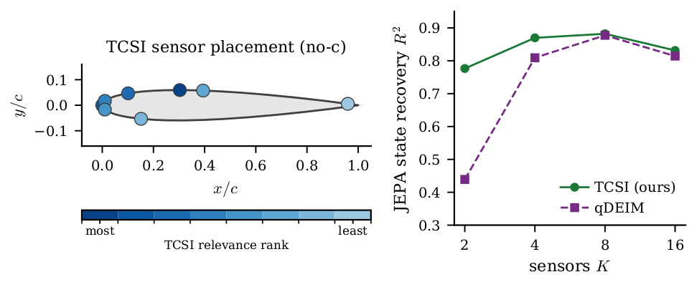
CONTROL RELEVANCE
Sparse sensor placement
• Sparse wall-pressure sensors selected by TCSI / qDEIM vs uniform
• Model: the pressure → latent map is a KernelRidge (RBF) regressor on the K-sensor × pre-impact-window vector; K = 2 / 4 / 8 / 16 (LSTM / KRR 5-fold-CV selected to guard small-sample overfitting)
• Metric — state-recovery R²: the fraction of the held-out latent's variance recovered from the K pressure taps (1 = perfect, 0 = no better than the mean), for the unconditioned tf-no-c latent (no gust parameters anywhere)
Optimal sparse sensor placement on the airfoil surface; state-recovery R² is the fraction of the unconditioned latent's variance recovered from K taps.
Sparse-sensing state estimation, vortex-gust interactions · EUROMECH colloquium
24

Slide 25
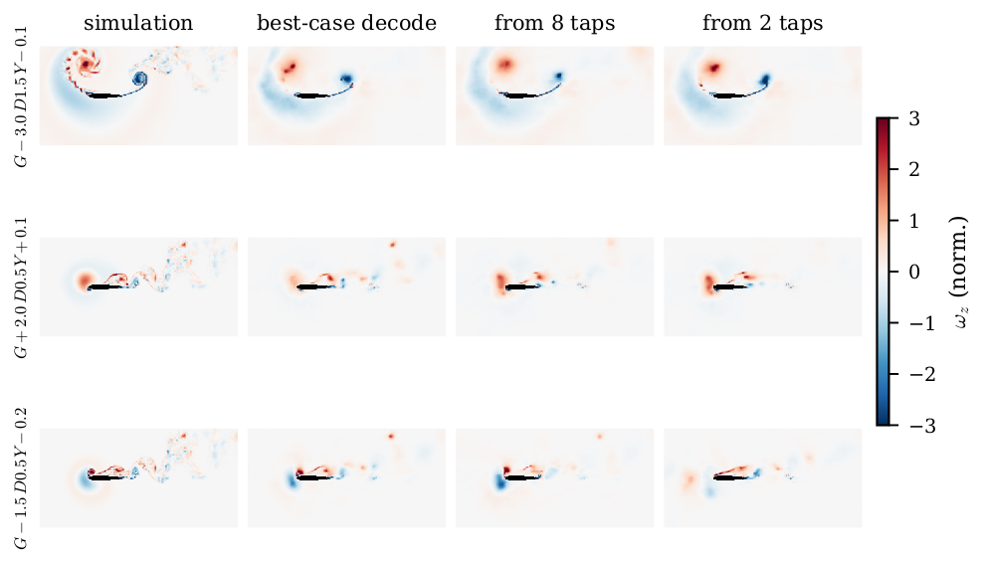
CONTROL RELEVANCE
Flow recovered from sparse wall pressure
• Model: a KernelRidge (RBF kernel) regressor maps the K wall-pressure taps over a pre-impact window to the impact-frame latent; the frozen decoder then renders the field
• K = 8 taps recover the leading-edge vortex and shear layer; K = 2 coarsens but keeps the gross wake structure
• Benchmarked against the best-case decode (decode of the true simulation latent, i.e. the ceiling decode) and the simulation
• So the predictive state is reconstructible from a few wall sensors, a deployment-relevant observability result
Flow recovered from sparse wall pressure: simulation, best-case (ceiling) decode of the true simulation latent, and decode of the latent estimated from K = 8 and K = 2 taps (held-out).
Sparse-sensing state estimation, vortex-gust interactions · EUROMECH colloquium
25
Notes:
Reframed to match the figure (flow from pressure). The 'best-case decode' column is the CEILING decode (decode of the true simulation-encoded latent), i.e. the best the decoder could do given a perfect latent. The predictive-vs-reconstructive wake tracking is already on the scale-decomposition slide.

Slide 26
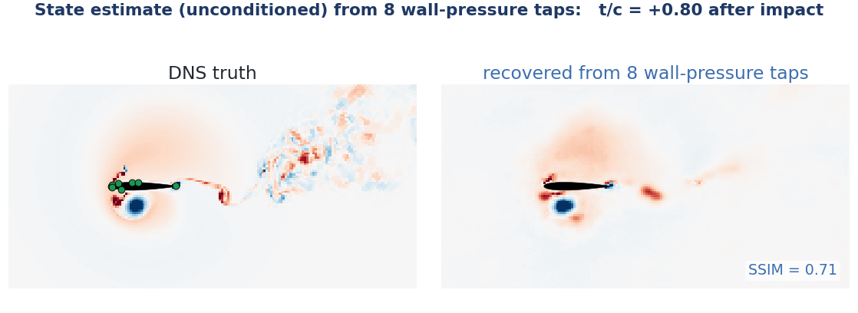
CONTROL RELEVANCE
Sparse-sensor state estimation in action
No predictor here: a per-frame MLP maps a causal 6-frame window of 8 wall-pressure taps to the latent, then the frozen decoder renders the field.
DNS truth (green dots mark the 8 TCSI taps) vs the field recovered from wall pressure alone, on a held-out encounter. Held-out-encounter latent R² = 0.74, SSIM 0.63. Wall pressure fixes the near-body LEV and shear layer; the far wake is not surface-observable.
Sparse-sensing state estimation, vortex-gust interactions · EUROMECH colloquium
26
Notes:
Dynamic companion to the static flow-recovery slide: a causal 6-frame pressure window at 8 TCSI taps -> MLP -> latent -> frozen decoder, applied frame by frame (unconditioned tf-no-c latent). This is state ESTIMATION, not forecasting; the JEPA predictor is not used here.

Slide 27
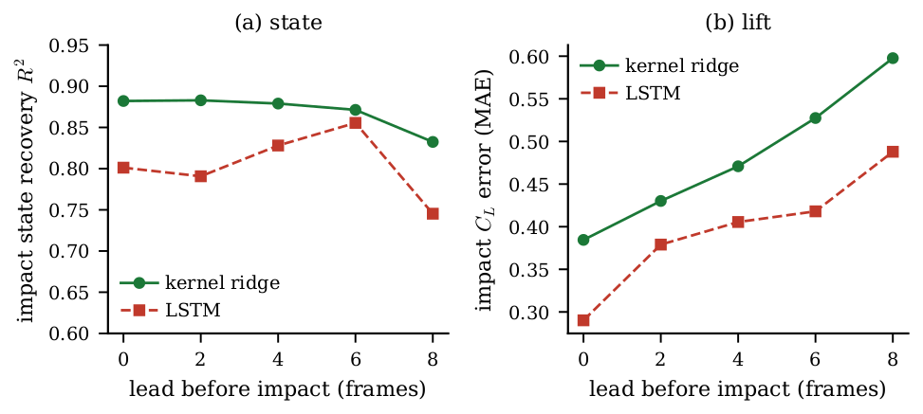
CONTROL RELEVANCE
Control relevance: observable ahead of impact
• From a causal window of sparse wall pressure, recover the impact-frame latent at a lead time before impact (held-out test_b)
• Impact state is recovered at R² ≈ 0.88 right at impact and stays above 0.83 out to 8 frames ahead (kernel ridge; LSTM comparable)
• Impact lift C_L is estimated with MAE rising gracefully from ≈ 0.38 at impact to ≈ 0.60 at 8 frames ahead (LSTM lower, 0.29 to 0.49)
• So the unconditioned state is observable ahead of impact from a few wall sensors: the ingredient a controller consumes
Recovered from sparse wall pressure at each lead time before impact (test_b): (a) impact-state R²; (b) impact-C_L MAE. Kernel ridge vs LSTM.
Sparse-sensing state estimation, vortex-gust interactions · EUROMECH colloquium
27
Notes:
The venue hook, reframed to the unconditioned figure: from sparse wall pressure we recover the impact-frame latent ahead of impact (state R^2 ~0.88 at impact, >0.83 out to 8 frames) and estimate impact lift (MAE 0.38->0.60 over 0-8 frames). Observable ahead of impact, the ingredient a controller needs. No predictor-in-loop / oracle three-way claim here.

Slide 28
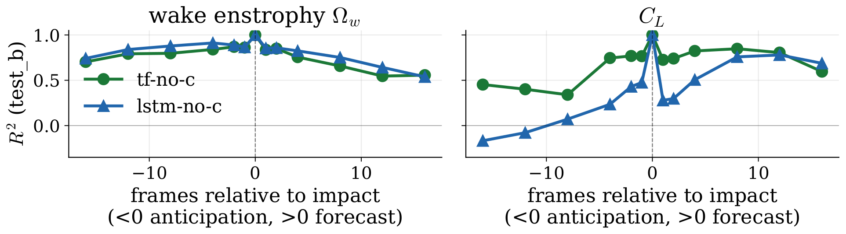
CONTROL RELEVANCE
Two forecast windows: early warning, then forecast
• We roll the unconditioned JEPA's own predictor forward in latent space and read each observable off the rolled latent with a fixed linear probe: we predict the JEPA latent, then probe wake / lift from it
• Wake: a wide ±16-frame (≈ ±0.8 t/c) window around impact (R² 0.7-0.9) -- the structural signature gives early warning and short-range forecast
• Lift C_L: hard to anticipate (flat before impact) but strongly forecastable after (R² ≈ 0.8 to +12) -- the load is predictable once impact hits
Wake (left) and lift (right) R² vs frames relative to impact (test_b): x < 0 anticipation lead, x > 0 forecast horizon; tf-no-c and lstm-no-c.
Sparse-sensing state estimation, vortex-gust interactions · EUROMECH colloquium
28
Notes:
Two forecast windows for the unconditioned predictor (markov rollout, wake/C_L linear probes on the rolled latent): wake is predictable in a roughly symmetric +/-16-frame window around impact (early warning); lift is asymmetric -- hard to anticipate (flat pre-impact) but strongly forecastable post-impact.

Slide 29
CONCLUSIONS
Conclusions
• A fully unconditioned predictive latent (no gust parameters anywhere) representationally keeps the wake (wake R² ≈ 0.71) that force-only and reconstruction-only states lose
• That latent traces a single clean cycle, is transport-consistent within an encounter, and is observable from sparse wall pressure
– compact (d = 32 ≈ d = 64, participation ratio ≈ 1.7)
• The rollout is shown qualitatively: it stays on-manifold and tracks the wake, but we make no forward-closure R² claim
• It is a substrate for model-based control and RL world-models, not yet a validated controller
• Next: add an actuation channel (same machinery), close the loop, push to 3D observability at |G| = 4, and carry the recipe to other parametric flows
Sparse-sensing state estimation, vortex-gust interactions · EUROMECH colloquium
29
Notes:
Single closing slide, reframed to the UNCONDITIONED latent. What we built: an unconditioned predictive latent that representationally keeps the wake (R^2 ~0.71), traces a single clean cycle, is transport-consistent and observable from sparse pressure. The rollout is qualitative; no forward-closed wake R^2 0.84 claim. Honest boundary: a substrate, not a validated controller. Outlook: actuation channel, close loop, 3D observability, other flows.

Slide 30

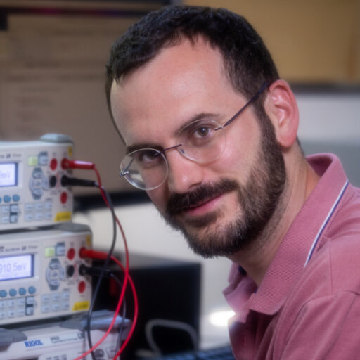



THANKS
Acknowledgements
This work is a collaboration with:
Alberto Solera-Rico
INTA · UC3M
Arnau Miró
UPC · BSC
Oriol Lehmkuhl
BSC
Work produced with the support of a 2024 Leonardo Grant for Researchers and Cultural Creators, BBVA Foundation, project PREVENT (grant LEO24-2-15988). The Foundation takes no responsibility for the opinions, statements and contents of this project, which are entirely the responsibility of its authors.
Sparse-sensing state estimation, vortex-gust interactions · EUROMECH colloquium
30
Notes:
Acknowledgements: author photos (Solera-Rico, Miró, Lehmkuhl) and the BBVA Foundation / Red Leonardo funding logos. Funding: 2024 Leonardo Grant, project PREVENT (LEO24-2-15988).

Slide 31
Backup slides
Supporting detail and ablations
31

Slide 32
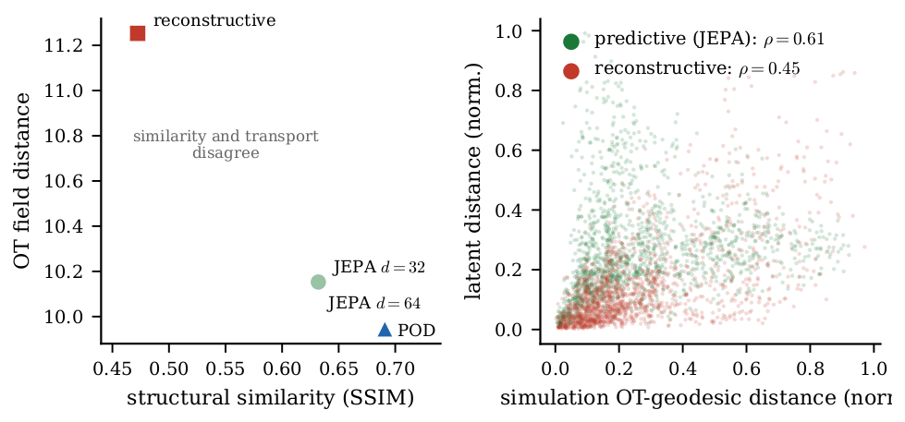
BACKUP, MECHANISM
Transport geometry (optimal transport)
• Why: Euclidean / pixel distance ignores where structures move; control cares about advection of the LEV and shear layer
• OT field distance (after Tran, Yeh & Taira, JFM 2026): split vorticity into ± parts, transport each with unbalanced Sinkhorn OT and sum, the least work to rearrange one field into another
• We did not train the latent to match OT (that paper does); this is a post-hoc test: per encounter, Spearman-correlate the latent distance matrix with the OT matrix (n = 42)
• Within-encounter: the unconditioned JEPA 0.61 vs reconstructive 0.45, order-preservation along the trajectory, not an isometry
• Honest caveat: *pooled across* encounters the alignment does not hold, so it is trajectory-local, not a global latent metric
Per-encounter latent-vs-OT distance alignment (Shepard). OT field distance after Tran, Yeh & Taira (JFM 2026). Within-encounter Spearman 0.61 vs 0.45; pooled it does not hold.
Sparse-sensing state estimation, vortex-gust interactions · EUROMECH colloquium
32
Notes:
Moved to backup: real but the weakest mechanism diagnostic (post-hoc, trajectory-local, pooled reverses). OT method = signed-vorticity split + unbalanced Sinkhorn (Tran, Yeh & Taira JFM 2026, eq 5); our code uses the entropic transport cost, not the debiased divergence, which does not change orderings.

Slide 33
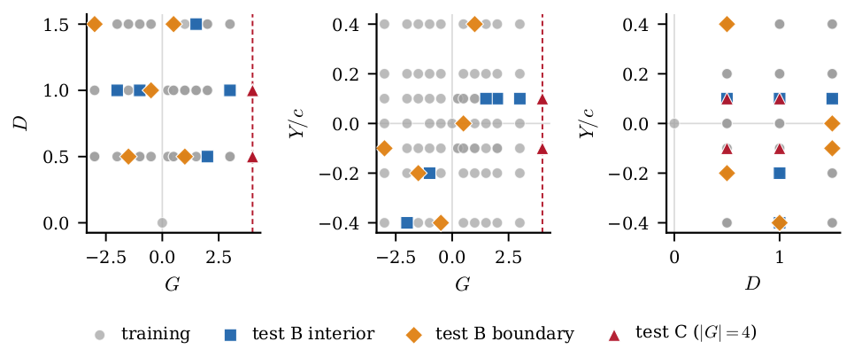
BACKUP
Dataset and protocol
• Partition v2 (locked, sha256-anchored): 84 cases
• 226 train encounters · 42 test_b · 24 test_c (|G| = 4)
• ω_z pipeline v1: spatial mask + p99.99 clip + 3σ scale (train_std 3.55), no mean shift (preserves vorticity antisymmetry)
• Reporting: bootstrap n = 2000 CIs · 3 encoder seeds · 5-fold probe CV
Training envelope in (G, D, Y).
Sparse-sensing state estimation, vortex-gust interactions · EUROMECH colloquium
33

Slide 34
BACKUP (CONDITIONED-MODEL CONTROL)
Matched-capacity: d = 32 vs d = 64
• (Conditioned-model control; no unconditioned variant run.) Halving the latent leaves the representation and every mechanism diagnostic intact
– representational wake R² 0.74 (d=32) vs 0.75 (d=64); drift ratio 0.86 vs 0.85; OT 0.61 vs 0.63
• Cost is in-distribution forecast sharpness: H = 16 wake closure 0.45 → 0.21
• Participation ratio ≈ 1.7, leading PC ≈ ¾ of variance → the effective dimension is a handful
Sparse-sensing state estimation, vortex-gust interactions · EUROMECH colloquium
34

Slide 35
BACKUP (CONDITIONED-MODEL CONTROL)
Seed variance
• (Conditioned-model control; no unconditioned variant run.) Three encoder seeds per cell; wake-closure means reported ± standard deviation
• The reconstructive CNN+ViT cell has large seed variance (±0.27), consistent with the drift mechanism: without a forward-predictable geometry, closure is unstable across initialisations
• Predictive cells are tight (±0.03–0.06)
Sparse-sensing state estimation, vortex-gust interactions · EUROMECH colloquium
35

Slide 36
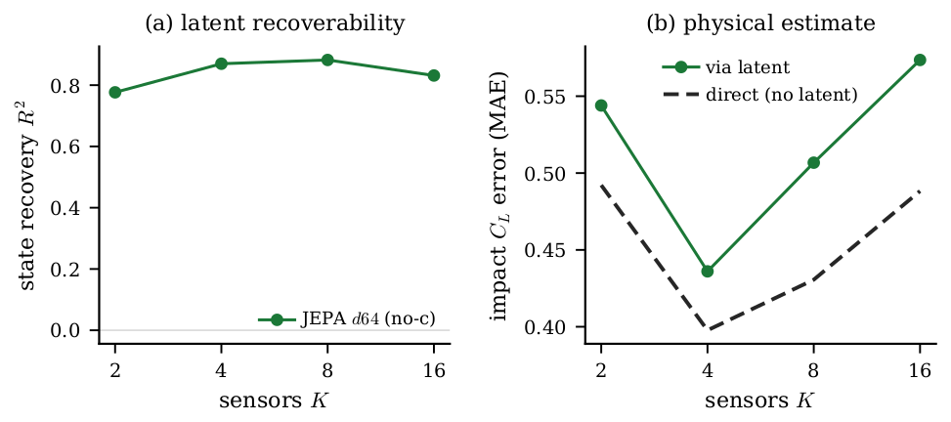
BACKUP
Parameter observability from the latent
• z → (G, D, Y) probe R² from the rolled-out latent, K = 8 pre-impact sensors
• test_b: G 0.46 · D 0.80 · Y 0.10, gust strength and core diameter recoverable; cross-stream offset Y is marginal
• test_c (|G| = 4): negative, the 3D observability boundary of a single mid-plane slice
Gust parameters implicit in the latent on held-out cases.
Sparse-sensing state estimation, vortex-gust interactions · EUROMECH colloquium
36

Slide 37
BACKUP
SSIM convention
• Reconstruction SSIM uses the Wang convention (K1 = 0.01, K2 = 0.03) on pipeline-normalised ω
• Data range L = 2 · global p99.9(|target|) ≈ 8.31 (split v2)
• Decoder test_a SSIM ≈ 0.73 at this convention
Sparse-sensing state estimation, vortex-gust interactions · EUROMECH colloquium
37

Slide 38
BACKUP
Parameter-only floor
• KRR-RBF on (G, D, Y) → observable at impact; train / test_b / test_c R²
– on train, (G, D, Y) interpolates C_L and C_D well (226 points in 3-D)
• On test_b the floor collapses across observables; on test_c it is negative for 5 of 6
• → JEPA's generalisation is not explained by the gust parameters alone
Sparse-sensing state estimation, vortex-gust interactions · EUROMECH colloquium
38

Slide 39
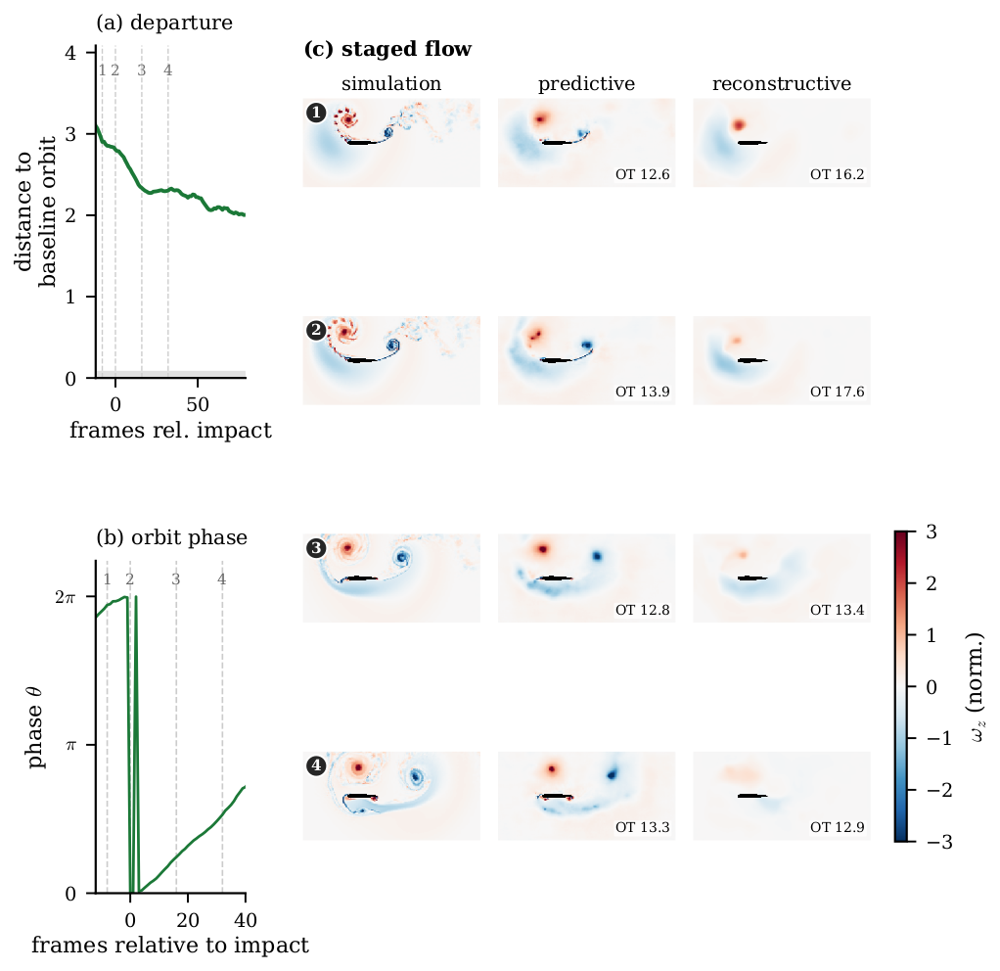
BACKUP
Phase–amplitude reading
• Phase–amplitude decomposition of the encounter cycle in the predictive latent
• The sharp 2π → 0 step in panel (b) is a phase wrap (θ is a cyclic angle on the orbit; it resets at the branch cut, which falls near impact), not a physical jump
• Connects the predictor to the sensitivity-function control designed for these flows
• An actuation channel is the natural next input for closed-loop control
The 2π → 0 step in panel (b) is a phase wrap (cyclic angle resetting at the branch cut near impact), not a physical discontinuity.
Sparse-sensing state estimation, vortex-gust interactions · EUROMECH colloquium
39
Notes:
Phase-amplitude reading of the encounter cycle. Note for the audience: the abrupt 2*pi -> 0 step in panel (b) is a phase WRAP (theta is a cyclic angle on the orbit, it resets at the branch cut, which falls near impact), not a physical jump.

