Slide 1
TKINTER CHATROOM
-Python Tkinter Mini-Project
Presenter:
Sanmit Sahu 1811038
Rahil Parikh 1811032

Slide 2
OUTLINE
Project Description
Functionalities
User Manual Link
Implementation
Algorithm
Demo
Video
Further Scope
References

Slide 3
PROJECT DESCRIPTION
We made a server and client chat room system using Socket Programming with Python and Python GUI toolkit tkinter.
The sockets are the endpoints of any communication channel. These are used to connect the server and client. Sockets are Bi-Directional. In this area, we will setup sockets for each end and setup the chat-room system among different clients through the server. The server side has some ports to connect with client sockets. When a client tries to connect with the same port, then the connection will be established for the chat room.
There are basically two parts. The server side and the client side. When the server side script is running, it waits for any active connection request. When one connection is established, a client can communicate with other clients.

Slide 4
FUNCTIONALITIES
Clients can connect to server to communicate with each other.
This project allows multiple users to connect to each other.
User is free to logout anytime he/she wishes to.
Arrival of new users is notified to all users in chat-room.
Once a user leaves a chat room they will not receive any new messages.
All data regarding chatroom (Usernames , new messages , users entering chat-room , users leaving chat-room etc.) is visible on server.

Slide 5
USER MANUAL
https://github.com/sanmitsahu/Chat-Room/blob/master/User%20Manual/Chat%20Room-User%20Manual.pdf

Slide 6
IMPLEMENTATION
and TOOLS USED
The Clients basically opens a socket connection and send queries to the server. The Server responds back. This design also takes care to continue periodical data push and pull. It’s useful to push data periodically so that the same client doesn’t need to open connection repeatedly.
Socket programming is a way of connecting two nodes on a network to communicate with each other. One socket(node) listens on a particular port at an IP, while other socket reaches out to the other to form a connection. Server forms the listener socket while client reaches out to the server.
A thread is a sub-program within a program that can be executed independently of other section of the code. A thread executes in the same context sharing program’s runnable resources like memory.When in a single process, we are executing multiple threads simultaneously, it is called Multi-threading.

Slide 7
SOCKET PROGRAMMING
Sockets and the socket API are used to send messages across a network. They provide a form of inter-process communication (IPC). The network can be a logical, local network to the computer, or one that’s physically connected to an external network, with its own connections to other networks.
The primary socket API functions:
socket()
bind()
listen()
accept()
connect()
connect_ex()
send()
recv()
close()

Slide 8
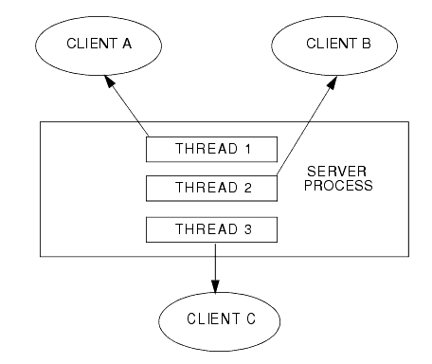
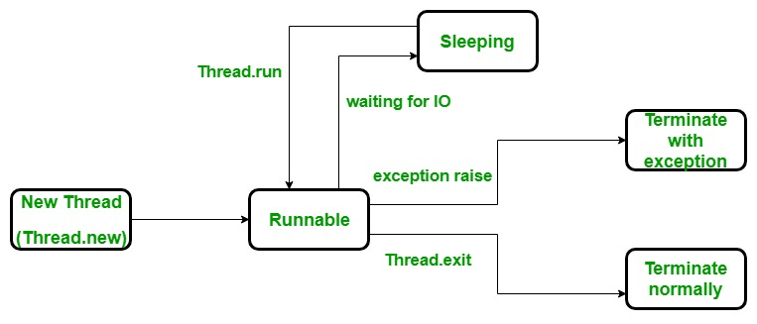
MULTI-THREADING
Multithreading is the inclusion of more than one unit of execution in a single process.
We want our architecture to support multiple clients at the same time. For this reason, we must use threads on server side so that whenever a client request comes, a separate thread can be assigned for handling each request.

Slide 9
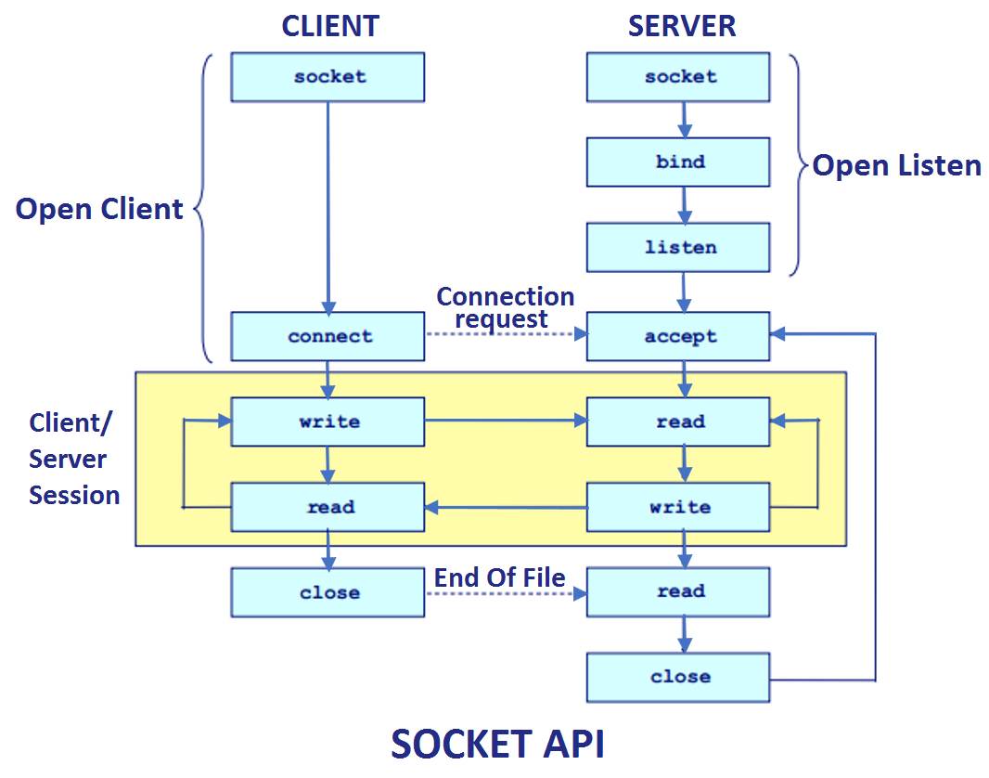
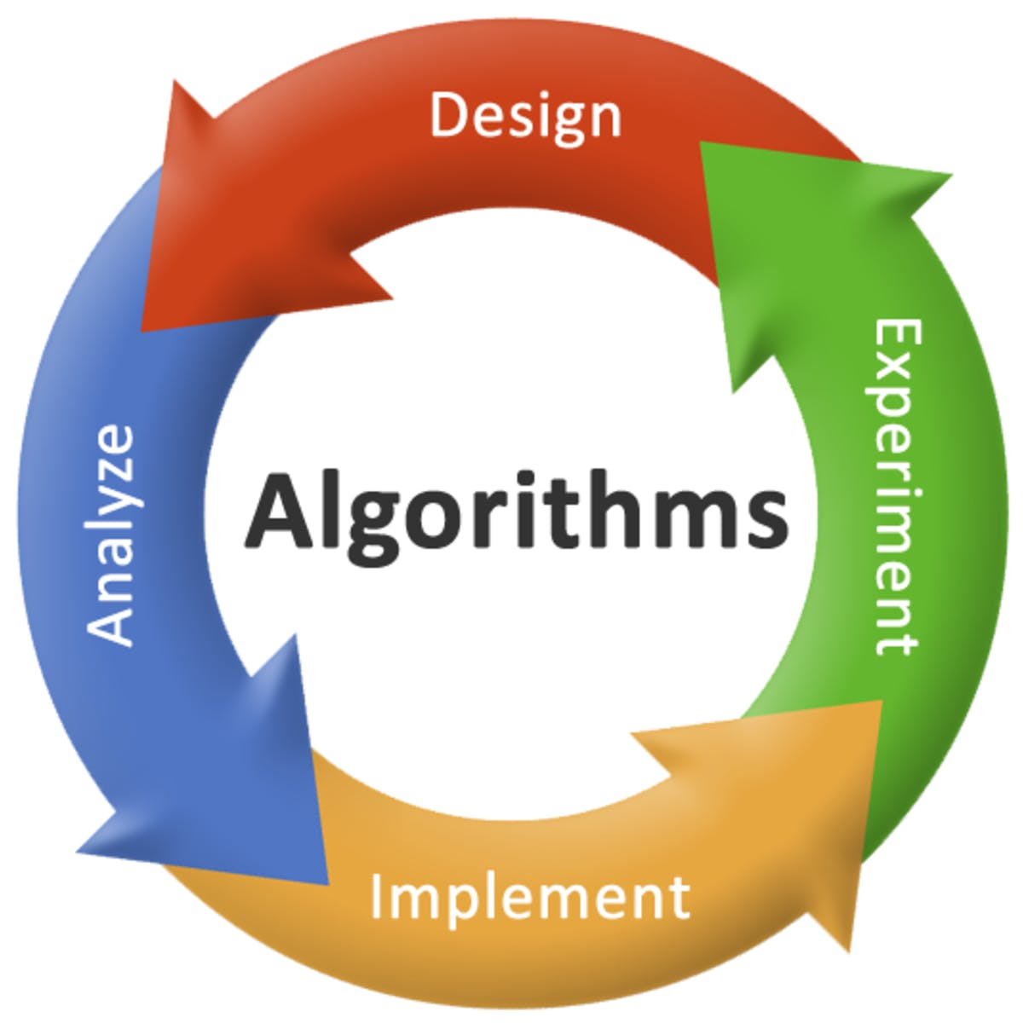
ALGORITHM
Different files
Server
Client

Slide 10
FURTHER SCOPE
Limitation/Unimplemented Feature
Does not store history of chatroom in in output file.
Does not limit history (Lead to DoS attack).
Server sends too many messages
Clients uses up resources if history is large
Multiple chatrooms for different categories
Sharing Media like audio, video, images
Auto correct feature of the writing text in a chat

Slide 11
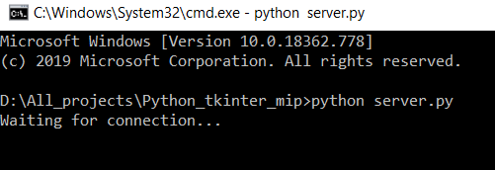
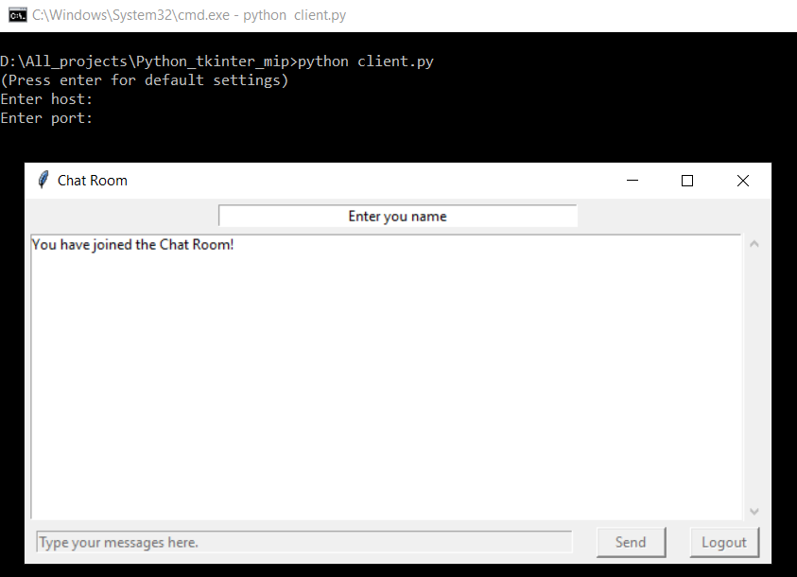
DEMO
http://people.wku.edu/peter.harlan996/tic-tac-toe.html
Starting the server
Joining the Chatroom
Entering the Name
Sending Messages

Slide 12
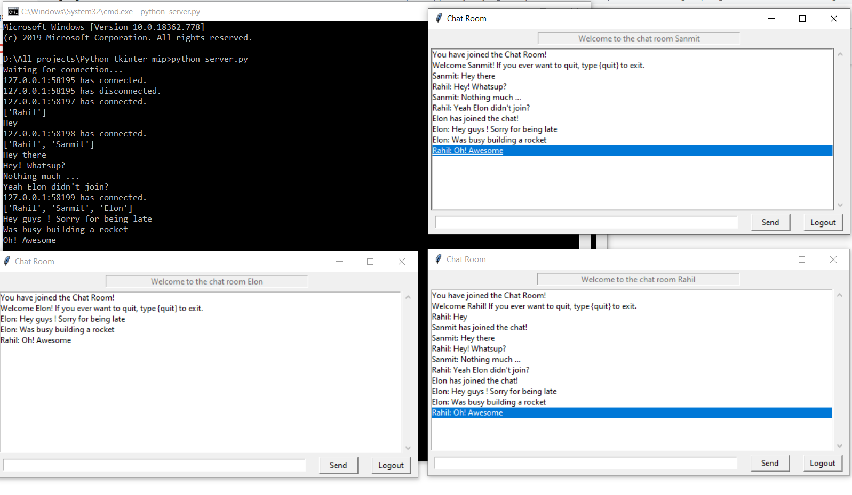
Chat Activity
Multiple clients connected through Sockets to the server with multi threading. One thread to handle each client.
🡪 Auto capitalizing the first letter while typing feature.

Slide 13
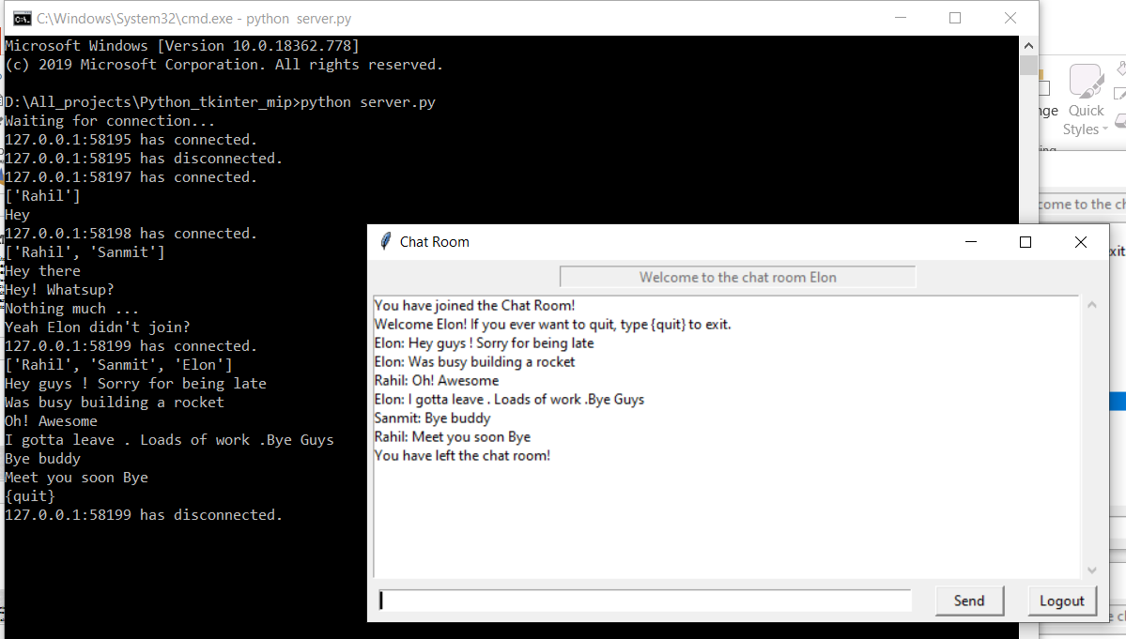
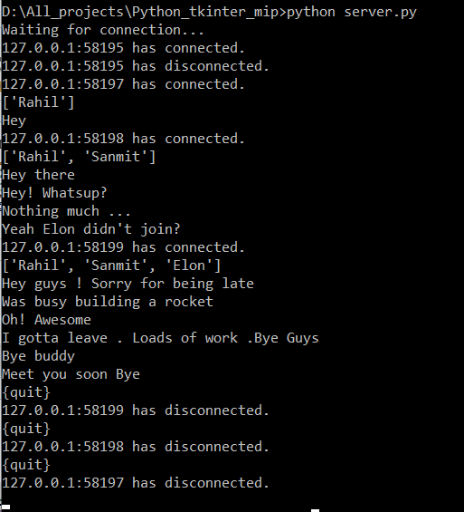
Logout Activity
🡪Logout on Clicking Logout button
🡪Auto - Logout on closing the tkinter application

Slide 14
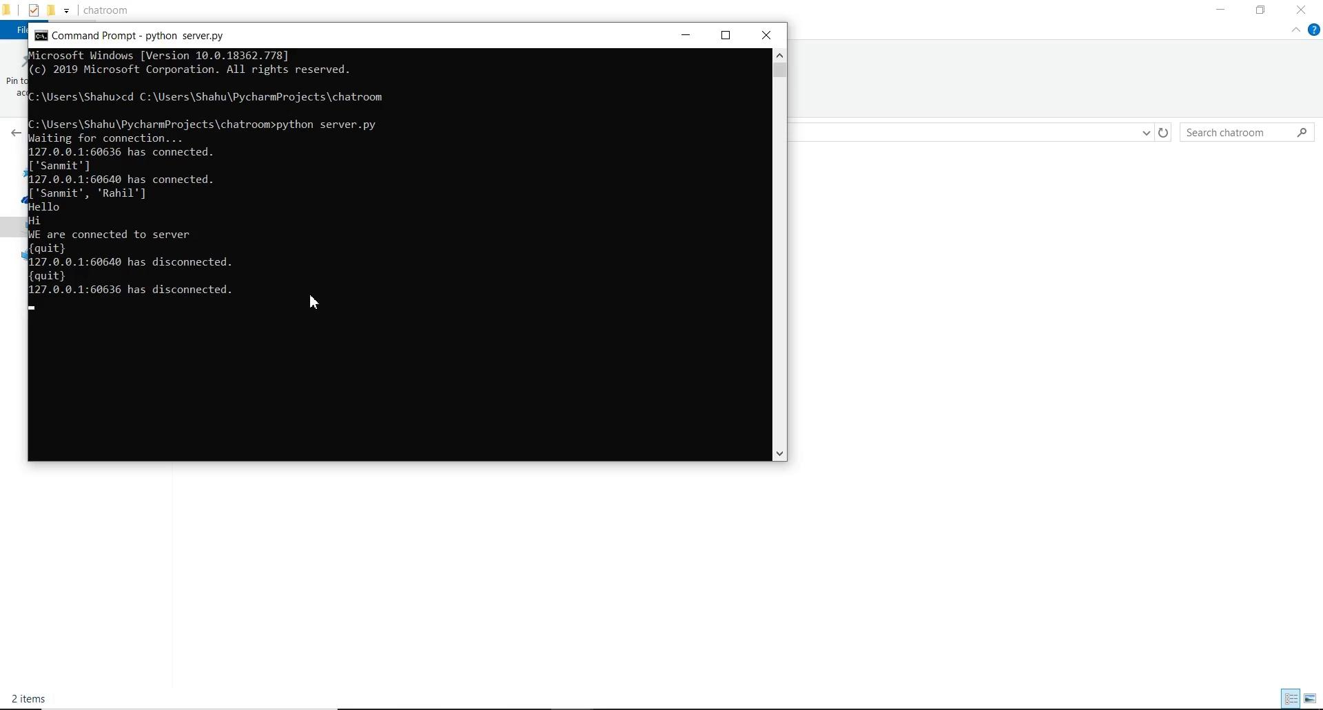
VIDEO

Slide 15
REFERENCES
https://www.geeksforgeeks.org/ruby-thread-life-cycle-its-states/
https://realpython.com/python-sockets/
https://effbot.org/tkinterbook/tkinter-classes.htm

