Slide 1
GOLD for LEXERS
Example

Slide 2
Lisp Like
The following grammar generates arithmetic expressins of sums and products à la LISP.
E → num
E → var
E → (plus L)
E → (times L)
L → E
L → L E

Slide 3
Tokens
num
var
plus
times
(
)

Slide 4
Which will be coded like this
num
var
plus
times
(
)
n
v
+
*
(
)

Slide 5
Lexer
Reads but does not require spaces
Spaces are separators
Example 1
This string: (plus (plus ee 3243 ee) 4)
Is the same as this one (plus(plus ee 3243) 4)
Both will be coded like this: (+(+vnv)n)
Example 2:
This string (plus (plus ee 3243 ee) 4)
Is not the same as this one: (plus(plus ee3243 ee)4)
The first one is coded like this (+(+vnv)n)
While the second one would be coded like this: (+(+vv)n)
Example 3:
This string generates a lexical error (plus (plus ee 3243ee) 4)

Slide 6
GOLD Transfucer
function createTransducer():ITransducer begin
// Analizador léxico: Recibe una cadena de letras minúsculas,
// dígitos, paréntesis y epacios.
// genera una cadena de {'(',')','+','*','v','n'}
Q:= {"I","Id", "p", "pl" ,"plu", "plus", "t", "ti" ,"tim", "time",
"times", "Num","Err"}
Σ:=('0'‥'9') ∪ ('a' ‥ 'z') ∪ {'(',')',' '}
Out:={'(',')','+','*','v','n'}
q₀:="I"
F:= {"I"}
return GDeterministicTransducer(Q,Σ,Out,q₀,F,δ,g,h)
end

Slide 7
Delta
function δ(q,σ) begin
if (q = "Err") then return "Err”
elseif σ ∈ {'(',')',' '} then return "I"
elseif q="I" and σ='p' then return "p"
elseif q="I" and σ='t' then return "t"
elseif q="I" and σ ∈ ('0' ‥ '9') then return "Num"
elseif q="Num" and σ ∈ ('0' ‥ '9') then return "Num"
elseif q="Num" and σ ∈ ('a' ‥ 'z') then return "Err"
elseif q="p" and σ='l' then return "pl"
elseif q="pl" and σ='u' then return "plu"
elseif q="plu" and σ='s' then return "plus"
elseif q="t" and σ='i' then return "ti"
elseif q="ti" and σ='m' then return "tim"
elseif q="tim" and σ='e' then return "time"
elseif q="time" and σ='s' then return "times"
else return "Id"
end
end

Slide 8
H
function h(q,σ) begin
var s: String
s := λ
if q ∉ {"Err"} and σ ∈ {'(',')',' '} then
if σ ∉ {' '} then s=String.valueOf(σ) end
if q=="I" then return s
elseif q=="plus" then return "+"+s
elseif q=="times" then return "*"+s
elseif q=="Num" then return "n"+s
else return "v"+s
end
else return λ
end
end

Slide 9
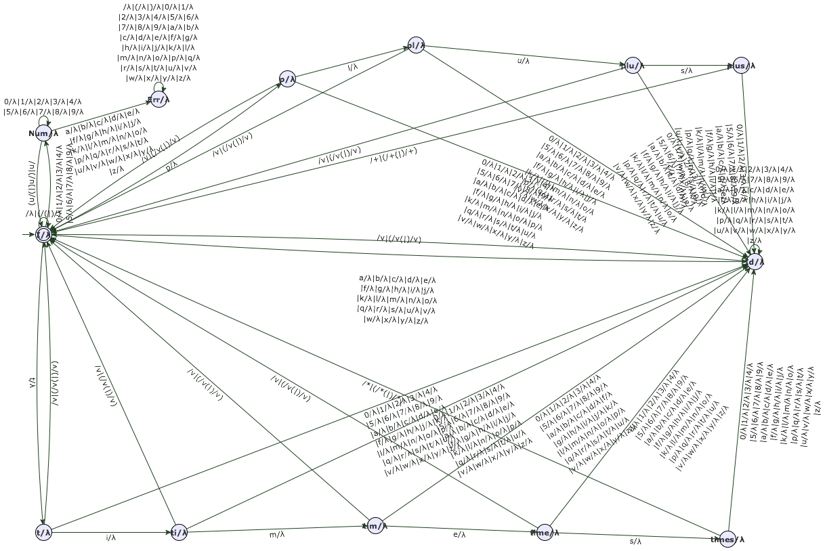
Autómata resultante

Slide 10
The next slide shows a condensed view of the transducer:
The idea is to read letters:
If you read p or t your try to complete plus or times, respectively.
Iif you manage to complete it, and then you have a space or a parenthesis, then you output + or *, respectively, if not you output v, because it is a variable name.

Slide 11
p
pl
plu
plus
l / λ
u/ λ
s/ λ
”)”/ ”v)” | ”(” / ”v(” | ” ”/ ”v”
p / λ
”)”/ ”v)” | ”(” / ”v(” | ” ”/ ”v”
”)”/ ”v)” | ”(” / ”v(” | ” ”/ ”v”
({a..z,0..9}\{s}) / λ
({a..z,0..9}/ λ
”)”/”)” | ”(”/ ”(” | ” ” / ””
”)”/ ”v)” | ”(” / ”v(” | ” ”/ ”v”
({a..z,0..9}\{l} / λ
({a..z,0..9}\{u}) / λ
I
({a..z}\{p,m}) / λ
Id
”)”/” n)” | ”(”/ ”n(” | ” ” / ”n”
”)”/ ”v)” | ”(” / ”v(” | ” ”/ ”v”
”)”/ ”v)” | ”(” / ”v(” | ” ”/ ”v”
({0..9} ) / λ
”)”/ ”v)” | ”(” / ”v(” | ” ”/ ”v”
”)”/ ”v)” | ”(” / ”v(” | ” ”/ ”v”
”)”/ ”v)” | ”(” / ”v(” | ” ”/ ”v”
”)”/ ”v)” | ”(” / ”v(” | ” ”/ ”v”
num
t / λ
({a..z,0..9}/ λ
({0..9} ) / λ
({a..z,0..9}\{e}/ λ
({a..z,0..9}\{s}/ λ
({a..z,0..9}\{m}/ λ
({a..z,0..9}\{i}/ λ
times
ti
tim
time
t
s / λ
i / λ
m/ λ
e / λ

Slide 12
Some examples
Enter an input string:
(plus (plus ee 3243 ee) 4)
The lexer did accept the string.
Token Stream: (+(+vnv)n)
----------------------------
Enter an input string:
(plus ee 33r)
The lexer did not accept the string.
----------------------------
Enter an input string:
(pluss fff 4)
The lexer did accept the string.
Token Stream: (vvn)
----------------------------
Enter an input string:

