Slide 1
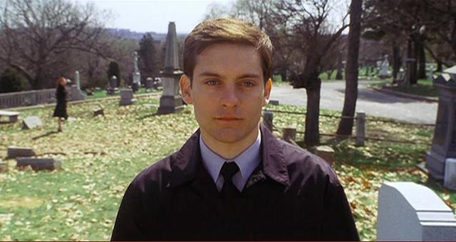
ORIGINAL PHOTO
REWORKED PHOTO

