Slide 1

Note: The data and information in this document is reflective of a hypothetical situation and client. This document is to be used for KPMG Virtual Internship purposes only.
Sprocket Central Pty Ltd
Data analytics approach
[Division Name] - [Engagement Manager], [Senior Consultant], [Junior Consultant]

Slide 2
Note: The data and information in this document is reflective of a hypothetical situation and client. This document is to be used for KPMG Virtual Internship purposes only.
Agenda
Introduction
Data Exploration
Model Development
Interpretation

Slide 3
Note: The data and information in this document is reflective of a hypothetical situation and client. This document is to be used for KPMG Virtual Internship purposes only.
Objective & Scope
Objective
To identify the set of valuable customers from a pool of customer base that should be targeted to pitch a product based on demographics and previous purchase pattern .
Scope
To develop a model that will identify the right set of customer who are likely to make a purchase in future and generate revenue for Sprocket Central Pty Ltd.

Slide 4
Note: The data and information in this document is reflective of a hypothetical situation and client. This document is to be used for KPMG Virtual Internship purposes only.
Introduction
We have been provided 3 Dataset
Transactions
Customer Demographics
Customer Address
The above 3 datasets have been combined to create a new set unique records and profit is calculated.
Profit = list_price – standard_cost.
We have based all our exploration on the basis of Profit that is to identify the set of attributes causing the maximum variability in profit for Sprocket Central Pty Ltd.

Slide 5
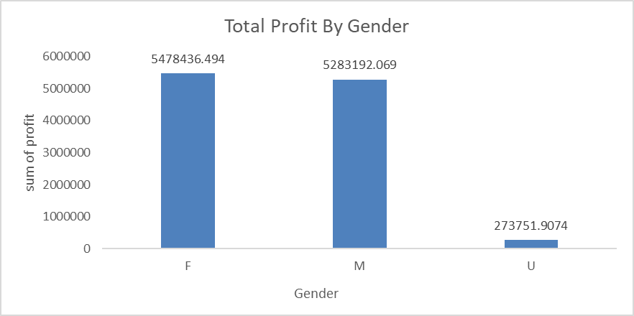
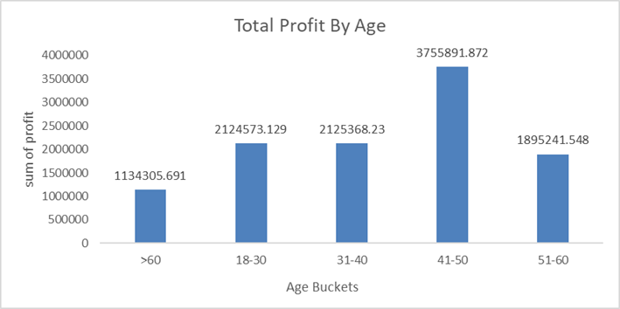
Note: The data and information in this document is reflective of a hypothetical situation and client. This document is to be used for KPMG Virtual Internship purposes only.
Data Exploration
Gender
Females contributes nearly 50% of the purchase revenue.
Male contributes approx. 48% of total purchase.
Age Buckets
Age group of 41-50 makes up 34% of the total purchase as well as contributes the same toward profit.

Slide 6
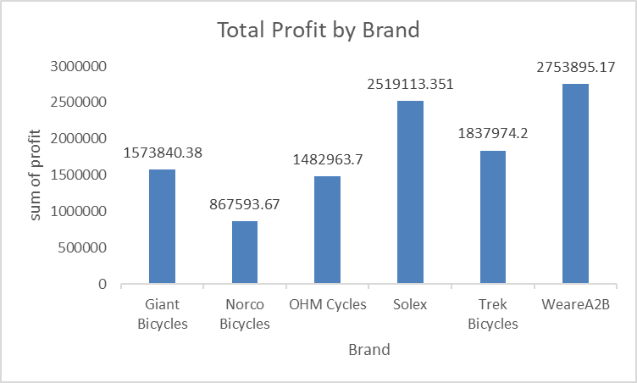
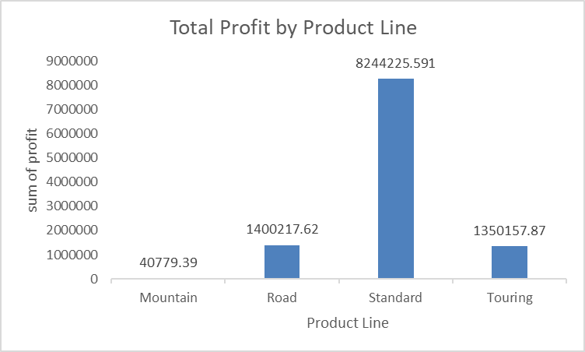
Note: The data and information in this document is reflective of a hypothetical situation and client. This document is to be used for KPMG Virtual Internship purposes only.
Data Exploration
Brand
Solex and WeareA2B are two main contributors towards profit generation for Sprocket Central Pty Ltd, contributing 22% and 25% respectively.
Product Line
Nearly 75% of the customer buy the standard of bicycle.

Slide 7
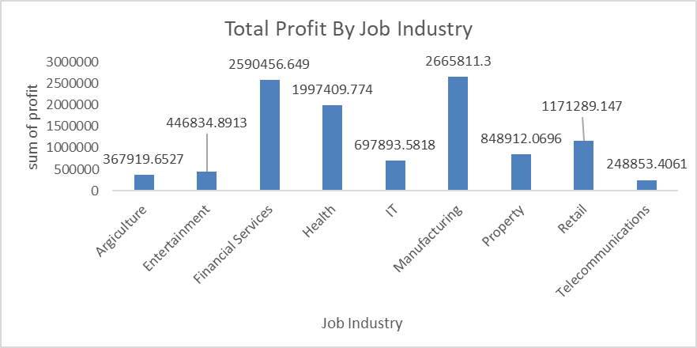
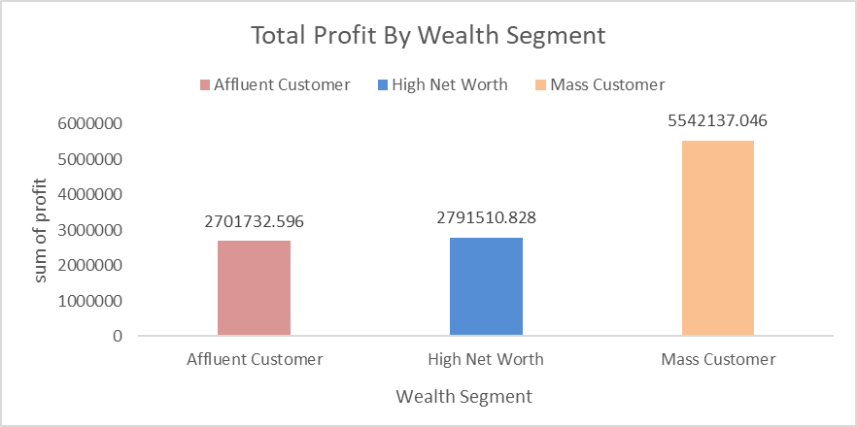
Note: The data and information in this document is reflective of a hypothetical situation and client. This document is to be used for KPMG Virtual Internship purposes only.
Data Exploration
Job Industry
Customers from Financial Services and Manufacturing both contributes nearly 24% towards profit generation for Sprocket Central Pty Ltd.
Wealth Segment
Mass Customer contributes nearly 50 % of profit generation.

Slide 8
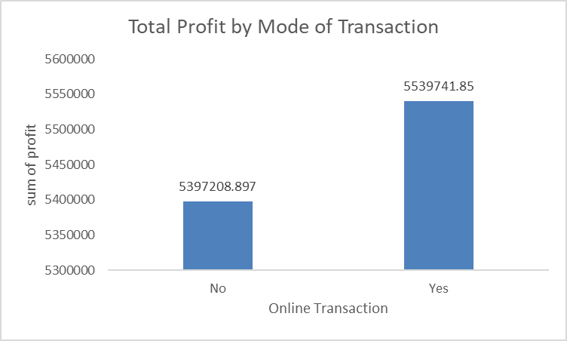
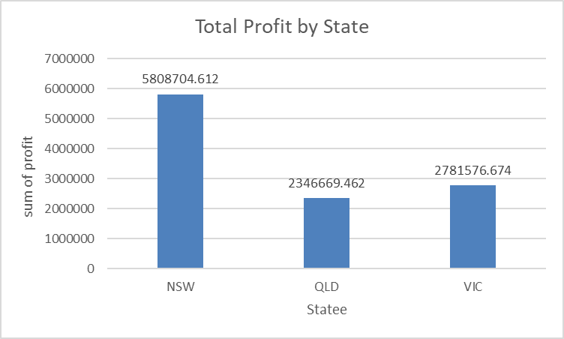
Note: The data and information in this document is reflective of a hypothetical situation and client. This document is to be used for KPMG Virtual Internship purposes only.
Data Exploration
Mode of Transaction
Online Transaction generates more profit for Sprocket Central Pty Ltd than other modes of transaction.
State
NSW contributes more than 53% out of total profits as compared to other states.

Slide 9
Note: The data and information in this document is reflective of a hypothetical situation and client. This document is to be used for KPMG Virtual Internship purposes only.
Model Development
In order to identify the potential customers, we have done segmentation/clustering based on customer demographics.
We have used Kmodes clustering to form distinct clusters in order to identify potential set of customers who are likely to purchase than those who are unlikely to purchase
Place any supporting images, graphs, data or extra text here.

Slide 10
Note: The data and information in this document is reflective of a hypothetical situation and client. This document is to be used for KPMG Virtual Internship purposes only.
Interpretation
Place headline insight or information here. This should be the most important point for this slide.
Place any information about this point here.
Place any supporting images, graphs, data or extra text here.

Slide 11
Note: The data and information in this document is reflective of a hypothetical situation and client. This document is to be used for KPMG Virtual Internship purposes only.
Appendix

