Slide 1
Stock Market
Forecasting
Presented by:
Sannan Saleem
Shumail Moen
Chris Anderson
Moein

Slide 2
Introduction and Overview
Data
Past Years’ Data on stock market value
Purpose
Provide data driven insights to consumers so they can make informed decisions
Analysis
Linear Regression
Facebook Prophet
Results
Close price and trending forecast for future close prices of selected stocks

Slide 3




Purpose
Facebook Prophet (additive regression) used to analyze the present data in forecasting stock market closing prices using past closing prices as a benchmark.
Statistical machine learning models were run to observe the trends in stock closing prices.
Tools used: AWS, Python, Facebook Prophet.

Slide 4
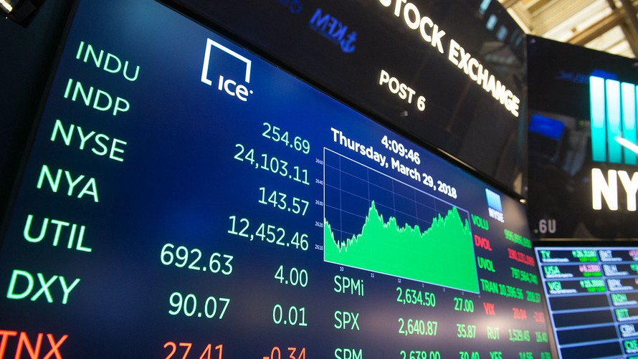
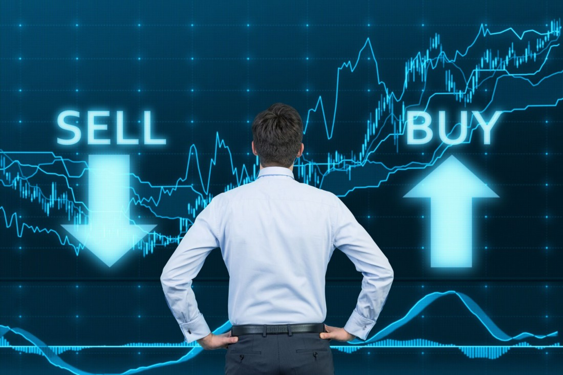
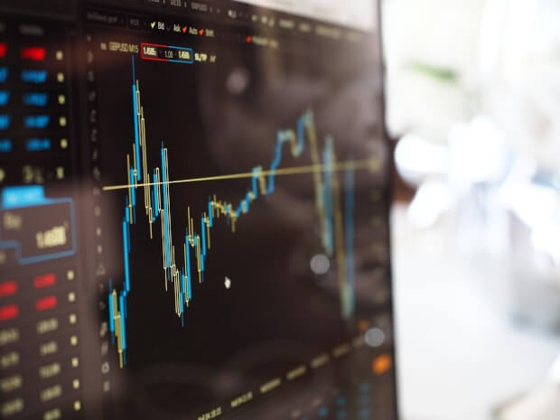
Questions we aim to answer
Forecast
To Forecast the close prices of stock data given past trends.
Decisions
Data driven decisions based on past data trends
Snapshot
Preview accurate trend of stock data in the near future

Slide 5
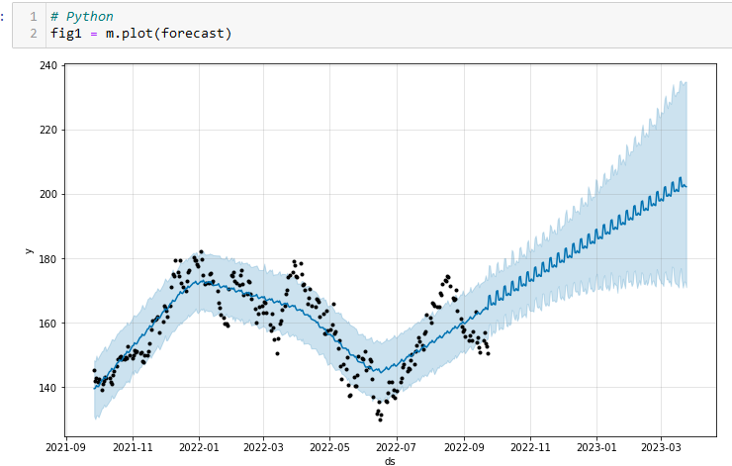
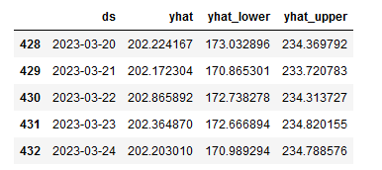
Machine Learning Model
Facebook Prophet (additive regression) was used alongside Python for the implementation.
Predictions are made on a dataframe with the column ‘ds’ containing the dates for which a prediction is to be made. Our dataframe extends into the future for 182 days using the helper method.
Using the predict method we assigned each row in future a predicted value which it named ‘yhat’ for Price, ‘yhat_Lower’ for lowest price for that date (ds), ‘yhat_upper’ for high price for that date.

Slide 6

Description of Source Data
Our stock market data is collected using Microsoft Excel with the ‘STOCKHISTORY’ function.
The STOCKHISTORY function retrieves historical financial data and loads it as an array. Using Excel as a tool, Excel dynamically created the appropriate sized array range for our values.

Slide 7
Description of Analysis Phase
Our framework relies on the following values:
Date
Opening Price
Closing Price
Lowest Price
Highest Price
Volume
Using additive Regression and Facebook Prophet as our framework. The goal is to focus on determining the Closing Price in a trending forecast based off of our values for future close prices of selected stocks.

Slide 8
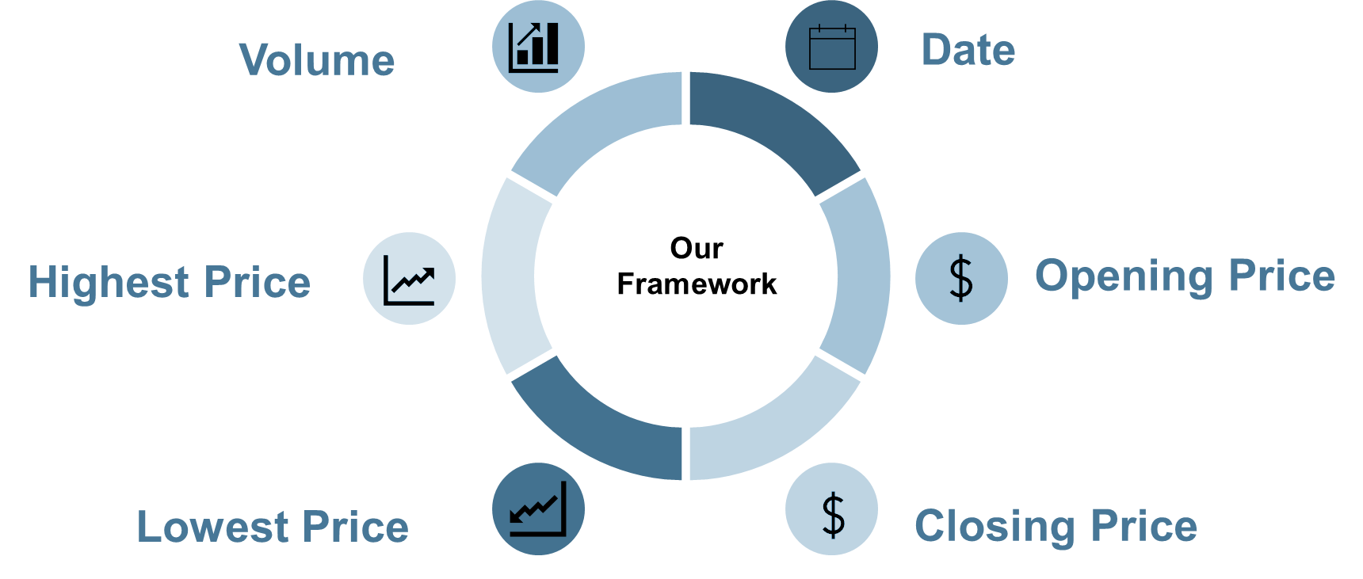
Description of Analysis Phase
Using additive Regression and Facebook Prophet as our framework. The goal is to focus on determining the Closing Price in a trending forecast based off of our values for future close prices of selected stocks.

Slide 9

Technology Used

Slide 10
Recommendation for future analysis
Modeling other stocks
Future analysis could include fitting the model on more or less volatile stocks
Flexibility of use
Pipeline
While facebook profit is very simple to use, it does offer a high level of customisation that we werent properly able to delve into
Future analysis may make use of a pipeline to automate the retrieval and run time processing of the model to visualize ad display updates on a weekly/monthly/yearly basis

Slide 11
What could we have done differently
1
3
Our initial analysis on what tools/frameworks we wanted to use should have been cemented within our plan.
Manually going through each training model to decide the differences (pros/cons) of each
2
4
Implementing the graphics produced by facebook prophet and plotly to create a dashboard using live data
Defining more detailed parameters within the facebook prophet model

