Slide 1

Neural ODEs and Runge Kutta methods
MA8404 – Autumn 2023

Slide 2
The Vanishing Gradient Problem
Gradients of the loss function becomes extremely small when backpropagating in the training process.
Highly dependent on activation functions, like sigmoid and tanh.
Stacking -> Problem happens in each layer -> the gradients vanish!
Example: n hidden layers –> n derivatives multiplied together –> gradient decreases exponentially as we backpropagate through the neural network.

Slide 3
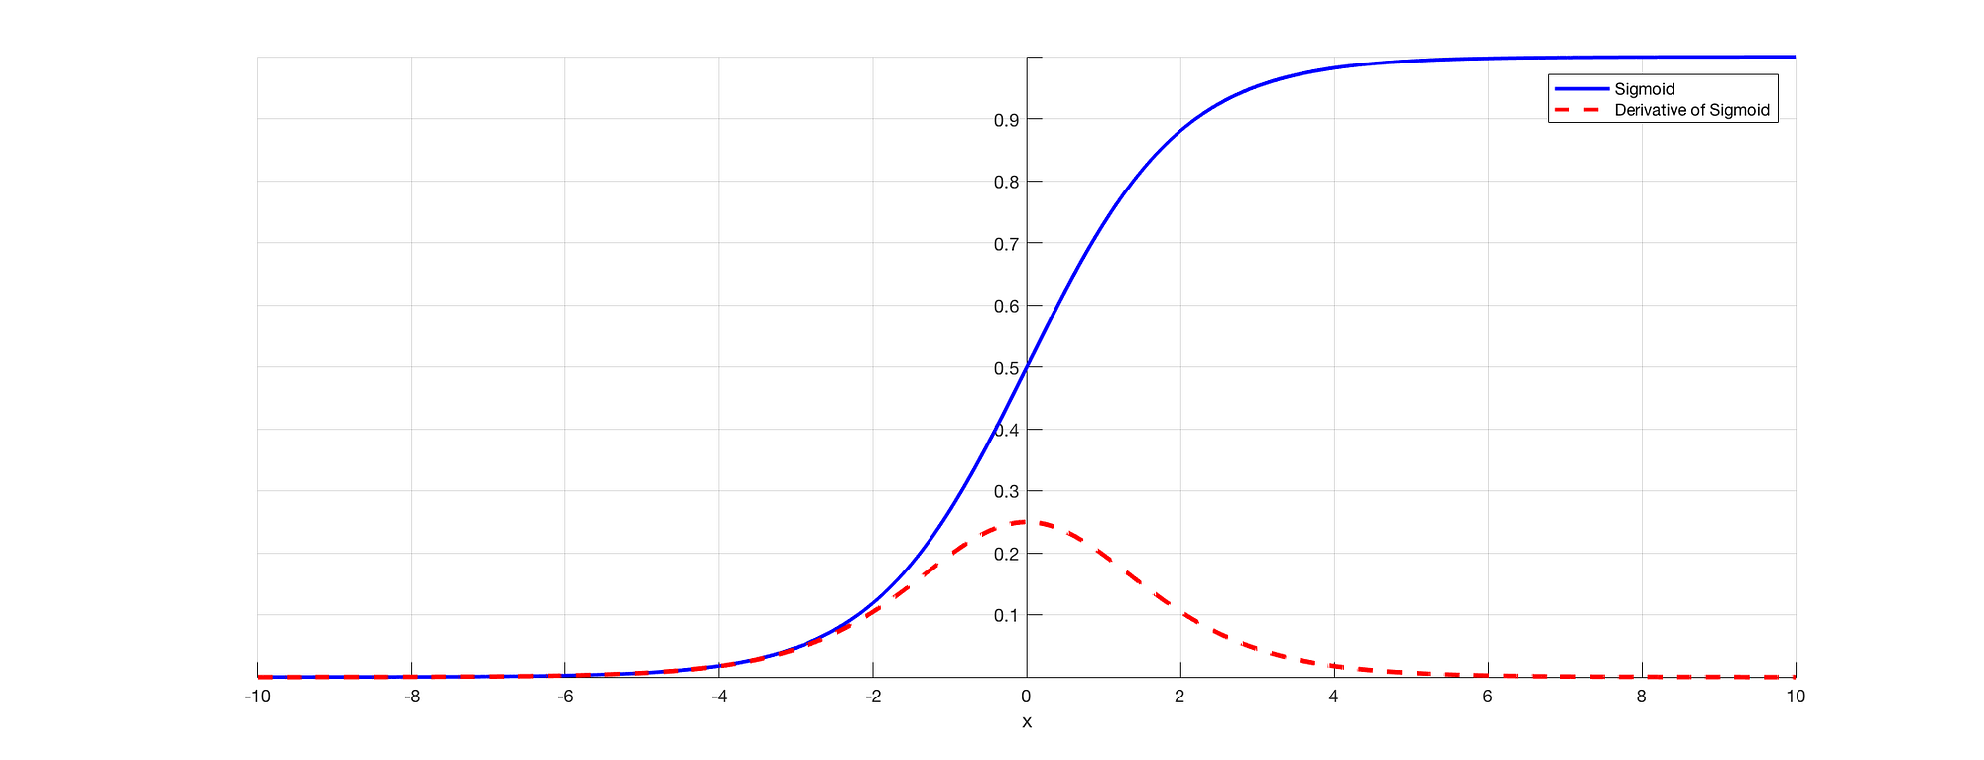
Example
Sigmoid and Tanh squishes large input between 0 and 1. Thus, a large change in the input causes a small change in the output -> small derivative…

Slide 4


Residual Neural Networks (ResNets)
Solves the vanishing gradient problem
Skip connections -> Gradients flow easily through network
The update in each layer looks like discretized Euler with h = 1!
What if we switched it out with a different Explicit Runge Kutta method?

Slide 5
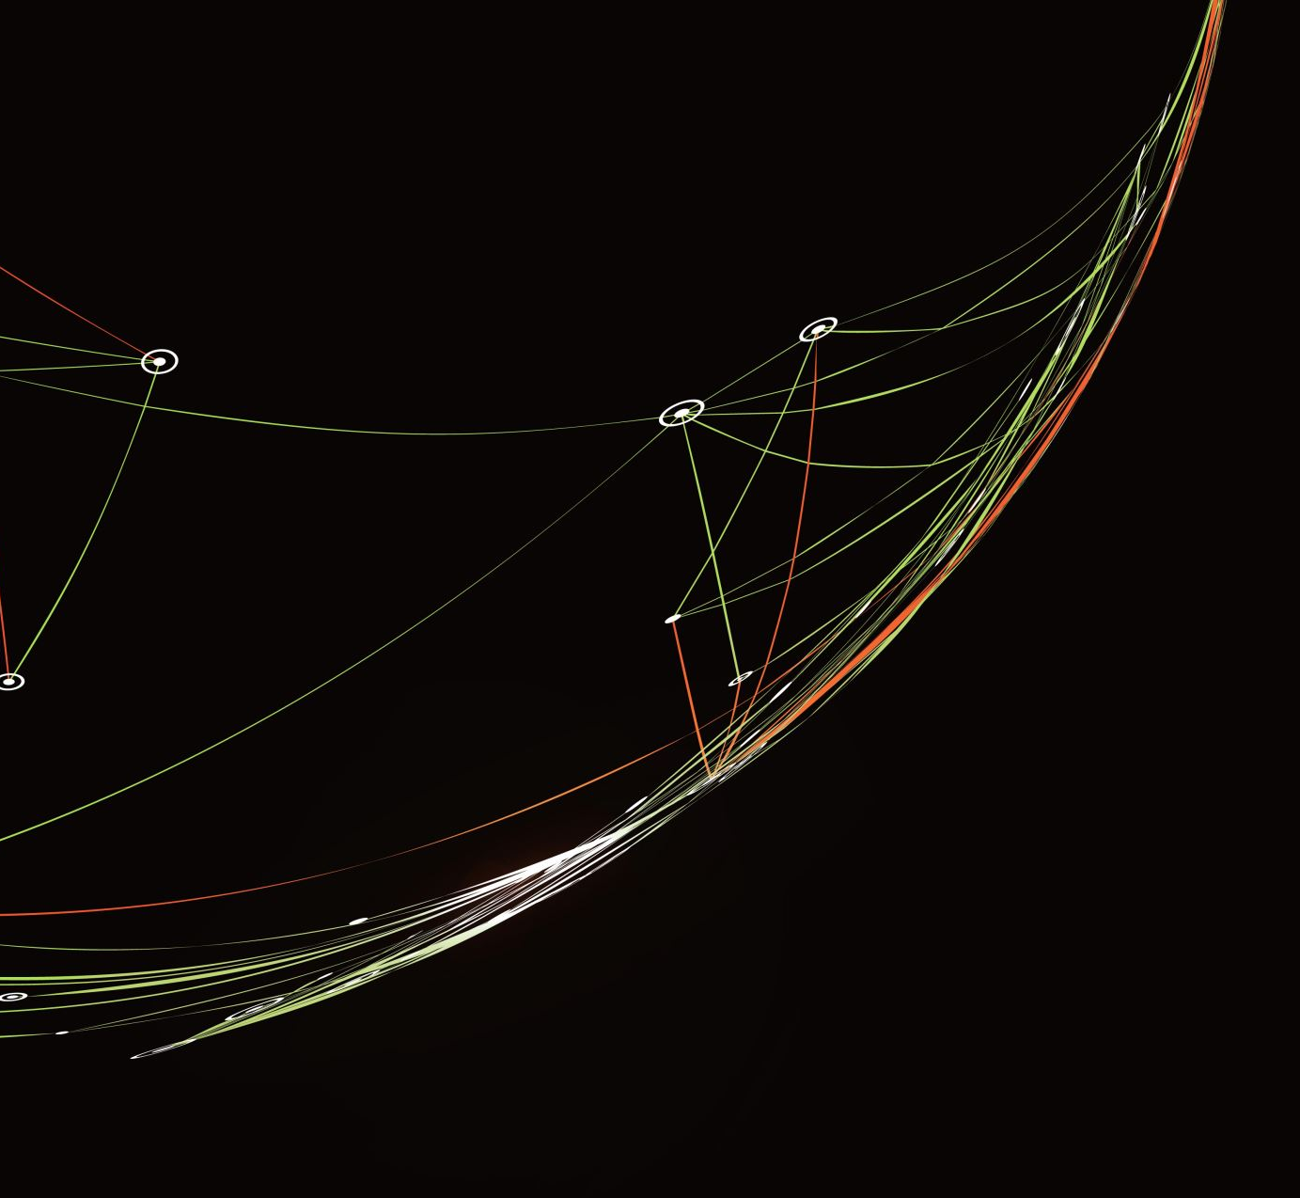
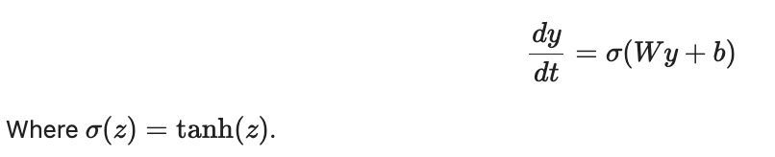
Neural ODEs
Defines the dynamics of the network continously using ODEs
Forward pass is an initial value problem
Can capture continous time begavior and model complex data
Models transformation within each layer of a ResNet

Slide 6
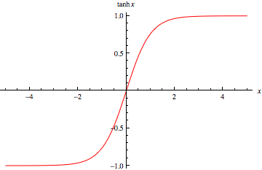
Why tanh?
Zero-centered
Smooth and continous -> differentiable, stable and predictable gradients during training.
Non-Linear –> Enable NNs to learn complex and non-linear relationships in the data.

Slide 7
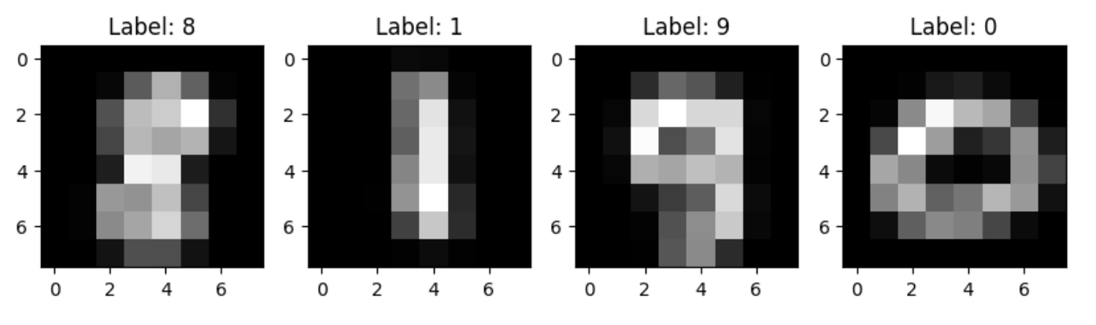
The Data
MNIST Dataset (torch library)
Handwritten digits (with label)
Only looking at 8x8 pixels. (Reduce computational cost + same size for every datapoint)
Shuffled -> Avoid overfitting if there is a fixed order

Slide 8
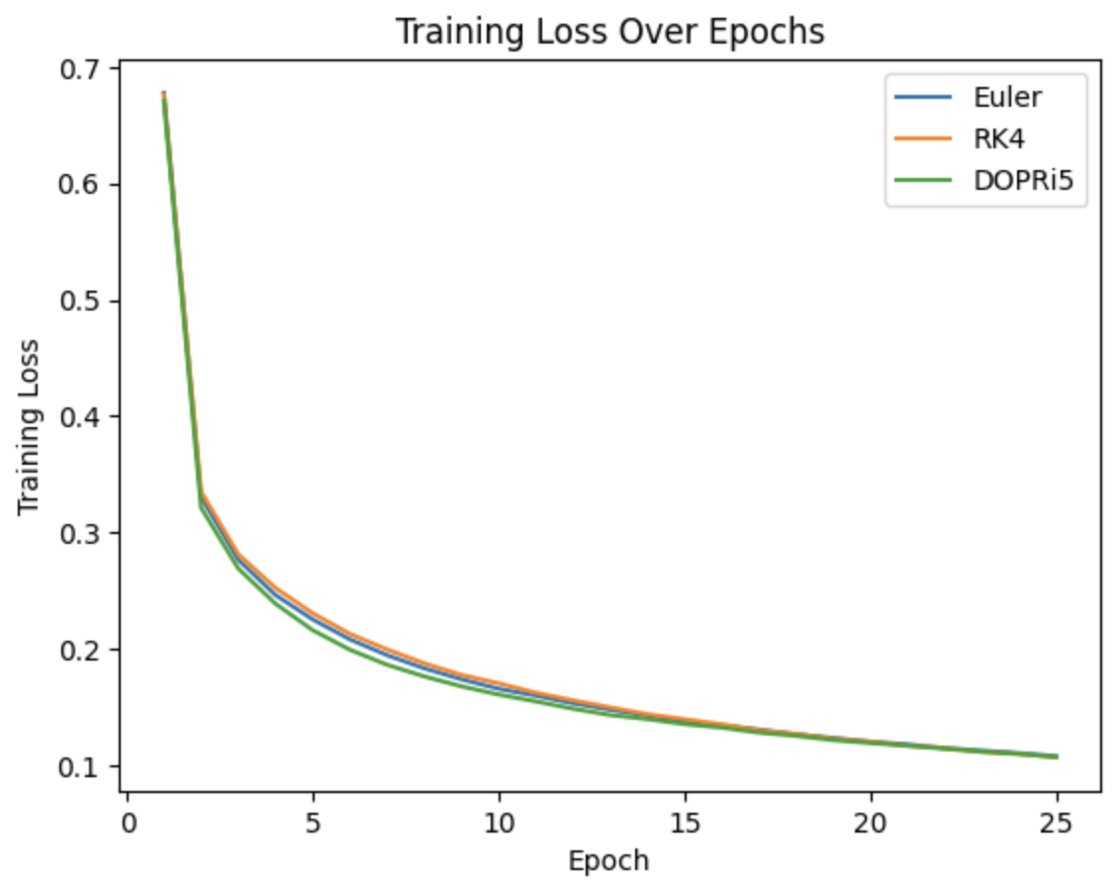
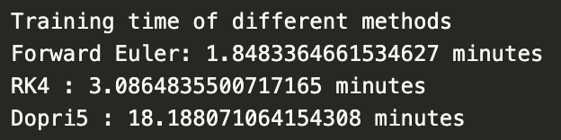
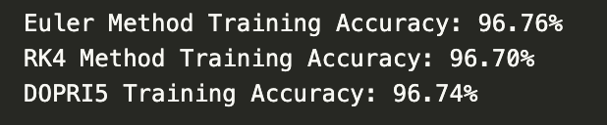
Training Results
Training time and accuracy
Loss over epochs

Slide 9
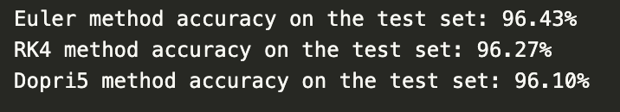
Testing Results
Very similar accuracy
Euler method performed the best!

Slide 10
Conclusion
Higher order Runge-Kutta methods resulted in a significantly longer training time.
Higher order Runge-Kutta methods does not necessarily produce more accurate predictions.
However, our data was rather simple. Maybe higher order Runge-Kutta methods are better for more complex data?

