Slide 1
Basis of frequency analysis Important concepts for EEG application
M-BIC: Disclosing fine-grained temporal processing: Common and advanced analysis of EEG time-series
Sanne ten Oever

Slide 2
Outline:
Fourier analysis
Basis
Tapering
Assumptions
Fourier for interpretation of EEG data
Evoked power, induced power, ITC

Slide 3
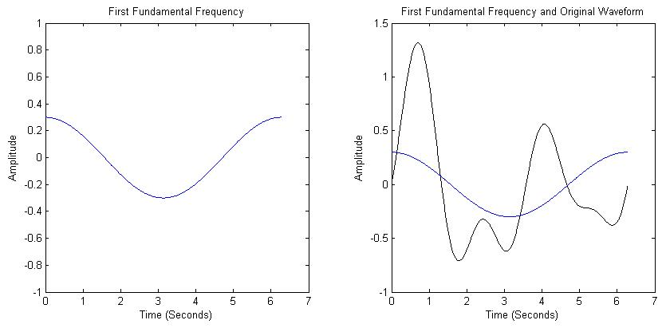
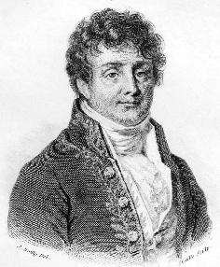
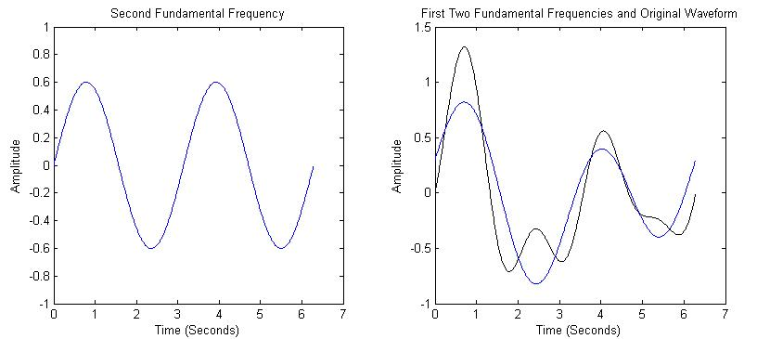
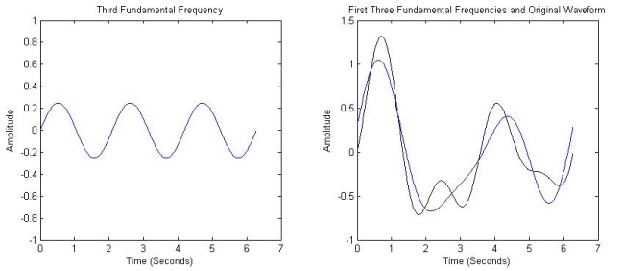
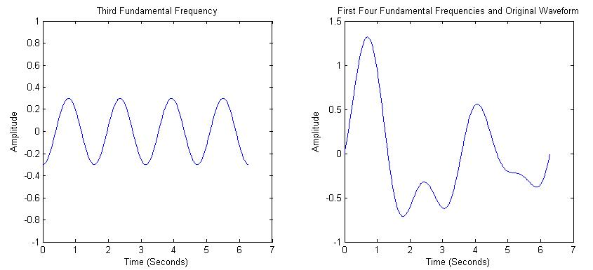
Fourier
Joseph Fourier (18th C.)
One of the Fundamental Secrets of the Universe
"All waveforms, no matter what you scribble or observe in the universe, are actually just the sum of simple sinusoids of different frequencies"

Slide 4
EEG is sampled data (compared to continuous data), thus we work with discrete Fourier transforms
Which can be computed fast with fast fourier transforms (FFT)
Most optimal at 2^n
Notes:
https://jakevdp.github.io/blog/2013/08/28/understanding-the-fft/

Slide 5
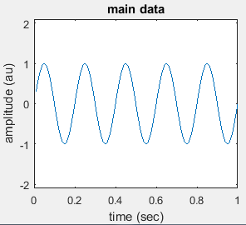
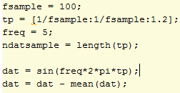
Basis of Fourier: explained via covariation of sine and cosine
Some data:
100 Hz sample rate
1 sec
5 Hz
Noise added
Demeaned

Slide 6
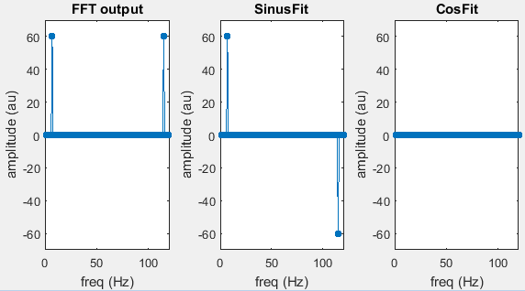

Matlab FFT

Slide 7
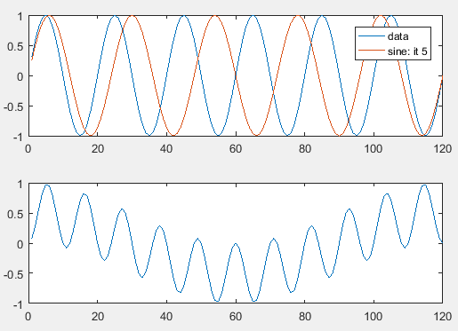

= 0

Slide 8
Matlab FFT

Slide 9
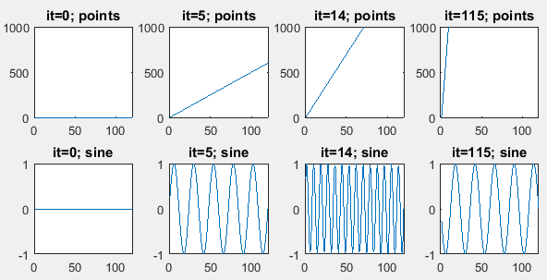
Amount of points in freq axis
Notes:
600/120 = 5 cycle for it = 5.

Slide 10
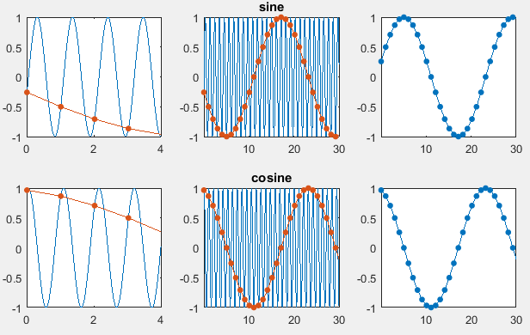
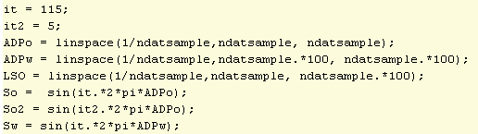
“aliasing” in the FFT

Slide 11

All frequencies are captured in half of the spectrum
Still to transform to Hertz, now in data units, not time.
In other words:
Amount of frequencies estimated: Nsamples/2+1
Frequency resolution: 1/LengthTimeWindow

Slide 12
Matlab FFT

Slide 13
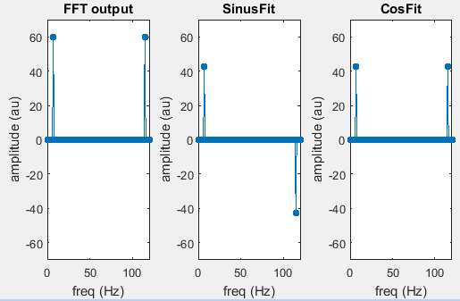
Notes:
+ 0.25 pi

Slide 14
Get full spectrum

Slide 15
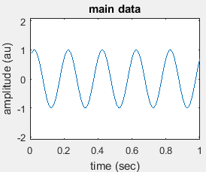
Sin and cosine together make phase
vs
100% sin
50% sin
50% cos

Slide 16
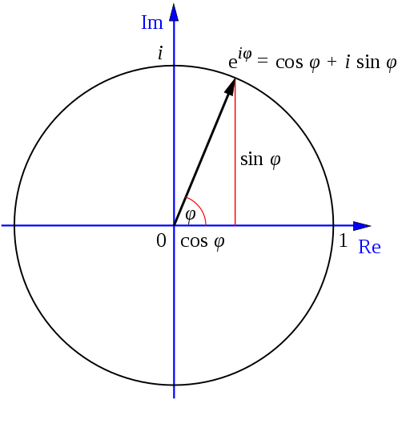
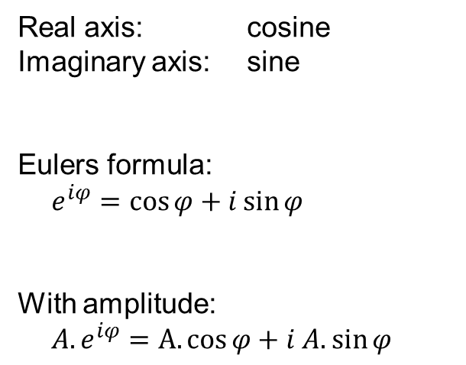
Complex Fourier spectrum
Real axis: cosine
Imaginary axis: sine
Eulers formula:
$e^{iφ}=\cos{φ}+i\sin{φ}$
With amplitude:
${A.e}^{iφ}$ $=A.cos{φ}+i A.\sin{φ}$

Slide 17
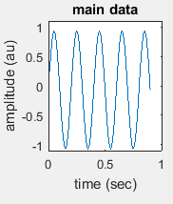
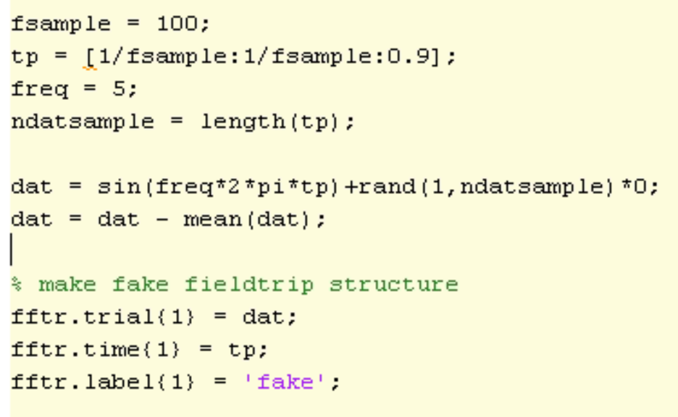
Full story of toolbox FFTs?
100 Hz sample rate
0.9 sec
5 Hz
Demeaned
In fieldtrip structure

Slide 18
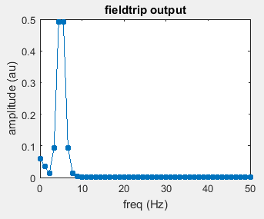

Fieldtrip FFT
Ask for method mtmfft: fft
Output power
Taper: later
pow = (amp).^2
amp = sqrt(pow)

Slide 19
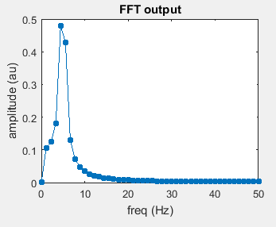

Matlab FFT
Function: fft
Normalized
Get amplitude.
Function abs
Notes:
Frobenius normalization = square root of the sum of the absolute squares of its elements
Code: A/sqrt(sum((A.^2))

Slide 20
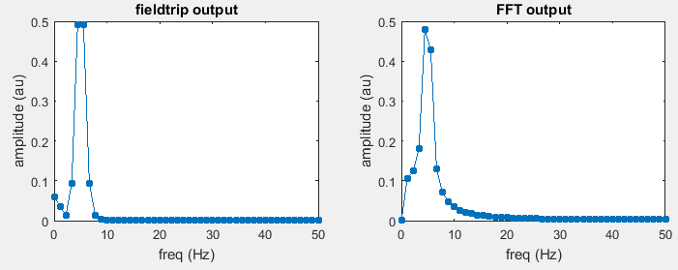
Fieldtrip output seems more narrow

Slide 21
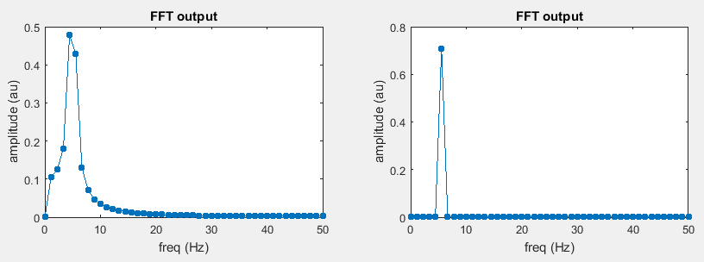
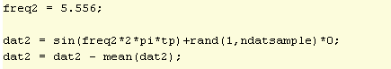
Spectral leakage
5 Hz
5.6 Hz

Slide 22
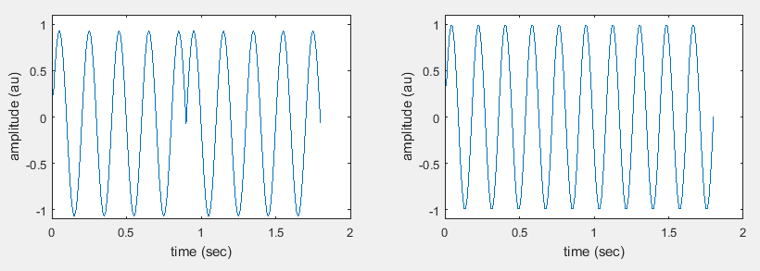
Periodic assumption
5 Hz
5.6 Hz

Slide 23
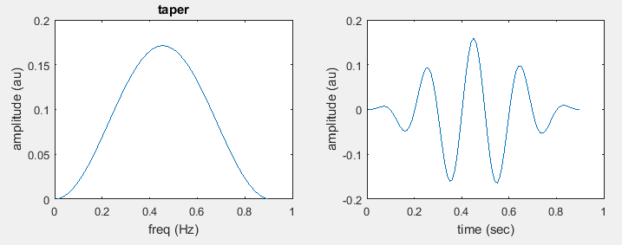

“Solution”: Tapering

Slide 24
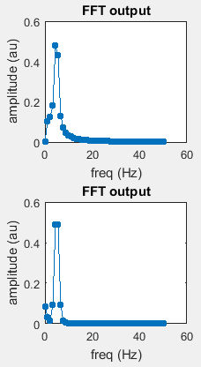
Before tapering
After tapering

Slide 25
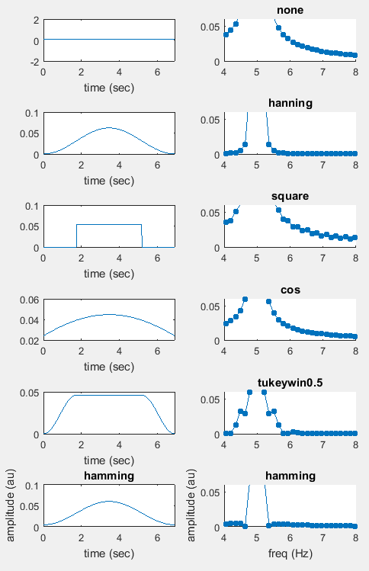
Different kinds of tapers

Slide 26
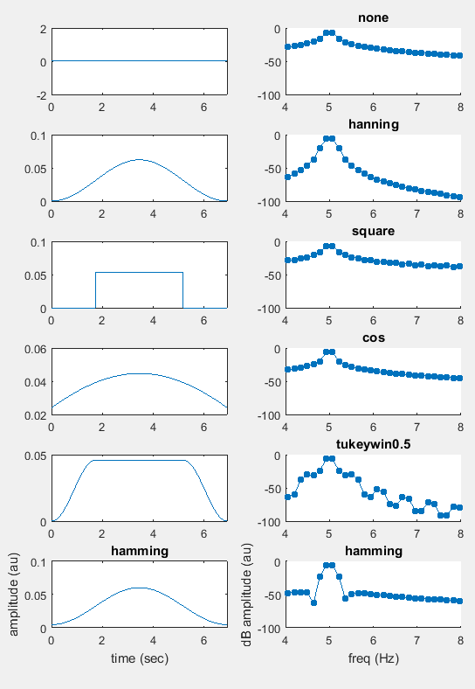
Different kinds of tapers (dB)
Narrowing down + leakage at wider range

Slide 27
Most EEG applications prefer leakage around the frequency of interest than wider band leakage
Hanning

Slide 28
Multi-tapering
Reduce noise by estimate power at different independent instances

Slide 29
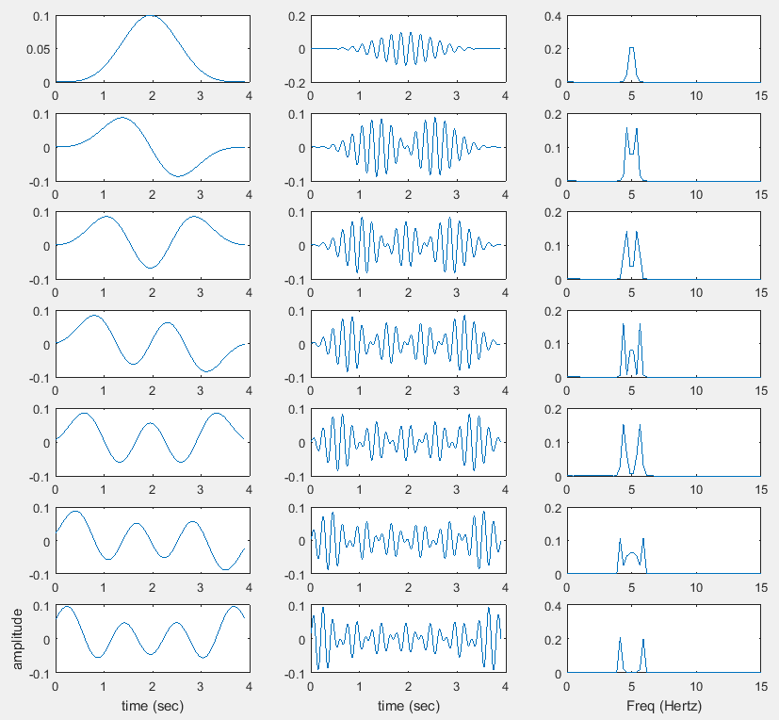
Notes:
discrete prolate spheroidal sequence: max suppressed sidelobes (Hanning like).

Slide 30
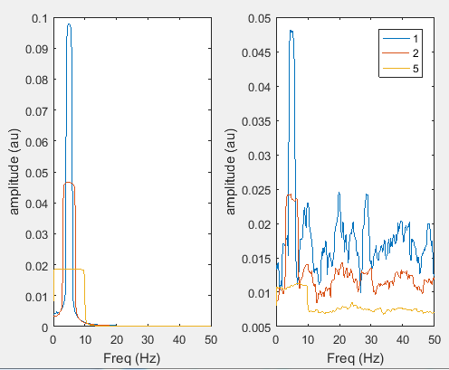
Multi-tapering
Notes:
More tapers for higher smoothing. Exact taper amount then depends again on width of the time window (as that is related to the frequency resolution).

Slide 31
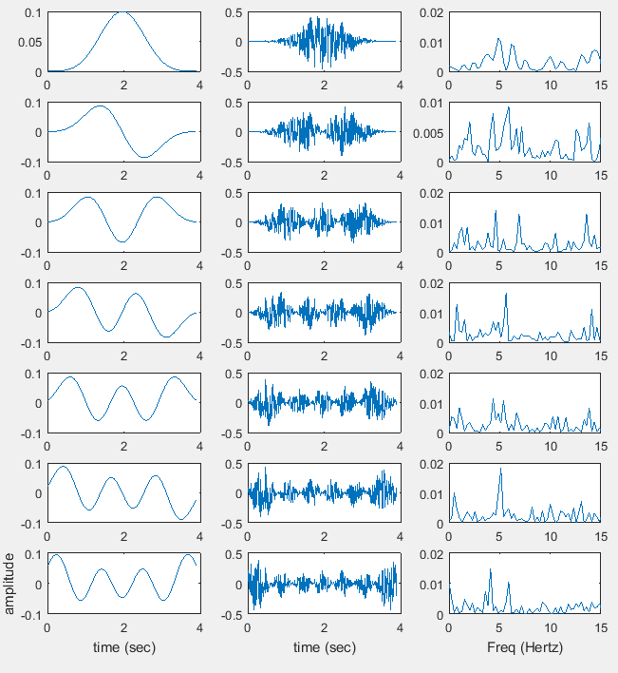

Slide 32
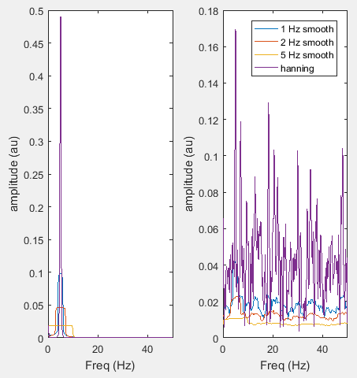
Dpss vs Hanning
Note: dpss without smoothing (at frequency resolution, 1 taper) is equal to Hanning

Slide 33
“All waveforms, no matter what you scribble or observe in the universe, are actually just the sum of simple sinusoids of different frequencies”
The world only consist of sinuses?
No!
Just another mathematical description of your data.

Slide 34
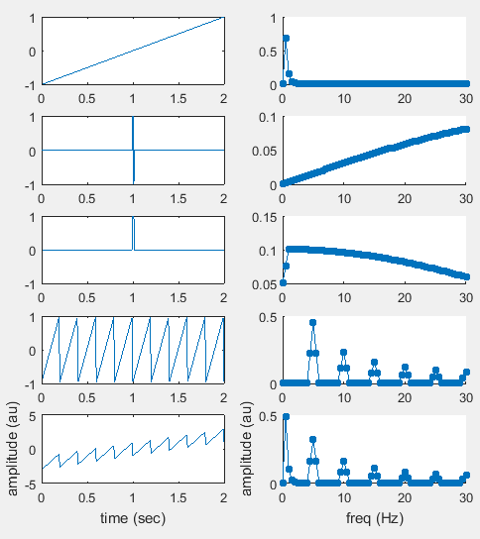
Some non-sinus Fourier output
Hanning taper

Slide 35
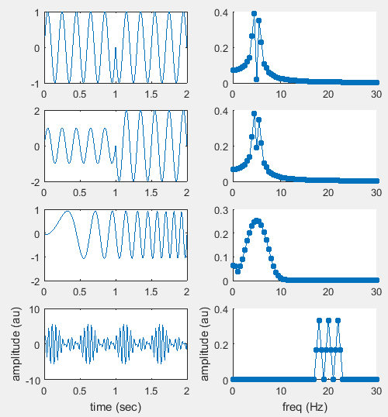
Some other sinus-like data
Hanning taper

Slide 36
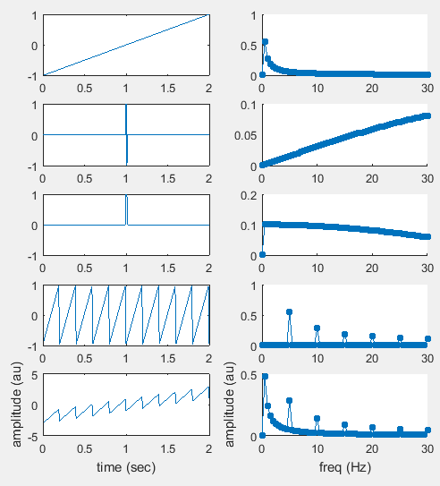
Some non-sinus Fourier output
no taper

Slide 37
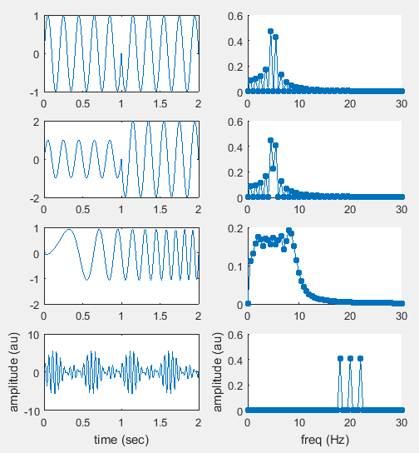
Some other sinus-like data
No taper

Slide 38
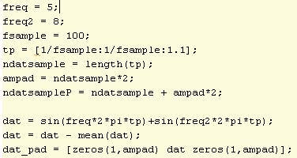
Padding
Frequency resolution: 1/LengthTimeWindow
Why not just increase our time window by adding zeros!

Slide 39
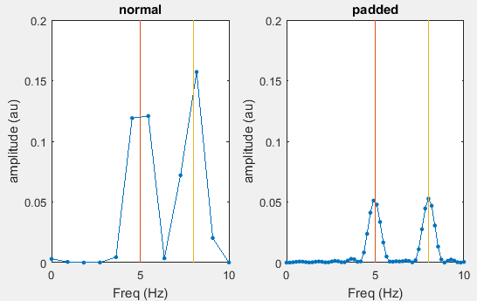

Slide 40
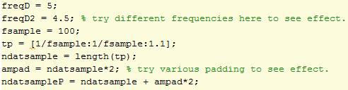
Padding

Slide 41
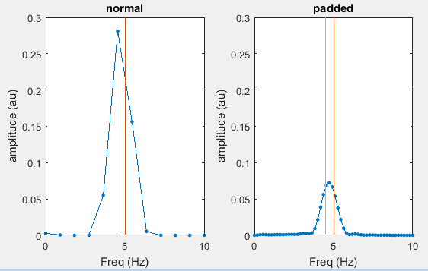

Slide 42
To the other side: phase.
Power: abs(complexFourier).^2
Phase: angle(complexFourier)

Slide 43
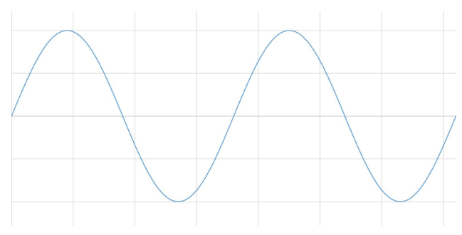
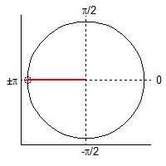
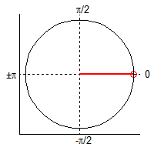
Circular data: point estimate, but need time integration
@ convention of matlab.
Notes:
In other applications peak is 0.5pi

Slide 44
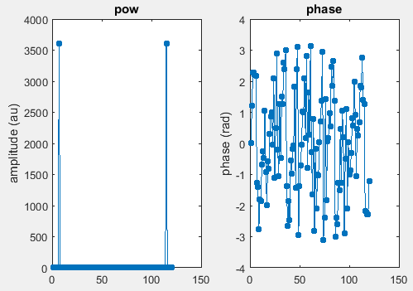

Slide 45
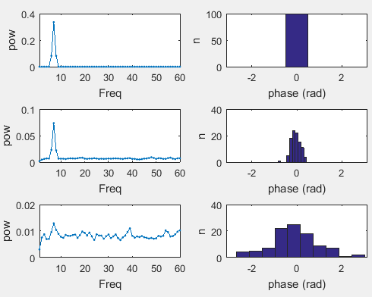
Reliability of phase estimation

Slide 46
Interpreting absolute EEG phase
Summation of many currents
Difficult to interpret it as depolarized/hyperpolarized
Might be consistent within a subject, but not over a subjects

Slide 47
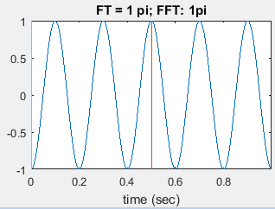
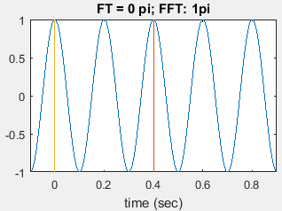
Important note:
Normal FFT estimates phase for the whole window > so at the middle point
Fieldtrip adjusts this FFT phase by the phase distance of data point 1 with time 0.
Why? no idea.
Notes:
determine phase-shift so that for all frequencies angle(t=0) = 0 (line 216 of ft_specest_mtmfft)

Slide 48
What should you take from this when you do your EEG Fourier
Your frequency resolution depends on the window length you put in the FFT.
You cannot distinguish theta from alpha with short window lengths (even with padding)
You cannot estimate high frequencies with a low sampling rate
Gamma needs higher sampling rates
There will always be some spectral leakage
Be cautious with interpreting nearby frequencies
Non-period signals also give a non-zero power spectrum.
Not everything is an oscillation! Look at your spectrum and do not only extract specific bands.
Phase cannot be interpreted well at very low power
Is your signal really periodic at the frequency of interest?
Time-frequency analysis

Slide 49
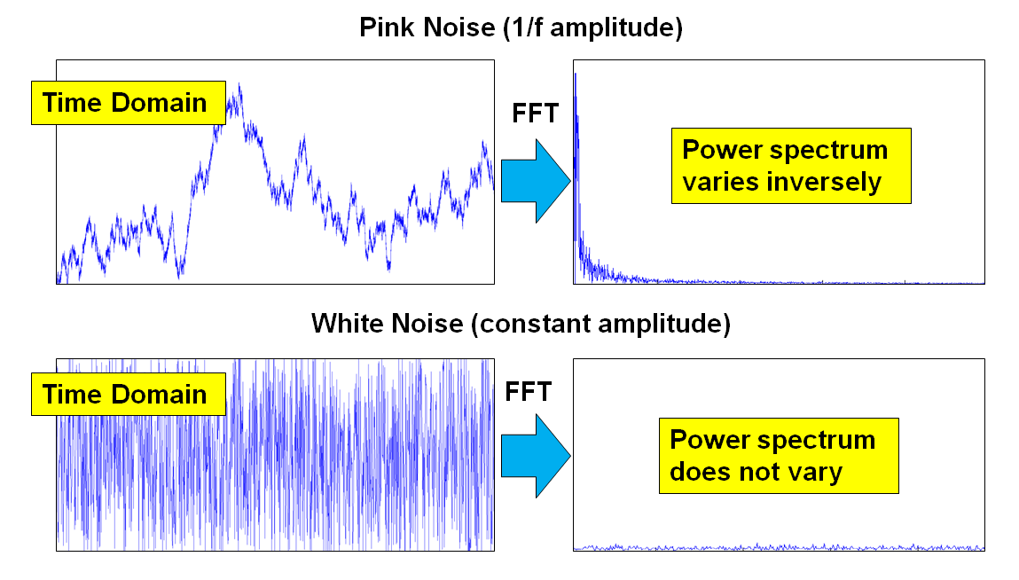
More real data

Slide 50
How to deal with this:
Transform
decibels
Baseline
Conditions
Remove 1/f trend trough fitting
Might be a signal though! (Voytek et al., 2015)

Slide 51
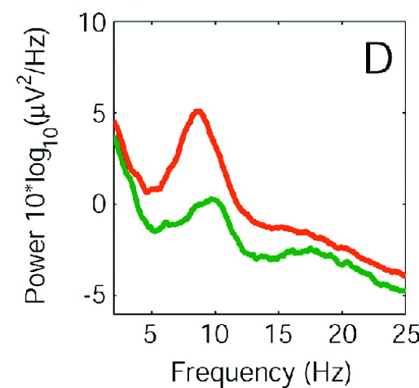
Example: eyes open/eyes closed

Slide 52
Most typical measures with EEG
Evoked power
Induced power
Inter-trial coherence

Slide 53
Evoked power
Power of your ERP
Single FFT estimation per condition per participant.
Phase locked power only

Slide 54
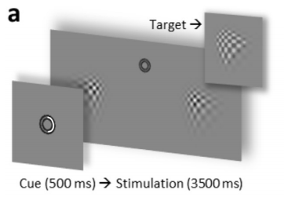

Evoked power - SSVEP
Keitel et al., 2017
Notes:
Keitel, 2017;

Slide 55
Induced power
Estimate power for individual trials
Average the power spectra
Phase and non-phase locked estimates

Slide 56


Induced power: alpha power
Heagens et al., 2011
Notes:
Heagens et al., 2011

Slide 57
Inter-trial coherence
Phase consistency over trials
Careful with in interpreting when differences in induced power.
Lower power, more noisy phase estimate > lower ITC
But could provide interesting additional information

Slide 58

ITC – sensory entrainment
Ten Oever et al., 2017
Notes:
Ten Oever et al., 2017

Slide 59


Slide 60
Very useful to have a deeper understanding of what you are doing with your data
Be careful interpreting your effect
Unpredictable responses could occur
Always look at the full spectrum!
Always look at the raw data and ERPs

Slide 61
Thank you for listening

