Slide 1
DESIGN AND IMPLEMENTATION OF A WEB APPLICATION FOR AN E-LEARNING PLATFORM SANNI OPEYEMI MOSHOOD MATRIC NUMBER: 180591052

Slide 2
TABLE OF CONTENTS
01
02
03
04
05
06
INTRODUCTION
LESSONS
ACTIVITIES
Describe the topic of the section here
Describe the topic of the section here
Describe the topic of the section here
RESOURCES
PROCESS
OUR TEAM
Describe the topic of the section here
Describe the topic of the section here
Describe the topic of the section here

Slide 3
CHAPTER ONE INTRODUCTION
BACKGROUND OF THE STUDY
E-Learning is a form of learning that uses electronic media, usually the Internet.
E-Learning is convenient in time and place, with 60% of internet users engaged in online learning (Rungta, K. 2022).
With over 5 billion internet users worldwide, e-learning has become a popular method of education.
The principles behind e-learning have existed since the 19th century, with the first e-learning system established in the 1970s.
The Open University in the UK used e-learning to offer a wider range of interactive educational experiences and faster communication with students.
E-Learning has even evolved to include 3D virtual environments, offering students a unique educational experience.

Slide 4
STATEMENT OF THE PROBLEM
Students face setbacks due to teaching methods and environmental factors
Inadequate learning environments can hinder learning and focus
Some schools struggle to provide adequate teaching structures for large student populations.
COVID-19 pandemic has led to the adoption of online home-schooling using e-learning tools

Slide 5
AIM AND OBJECTIVES
The aim of this research is to develop a web-based e-learning platform that provides students with a comprehensive and interactive learning experience in computer science courses.
The objectives of this study are:
Do a literature review on existing literature, books, articles, websites, and projects on e-learning.
Design and Implementation of a model for an e-learning platform where learning takes place.
Testing and evaluation of the e-learning application for its functionality.
To provide an alternative means of acquiring education in addition to traditional learning methods.

Slide 6
SCOPE OF THE STUDY This study is focused on developing a web-based E-learning platform for students of Lagos State University (LASU) in the field of computer science.
GENERAL LIMITATIONS OF E-LEARNING PLATFORMS
Adaptable platform required for changing circumstances
Limited availability of certain courses
Creating and managing content can be challenging
Limited accessibility features for students with disabilities
Replicating classroom interactions can be difficult
Requires a robust infrastructure for multiple users.

Slide 7
Chapter 2 LITERATURE REVIEW
Overview:
E-Learning goes by many names and is essential in improving competitiveness globally
Open learning is a crucial quality for e-learning platforms (H. Fasihuddin, et al., 2017),
The Internet supports open learning due to its flexibility in location, device, and time
E-Learning is a flexible and accessible way to learn
E-Learning platforms should focus on creating an open and distributed learning environment
E-Learning features support learning and must be well-integrated into the design of the program
Features:
A well-designed e-learning program includes many features that support learning
The three main focuses when designing e-learning are open and flexible distributed learning environments
E-learning features include interactivity, learner control, convenience, ease of use, online support, course security, and many more
E-learning provides convenience, learner control, ease of use, access to multiple expertise, and online support
Key Takeaways:

Slide 8
Approaches to E-Learning:
Synchronous learning: real-time interaction between students and instructors, examples include video conferencing and instant messaging systems.
Asynchronous learning: students access course materials and complete assignments on their own schedule, examples include email and discussion forums.
Hybrid learning: a combination of both approaches (Amiti, F. 2020).
Differences between Asynchronous and Synchronous Learning:
Synchronous learning is real-time, while asynchronous learning is not.
Synchronous learning is more engaging and interactive, while asynchronous learning is more flexible and convenient.
The choice between them depends on the individual student and course requirements.

Slide 9
E-Learning and Instructional Design
E-Learning requires both design and development
Design involves decision making, creativity, and affects project outcomes
Instructional design involves selecting, organizing, and specifying learning experiences
Good instructional design is independent of technology or people involved
Poor or non-existent instructional design is a common reason for e-learning project failure
Common instructional design errors include teaching too much, failing to teach what people really need, omitting supporting objectives, teaching what is easy instead of necessary, boring and frustrating learners, and forcing awkward learning styles
While some claim their methodology guarantees successful learning, outcomes involving more than a few people cannot be guaranteed.

Slide 10
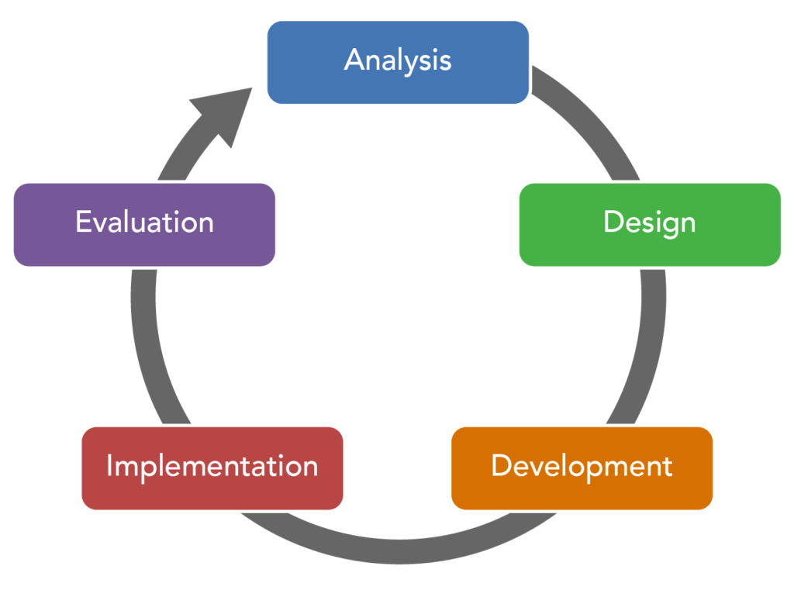
The ADDIE Model for Effective Training Materials
The ADDIE model is a five-stage process for designing and developing instruction.
It is the most popularly used instructional design model.
The five stages are Analyze, Design, Develop, Implementation, and Evaluate.
Analyze: Understand goals, objectives, requirements, needs, skills, and knowledge of learners.
Design: Identify learning objectives and outcomes.
Develop: Create a teaching strategy to help learners achieve their goals.
Implementation: Try out training programs with learners.
Evaluate: Measure success of the training material and note what needs to be changed.

Slide 11
Learning Management System (LMS)
LMS is widely used in businesses with the global market expected to reach $23.21 billion by 2023.
Recent studies indicate increasing LMS use (73% of respondents).
LMS offers interactive features such as discussion boards, video conferencing, and threaded discussions.
LMS is a system designed to facilitate training and development and provides an online classroom.
LMS is also used for extended enterprise training (e.g., customer training) to improve interaction and satisfaction.
LMS can be referred to as a course management system (CMS) or virtual learning environment (VLE).
LMS features include course management, administration, learning access, tracking and reporting, collaboration tools, and personal learning spaces.
Popular LMS options include Moodle, Adobe Captivate Prime, Blackboard Learn, TalentLMS, and eFront.
LMS can be used for creating and delivering online courses, tracking employee performance, facilitating communication and collaboration, selling online courses, and organizing e-learning content.
LMS is simple, easy to use, accessible from anywhere, offers interactive learning and creates a collaborative environment while being secure and reliable.
The different types of LMS deployment options are cloud-based LMS, self-hosted LMS, desktop application LMS, and mobile application LMS.

Slide 12
Slide 1: Introduction
E-learning has grown in recent years but not fully utilized due to lack of acceptance by schools and users
Understanding factors affecting user acceptance is crucial for enhancing students’ learning experience
Slide 2: Challenges of E-Learning
E-learning not suitable for all pedagogies
Users’ perception, knowledge, and skills in computer usage affect implementation
Slide 3: Technology Acceptance Model (TAM)
TAM shows how users accept technology
TAM used to measure students’ acceptance of e-learning platforms
Perceived usefulness has a stronger effect on intention to use than perceived enjoyment or ease of use
Slide 4: SAPANA PATEL’S E-LEARNING SYSTEM
Patel et al. (2018) developed an e-learning system using instructional design framework (ADDIE)
Three modules were designed for supported employment for community behavioral health treatment programs
Learners rated the modules positively and demonstrated high knowledge acquisition

Slide 13
Slide 5: DEBATTISTA’S COMPREHENSIVE RUBRIC FOR INSTRUCTIONAL DESIGN
Daniels et al. (2019) studied students’ perception on e-learning implementation
Used Debattista’s comprehensive rubric to measure importance of specific standards
Students perceive all standards relevant, with openness, resolution, and interface having the highest mean
Slide 6: Impact of Learning Materials
Table shows mean ratings from public school respondents are higher than those from private schools
Female respondents have higher mean than male respondents
Concludes that Debattista’s specific standards are highly accepted by students
Slide 7: Conclusion
E-learning has potential to enhance students’ learning experience
Understanding users’ perception and acceptance of e-learning is crucial for successful implementation
Instructional design approaches and specific standards, such as those provided by Debattista, may offer flexible and systematic approaches for e-learning development and implementation.

Slide 14
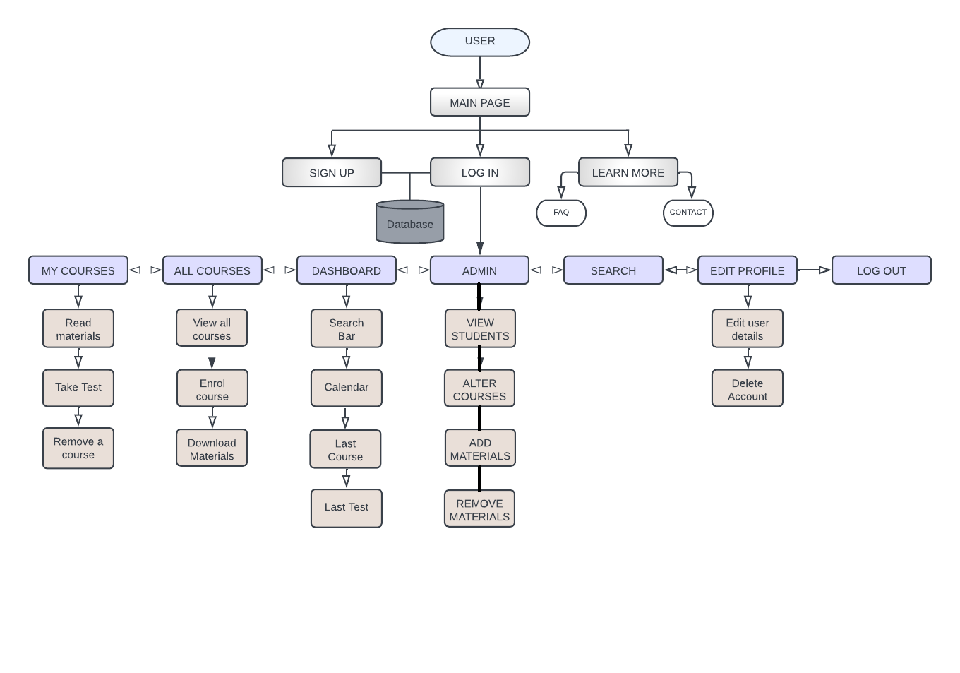
Framework of E-Learning System:
Main Page: landing page with navigation bar for login and sign-up, and Learn More button for additional information.
Learn More: FAQ, e-learning project details, support information, and links to Lagos State University.
Sign-Up Page: user registration with personal details and matriculation number (for students).
Login Page: secure access to main features of the web application.
Dashboard: visual display of user's data including notifications, calendar, and search bar.
Search: web page for searching information and content about courses.
Edit Profile: personal information and settings update page.
All Courses: page with list of courses, course codes, titles, levels, and images for reading and downloading materials.
My Courses: page with list of courses user is enrolled in.
Take Test: section for short tests on specific courses to evaluate knowledge.
Admin: page for admin users to manage database, add and remove courses and materials.
Log Out: feature for ending current session and protecting user's account from unauthorized access.

Slide 15
Implementation Tools:
HTML 5: used to structure web content
CSS 3: style sheet language for document presentation
JavaScript (JS): scripting language for dynamic content
JSON: file format for structured data
PHP: server scripting language for dynamic and interactive web pages
Bootstrap 5: CSS and JS framework for responsive websites
Visual Studio Code: text editor and IDE with debugging and extension support
MySQL: open-source RDBMS for managing databases
Git: tool for version control and collaboration
Ajax: technology for dynamic web page behavior
XAMPP: platform for testing projects with Apache, MySQL, PHP, and more.

Slide 16
Implementation Approach: Asynchronous Learning
Asynchronous learning will be used for the development of the web application.
Learners can access materials and complete coursework on their own time, offering flexibility and convenience.
Students and instructors do not need to be online at the same time.
Benefits include engagement, catering to different learning styles, and allowing learners to fit their studies around other commitments.
Learners can learn at their own pace, promoting self-guided learning.
Benefits include greater flexibility, personalized learning, and increased engagement and motivation.

Slide 17
Why Asynchronous Learning is the Right Approach
Flexibility
Access course materials and participate at their own pace
Beneficial for busy learners or learners in different time zones
Convenience
Accessible from any device with an internet connection
Learners can participate from anywhere at any time
Self-paced learning
Progress through course materials at own speed
Helpful for learners who need more time to absorb content or have different learning styles

Slide 18
Database Specifications
A database is a structured collection of data that is stored and organized to allow for efficient retrieval and management
Databases can be accessed and managed through software known as a database management system (DBMS)
The database for this system is called learning and it consists of 4 tables: Users, Courses, Test, and Dashboard
The database was built using MySQL
The Users table consists of 10 columns, including a primary key to identify each user, their name, email, password, courses they enroll for, and admin status
The Courses table consists of 5 columns, including a primary key to identify each course, the course code, title, level, and a short description of the course
The Test table consists of 8 columns, including a primary key to identify each question, the question itself, answer, and multiple options, as well as the course code it belongs to
The Dashboard table consists of 4 columns, including a foreign key to the Users table, and holds information on the last course read, last test taken, and test score.

Slide 19
E-Learning Platform System Design
Purpose:
Improve students' access to course materials in Lagos State University
Enhance the learning process
Key Features:
Web-based learning system with an efficient and easy-to-use interface
Course descriptions and downloadable materials
Quiz page for evaluating the learning process
System Life Cycle:
ADDIE Instructional Model: Planning, Research, Design, Implementation, Testing & Maintenance
System Requirements: Server-Side:
Operating system: Window, UNIX/Linux, MacOS
Web Server: Apache
Programming language: PHP, JS
Database: MySQL
Disk space on server: 3GB
Client-Side:
Hardware Specification: Compliant with any smartphone or personal computer
Operating System: Works smoothly on any device that has a browser
Browser Support: Opens up on any computer running scripts for PHP and JavaScript.

Slide 20
System Implementation Slide
Consists of modules for easy navigation
Modules:
Landing Page (Get started, Login, Learn more)
Sign Up Page (with error handling and input restrictions)
Login Page (with email and matric number options)
Activities After Logging In (Dashboard, My Courses, All Courses, Search List, Edit Profile, Admin Page, Log Out)
Dashboard (shows user details, last course and test taken, calendar, and quote)
My Courses (enrolled courses with activities to perform)
All Courses (view all available courses)
Search (searches for content by course code or title)
Edit Profile (change account details and delete account)
Admin Page (accessible to admin users only for managing users and courses)
Log Out (ends session and takes user back to home page)
Learn More Page (FAQ and contact information)

Slide 21
E-Learning Web Application Evaluation Results
ADDIE model used to develop an asynchronous web app for online learning.
App is easy to navigate, accessible from various devices, and provides a wide range of course materials.
Users receive instant feedback on performance, but there is a risk of cheating due to no time limits on quizzes.
Main flaws include lack of interactivity, engagement, and collaboration features, making it difficult for users to apply knowledge and learn from each other.
Future iterations should focus on incorporating more interactive and collaborative features to enhance the user experience and improve learning outcomes.

Slide 22
Introduction
Discuss potential benefits and limitations of web-based e-learning
Based on literature review, expert opinions, and explanation of web application
Literature Review
Key benefits: convenience, accessibility, larger audience, flexibility, student engagement
E-learning enhances retention rate by 25-60%
Limitations: technological issues, lack of personal interaction, concerns about quality and academic dishonesty
Implementation Review
Web application for asynchronous learning in computer science at LASU
Reliable content quality from recommended and past materials
ADDIE model used for instructional design
Assessment and evaluation features with randomized questions and retakes
Compatible with all devices supporting PHP and JavaScript
Overall, web-based e-learning offers many benefits but also has limitations to consider. The implemented web application offers reliable content and features to enhance student engagement and learning.

Slide 23
Title: Contribution to Knowledge
Web-based e-learning platform accessible from any device and location
Asynchronous learning for flexibility
Customized to meet individual student needs
Provides online testing and assessment
Organized materials for easy access
Slide 2: Title: Limitations, Expert Opinions, and Future Recommendations
Limitations:
No social media integration
Requires internet connection
Limited to computer science topics
Lacks real-time interaction with instructors and learners
Limited assessment questions
Fails to improve collaboration and communication
Expert Opinions:
Potential for highly effective educational delivery
Consider benefits and limitations
E-learning should not replace traditional learning
Gamification elements can increase engagement
Recommendations:
Include learning analytics features
Incorporate gamification elements
Provide support for multimedia
Offer collaboration tools
Offer multiple learning paths

Slide 24
REFERENCES
Amiti, F. (2020). Synchronous and asynchronous E-learning. European Journal of Open Education and E-Learning Studies, 5(2).
Amoako-Gyampah, K. (2007). Perceived usefulness, user involvement and behavioral intention: an empirical study of ERP implementation. Computers in human behavior, 23(3), 1232-1248.
Athuraliya, Amanda. 2022. “Top 7 Instructional Design Models to Create Effective Learning Material -.” Creately.
Belanger, F., & Jordan, D. H. (Eds.). (2000). Evaluation and Implementation of Distance Learning: Technologies, Tools and Techniques: Technologies, Tools and Techniques. Igi Global.
Berge, Z. L (2000). Evaluating Web-based training programs. 515-522.
Brush, K. (2019). What is a Learning Management System (LMS) and What is it Used For? TechTarget. from https://www.techtarget.com/searchcio/definition/learning-management-system
ChatGPT (OpenAI). (2023, January 5). Differences between Synchronous and Asynchronous learning. Retrieved from https://openai.com/
Chesney, T. (2006). An acceptance model for useful and fun information systems. Human Technology: An Interdisciplinary Journal on Humans in ICT Environments.
Cooke, C. (2022, December 19). Coursera Review - 7 Pros & Cons You Should Know In 2023. Upskillwise. Retrieved January 25, 2023, from https://upskillwise.com/reviews/coursera
Daniels, M. M., Sarte, E., & Cruz, J. D. (2019, February). Students’ perception on e-learning: a basis for the development of e-learning framework in higher education institutions. In IOP Conference Series: Materials Science and Engineering (Vol. 482, No. 1, p. 012008). IOP Publishing.
Day of 8 billion | United Nations. (2022, November 15). the United Nations. Retrieved November 16, 2022 from https://www.un.org/en/dayof8billion
eLearnity (2000), e-learning: The future of learning, eLearnity Ltd, Cirencester
Epignosis, LLC. (2014). E-learning concepts, trends, applications. California: Epignosis
Emmanouilidou, K., Derri, V., Antoniou, P., & Kyrgiridis, P. (2012). comparison between synchronous and asynchronous instructional delivery method of training programme on in-service physical educators’ knowledge. Turkish Online Journal of Distance Education, 13(4), 193-208.
Epic Group plc (1999), Taking Training Online: Exploiting the potential for web-based training in the UK, Technologies for Training Ltd and Epic Group plc
Fasihuddin, H., Skinner, G., & Athauda, R. (2017). Towards adaptive open learning environments: Evaluating the precision of identifying learning styles by tracking learners’ behaviours. Education and Information Technologies, 22(3), 807-825.

Slide 25
Gogos, Roberta. n.d. A brief history of elearning (infographic) - eFront https://www.efrontlearning.com/blog/2013/08/a-brief-history-of-elearning-infographic.html.
Hendrix, E.(2019, December 19). How your surroundings affect the way you study. UCAS. https://www.ucas.com/connect/blogs/how-your-surroundings-affect-way-you-study
Horton, William (2011). E-learning by design. John Wiley & Sons.
Keegan, L. (2021, July 20). 79+ Staggering Online Learning Statistics Revealed!???(2022). SkillScouter.com. Retrieved from https://skillscouter.com/online-learning-statistics/
Khan, B. H. (Ed.). (2005). Managing e-learning: Design, delivery, implementation, and evaluation. IGI Global.
Kim, K. S., & Moore, J. L. (2005). Web-Based Learning: Factors Affecting Students. satisfaction and learning experiences’.
(n.d.). Growjo - The Fastest Growing Companies in 2022. Retrieved January 5, 2023, from http://growjo.com
(n.d.). Website Traffic - Check and Analyze Any Website | Similarweb. Retrieved January 5, 2023, from http://similarweb.com
Patel, S. R., Margolies, P. J., Covell, N. H., Lipscomb, C., & Dixon, L. B. (2018). Using instructional design, analyze, design, develop, implement, and evaluate, to develop e-learning modules to disseminate supported employment for community behavioral health treatment programs in New York State. Frontiers in public health, 113.
Perveen, A. (2016). Synchronous and asynchronous e-language learning: A case study of virtual university of Pakistan. Open Praxis, 8(1), 21-39.
Robinson, S. (2018, February 20). New From ATD Research: Is the LMS Dead? | ATD. Association for Talent Development. Retrieved from https://www.td.org/insights/new-from-atd-research-is-the-lms-dead
Rungta, K. (2022, November 26). 100+ Must Know Online Learning Statistics in 2023. Guru99. Retrieved from https://www.guru99.com/online-learning-statistics.html
Sindhya, V. (2022). Challenges for teachers during COVID-19. UNIZIK Journal of Educational Research and Policy Studies, 2(1), 1-7.
Statista. (2022, September 20). Internet and social media users in the world 2022. Retrieved from https://www.statista.com/statistics/617136/digital-population-worldwide/
Tarhini, A., Hone, K. S., & Liu, X. (2013). Factors affecting students’ acceptance of e-learning environments in developing countries: a structural equation modeling approach.
Unwin, T. (2008). Survey of e-Learning in Africa available at www.elearning-africa.com/Publicationssurvey/elearning-africa.pdf.
Violante M G and Vezzetti E. Implementing a new approach for the design of an e‐learning platform in engineering education. Computer Applications in Engineering Education, 2014, 22(4): 708-727.
Wood, W. (2022, April 11). Skill share Review 2022: Is This the Platform for You? Mirasee. Retrieved January 25, 2023, from https://mirasee.com/blog/skillshare-review/
9 Advantages and Disadvantages of JSON to Pay Heed to. (2022, January 5). Tech Quintal. Retrieved November 29, 2022, from https://www.techquintal.com/advantages-and-disadvantages-of-json/

