Slide 1


Artificial Intelligence (AI)
University of Science and Technology
Faculty of Computer Science and Information Technology
4th Year B.Sc : Information Technology
Academic Year : 2017-2018
Instructor : Diaa Eldin Mustafa Ahmed
Problem Solving
(Searching Strategies )-1/2

Slide 2
You will be expected to know
Problem formalization.
Problem Space (state , state space ,search tree , search node , goal , action and successor function )
Uninformed Search :Depth First Search (DFS), Breadth First Search (BFS), Depth First Iterative Deeping Search (DFIDS).
Heuristic Search: Best First Search, Hill Climbing, Constraint Satisfaction
AI - (2017-2018) -Diaa Eldein Mustafa - Lecture (5)

Slide 3
Problem solving
Using artificial intelligence
(using intelligence similar to human intelligence or using Intelligent Agents )
We want:
  To automatically solve a problem.
We need:
  A representation of the problem.
  Algorithms that use some strategy to solve the problem defined in that representation.
Formalization
Searching technique
AI - (2017-2018) -Diaa Eldein Mustafa - Lecture (5)

Slide 4
Problem Formulation
Goal formulation
    Based on the current situation and the agent’s performance measure, is the first step in problem
    solving.
    Goal is a set of states:
    The agent’s task is to find out which sequence of actions will get it to a goal state.
    Problem formulation :
    is the process of deciding what sorts of actions and states to consider, given a goal .
AI - (2017-2018) -Diaa Eldein Mustafa - Lecture (5)

Slide 5
Search Techniques for Artificial Intelligence
Searching strategies is a central topic in Artificial Intelligence.
This part of the course will show why search is such an important topic, present a general approach to representing problems to do with search.
Introduce several search algorithms, and demonstrate how to implement these algorithms in Prolog.
Problem solving strategies
Representing problem solution.
Basic search strategies.
    Informed search strategies.
    Uninformed search strategies .
Search in AI.
Automated reasoning
Theorem proving
Game playing
Navigation
AI - (2017-2018) -Diaa Eldein Mustafa - Lecture (5)

Slide 6
Classification of AI searching Strategies
بحث أعمي
Searching Strategies in AI
بحث إرشادي(المعلوم)
Un-informed
(Blind Search)
Informed
(Heuristic Search)
Depth-first (DFS)
Breadth-
First (BFS)
Cost-
First (CFS)
Best-First
Search (BFS)
Hill Climbing
Constraint Satisfaction
Depth-
Limited
(DLS)
A* Search
A very large number of AI problems are formulated as search problems.
معظم المشكلات في الذكاء الإصطناعي يتم صياغتها كمشكلات بحث
Iterative
Deepening
AI - (2017-2018) -Diaa Eldein Mustafa - Lecture (5)

Slide 7
What is Search strategy ?
Search
  Search is the systematic examination of states to find path from the start/root state to the goal state.
  Search usually results from a lack of knowledge.
  Search explores knowledge alternatives to arrive at the best answer.
  Search algorithm output is a solution, ie, a path from the initial state to a state that satisfies the goal test.
AI - (2017-2018) -Diaa Eldein Mustafa - Lecture (5)

Slide 8

Defining a Search Problem
A well-defined problem can be described by
State space S : all possible configurations(situations) of the domain of interest .
    All states reachable from initial by any sequence of actions.
        Is a graph whose nodes are the set of all states, and whose links are actions that transform one state into another.
        Each state is an abstract representation of the environment.
        The state space is discrete.
An initial (start) state: ∈ S
      Usually the current state .
    Sometimes one or several hypothetical states (“what if …”)
Goal states G ⊂ S :
    The set of end states –Often defined by a goal test rather than enumerating a set of states.
AI - (2017-2018) -Diaa Eldein Mustafa - Lecture (5)

Slide 9
Defining a Search Problem
A well-defined problem can be described by
Operators (Action) A :
  The actions available–often defined in terms of a mapping from a state to its successor.
  Is something that the agent can choose to do.
Search tree :
  (A graph with no undirected loops) in which the root node is the start state and the set of children for each node consists of the states reachable by taking any action.
Search node :
  Is a node in the search tree.
Goal :
    Is a state that the agent (solution) is trying to reach.
AI - (2017-2018) -Diaa Eldein Mustafa - Lecture (5)

Slide 10

Defining a Search Problem
A well-defined problem can be described by
Path :
    A sequence of states and operators.
    Sequence through state space.
Path cost:
    A number associated with any path.
    Measures the quality of the path.
    Sum of costs of individual actions along the path.
    Usually the smaller, the better.
Solution of a search problem:
    Is a path from to some ∈ G.
Optimal solution:
    Any path with minimum cost.
Goal test :
  Test to determine if at goal state.
AI - (2017-2018) -Diaa Eldein Mustafa - Lecture (5)

Slide 11
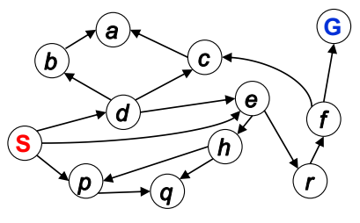
State Space Graph versus Search Trees
State Space Graph
Graph of states with arrows pointing to successors.
State graph shows the possible states of a system.
A state is a node in which a system can be at any given time.
May contain a loop.
State Space Graph
AI - (2017-2018) -Diaa Eldein Mustafa - Lecture (5)

Slide 12
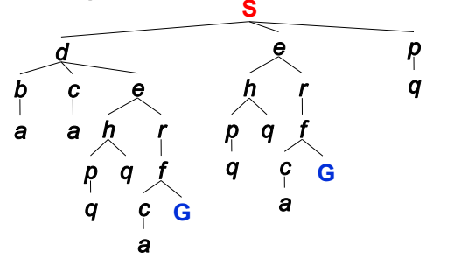
Defining a Search Problem
State Space Tree
Tree is a special case of a graph.
The topmost node in a tree is called the root node; at root node all operations on the tree begin.
Each NODE in in the search tree is an entire PATH in the problem graph.
Represent a plan (sequence of actions) which results in the node’s state .
State Space Tree
AI - (2017-2018) -Diaa Eldein Mustafa - Lecture (5)

Slide 13
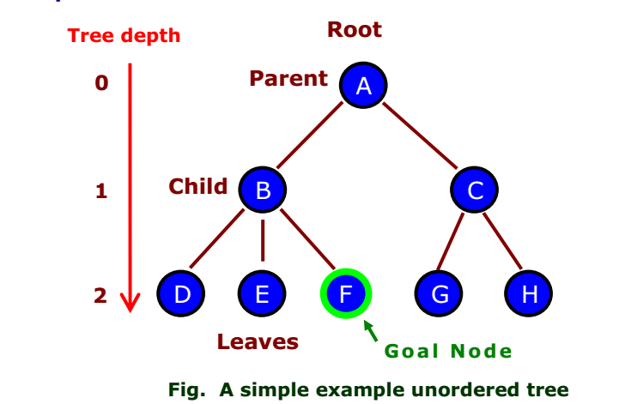
Defining a Search Problem
AI - (2017-2018) -Diaa Eldein Mustafa - Lecture (5)

Slide 14
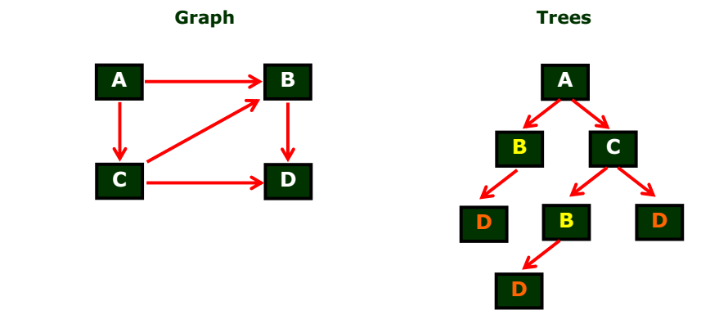
Graph vs. Tree
AI - (2017-2018) -Diaa Eldein Mustafa - Lecture (5)

Slide 15
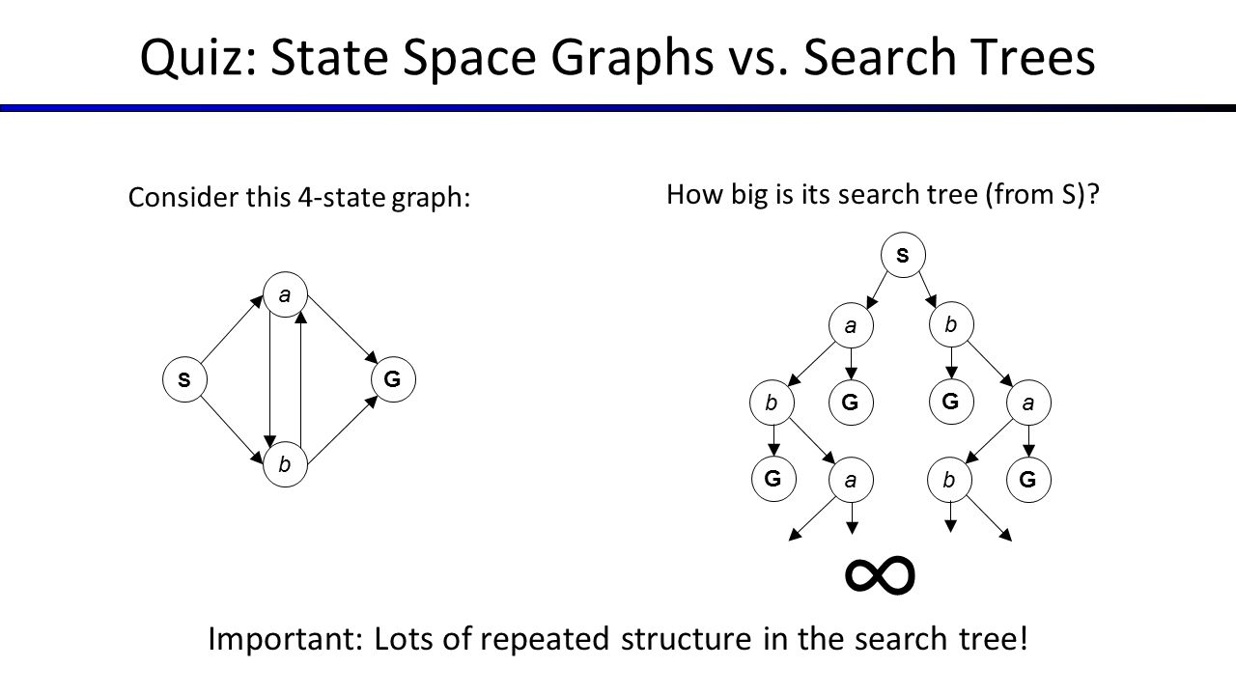
AI - (2017-2018) -Diaa Eldein Mustafa - Lecture (5)

Slide 16
Problem Solving by Search
An important aspect of intelligence is goal-based problem solving.
The solution of many problems can be described by finding a sequence of actions that lead to a desirable goal.
Each action changes the state and the aim is to find the sequence of actions and states that lead from the initial (start) state to a final (goal) state.
AI - (2017-2018) -Diaa Eldein Mustafa - Lecture (5)

Slide 17

Example (1) : Vacuum Cleaner world state space graph
States? | Discrete: dirt and robot location
Initial state? | Any
Actions? | Left, right, suck
Goal test? | No dirt at all locations
Path cost? | 1 per action
Solution | Optimal sequence of operations(actions)
AI - (2017-2018) -Diaa Eldein Mustafa - Lecture (5)

Slide 18

Example (1) : Vacuum Cleaner world state space
Observable, start in #5.
Solution? [Right , Suck]
Observable, start in #2.
Solution? [Suck , Left , Suck]
Observable, start in #6.
Solution? [Suck , Left]
Observable, start in #1.
Solution? [Suck , Right , Suck]
Unobservable, start in {1,2,3,4,5,6,7,8}
Solution? [Right , Suck , Left , Suck]
AI - (2017-2018) -Diaa Eldein Mustafa - Lecture (5)

Slide 19
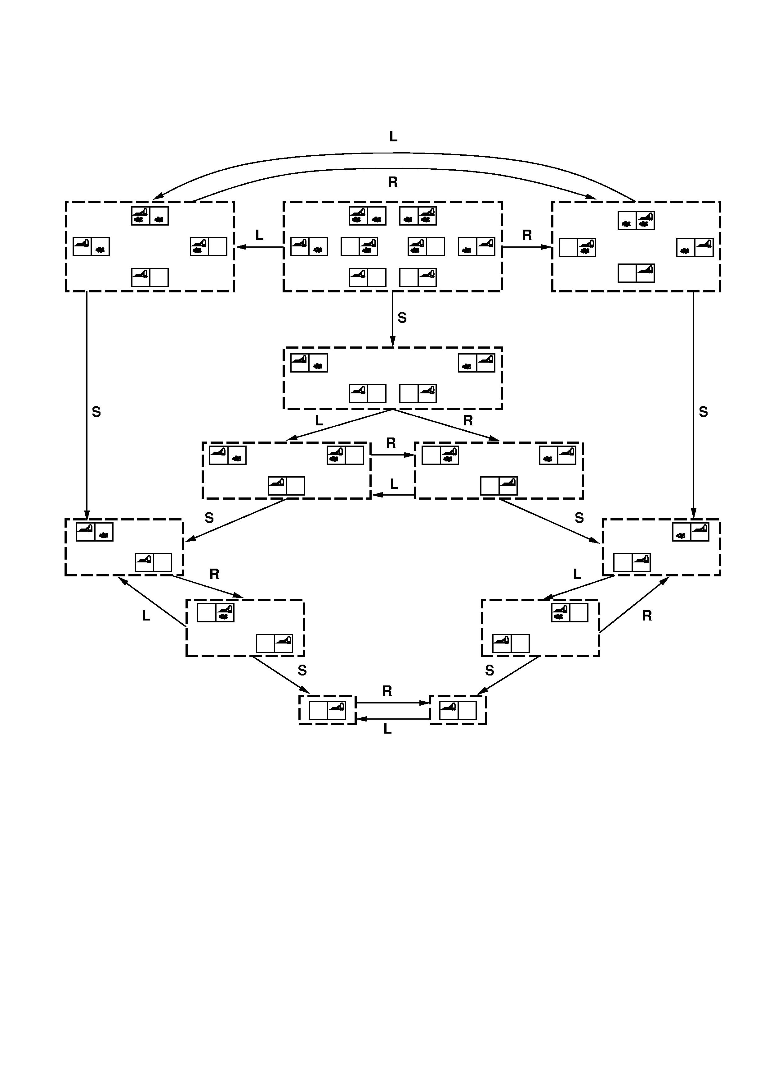
Example (1) : Vacuum Cleaner world state space graph
AI - (2017-2018) -Diaa Eldein Mustafa - Lecture (5)

Slide 20
Example (1) : Vacuum Cleaner world state space tree
Any State
L
R
S
1,3,5,7
4,5 ,7,8
2,4,6 ,8
R
S
L
R
L
S
2,4,6 ,8
5,7
4 ,8
4 ,6,8
1 ,3,5,7
4 ,8
L
S
R
S
S
S
L
6 ,8
5,7
4 ,8
5 ,7
3 ,7
1 ,3,5,7
4 ,8
S
R
L
R
S
S
R
8
6 ,8
3 ,7
6,8
7
5 ,7
3 ,7
S
S
S
R
S
8
7
8
6,8
7
S
8
AI - (2017-2018) -Diaa Eldein Mustafa - Lecture (5)

Slide 21
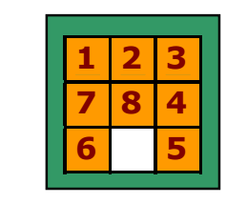
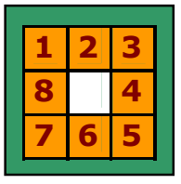
Example(2): The 8-puzzle Problem state space
Initial State: any configuration
Goal State : tiles in a specific order
States? | Locations of tiles
Initial State? | Given
Actions? | Move blank left, right, up, down
Goal test? | Goal state (given)
Path cost? | 1 per move
Solution: | Optimal sequence of operators
AI - (2017-2018) -Diaa Eldein Mustafa - Lecture (5)

Slide 22
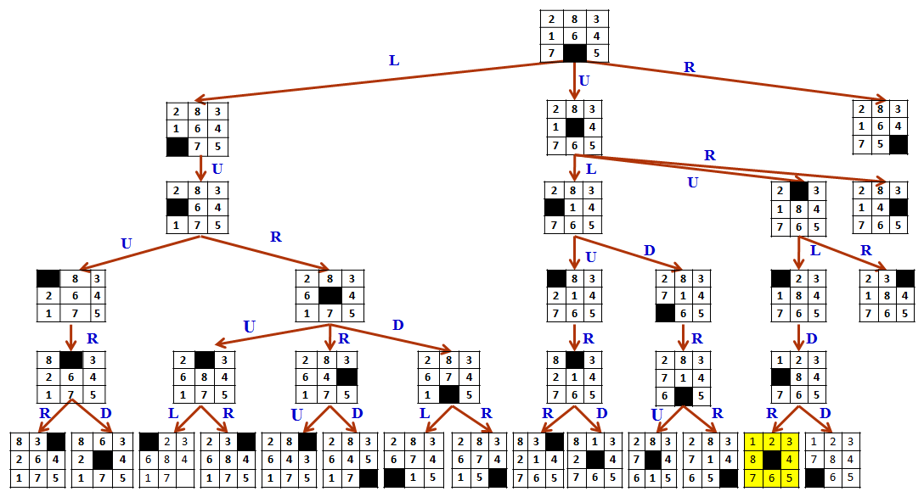
AI - (2017-2018) -Diaa Eldein Mustafa - Lecture (5)

Slide 23
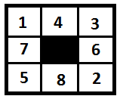
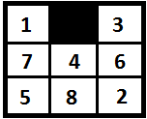
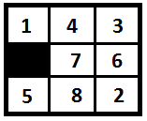
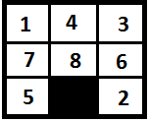
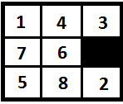
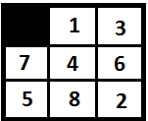
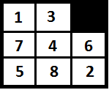
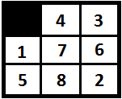
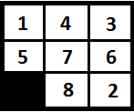
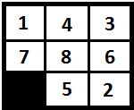
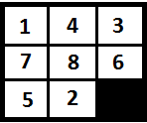
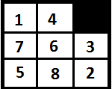
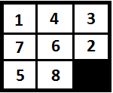
Example(2): The 8-puzzle Problem
State space tree
Up
Right
Left
Down
L
R
U
D
L
R
U
D
AI - (2017-2018) -Diaa Eldein Mustafa - Lecture (5)

Slide 24
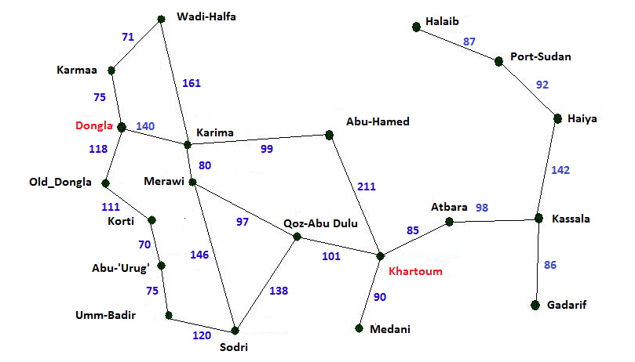
Example (3) :Route Planning: Dongla Khartoum
On holiday in Khartoum; currently in Dongla.
AI - (2017-2018) -Diaa Eldein Mustafa - Lecture (5)

Slide 25
Example (3) :Route Planning: Dongla Khartoum
States? | Various cities
Initial State? | Dongla
Actions? | Drive between cities or choose next city
Goal test? | Be in Khartoum
Path cost? | Distance in km
Solution: | Sequence of cities, e. g. Dongla, Karima , Abu-hammed, Khartoum.
AI - (2017-2018) -Diaa Eldein Mustafa - Lecture (5)

Slide 26
Dongla
75
118
140
Karmma
Karima
Old-Dongla
71
80
97
111
Wadi-Halfa
Marawi
Abu-Hammed
Korti
70
146
97
211
Abu-Urug
Sodri
Qoz-Abu-Dulu
Khartoum
75
120
138
101
Um-Badir
Um-Badir
Qoz-Abu-Dulu
Khartoum
120
101
Sodri
Khartoum
146
118
Marawi
Qoz-Abu-Dulu
97
101
Qoz-Abu-Dulu
Khartoum
101
Khartoum
AI - (2017-2018) -Diaa Eldein Mustafa - Lecture (5)

Slide 27

Example (4): Robotic assembly
states?: real-valued coordinates of robot joint angles parts of the object to be assembled
initial state?: rest configuration
actions?: continuous motions of robot joints
goal test?: complete assembly
path cost?: time to execute

Slide 28
Uninformed search
Uninformed Search (also called blind search) is a search that has no information about its domain.
  Use only the information available in the problem definition.
Generates the search tree without using any domain specific knowledge.
The only thing that a blind search can do is distinguish a non-goal state from a goal state.
Brute-force algorithms search, through the search space, all possible candidates for the solution checking whether each candidate satisfies the problem's statement.
AI - (2017-2018) -Diaa Eldein Mustafa - Lecture (5)

Slide 29
Uninformed search
  Breadth-first search (BFS)
  Depth-first search (DFS)
  Uniform-cost search
  Depth-limited search
  Iterative deepening search
AI - (2017-2018) -Diaa Eldein Mustafa - Lecture (5)

Slide 30
Informed Search
Informed Search algorithms use heuristic functions, that are specific to the problem, apply them to guide the search through the search space to try to reduce the amount of time spent in searching.
.
AI - (2017-2018) -Diaa Eldein Mustafa - Lecture (5)

Slide 31
Breadth-first search (BFS)
A Search strategy, in which the highest layer of a decision tree is searched completely before proceeding to the next layer is called Breadth-first search (BFS).
    When a state is examined, all of its siblings are examined before any of its children.
    The space is searched level-by-level, proceeding all the way across one level before doing down to the next level.
    In this strategy, no viable solution is omitted and therefore guarantee that optimal solution is found.
This strategy is often not feasible when the search space is large.
BFS explores nodes nearest to the root before exploring nodes that are father or further away.
AI - (2017-2018) -Diaa Eldein Mustafa - Lecture (5)

Slide 32
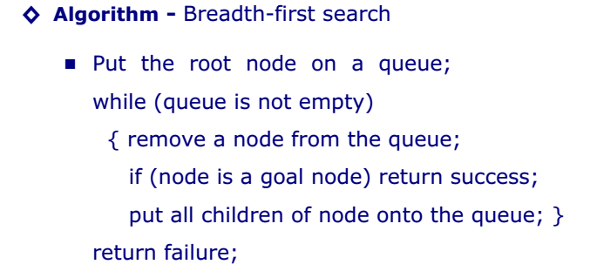
Breadth-first search (BFS)
AI - (2017-2018) -Diaa Eldein Mustafa - Lecture (5)

Slide 33
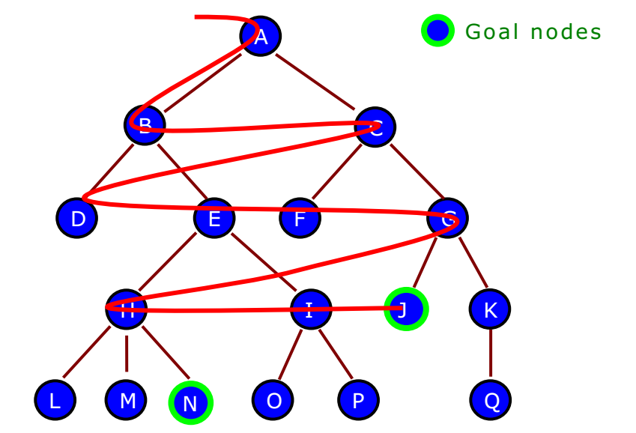
Breadth-first search (BFS)
Node are explored in the order :
A B C D E F G H I J K L M N O P Q
■ After searching A, then B, then C, the search proceeds with D,E, F, G, . . . . . . . . .
■ The goal node J will be found before the goal node N.
AI - (2017-2018) -Diaa Eldein Mustafa - Lecture (5)

Slide 34
Depth-first search (DFS)
A search strategy that extends the current path as far as possible before backtracking to the last choice point and trying the next alternative path is called Depth-first search (DFS).
When a state is examined, all of its children and their descendants are examined before any of its siblings.
DFS goes deeper in to the search space when ever this is possible only when no further descendants of a state can found.
This strategy does not guarantee that the optimal solution has been found.
    In this strategy, search reaches a satisfactory solution more rapidly than breadth first, an advantage when the search space is large.
AI - (2017-2018) -Diaa Eldein Mustafa - Lecture (5)

Slide 35
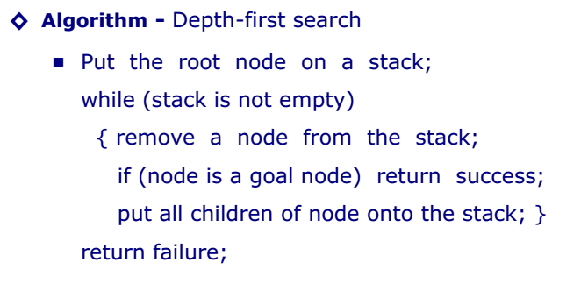
Depth-first search (DFS)
The Breadth-first search (BFS) and depth-first search (DFS) are the foundation for all other search techniques.
AI - (2017-2018) -Diaa Eldein Mustafa - Lecture (5)

Slide 36
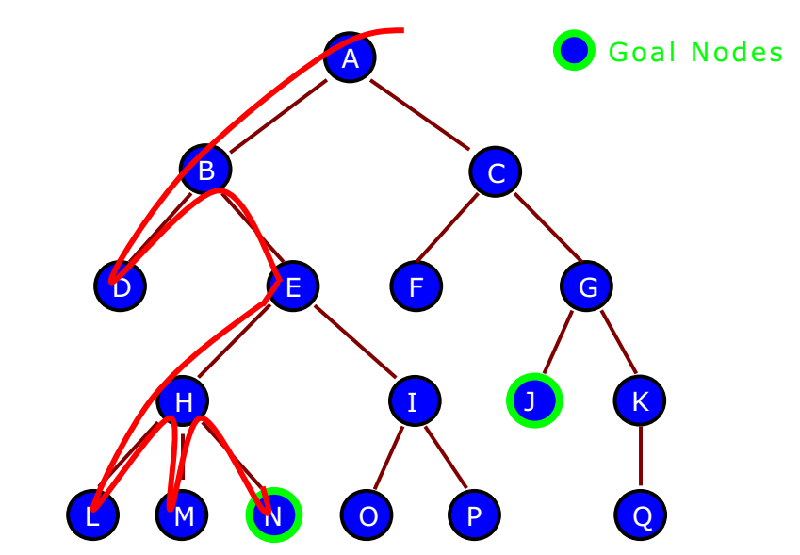
Depth-first search (DFS)
Node are explored in the order :
A B D E H L M N I O P C F G J K Q
■ After searching node A, then B, then D, the search backtracks and tries another path from node B .
■ The goal node N will be found before the goal node J.
AI - (2017-2018) -Diaa Eldein Mustafa - Lecture (5)

Slide 37
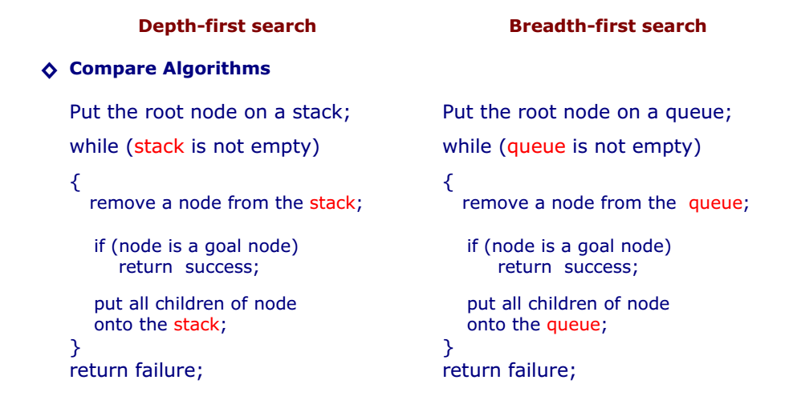
DFS vs BFS Algorithm
AI - (2017-2018) -Diaa Eldein Mustafa - Lecture (5)

Slide 38
Thank You
End
AI - (2017-2018) -Diaa Eldein Mustafa - Lecture (5)

