Slide 1
Contents
Introduction
Methodology
Hardware and Software Requirements
Results and Discussions
Conclusion
References

Slide 2
Introduction
In today’s fast-paced world, the Smart Cradle merges automation and real-time monitoring to transform childcare. Powered by the ESP32 microcontroller, it detects a baby’s cry, alerts parents instantly, and enables remote cradle rocking, while a moisture sensor ensures the baby’s comfort.
Blending smart sensing with seamless communication, the Smart Cradle offers convenience and peace of mind for modern families.

Slide 3
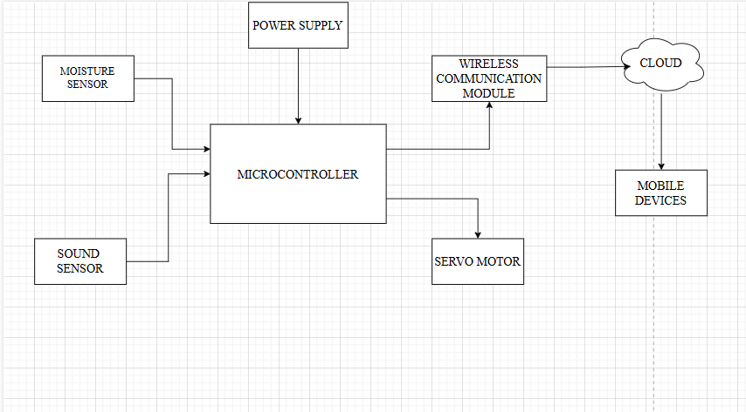
Methodology
Fig 1: Block Diagram

Slide 4
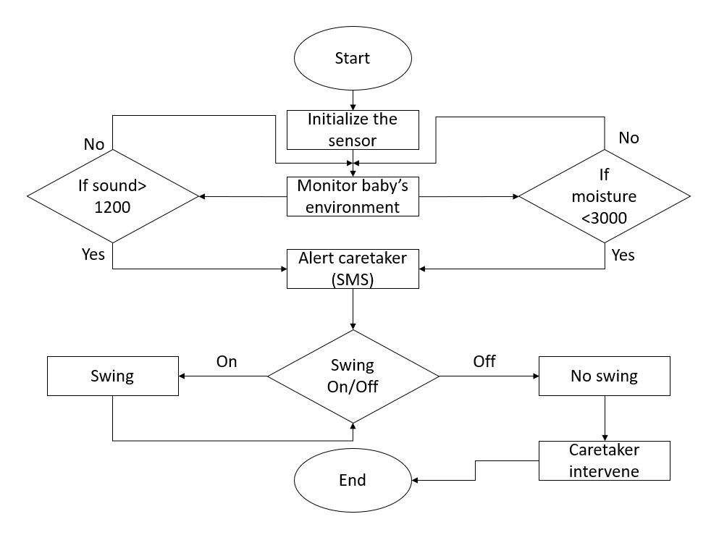
Methodology
Fig 2: Flow Chart

Slide 5
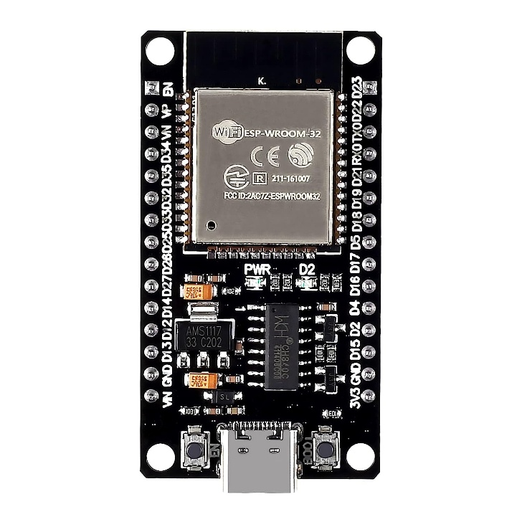
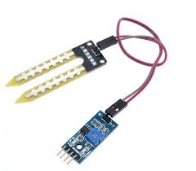
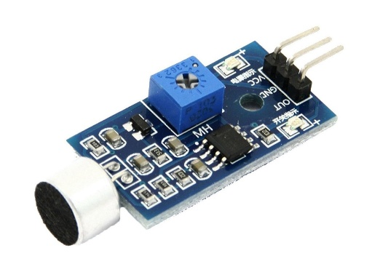
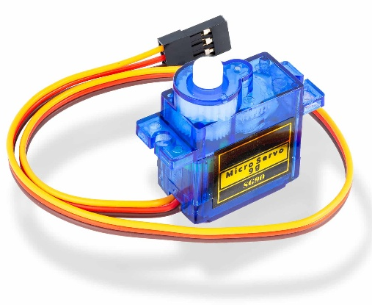
Hardware and Software Requirements
Hardware Components:
ESP32 Microcontroller
Moisture Sensor
Sound Sensor
Servo Motor
Software Components:
Arduino IDE
Twilio
MQTT
Fig 3: ESP32 Micontroller
Fig 4: Moisture Sensor
Fig 5: Sound Sensor
Fig 6: Servo Motor

Slide 6

Results and Discussion
The Smart Cradle reliably detected cries and wet conditions, sending instant alerts and enabling smooth, remote rocking. Seamless software integration ensured fast communication. Overall, it reduced caregiver effort, improved baby comfort, and shows great potential for future upgrades.
Fig 7: SMS Output

Slide 7
Conclusion
The Smart Cradle redefines infant care by combining intelligent sensing, automation, and real-time alerts. It delivers peace of mind, reduces caregiver burden, and ensures a safer, more comfortable environment for babies. With future enhancements like additional sensors and machine learning, it promises to become an even smarter, more personalized childcare solution.

Slide 8
References
[1] https://www.youtube.com/watch?v=grwsxXAPO7A
[2] Enhanced Baby Monitoring: IoT-driven Smart Cradle System (2023) by Deepika, Asst. Prof. Vishalakshi Patil
[3] Smart Baby Cradle By Using IoT | Frontiers in Health Informatics by Shital Pawar , Medha Wywahare, Ashwini Barbadekar, Payal Chavan, Simran Pathan, Rahul diware.

Slide 9
Thank You

