Slide 1

Advanced Programming Practices SOEN 6441 -- Fall 2023
Submitted By :-
Daivik - 40279335
Sannidhi Shetty - 40276709
Raghav Dalmia - 40263888
Nikita - 40243093
Pruthviraj - 40266887
Adarsh Pawar - 40276966
RISK GAME
Project Build 1

Slide 2
Objective
To develop a Java program that aligns with the rules, map files, and supports command-line play for the "Warzone" edition of the Risk game.
The game consists of start up, main gameplay and execute phase which controls the entire workflow of the game.
The game allows users to load existing and create new maps, edit maps to add or remove continents, countries, neighboring countries and players. Countries would be assigned to players in main game loop to issue and execute orders.
Players issues deploy orders in a round robin fashion until they place all the armies. The orders gets executed in execute phase to run the deploy orders of players to place num armies to country CountryID.

Slide 3
BUILD 1

Slide 4
Flow of Execution
Load
Load Map and Show Map
Edit
Edit Map
Add
Add/Remove Players
Assign
Assign countries and reinforcement to players
Deploy
Deploy all the reinforcement – Issue order phase
Execute
Execute Phase

Slide 5
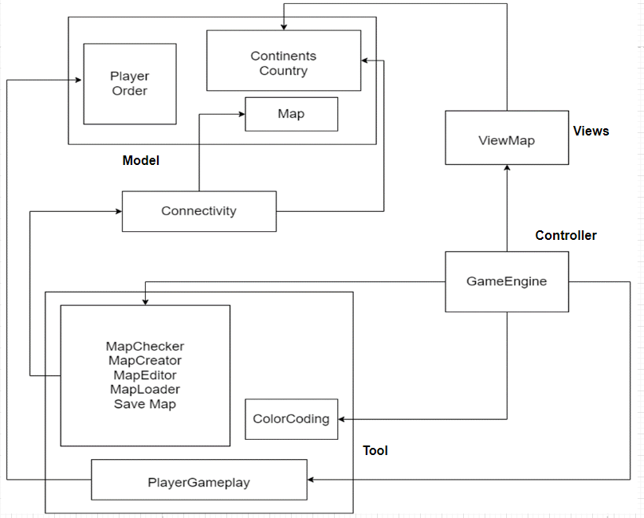
Implementation Architecture Diagram

Slide 6
MVC Architecture
Our project follows MVC architecture to organize the structure of the game
Model : Includes data for Country, Continent, Player, Order and Map containing state and behavior that can be accessed across entire architecture of the project.
Tool: Contains methods to perform startup, main game loop and execute phase.
View: Used to show the existing or updated map to the users in console. ViewMap displays Country, Continent, Neighboring countries and Army Control value in tabular format.
Controller: Acts as an intermediary between Model and View which takes user inputs via the View, processes it by interacting with Model and then updates the view to reflect the result. GameEngine is the center of the game that controls the entire functionality of the game

Slide 7
BUILD 2

Slide 8
Implementation Architecture Diagram

Slide 9
State Pattern
The game program structure has been modified to adopt state pattern as mentioned in the table below:
PHASE | COMMAND
Any phase | Show map
Edit:Preload | load map, edit country, edit continent, edit neighbor, validatemap
Edit:PostLoad | save map
Play:PlaySetup | gameplayer, assigncountries
Play:MainPlay:Reinforce | deploy
Play:MainPlay:Attack | advance, bomb, airlift, blockade, negotiate
Play:MainPlay:Fortify | fortify
End | end game
Any | next phase

Slide 10
State Pattern
State pattern for the game is designed to perform in a way described below:
showmap command can be used at any phase for the user to view the modified map at regular intervals
Preload phase allows user to load the map (loadmap), perform map edits(editcountry, editcontinent, editneighbor) and validate the map.
Postload phase wants user to save the map to move ahead to next phase which is PlaySetup
In PlaySetup phase, user can add/remove players and assign countries to them(assigncountries)
Once the countries are assigned in PlaySetup phase, game goes to next phase: Reinforce to allow users to deploy armies to the countries for every added player in round robin fashion.
Next phase is Attack where players can advance/attack or use their cards. If winner is not declared, the game gets passed to fortify phase
Fortify phase routes user back to Reinforcement to deploy newly added troops.
End Phase ends the game by displaying thank you message to the user. This phase is set on exit or when the winner is declared.

Slide 11
Observer Pattern
The project uses observer pattern for logging so that whenever a command is executed, or an order is issued or executed , a LogEntryBuffer object is filled with information about the effect of the action:
The Observable class is LogEntryBuffer. It notifies observers to update its state whenever the file is changed.
Observer LogWriter writes the content of the LogEntryBuffer to a log file when it is changed(when notified by observer).
Doing this, user can see all the actions that happened during a game in the log file along with all the phases executed in the game.

Slide 12
Command Pattern
Command pattern has been implemented in the project to encapsulate the user commands as an object to hide the processing of the commands from the sender of the request to achieve loose coupling between components of the game.
This is achieved by creating Order class which acts as a command class to encapsulate user command as an object. It contains execute() that represents the action to be performed when the command is invoked.
Invoker class is Player which invokes commands from Order and manages their execution. It acts as an intermediary between the client and the command objects.
GameEngine acts as a Client class that is responsible for configuring commands to decide when and how to execute them. It gets the Player’s orders from the Players using the next_order() method, then executes the orders by calling the execute() method of the Order (done in Reinforcement phase)

Slide 13
Cards Implementation
When player successfully conquers a country (in case of successful attack), cards gets assigned to them randomly. The implementation of bomb card is provided in PlayersGamePlay.java which will be executed in Order class as per command pattern
Cards that can be assigned can be one of the following:
Bomb: Used to destroy half of the armies located on an opponent’s country that is adjacent to one of the current player’s countries.
Blockade: Used to triple the number of armies on one of the current player’s countries and make it a neutral territory.
Airlift: Used to advance some armies from one of the current player’s countries to any another country.
Negotiate: Used to prevent attacks between the current player and another player until the end of the turn.
Once the card is executed for the player, the card gets removed from the player’s card array.

Slide 14
BUILD 3

Slide 15
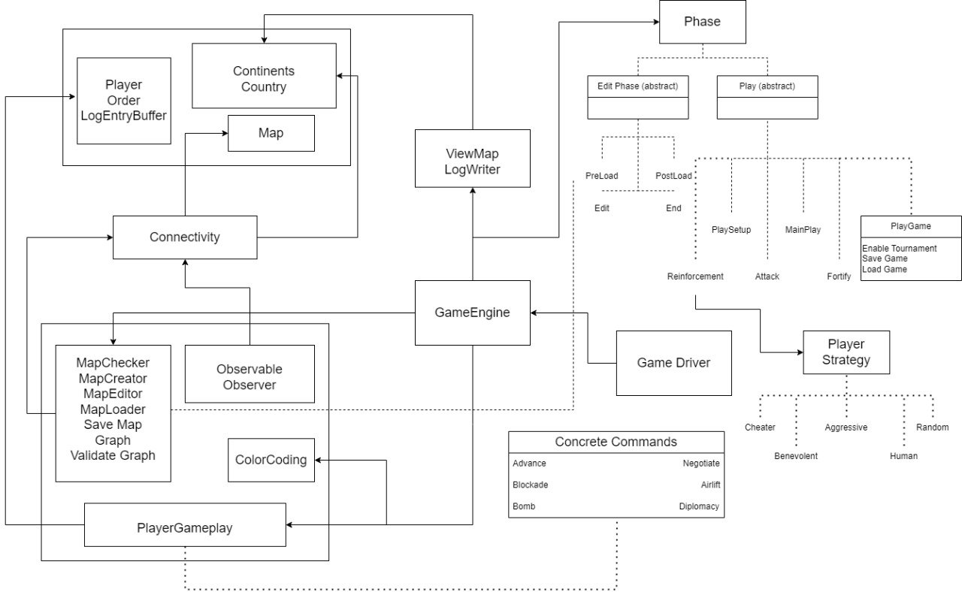
Implementation Architecture Diagram

Slide 16
Strategy Pattern
Strategy pattern for the game is designed to perform in a way described below:
PlayerStrategy (Interface/Abstract Class):
Purpose: Defines the interface for different player strategies.
Method: issueOrder(GameMap map): Represents the action the player takes during their turn based on the chosen strategy.
HumanPlayerStrategy (Concrete Class):
Purpose: Implements the PlayerStrategy for a human player.
Method: issueOrder(GameMap map): Allows user interaction to make decisions during the game.
AggressivePlayerStrategy (Concrete Class):
Purpose: Implements the PlayerStrategy for an aggressive computer player.
Method: issueOrder(GameMap map): Focuses on centralizing forces, attacking with the strongest country, and optimizing army movements.

Slide 17
Strategy Pattern
BenevolentPlayerStrategy (Concrete Class):
Purpose: Implements the PlayerStrategy for a benevolent computer player.
Method: issueOrder(GameMap map): Focuses on protecting weaker countries by reinforcing them.
RandomPlayerStrategy (Concrete Class):
Purpose: Implements the PlayerStrategy for a random computer player.
Method: issueOrder(GameMap map): Deploys armies randomly, attacks random neighboring countries, and moves armies randomly.
CheaterPlayerStrategy (Concrete Class):
Purpose: Implements the PlayerStrategy for a cheater computer player.
Method: issueOrder(GameMap map): Conquers all immediate neighboring enemy countries and doubles armies on specific conditions, directly manipulating the map.

Slide 18
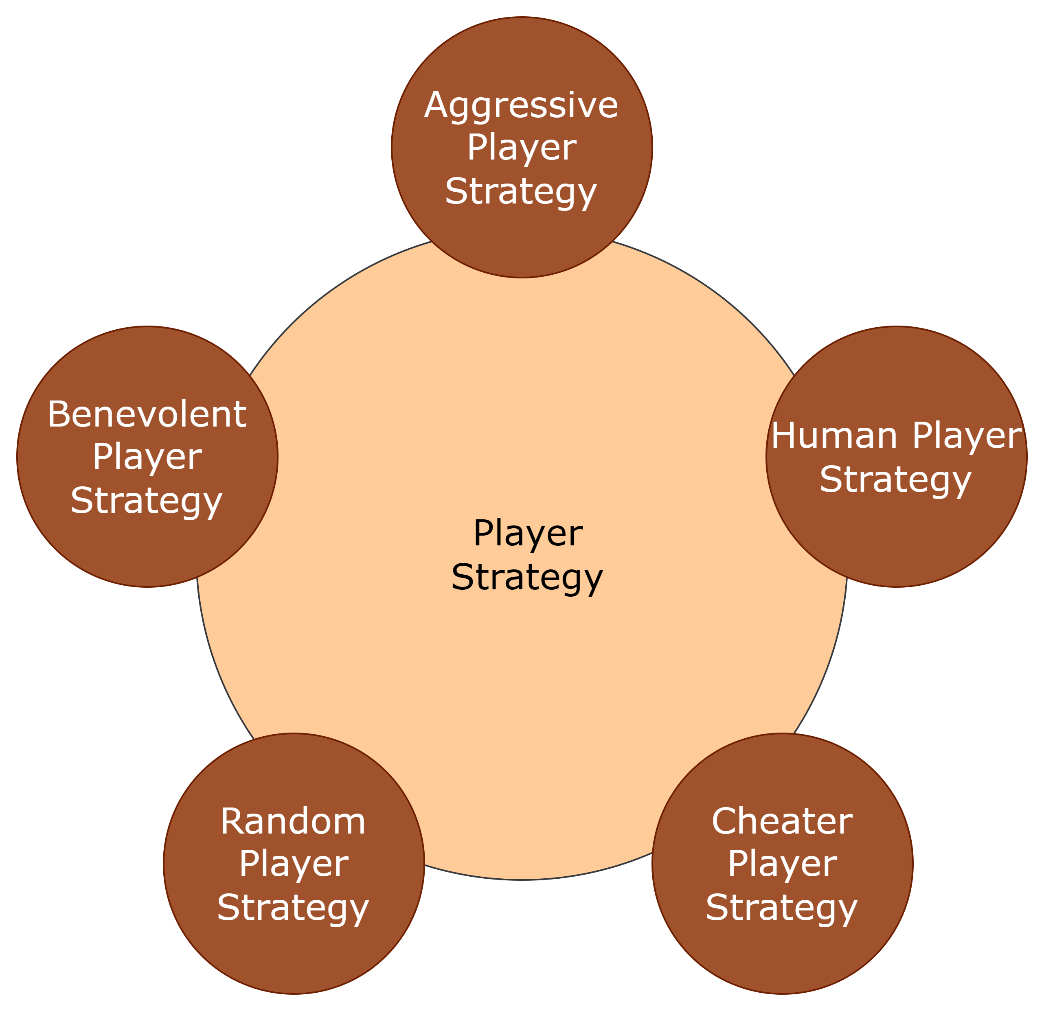
Strategy Pattern
The strategy pattern promotes:
Flexibility
Encapsulation
Easy maintenance
Run-Time Switching of Strategies:
Code Reusability

Slide 19
Adaptor Pattern
Implementation of Adaptor Pattern:-
Define the Target interface that the client code expects when working with map files.
Create the Adaptee class, representing the existing "domination" file reader.
Implement the Adapter class, adapting the "conquest" file reader to the Target interface.
Modify the client code to instantiate either the original file reader or the adapter based on the user's choice.
Allow the user to specify the output file format when saving the map.

Slide 20
Adaptor Pattern
Method CheckMap() gets the map name from the user, and then check its type whether it is a domination map or conquest map.
ConquestMapLoader is a class for map loading (conquest type). It has loadMap() which is used to load the Map selected by the user whether pre-defined or user made.
MapLoader class is used to load and validate the map of domination type (Adaptee Class).
SaveMap() used to save the map. If it is domination map, it gets saved as before.
For conquest map, conquestMapSaver() will be used.

Slide 21
Javadoc Javadoc documentation on all the classes, data members, and member functions has been implemented to generate comprehensive and easily navigable documentation in HTML format. Syntax: /** * Javadoc comment * */
@param | provide information about method parameter or the input it takes
@see | generate a link to other element of the document
@version | provide version of the class, interface or Enum.
@return | provide the return value
@author | Describes an author
@throws | Throws exception if something goes wrong

Slide 22
Junit
Includes 50+ test cases to cover the important test scenarios of the game mentioned below:
Assesses the accuracy of the "assigncountries" feature.
Validates the functionality of editing map commands, including adding/removing countries, continents, and neighbors.
Confirms precise allocation of armies to players.
Map validation – ensuring map and continents being connected graphs
Reading an invalid map file
Validation of a correct startup phase
For tournament validations where we are playing in correct phase or not.
Calculation of number of reinforcement armies
Various test for the order validation upon execution – including source/target validation for every order, conquering a country, moving of armies in the conquered country after conquering it, and end of game when conquering all countries
To check the accuracy of player strategies such as aggressive and benevolent player

Slide 23

Thank You

