Slide 1

Advanced Programming Practices SOEN 6441 -- Fall 2023
Submitted By :-
Daivik - 40279335
Sannidhi Shetty - 40276709
Raghav Dalmia - 40263888
Nikita - 40243093
Pruthviraj - 40266887
Adarsh Pawar - 40276966
RISK GAME
Project Build 1

Slide 2
Objective
To develop a Java program that aligns with the rules, map files, and supports command-line play for the "Warzone" edition of the Risk game.
The game consists of start up, main gameplay and execute phase which controls the entire workflow of the game.
The game allows users to load existing and create new maps, edit maps to add or remove continents, countries, neighboring countries and players. Countries would be assigned to players in main game loop to issue and execute orders.
Players issues deploy orders in a round robin fashion until they place all the armies. The orders gets executed in execute phase to run the deploy orders of players to place num armies to country CountryID.

Slide 3
Flow of Execution
Load
Load Map and Show Map
Edit
Edit Map
Add
Add/Remove Players
Assign
Assign countries and reinforcement to players
Deploy
Deploy all the reinforcement – Issue order phase
Execute
Execute Phase

Slide 4
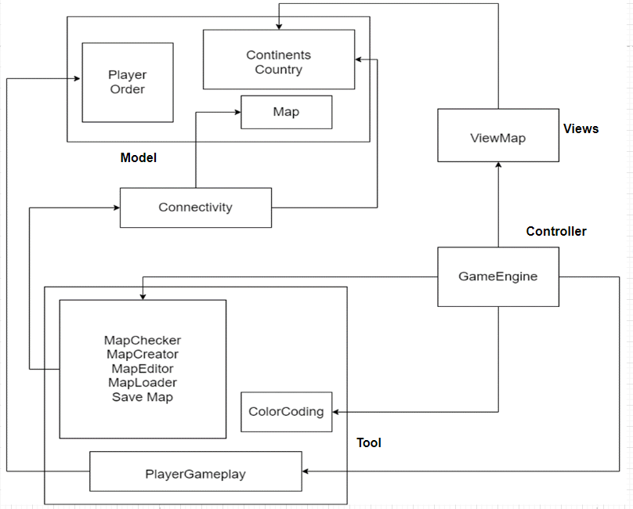
Implementation Architecture Diagram

Slide 5
MVC Architecture
Our project follows MVC architecture to organize the structure of the game
Model : Includes data for Country, Continent, Player, Order and Map containing state and behavior that can be accessed across entire architecture of the project.
Tool: Contains methods to perform startup, main game loop and execute phase.
View: Used to show the existing or updated map to the users in console. ViewMap displays Country, Continent, Neighboring countries and Army Control value in tabular format.
Controller: Acts as an intermediary between Model and View which takes user inputs via the View, processes it by interacting with Model and then updates the view to reflect the result. GameEngine is the center of the game that controls the entire functionality of the game

Slide 6
Javadoc Javadoc documentation on all the classes, data members, and member functions has been implemented to generate comprehensive and easily navigable documentation in HTML format. Syntax: /** * Javadoc comment * */
@param | provide information about method parameter or the input it takes
@see | generate a link to other element of the document
@version | provide version of the class, interface or Enum.
@return | provide the return value
@author | Describes an author
@throws | Throws exception if something goes wrong

Slide 7
Junit
Includes 20+ test cases to cover the important test scenarios of the game mentioned below:
Assesses the accuracy of the "assigncountries" feature.
Validates the functionality of editing map commands, including adding/removing countries, continents, and neighbors.
Confirms precise allocation of armies to players.

Slide 8

Thank You

