Slide 1

VCS: Git
Day 19

Slide 2
1
Git
Outline Class
2
Git Branching
3
Git Workflows

Slide 3
Git Reset
When you want to revert the changes that you just made and go back to the files that you had.
- Hard reset
- Soft reset

Slide 4
Git Reset – Hard Reset
Removes changes on reset commits as well as uncommitted changes.
git reset --hard HEAD (going back to HEAD)
git reset --hard HEAD^ (going back to the commit before HEAD)
git reset --hard HEAD~1 (equivalent to "^")
git reset --hard HEAD~2 (going back two commits before HEAD)
git reset --hard [commit] (going back to commit)
comA
comB
comC
git reset --hard comB
comA
comB

Slide 5
Git Reset – Soft Reset
Make changes on reset commits on stage.
git reset --soft HEAD (going back to HEAD)
git reset --soft HEAD^ (going back to the commit before HEAD)
git reset --soft HEAD~1 (equivalent to "^")
git reset --soft HEAD~2 (going back two commits before HEAD)
git reset --soft [commit] (going back to commit)
Files on comC is on staged
comA
comB
comC
git reset --soft comB
comA
comB

Slide 6
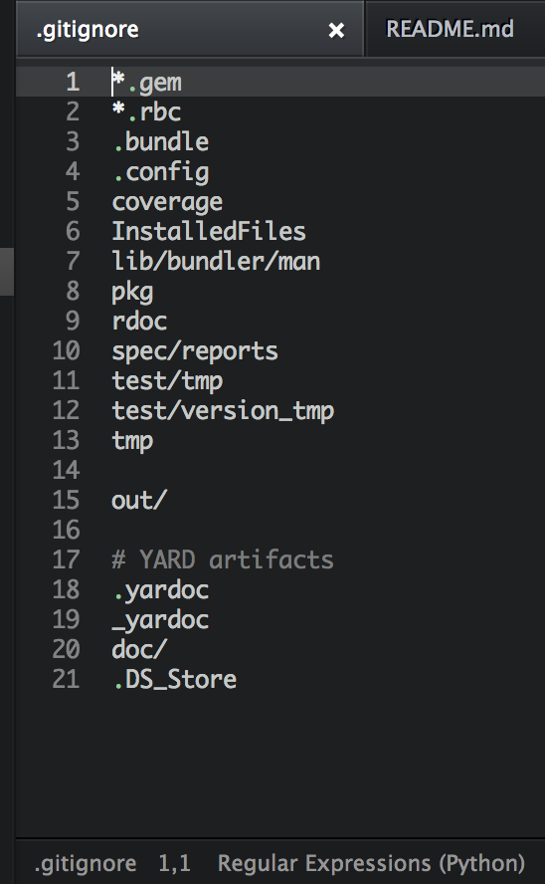
.gitignore
Specifies intentionally untracked files that Git should ignore.

Slide 7
Git Tagging
Typically, people use this functionality to mark release points (v1.0, v2.0 and so on).
To tag specific points in a repository’s history as being important. Typically, people use this functionality to mark release points (v1.0, v2.0).
git tag –a [tagname] –m “[message]”
git tag –a v1.4 –m “version 1.4”
To push tag to remote repository:
git push origin v1.4 -> push specific tag
git push origin --tags -> push all tags that are not already on the remote repository

Slide 8
Basic Git Workflow
feature
main / master

Slide 9
Basic Git Workflow
Create branch from master/main
feature
main / master

Slide 10
Basic Git Workflow
Commit on feature branch
feature
main / master

Slide 11
Basic Git Workflow
Merge to master/main
feature
main / master

Slide 12
Git Branches
Typically, people use this functionality to mark release points (v1.0, v2.0 and so on).
git checkout –b [branchname] -> Create the branch on your local machine and switch in this branch
git push origin [branchname] -> Push the branch to remote repository
git branch –a -> See all available branch on local machine

Slide 13
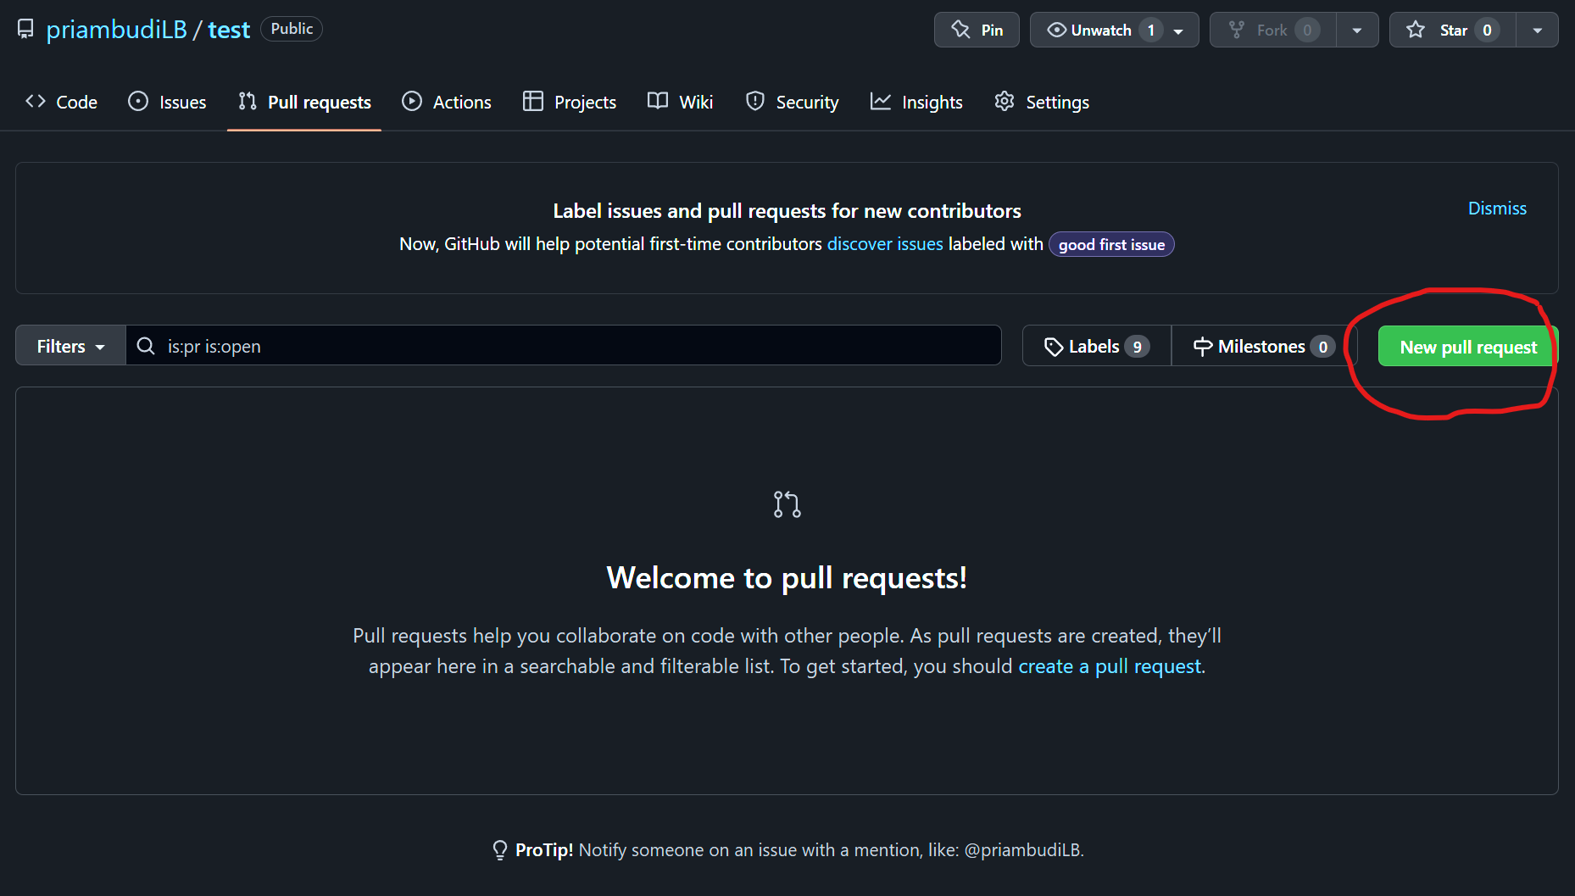
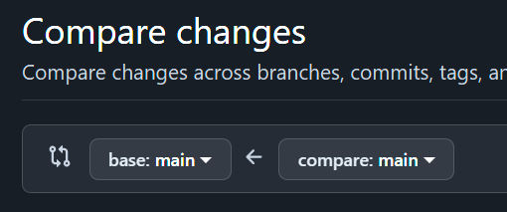
Merging Branches
Typically, people use this functionality to mark release points (v1.0, v2.0 and so on).

Slide 14
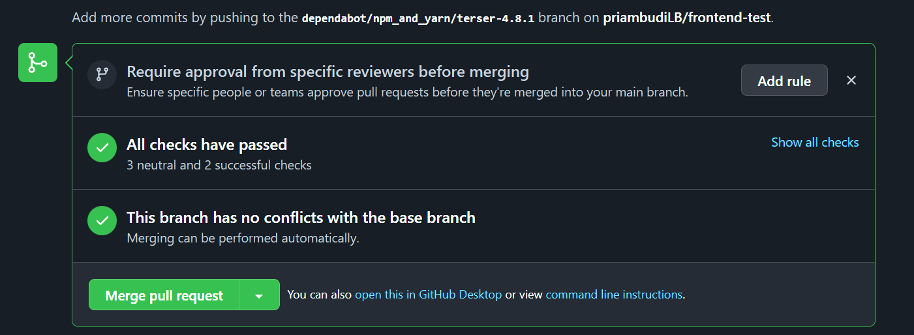
Merging Branches
Typically, people use this functionality to mark release points (v1.0, v2.0 and so on).

Slide 15
Git Workflow - Basic
feature
main / master

Slide 16
Git Workflow - Basic
feature
feature
main / master

Slide 17
Git Workflow – Fork (open source)
Repo: hehe
B: feature
Repo: hehe
B: main
Repo: test
B: main

