Slide 1

Portofolio and Business Understanding
Day 18

Slide 2
1
Portfolio
Outline Class
2
Business Understanding
3
Version Control

Slide 3
Portfolio
A Front-End Developer portfolio serves to showcase your skills, past projects, and experience with front-end development.
The benefits of having a Front-End Developer portfolio include:
Increasing credibility and visibility in a highly competitive industry
Creating trust with potential employers by illustrating your experience
Showcasing your variety of skills

Slide 4
Portfolio
Linkedin profile
Personal website
Blog (web-related)
Projects
Contribute to open-source projects

Slide 5
Business Understanding
Common Software Development Methodology
Waterfall
Agile

Slide 6
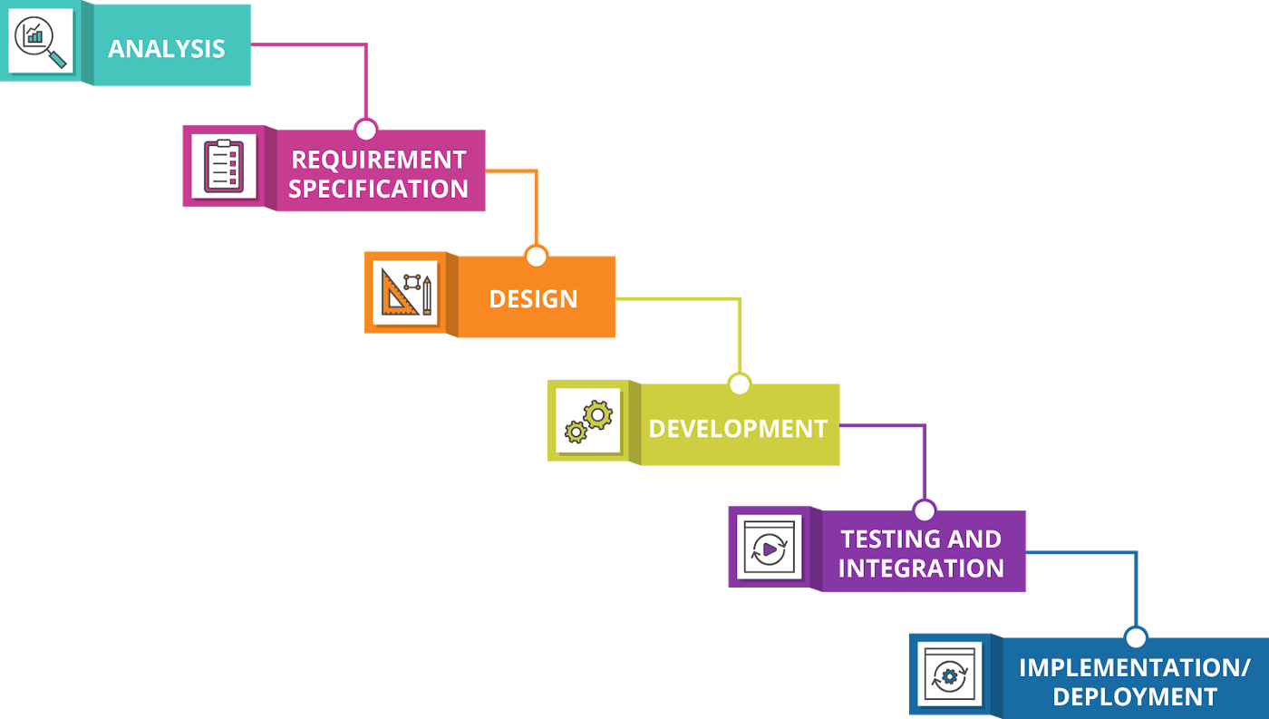
Business Understanding
Waterfall
Waterfall is a project management method that is relatively old. Waterfall emphasizes a sequential design process which in the process looks like a waterfall flow from the concept design process, project analysis, project initialization, design, system creation, testing, implementation and maintenance.

Slide 7
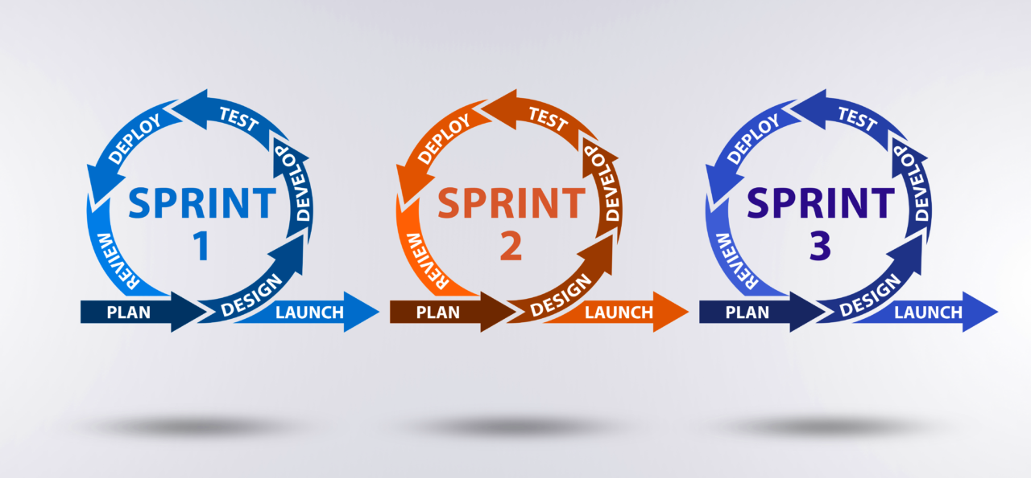
Business Understanding
Agile
A collection of software development methods based on the Iterative and Incremental Model. Agile makes it possible to develop software that has rapidly changing requirements.

Slide 8
Business Understanding
Full Stack Developer & Stakeholders
Fullstack Developers works with other stakeholders:
Product Manager
User Interface & User Experience
Frontend Developer
Backend Developer
Quality Assurance
DevOps

Slide 9
Version Control
What is Version Control?
A system that records changes to a file or set of files over time so that you can recall specific versions later.
It allows you to revert selected files back to a previous state, revert the entire project back to a previous state, compare changes over time, see who last modified something that might be causing a problem, who introduced an issue and when.

Slide 10
Git
What is Git?
Free and opensource distributed version control system.
Why Git?
Most used Version System.
Tracks the changes you create to files.
Multiple user with multiple changes or multiple user to one source.

Slide 11
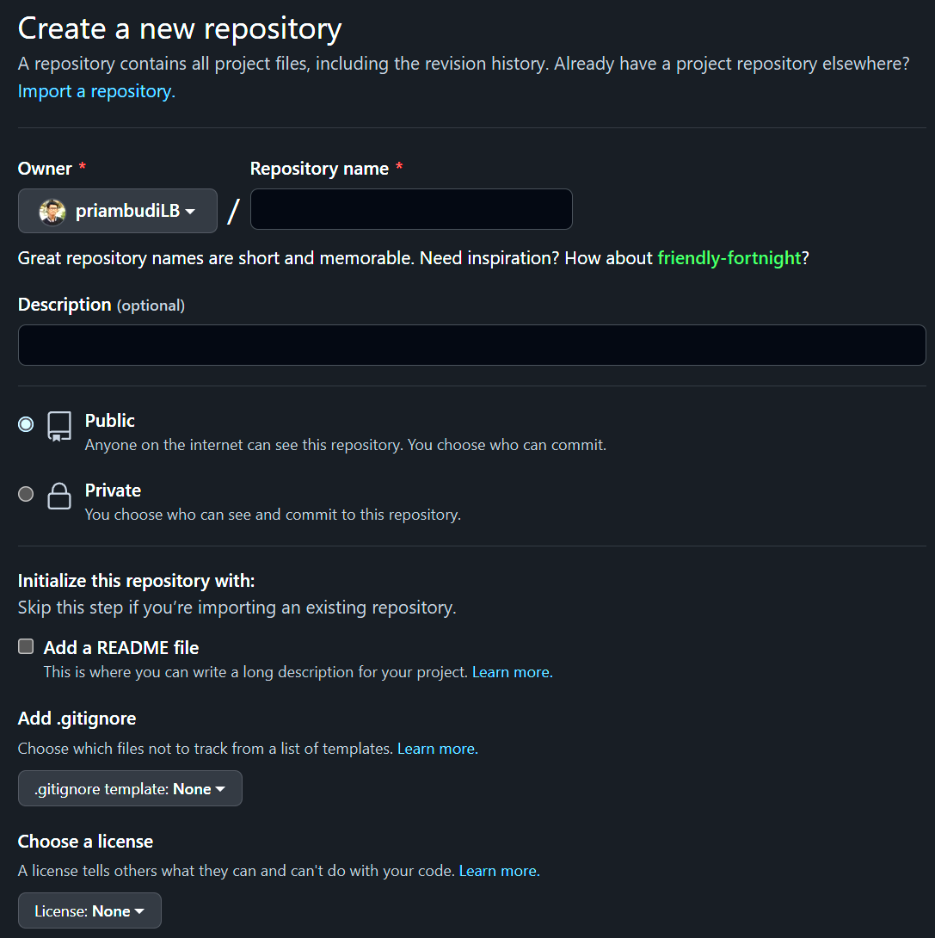
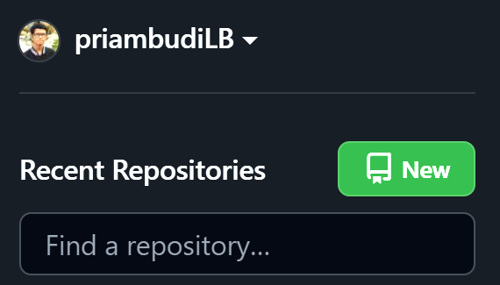
Git – Create Repository

Slide 12
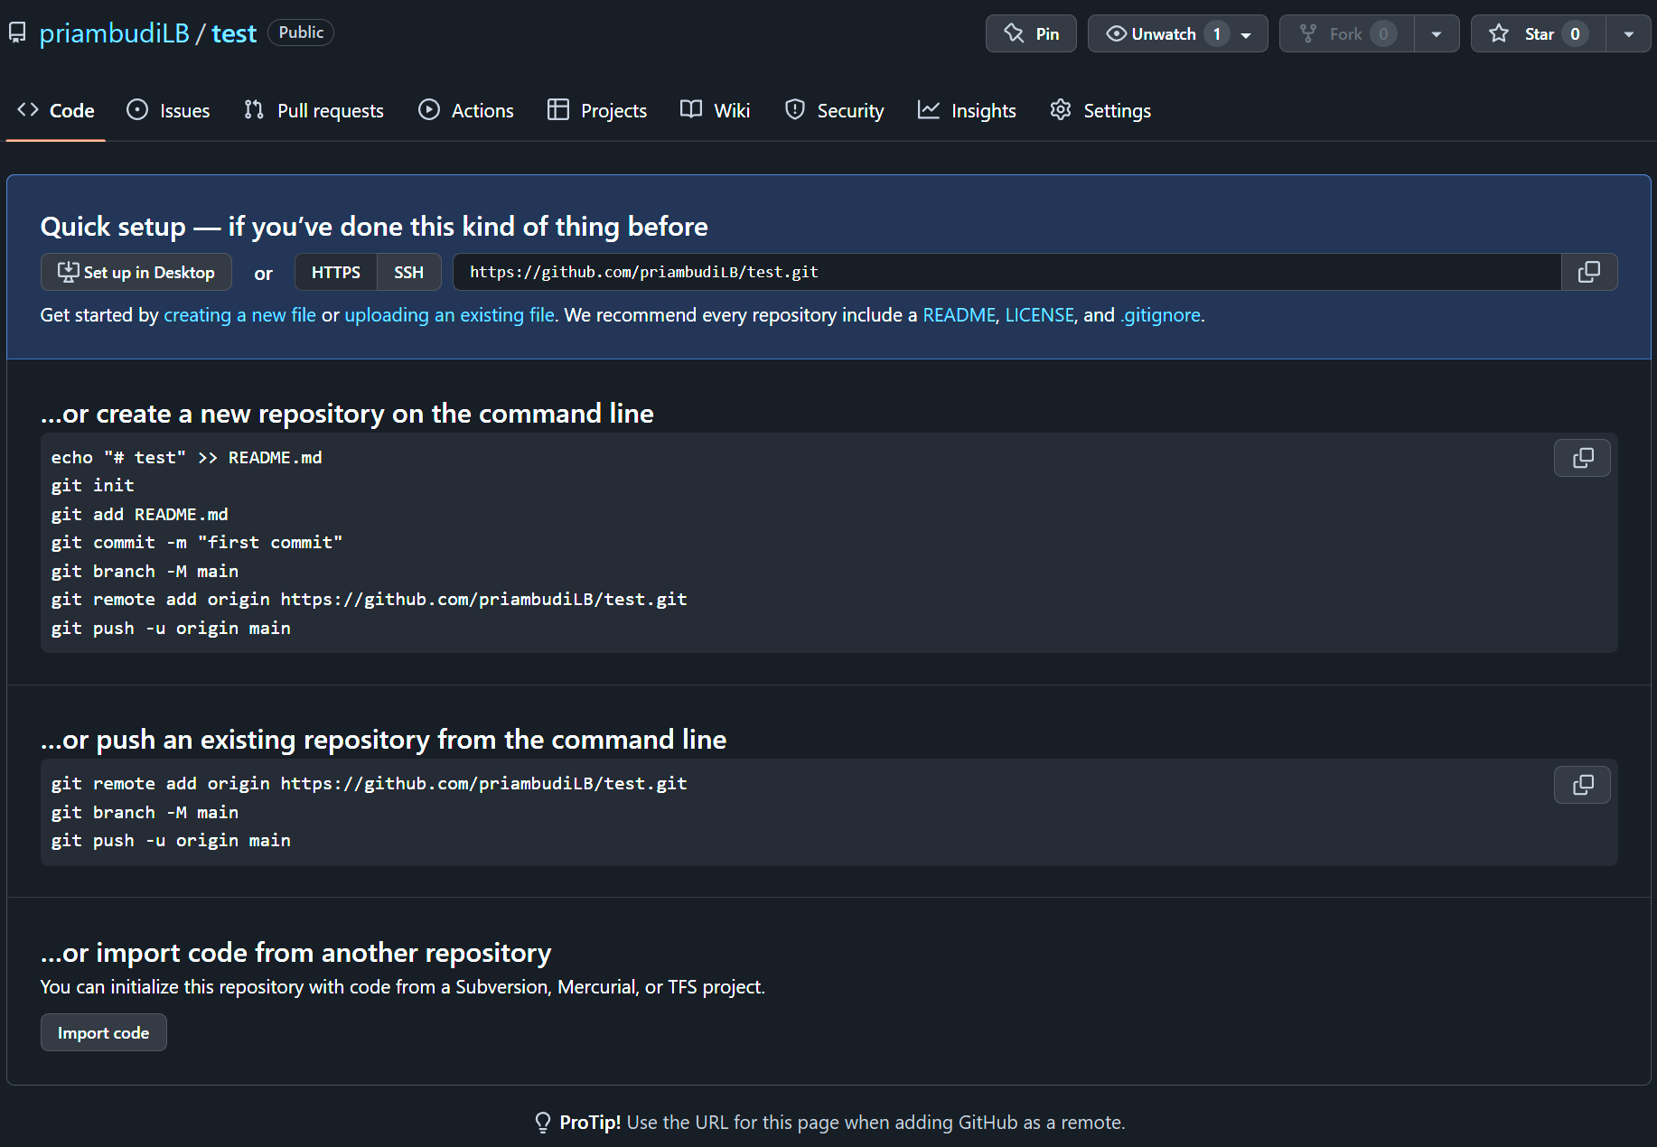
Git – Create Repository

Slide 13
Git – Create Repository
Github
Local A
Local B

Slide 14
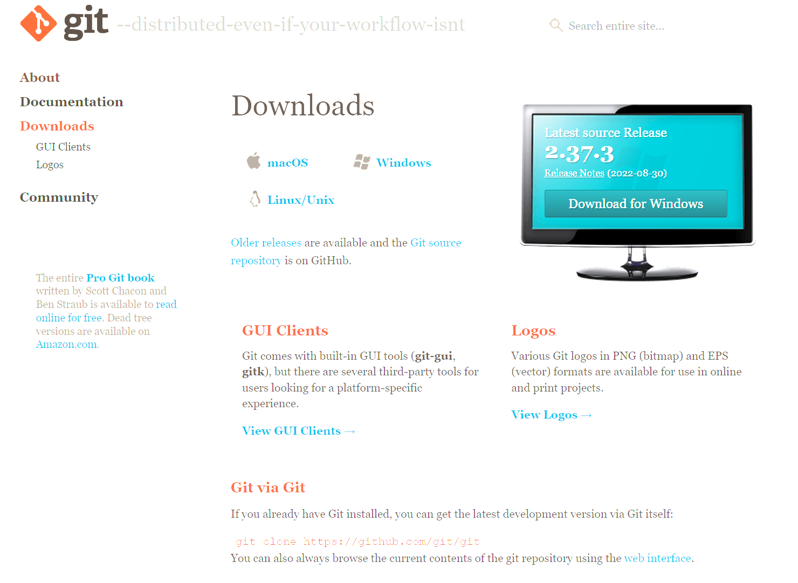
Git – Create Repository
https://git-scm.com/downloads

Slide 15
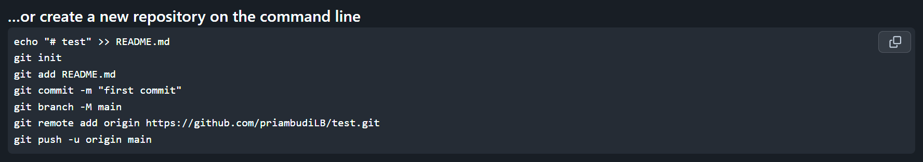
Git – Create Repository

Slide 16

Git Commands - add
Adding file(s) to be committed.
git add [filename] -> add 1 file
git add . -> add all file on current directory

Slide 17

Git Commands - commit
To save locally, file(s) that have been added.
git commit –m “commit message”

Slide 18
Git Commands - commit
Can commit (added files) more than once.

Slide 19
Git Commands - push
To upload / “Push” commits to other repository.
Github
git push [remote] [branch]
git push origin master
Local A

Slide 20
Git Commands - push
To upload / “Push” commits to other repository.
Github
Local A

Slide 21
Git Commands - pull
To download / “Pull” commits to other repository.
Github
git pull [remote] [branch]
git pull origin master
Local A

Slide 22
Git Commands - pull
To download / “Pull” commits to other repository.
Github
Local A

Slide 23
Git Commands - clone
To create local repository instantly, cloning existing target repository.
Github
git clone [https/ssh address]
Local A

Slide 24
Git Commands - clone
To create local repository instantly, cloning existing target repository.
Github
Local A

