Slide 1
A Novel Support Vector Machine Approach to High entropy Data Fragment Classification
ASHISH PERALA
1602-19-733-065

Slide 2
Abstract
A major challenge in digital forensics is the efficient and accurate file type classification of evidence data fragments, in the absence of header and file system information
For example, when we try to recover important data from a hard disk with a corrupted partition table, it is desirable to identify the type of the data fragments found on the hard disk before trying to recover the data
Although it is often easy to distinguish between high entropy file types (e.g., compressed data-JPEG, zip, EXE files) and low entropy types (e.g., text files and HTML files), the challenge arises when it is required to differentiate among high entropy file types.
So we use Support Vector Machine(SVM) in which we extract feature vectors from the byte frequencies of a given fragment, and use an SVM to predict the type of the fragment under supervised learning

Slide 3
Introduction
A typical approach to data fragment classification is to examine its byte frequency histogram
A statistical distance between the histogram and known distributions of different types of files can be computed and used to differentiate different data types
This is used in methods like Oscar… but the accuracy suffers for very high entropy file types where the histograms may look alike
Another method is to look for the existence (or the lack of) certain keywords that would only appear (or would never appear) in certain types of files
it works for high entropy file types where a certain byte pattern appears significantly more (or significantly less) often than others, it does not work well when there is no obvious pattern in the data.
Machine learning methods like Fisher’s linear discriminant on a combination of a number of different statistics, which achieves reasonable accuracies at the cost of classification complexity are proposed
Later SVMs are given in which we treat the histogram derived from a data fragment as its feature vector, and use a trained SVM to classify a given feature vector

Slide 4
Related work
McDaniel and Heydari (2003) proposed three algorithms, Byte Frequency Analysis (BFA), Byte Frequency Cross-correlation (BFC) and File Header/Trailer (FHT), to generate the characteristic fingerprints to identify different computer file types.
The classification accuracy was 27.50%, 45.83% and 95.83% for the BFA, BFC and FHT algorithms, respectively
Li et al(2005) proposed enhanced version to BFA algorithm where each file type were computed by clustering the training files using K-means algorithm.
The classification accuracy approached 100% when only the first 20 bytes of the files were used to create the fingerprints. As the modeled portion increased in size, itdropped to 76.8% for gif files and 77.1% for jpg files
Karresand and Shahmehri (2006) proposed Oscar method where they built centroids of the mean and standard deviation of the byte frequency distribution of different file types.
The classification accuracy for JPEG files is 99% but for zip and exe files is 37%

Slide 5
Conti….
Hall and Davis (2006) proposed measuring the entropy and the data compressibility of the file using sliding windows of fixed sizes. The sliding window compressibility utilized the LZW algorithm.
The classification accuracy for zip files was 12%
Erbacher and Mulholland (2007) proposed keyword based methods to identify and locate presence of data of a particular type within a file or on a disk
Veenman (2007) proposed combining the byte frequency histogram, the entropy information and the Kolmogorow complexity measurement to classify the file type of a cluster.
The classification accuracies for the html, jpeg and exe types at 99%, 98% and 78% resp. but only 18% for zip and 59% for pdf

Slide 6
Support Vector Machines(SVMs)
SVMs are machine learning algorithms that are very useful in solving classification problems.
They solve this problem by first building a model from a training set and use it to predict classes of data samples of unknown classes
The accuracy of the SVM can be defined as the percentage of the testing samples with correctly predicted class labels
A support vector machine treats all the features of a data sample as a point in a high dimensional space, and tries to construct hyperplanes to divide the space into partitions
Points with different class labels are separated while those with the same class label are kept in the same partition

Slide 7
Conti…
To build the model from the training set, the key is to choose the right kernel function and find its optimal parameters. Some of the most commonly supported kernel types include: (1) linear, (2) polynomial, (3) radial basis function (RBF), and (4) sigmoid
Once a kernel function is chosen, the optimal parameters are selected using a k-fold cross-validation procedure
The accuracies are then averaged and recorded as the accuracy of the selected parameters. This procedure is iterated for many possible combinations of parameters until a certain stop condition is satisfied.
The parameters are optimized in this way to avoid over-training of the SVM, which yields good results on the training set but poor results for unseen testing data

Slide 8
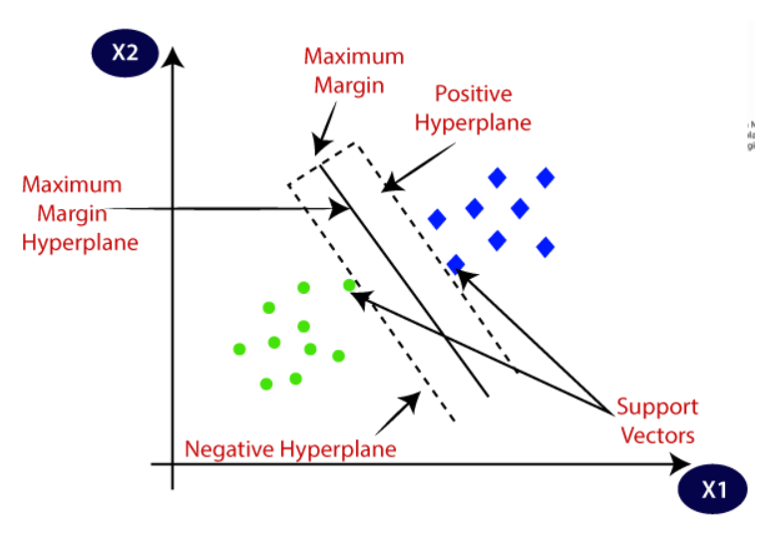

Slide 9
Proposed method
Assumptions and models:
We assume that each time we are given one fragment for classification, and the result is independent of any other fragments
In reality, this memoryless model is clearly an over simplification, since neighboring memory fragments are likely to be of the same type, where neighboring may mean physical proximity or logical distance, e.g., consecutive memory address locations
We consider n distinct types of data, where no type is a sub-type of another. In other words, given a data fragment, it should unambiguously belong to exactly one of the n types. For example, we can consider two types: JPEG and MP3, which are mutually exclusive1, but we cannot have TIFF and JPEG, since the former is a container type and may contain a JPEG image
Another more general kind of questions are those that require to identify the given data fragment as one out of n types, where n > 2. This is often referred to as multi-class classification problems

Slide 10
Conti….
Feature representation:
let f be a data fragment of ℓ bytes. The size ℓ is a multiple of the sector size, which is 512 in a typical file system. For example, ℓ may be 4096, a typical size of a cluster or a memory page in an operating system with paged memory. We treat each byte as an unsigned integer, with values from 0 to 255.
The feature vector vf of a data fragment f is defined as the sequence vf =<p0,p1,…,p255> , where pi is the frequency at which byte value i occurs in f. For example, if byte 0x00 occurs c times in a fragment of size ℓ, we compute p0 = c/ℓ. In other words, each feature vector represents the histogram of the data bytes.
When an SVM is applied, each data fragment (i.e., each feature vector) is considered as a point in a 256 dimensional space or mapped to a higher dimensional space. The objective is to construct hyperplanes to partition the space according to the different types and put these points into appropriate partitions in the space that represent the different types

Slide 11
Conti….
Training and prediction
Support vector machines are a group of supervised machine learning algorithms that need to be trained before it can be used for classification.
To train an SVM, we firstly gather data fragments from files with known types, and then we feed the feature vectors of the data fragments and their type information to the SVM
Then choose one of the kernel functions and then search for optimal parameters using cross validation techniques
In the end we determine the set of parameters to be used for the SVM and build corresponding trained models
With the trained models and optimal parameters, we can ask the SVM to predict the type of a new data fragment.

Slide 12
Evaluation
Training and testing datasets:
To create the training dataset, 800 JPEG images, 800 MP3 music files, 800 PDF documents and 800 dynamic link library files (DLLs) are collected
Note that files with these types are usually of high entropy and the histograms of these file types are very similar
Each file is divided into 4096 bytes each, then remove the first and last segments as they are easily identified using keywords as in header and footer and also they contain data that is not part of the main contextual content
We then compute the training feature vectors from the remaining parts of the training files by counting the frequencies at which each of the byte values occur in each file.
In addition to the training data, 80 JPEG images, 80MP3 music files, 80 DLLs and 80 PDF documents are collected for testing and divided into 4096 bytes with first and last fragments removed
testing feature vectors are computed from the testing files. However, instead of computing one vector per file, they computed one vector per data fragment

Slide 13
Conti….
SVM training and testing:
Parameter optimization for the SVM :
Choose the kernel type.
Choose a set of parameters according to the kernel type and previous results.
Perform a 5-fold cross validation.
Record the resulting accuracy.
Check the completion condition and repeat from Step 2 if necessary.
Repeat from Step 1 until all supported kernel types are tested.
Note that Step 2 and 5 are specific to the kernel types and we omit the details here.
After the SVM is trained, we test the accuracy of the SVM by using data fragments extracted from the testing dataset

Slide 14
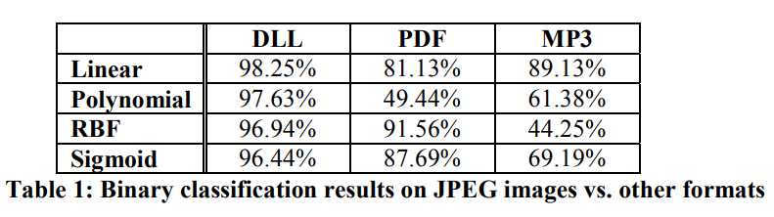
Results
The experiment results of binary classification are obtained using the JPEG image fragments against fragments in DLL, PDF and MP3 formats. The results are summarized in Table 1:
We observe that the SVM performs well when the kernel type is chosen correctly. In particular, linear kernel works best for 2 of the 3 file types, and works reasonably well for all 3 types.

Slide 15
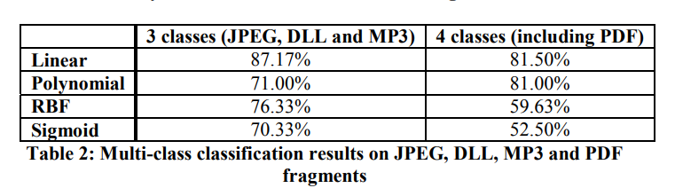
Conti….
For multi-class classification, we present the results in Table 2:
From Table 2 we can see that, in general, the classification accuracy drops as the number of classes increases. Part of this performance drop may be due to the overlap between JPEG and PDF files. Nevertheless, the linear kernel SVM maintains high accuracies for multiple file types for these high entropy data fragments.

Slide 16
Conclusion
In this paper we studied the problem of the file type classification of evidence data fragments in the absence of header and file system information
Previous statistical approaches are mainly based on computing the statistical distance between a given data fragment and known file types
Although these previous techniques can achieve certain level of accuracy in some cases, but they fail to handle high entropy file types, such as multimedia files, compressed archives and executable programs
Support vector machines maintain the simplicity of the classification system and achieve high efficiency, where a simple feature vector space, namely the byte frequencies, are used and SVM is trained with large amount of data and performed parameter optimization to achieve high accuracy
Compared with the previous methods, we can achieve a high accuracy by using the byte frequencies, which makes our scheme efficiently implementable and robust.
It is also proven that when trained with properly chosen parameters, SVM can be very powerful in differentiating data fragments from different types of files, even when no header or structure is available in the fragment.

Slide 17


