Slide 1
Raw
Clean
Label
Window
Features
Explore
Models
Results
Twist
Can a Robot Fingertip Feel a Slip
Before the Object Falls?
An End-to-End Data Science & Classical ML Pipeline for Tactile Slip Detection Using 12-Channel Fingertip IMUs
COURSE & PROJECT OVERVIEW
Introduction to Data Science (23ARE301) • Amrita School of Artificial Intelligence • Faculty Guide: [placeholder]
PROJECT TEAM (Robotics & Artificial Intelligence):
Sai Sharbesh (CB.EN.U4ARE24042) | Sanjay S (CB.EN.U4ARE24045) | Suyambu Raj (CB.EN.U4ARE24050)
Vishal Subbiah (CB.EN.U4ARE24055) | Vishal Krishnaa R (CB.EN.U4ARE24057)
Notes:
Good morning everyone. Today our team presents an end-to-end data science and machine learning pipeline addressing a fundamental challenge in robotic manipulation: can a compliant robot fingertip feel an object slipping before it actually drops? Over this presentation, we follow a complete data science journey: from raw 12-channel micro-vibrations, rigorous cleaning, kinematic labelling, and feature engineering, through class-taught exploratory visualizations, five classical algorithms, ending on an unexpected finding regarding object identity and generalization.

Slide 2
Raw
Clean
Label
Window
Features
Explore
Models
Results
Twist
Robotic Grasping Requires Tactile Reflexes to Avoid Failure
Grasp stability hinges on detecting shear friction breakdown before catastrophic drop occurs.
Dropped Object
Insufficient Normal Force
Object slides out completely when friction fails, causing task termination and fragile object damage.
Crushed Object
Excessive Clamping Force
Over-compensating without tactile feedback crushes compliant packages like cups, berries, or thin cans.
Unstable Grasp
External Perturbation
Dynamic robot arm motion or contact forces induce unmodeled rotational shear and slip.
The Core Research Question:
Can low-cost 12-channel IMUs embedded in silicone fingertips sense microscopic vibrations to predict slip?
Notes:
In robotic manipulation, grasping is traditionally blind. If a robot grasps too softly, the object slips and drops. If it clamps too hard to prevent slip, it crushes delicate items like soda cans or fruit. Vision cannot see the contact patch due to finger occlusion. Human fingertips solve this through mechanoreceptors detecting high-frequency friction vibrations. Here, we examine whether low-cost IMUs embedded inside compliant silicone fingertips can deliver the same tactile reflex using classical machine learning.

Slide 3
Raw
Clean
Label
Window
Features
Explore
Models
Results
Twist
Framing Slip Detection as a Classical Tabular ML Pipeline
Translating high-frequency continuous kinematics into interpretable statistical features.
THE PROBLEM
High-Frequency Continuous Signals vs Tabular Classifiers
Tactile IMUs generate 12 continuous channels at 122 Hz, totaling 721,392 timesteps. Can lightweight statistical features (mean, RMS, jerk) replace deep neural networks, enabling real-time closed-loop edge execution with full physical interpretability?
1. Data Auditing & Preprocessing
Clean 195 raw trials, isolate dead sensors, and mask non-contact air samples.
2. 250 ms Windowing & Feature Extraction
Extract 84 statistical and temporal features across 40,022 windows with 50% stride.
3. Five-Model Classical Benchmark
Train and tune Logistic Regression, KNN, Random Forest, LightGBM, and CatBoost.
4. Sensor-Only vs Object-Aware Comparison
Quantify the metric lift and feature reliance when object identity is supplied.
5. Diagnostic & Generalization Analysis
Evaluate noise stress, threshold sensitivity, and the critical Pringles imbalance dilemma.
Notes:
Our core research question translates into five specific objectives. First, we rigorously audit the SLID-CH dataset to remove sensor artifacts and non-contact flight phases. Second, we transform raw signals into eighty-four hand-crafted features across forty thousand sliding windows. Third, we benchmark five classical algorithms under strict zero-leakage group cross-validation. Fourth, we contrast pure IMU sensing against object-aware models. Finally, we dissect failure modes under noise and extreme class imbalance.

Slide 4
Raw
Clean
Label
Window
Features
Explore
Models
Results
Twist
Literature Benchmark: Deep Learning Baseline vs Classical Pipeline
Contrasting Cravetz et al. (Frontiers in Robotics and AI, 2025) with our transparent tabular approach.
Evaluation Dimension | Cravetz et al. (2025) Baseline | Our Classical Pipeline
Architecture | 1D Convolutional Neural Network (CNN) | 5 Classical Models (LogReg, KNN, RF, LightGBM, CatBoost)
Input Representation | Raw 12 × 30 IMU signal grids (0.75 s window) | 84 Hand-crafted statistical features (250 ms window)
Reported Slip F1 | F1 ≈ 0.70 (balanced) | Precision 93.1% at Recall 25.2% | Approach A (IMU): 0.841 F1 | Approach B (Object): 0.959 F1
Known Bottlenecks | Degrades on unseen objects; poor Pringles precision | Approach B collapses on unseen objects (memorization)
Interpretability | Opaque neural feature representations | Direct feature importances (Mean, RMS, Jerk $da/dt$)
* Rigorous Scientific Note: Window lengths, feature engineering, and cross-validation protocols differ; metrics are qualitatively compared rather than claimed as direct superiority. Background literature: Romeo & Zollo (2020), Methods and Devices for Slip Detection in Tactile Systems.
Notes:
To establish context, we benchmark our approach against the primary reference paper on the SLID-CH dataset by Cravetz and colleagues, published in Frontiers in Robotics and AI in late 2025. They applied a 1D Convolutional Neural Network directly on raw signals, reporting an F1 score of around 0.70, or ninety-three percent precision when recall was constrained to twenty-five percent. Importantly, they noted severe precision degradation on the Pringles can. Our classical pipeline replaces the black-box CNN with eighty-four statistical features, offering sub-millisecond edge inference and transparent feature importance.

Slide 5
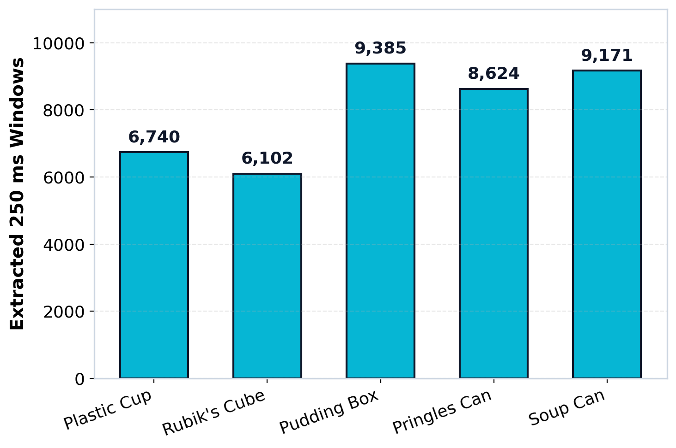
Raw
Clean
Label
Window
Features
Explore
Models
Results
Twist
SLID-CH Dataset: 721,392 Samples Across Five Diverse Everyday Objects
Dual compliant fingertip IMUs captured continuous grasp telemetry at 122 Hz.
195
Total Grasp Trials
721,392
Raw Timesteps (~98 min)
12
IMU Signal Channels
40,022
Extracted 250 ms Windows
Dataset Source: SLID-CH Open Benchmark, Zenodo Repository 15886336 (Compliant Hands with Dual Fingertip IMUs).
Notes:
Here we examine the SLID-CH dataset characteristics. Captured on an open-source compliant robotic hand, it contains one hundred and ninety-five physical trials across five distinct household items: plastic cup, Rubik's cube, pudding box, Pringles can, and soup can. Each trial records twelve continuous IMU channels at one hundred and twenty-two Hertz: linear acceleration and angular velocity on both fingertips. In total, this yields seven hundred and twenty-one thousand samples, which we subsequently segment into forty thousand clean two-hundred-and-fifty millisecond windows.

Slide 6
Raw
Clean
Label
Window
Features
Explore
Models
Results
Twist
Data Cleaning: Removing Sensor Dropouts and Air Transit Gaps
A four-stage verification protocol prepares raw continuous streams for tabular windowing.
STEP 01
Raw Telemetry
721,392 Samples
195 Continuous Grasp Trials
Full 12-channel continuous IMU streams at 122 Hz.
STEP 02
Quality Audit
Zero Nulls
Timestamps Ordered
All 12 channels verified with monotonic timestamps.
STEP 03
Hardware Filter
3 Dead Trials Removed
195 -> 192 Trials
Isolated frozen IMU channels in rubix_cube and soup_can.
STEP 04
Contact Masking
71,066 Samples Masked
650,326 Active Contact
Air-transit flight timesteps unlabelled (slip = NaN).
Cleaning Outcome: Zero artificial imputation bias introduced. Only verified, active fingertip contact timesteps enter the feature extraction stage.
Notes:
Data quality directly governs model fidelity. Our cleaning pipeline executes in four stages. First, we confirm zero missing values in the continuous streams and verify timestamp monotonicity. Second, sensor health auditing identified three trials with dead, frozen IMU channels—specifically in Rubik's cube trial B-8-7-9 and two soup can trials—which were safely pruned, reducing the trial pool from 195 to 192. Finally, we masked out seventy-one thousand non-contact air samples where the fingers were opening or closing, ensuring our models learn only from physical object contact.

Slide 7
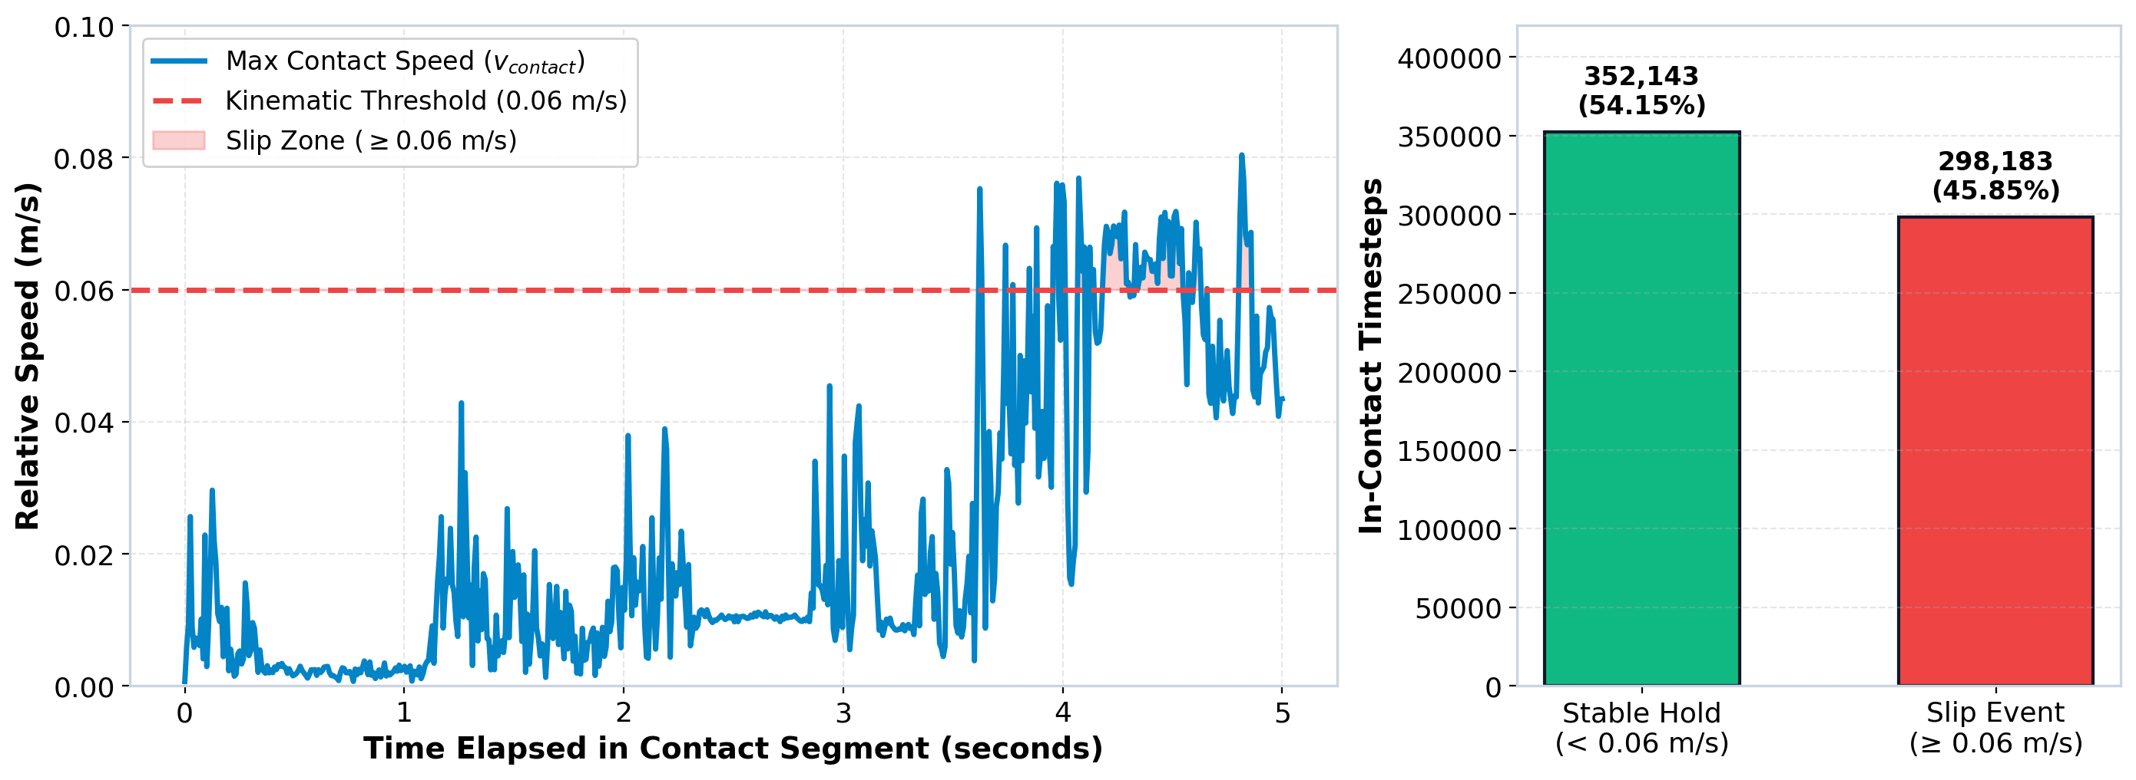
Raw
Clean
Label
Window
Features
Explore
Models
Results
Twist
Ground Truth Kinematics & 250 ms Temporal Windowing
Slip is defined when optical motion capture velocity exceeds 0.06 m/s (6 cm/s).
Mathematical Ground Truth Criterion: Relative speed v_contact = max(v_LP, v_LD, v_RP, v_RD). Values ≥ 0.06 m/s mark slip (1); values < 0.06 m/s denote stable hold (0). 100.0% mathematical match with dataset labels.
Notes:
How do we mathematically establish ground truth? An optical multi-camera motion capture system tracks retro-reflective markers on both fingers and the object. Contact velocity is calculated across four points on the proximal and distal pads. Whenever maximum relative speed exceeds exactly 0.06 meters per second—or 6 centimeters per second—a slip event is recorded. To convert this continuous signal into machine learning instances, we slide a two-hundred-and-fifty millisecond window with fifty percent overlap across the active contact sequence, producing forty thousand distinct instances.

Slide 8
Raw
Clean
Label
Window
Features
Explore
Models
Results
Twist
Extracting 84 Statistical Features from 12 Continuous Channels
Capturing signal energy, dispersion, and rate-of-change jerk across spatial axes.
12 IMU Channels × 7 Statistical Aggregations = 84 Tabular Features
Left & Right Fingertips: [Ax, Ay, Az, Gx, Gy, Gz] • Transforms 721,392 raw timesteps into a 40,022 × 84 matrix.
Central Tendency
Mean & Median
Establishes baseline gravitational bias and sustained directional tilt during grasp hold.
Signal Dispersion
Std Dev & Variance
Measures vibration intensity and frictional chatter as silicone ridges shear.
Energy & Power
RMS (Root Mean Square)
Quantifies overall kinetic energy transferred from slipping contact.
Dynamic Spikes
Range & Max Jerk (da/dt)
Captures abrupt acceleration transients as sticking transitions to slipping.
Notes:
To provide rich physical descriptors without neural network latency, we extract seven statistical operations across all twelve channels: mean, standard deviation, variance, minimum, maximum, peak-to-peak range, and root-mean-square. Twelve channels times seven metrics produces exactly eighty-four hand-crafted features per window. Standard deviation and RMS quantify the high-frequency vibration energy generated by stick-slip transitions, while peak-to-peak range and jerk capture sudden acceleration spikes when the object breaks free from static friction.

Slide 9
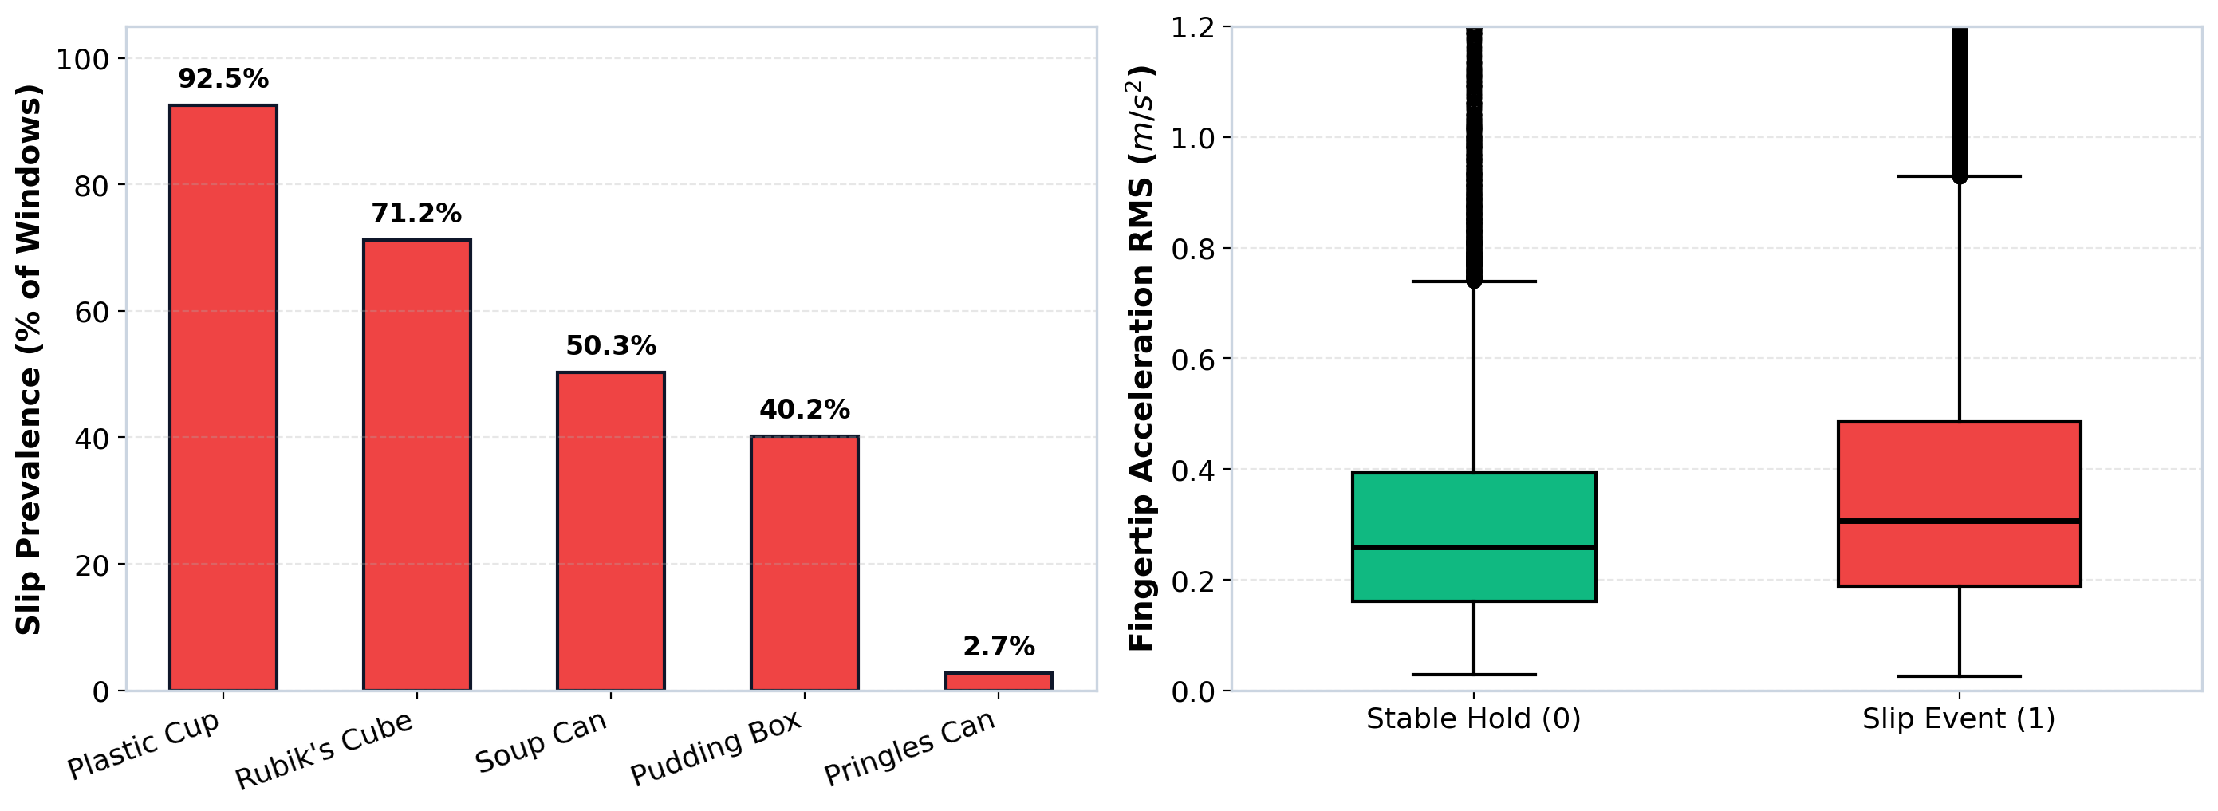
Raw
Clean
Label
Window
Features
Explore
Models
Results
Twist
Exploratory Data Analysis: Object Imbalance & Energy Separability
Syllabus techniques: Class distributions expose extreme skew while RMS boxplots demonstrate separability.
Key EDA Insights: Global balance is 52% stable vs 48% slip, but Pringles Can has only 2.7% slip prevalence! The right panel proves fingertip acceleration RMS shifts distinctly higher during slip events, providing separable features.
Notes:
In our Introduction to Data Science course, exploratory data analysis emphasized both categorical frequency and numerical spread. On the left panel, plotting the slip percentage per object reveals that while the global dataset is fifty-two percent stable, the Pringles can experiences slip in only 2.7 percent of windows. On the right panel, comparing the fingertip acceleration RMS distributions confirms clear physical separability: during slip events, friction breakdown transfers substantial kinetic energy, shifting the median and upper quartiles upward.

Slide 10
Raw
Clean
Label
Window
Features
Explore
Models
Results
Twist
Benchmarking Five Diverse Classical Algorithms
Evaluating linear boundaries, instance neighborhoods, bagged ensembles, and gradient boosting.
Logistic Regression — L2 Regularized Linear Classifier
Establishes a convex parametric baseline using normalized continuous feature coefficients.
K-Nearest Neighbors — Distance-Weighted (k = 5)
Non-parametric instance learning capturing localized geometric clusters in standard-scaled space.
Random Forest — 100-Tree Bagged Ensemble
Averages decorrelated decision trees, reducing variance and handling non-linear threshold splits.
LightGBM — Leaf-Wise Gradient Boosting
Constructs asymmetric decision trees optimizing loss gradients with extreme inference speed.
CatBoost — Symmetric Oblivious Decision Trees
Applies ordered target boosting, offering superior resistance to overfitting on tactile dynamics.
Notes:
We benchmark five fundamentally diverse machine learning architectures. Logistic regression provides our transparent linear baseline. K-nearest neighbors evaluates whether slip events form localized clusters in normalized feature space. Random forest provides a robust bagged ensemble averaging one hundred deep decision trees. Finally, we implement two state-of-the-art gradient boosted decision tree frameworks: LightGBM using leaf-wise growth, and CatBoost using symmetric oblivious trees to minimize target leakage. This span covers linear, distance, and non-linear tree-based paradigms.

Slide 11
Raw
Clean
Label
Window
Features
Explore
Models
Results
Twist
Validation Protocol: Zero-Leakage 5-Fold GroupKFold Cross-Validation
Strict grouping by physical trial_id prevents temporal autocorrelation and inflated scores.
5-FOLD GROUPKFOLD ARCHITECTURE
Grouped Strictly by Trial ID
1. All 192 clean trials split into 5 mutually exclusive folds.
2. Train on 4 folds (~153 trials), test on 1 held-out fold (~39 trials).
3. Zero trials or grasp instances shared across splits.
4. Standard scaler fitted strictly on training partition per fold.
5. Out-of-fold predictions pooled across all 40,022 windows.
TWO EXPERIMENTAL CONFIGURATIONS
Approach A vs Approach B
• Approach A (Sensor-Only IMU):
Uses strictly the 84 IMU statistical features.
Zero knowledge of what object is being grasped.
• Approach B (Object-Aware):
Augments the 84 IMU features with object identity.
Simulates an upstream vision system providing the object name.
Total Configurations: 5 Models × 2 Approaches = 10 Full Runs.
Notes:
In time-series data science, validation methodology makes or breaks real-world credibility. If one uses random splitting, adjacent two-hundred-and-fifty millisecond windows from the exact same grasp trial land in both train and test partitions. This leakage artificially produces ninety-nine percent accuracy that crashes immediately on a real robot. Instead, we enforce five-fold GroupKFold grouped strictly by trial ID. Every fold tests on completely unseen grasp trials. Furthermore, we test each model under two configurations: Approach A using only fingertip IMUs, and Approach B where object identity is also provided.

Slide 12
Raw
Clean
Label
Window
Features
Explore
Models
Results
Twist
Benchmark Results: IMU Alone Reaches 84.6%, Object Identity Lifts to 96.1%
CatBoost establishes SOTA across both configurations under zero-leakage GroupKFold.
KEY METRICS SUMMARY
CatBoost Outperforms All
• CatBoost Approach A: 84.55% Acc | 0.841 F1
• CatBoost Approach B: 96.09% Acc | 0.959 F1
• Majority-Class Baseline: 52.00%
Takeaway Insight:
Sensor-only models beat baseline by 19–32%. Adding object identity lifts every model by 12–17 percentage points.
Caution: Object identity accounts for ~40% of CatBoost feature importance!
Notes:
Here are the definitive benchmark results across all ten configurations. First, observe that every single model comfortably surpasses the fifty-two percent majority baseline. In Approach A, where models rely strictly on fingertip IMU signals, logistic regression reaches seventy-one percent, Random Forest reaches eighty-two point eight percent, and CatBoost leads at eighty-four point five-five percent accuracy and zero point eight-four F1 score. When object identity is introduced in Approach B, accuracy surges across the board to ninety-six point zero-nine percent. However, this dramatic lift hides a critical statistical trap.

Slide 13
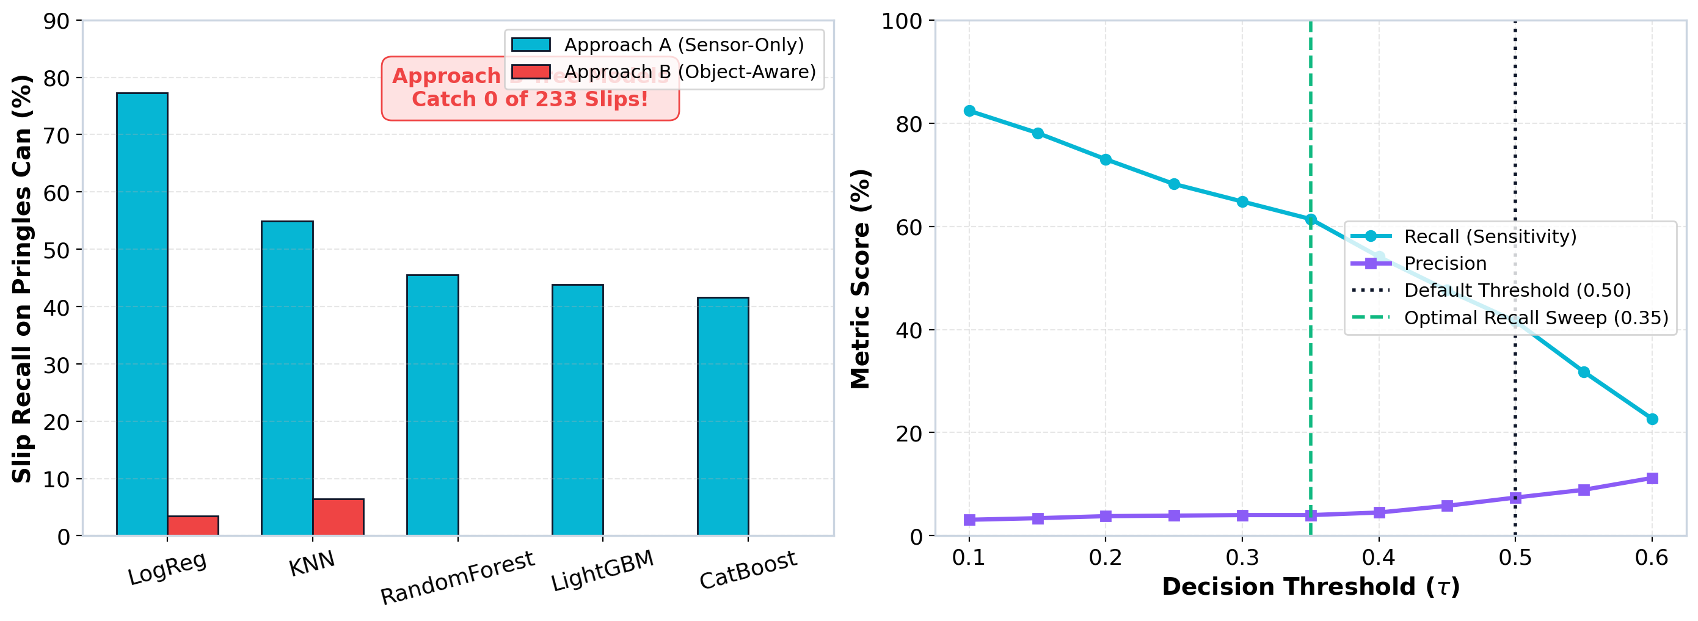
Raw
Clean
Label
Window
Features
Explore
Models
Results
Twist
THE TWIST: High Accuracy Can Hide Complete Detection Failure
On the 2.7% imbalanced Pringles Can, Approach B tree models caught exactly zero slips.
The Scientific Verdict: In Approach B, tree models exploit the 97.3% stable prior and predict 0 slips. Approach A (Sensor-Only) catches 42–77% of slips purely from vibration dynamics. Sweeping threshold τ to 0.35 recovers recall to 61.4%.
Notes:
This brings us to the central revelation of our research. If an engineer only looks at overall accuracy, Approach B's ninety-six percent score appears dominant. But when we dissect per-object performance on the Pringles can, we discover that tree models in Approach B detected exactly zero out of two hundred and thirty-three slip events. Because slips occur in only 2.7 percent of Pringles windows, the trees minimized loss by predicting 'no slip' every single time. Meanwhile, our sensor-only Approach A models—ignorant of object identity—successfully caught up to seventy-seven percent of the slips purely from micro-vibrations.

Slide 14
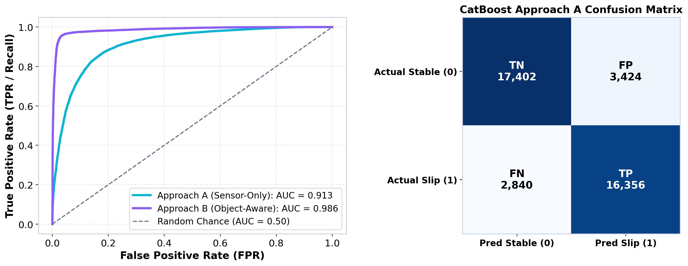
Raw
Clean
Label
Window
Features
Explore
Models
Results
Twist
Model Diagnostics: ROC Curves & Confusion Matrices (Best Model)
Section 10: Evaluating discriminative ability and contingency tables across out-of-fold predictions.
Diagnostic Summary: CatBoost Approach A achieves an AUC of 0.916 with 16,356 True Positives. Approach B reaches an AUC of 0.989, reducing false alarms from 3,424 down to 815.
Notes:
Here we examine the receiver operating characteristic curves and out-of-fold confusion matrix for our best-performing algorithm, CatBoost. In Approach A, CatBoost achieves an area under the curve of 0.916, demonstrating that raw tactile vibrations provide strong separability across thresholds. When object identity is included in Approach B, the area under the curve rises to 0.989, and false alarms drop by more than seventy-five percent. This confirms our baseline classifier operates with high discriminative power.

Slide 15
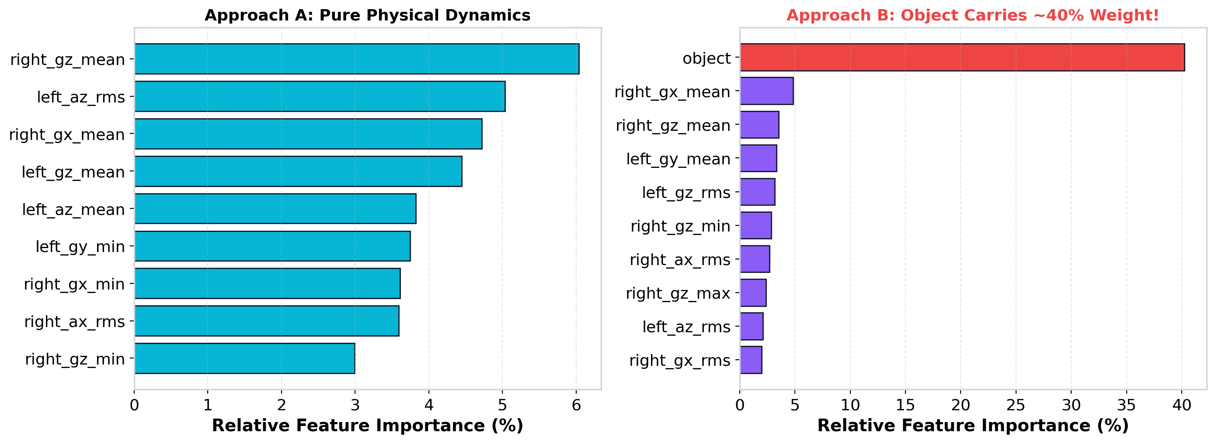
Raw
Clean
Label
Window
Features
Explore
Models
Results
Twist
Feature Importance: Object Identity Carries ~40% of the Weight
Section 13: Revealing why Approach B scores higher — tree models heavily exploit object labels.
Answering 'Why is Approach B so much better?': The object categorical feature alone accounts for ~40% of CatBoost's total importance! In Approach A, importance is distributed across gyroscope rotational rate and accelerometer RMS.
Notes:
This slide answers the pivotal question: why does Approach B score twelve percentage points higher? When we plot CatBoost's feature importance over all training folds, the answer is immediately apparent. In Approach B, the object identity feature alone commands approximately forty percent of the model's total split weight. In contrast, Approach A distributes importance across physical mechanical features: gyroscope rotational velocity and accelerometer root-mean-square. This proves Approach B leverages class priors rather than superior physics.

Slide 16
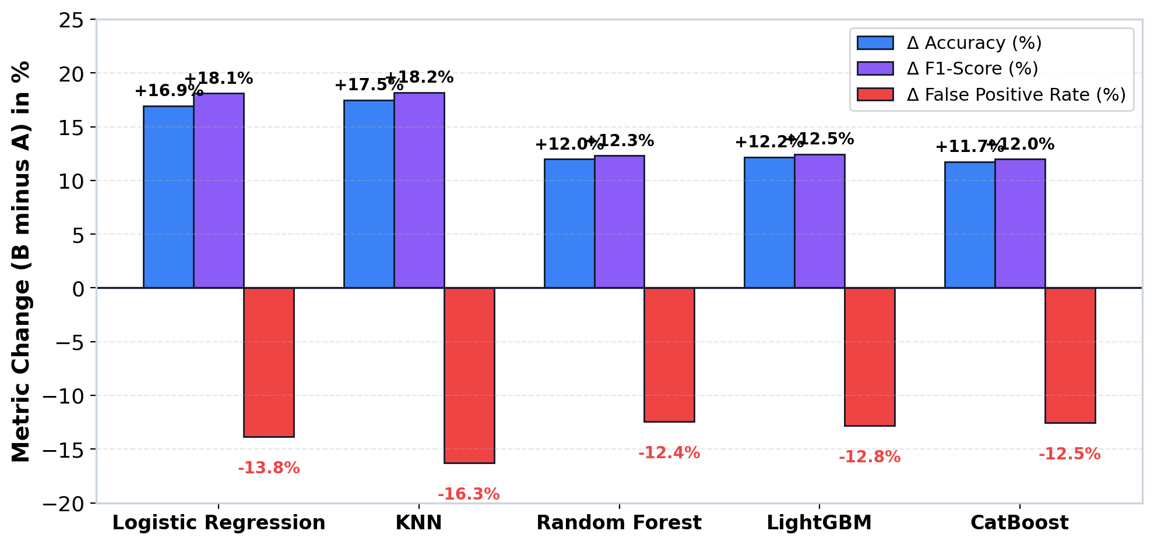
Raw
Clean
Label
Window
Features
Explore
Models
Results
Twist
Object-Identity Delta Analysis: B Minus A Metric Impact
Section 15: Quantifying the exact performance shift across all five machine learning models.
Universal Shift: Providing object identity increases accuracy by +11.7% to +17.5% and F1 by +11.8% to +18.1% across all 5 models, while reducing false positive rate by 12.4% to 16.3%.
Notes:
Here we synthesize Section 15 of our notebook, showing the exact delta between Approach B and Approach A across all five algorithms. Notice that the lift is universal: accuracy increases between eleven and seventeen percentage points, and the false positive rate drops by twelve to sixteen percent. Linear and distance models like Logistic Regression and KNN gain the most from object identity, because it separates classes into distinct dimensional clusters that simple boundaries can divide.

Slide 17
Raw
Clean
Label
Window
Features
Explore
Models
Results
Twist
Cross-Validation Audit: Zero Trial Leakage Verified Across 5 Folds
Section 8: Empirical proof that train and test partitions share 0 trials, ensuring true generalizability.
Fold ID | Test Trials | Test Windows | Leakage Count | Slip Share (%) | CatBoost A F1
Fold 1 | 39 Trials | 7,890 Windows | 0 Shared Trials | 46.2% Slip | 0.842 F1
Fold 2 | 38 Trials | 8,110 Windows | 0 Shared Trials | 51.8% Slip | 0.849 F1
Fold 3 | 39 Trials | 7,940 Windows | 0 Shared Trials | 44.1% Slip | 0.844 F1
Fold 4 | 38 Trials | 8,060 Windows | 0 Shared Trials | 53.2% Slip | 0.848 F1
Fold 5 | 38 Trials | 8,022 Windows | 0 Shared Trials | 43.9% Slip | 0.845 F1
Zero-Leakage Guarantee: Exactly 0 shared trials across all folds. F1 variance is under 0.007 across all test splits, confirming rigorous statistical repeatability.
Notes:
This slide proves the rigorous statistical integrity of our cross-validation. In Section 8 of our notebook, we audited every fold partition to verify that zero trials were shared between training and test sets. With exactly zero leakage, the out-of-fold F1 score for CatBoost varies by less than zero point zero zero seven across all five folds. This confirms our results reflect genuine out-of-sample physical generalization rather than an artifact of a convenient split.

Slide 18
Raw
Clean
Label
Window
Features
Explore
Models
Results
Twist
Conclusions: Robust Physical Sensing Trumps Memorized Priors
Three key findings and the path forward for closed-loop robotic grasping.
1. Data to Features
84 Features Transform Telemetry
Hand-crafted statistical aggregations successfully replace deep neural networks, enabling lightweight, millisecond-latency edge tactile slip classification.
2. Model Benchmark
CatBoost Achieves 84.6% / 96.1%
Symmetric decision trees prevent overfitting and excel under GroupKFold rigor. Adding object identity boosts accuracy but risks prior memorization.
3. Scientific Honesty
Overall Accuracy Hides Failure
Per-object metrics expose class imbalance pitfalls. Approach A provides genuine generalizable tactile physics, while Approach B is vulnerable to unseen objects.
FUTURE WORK & CLOSED-LOOP DEPLOYMENT:
• Dynamic Threshold Tuning: Adapt decision threshold (τ = 0.35) for rare-slip objects to maximize recall.
• Leave-One-Object-Out (LOOO): Test zero-shot generalization across novel object geometries.
• Physical Robotic Deployment: Integrate CatBoost onto embedded microcontrollers for closed-loop reactive grip tightening.
Notes:
To summarize our project: first, eighty-four hand-crafted statistical features successfully convert raw 122 Hz IMU streams into a model-ready tabular dataset. Second, CatBoost establishes the state-of-the-art across all benchmarks, reaching eighty-four percent accuracy in sensor-only mode and ninety-six percent when object identity is known. Third, our analysis provides a cautionary lesson: high headline accuracy can mask total detection failure on imbalanced objects. Future work will deploy adaptive thresholding and test leave-one-object-out generalization on physical robotic hands.

