Slide 1

Project Title: Intelligent pest management in maize using deep learning techniques
Team Number: B10
Team Members: 1. Karnika Bhardwaj 01FE19BCS085
2. Sakshi Jha 01FE18BCS182
3. Sanjay Keshwar 01FE18BCS192
4. Savitri Khyadad 01FE18BCS196
Guide : Dr. Meena S M
Under the co-guidance of Ms. Priyadarshini Patil

Slide 2
Project Overview / Summary
Domain/Problem Space :
Goals / Objectives :
Domain : Smart agriculture using deep learning techniques
We know how agriculture is an important aspect in our country and how more than 50% of the crop goes waste due to pest attacks.
So we try to improvise the harvest for a better yield.
Our main objectives are:
1. To develop an effective system using deep learning techniques, that is capable of identifying the disease.
This identification can help farmers in applying proper treatment on the plants and hence reduce the economic losses substantially.
We also aim at having an accuracy of above 80% from our model.
Problem Definition :
Technical Challenges :
Intelligent pest management in maize using deep learning techniques
Our main aim is to design a system using the various deep learning techniques which is able to take the affected crop picture as an input and output if the plant is healthy or one among affected by FallArmyworm, Common rust, Gray Leaf spot and Blight.
The few technical challenges identified are:
Model deployment
Requirement of high GPU

Slide 3
Problem Statement
Intelligent pest management in maize using deep learning techniques.
Our main aim is to design a system using the various deep learning techniques which is able to take the affected crop picture as an input and output if the plant is healthy or one among affected by FallArmyworm, Common rust, Gray Leaf spot, Blight.

Slide 4
Motivation
The global maize revolution is characterized by new technology, consumer demand and industrial farming. Maize today is used as an important raw material in food processing, poultry, dairy, meat and ethanol industry.
Two factors responsible for enormous success of maize as an industrial ingredient are its molecular versatility and development of high yielding seed varieties. While former made breaking down and reassembling of maize starch molecules easy, the latter has increased yields by 40% in last 20 years.
Maize is grown throughout the year in India. It is predominantly a kharif crop with 85 percent of the area under cultivation in the season. Maize is the third most important cereal crop in India after rice and wheat. It accounts for ~9 per cent of total food grain production in the country.

Slide 5
Objectives
The objective of this project is to develop an effective system using deep learning techniques, that is capable of identifying the pest infestation/disease.
An accurate detection of pest infestation/disease in maize crop can help farmers in applying proper treatment on the crop and hence reduce the economic losses substantially.
Input (image of an infected crop)
MODEL
Output
The identified pest
Measures to be taken

Slide 6
Requirements
Functional requirements:
The system should be able to accept an image fed to it.
The system should be able to tell if the plant is healthy or not.
If it is not healthy, the system should be able to identify which pest has attacked it or which diseases it is suffering from.
Non-Functional requirements
The response time of the system should be less than 10 seconds
The accuracy of the system should be more than 85%.

Slide 7
Proposed system / Solution
Working of the model
Image dataset
Result
Modification
Performance verification
Training data
Validation data
Data Augmentation
Train the model
Augmented data
Data modification
Build CNN Model to detect pest
Augmented and
modified data

Slide 8
Flow chart
User(Farmer)
Captures picture of infected crop
Is the picture clear enough
NO
Retake the picture
YES
Is the pest information present
Image is processed
OTHERS
NO
Output generated:
Type of pest
Matching % with each class
YES

Slide 9
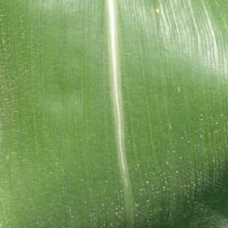
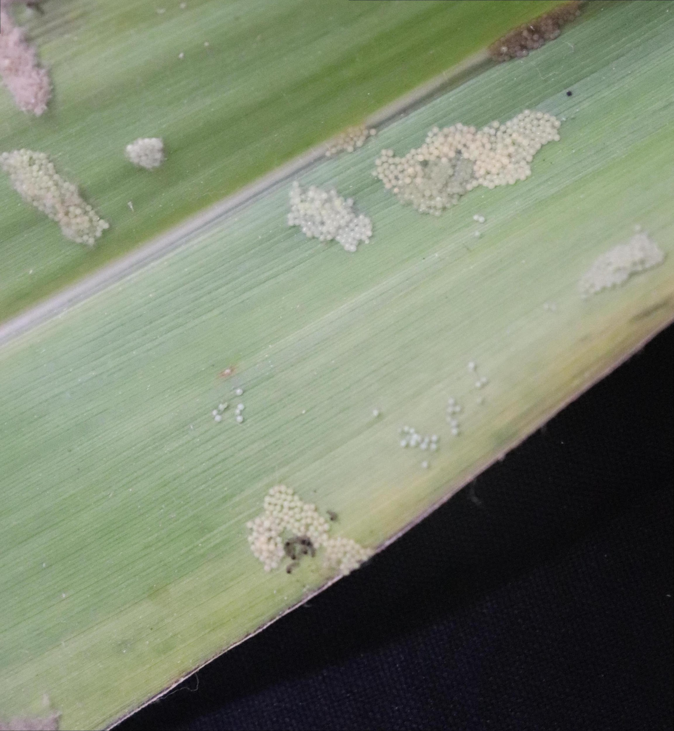
Dataset details
Dataset Source / Features/ Generation :
The dataset will be the pictures of maize crop affected/not affected and the pictures has to be clicked from the farm
Dataset suitability/ analysis :
We need to have both the affected and not affected pictures of maize plant so that the model successfully differentiates the output
Dataset Pre-Processing / Related Challenges (if any) :
Pre-processing of the images majorly include data augmentation, modification of data to a particular size, dividing the data into batches
The major challenge that is faced is collection of data because the model’s accuracy is directly proportional to the number of data.
Dataset:
Healthy :500
Infected : 500
Leaf Blight: 500
Common corn Rust: 500
Gray Leaf Spot: 500

Slide 10
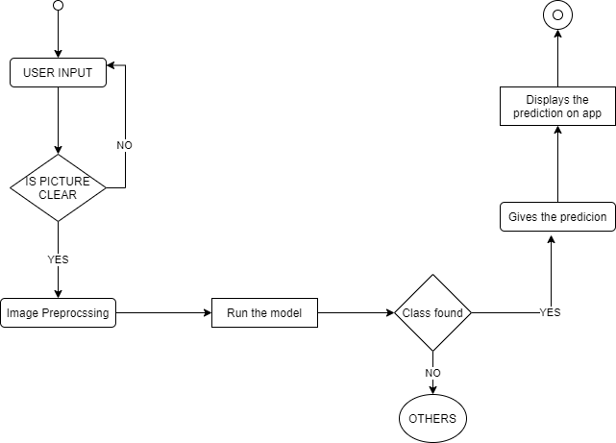
Activity Diagram

Slide 11
Results
Initially the model used for training the available dataset was RESNET50 with an accuracy of 68.40%. To improve the accuracy of the system, other models implemented were Inception V3 and VGG19. We also implemented our own model but the accuracy observed was 70.40% for Inception V3, 78.23% for our model and 79.40% for VGG19.
Hence, the selected model is improved VGG19.

Slide 12
Conclusion
A target recognition method based on improved VGG19 for quickly and accurately detecting diseases or infestation in live image was proposed. A pre-trained VGG19 architecture has been implemented using Keras framework and achieved successful feature extraction. The experimental results based on test accuracy and validation loss on current available data shows that the model is faster and accurate.
However, still some issues can be identified in this proposed method. This method performance can be further improved by expanding the database which can be done by collecting images regarding various diseases in the maize, manually in the future.

Slide 13
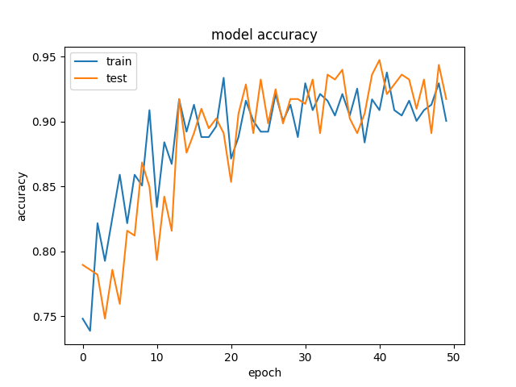
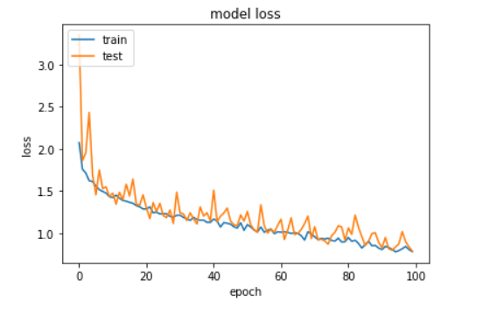
Expected Results / Measurable Outputs
We only need 2 graphs to check the performance of our model:
Major novelty / Observations / Conclusions :
Accuracy graph :
- Accuracy is the number of correctly predicted data points out of the all data points.
- Which should eventually increase with every epoch.
Loss :
- Loss is the penalty for bad prediction. That is, loss is a number indicating how bad the model’s
prediction was on a single example.
- If the model’s prediction is perfect the loss is zero; otherwise the loss is greater.
- And thus the loss should gradually decrease with every epoch

Slide 14
Plan to Complete Project
Final Probable deliverable:
Conference paper
Completion Plan :
Week 1 to 2
Step 1 The major goal this week is to collect data from as many resource as possible. More the data, better the result
Step 2 Integration of all the data
Week 2 to 4
Step 1 Pre-processing of data
Week 5 to 6
Step 1 Building the model
Step 2 Coding and training the data till the required accuracy
Week 7 to 8
Step 1 Building the UI for the model
Step 2 Testing the entire project

