Slide 1
Neighbourhood insights for buying a home in Edinburgh
Sander Tanni
12th of March 2019
Coursera Applied Data Science Capstone Project

Slide 2
Business problem
Estate agent in Edinburgh wants to attract more customers who are new to the city.
Presenting valuable insights about local amenities to potential buyers could attract more customers, particularly those new to the city.
AIM: Provide a solution for informing home buyers about neighbourhoods.
SOLUTION: Create categorisation tool that can be tailored to customer preferences

Slide 3
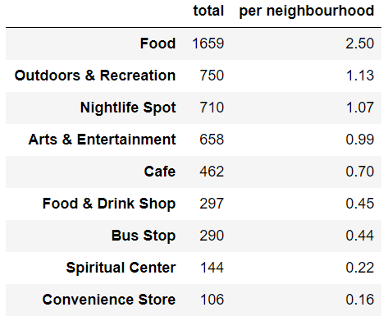
Foursquare venue data
API calls for 664 focal points
9 venue categories
Venue coordinates

Slide 4
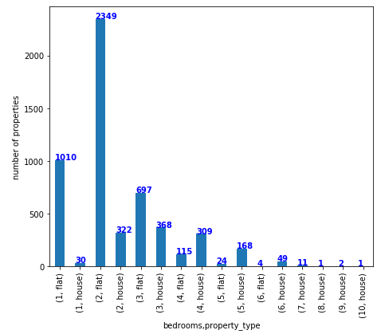
Rightmove sale price data
Two bedroom flats most common
Presentation shows results for 2 bed properties
Coordinates inferred from postcode

Slide 5
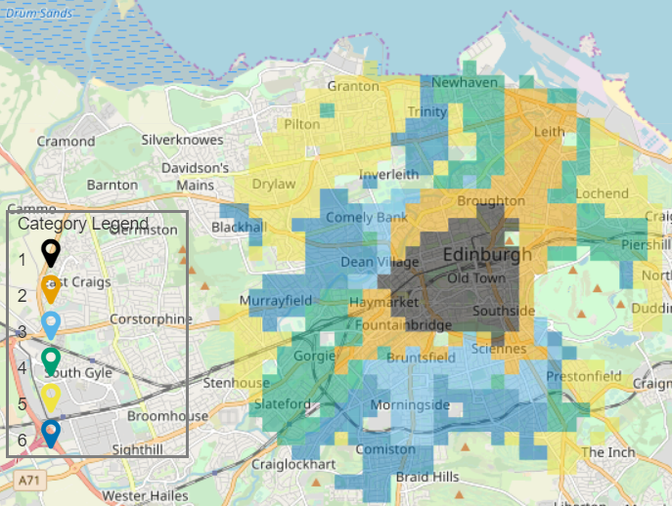
Neighbourhood categories
500 m neighbourhoods
Venue counts per category
Mean property price
K-means clustering
6 clusters

Slide 6
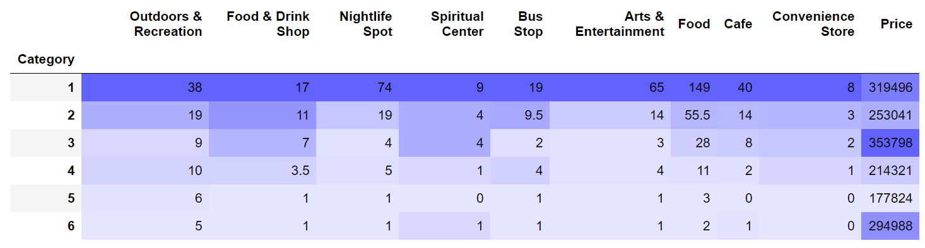
Neighbourhood categories
Contiguous regions on map
Median feature values per category
Central areas
Cheap and expensive residential areas

Slide 7
Conclusions
Six distinctive neighbourhood categories
Neighbourhoods of same category form contiguous areas
Not just in circular zones around the centre
Useful information for home buyers new to Edinburgh

