Slide 1
Cartoon Rendering Project 2
Sanny Chun
902759995

Slide 2
Intro
Wanted to use Gaussian Pyramid

Slide 3
Basic Workflow
DownSample Image
Using Gaussian Pyramid
On each level, apply bilateral filter
Upscale it back
Grayscale/medianBlur
Render
Shrink image if needed
Adaptive thresholding to get edges
Save it as mask
Bitwise AND it with source image to get the cartoon effect
Save image

Slide 4
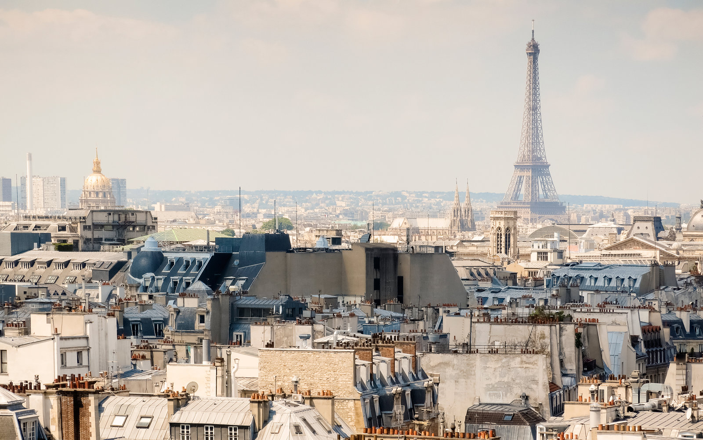
Example

Slide 5
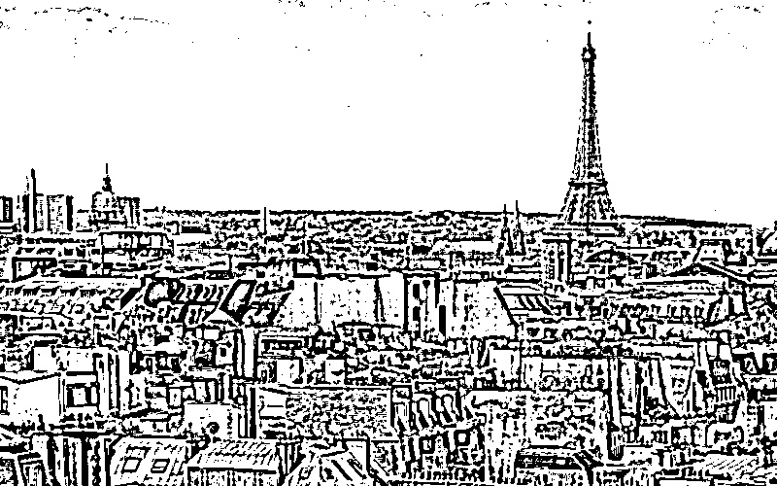
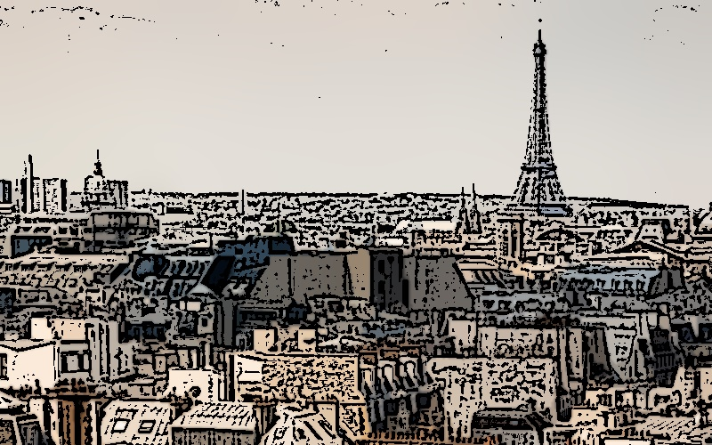
Mask and Output
Mask
Output

Slide 6
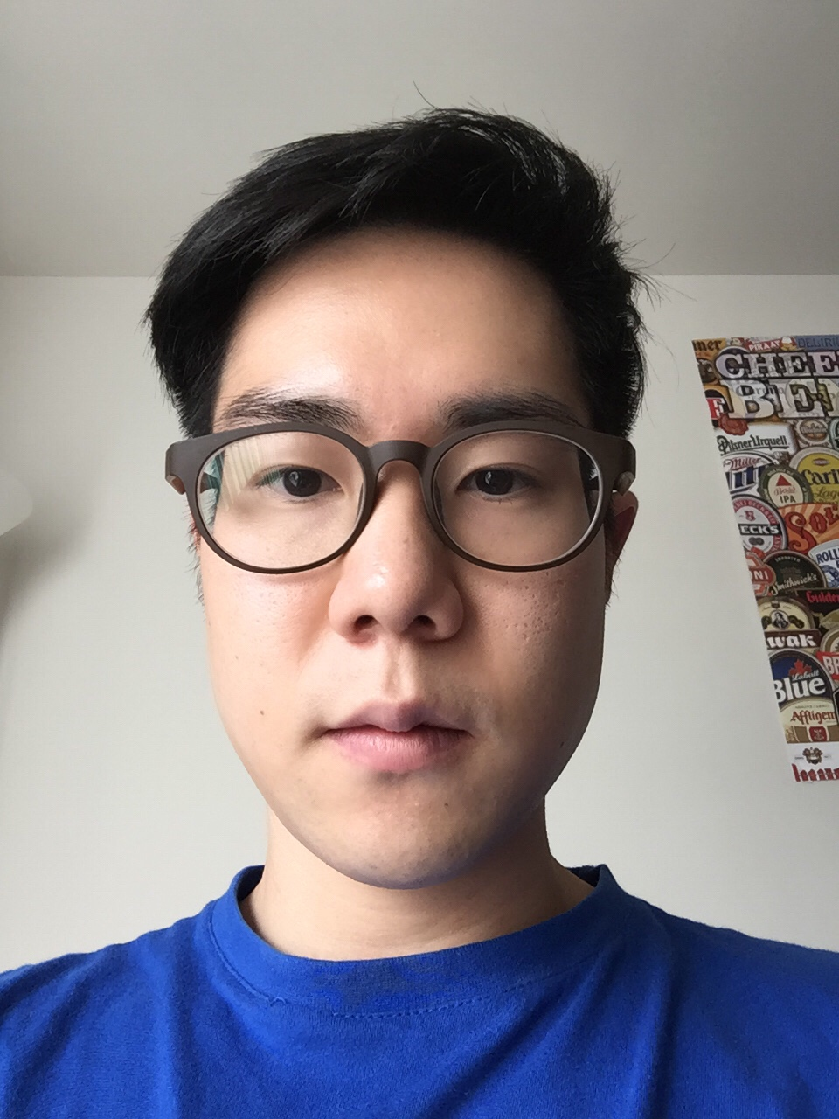
Another! (My face…)

Slide 7
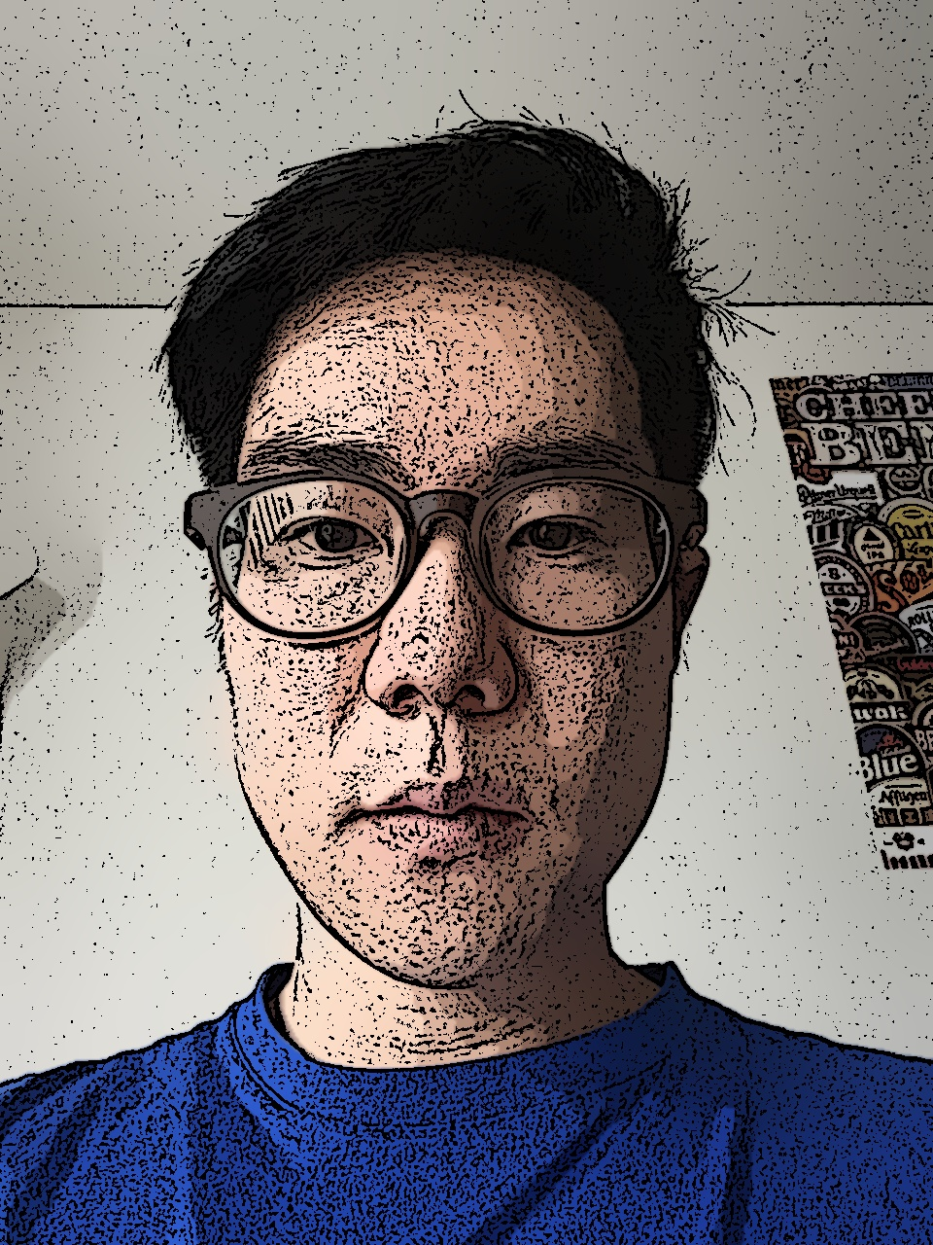
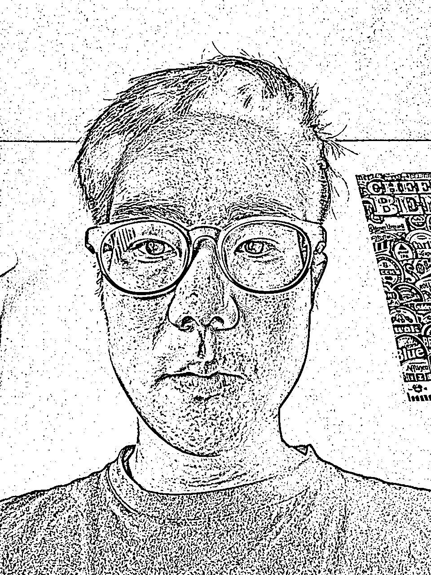
Mask and Output
Mask
Output

