Slide 1
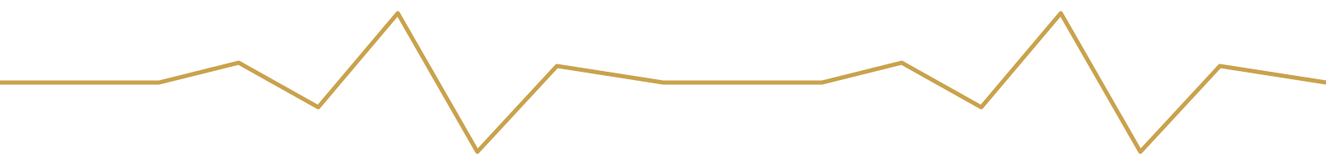
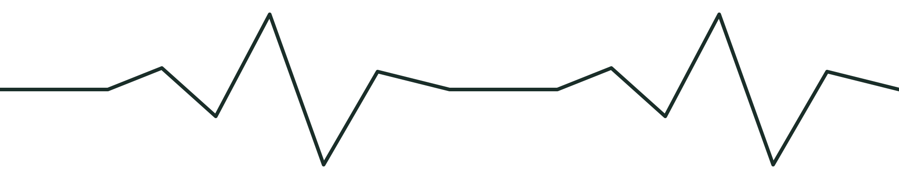
SAFESIGNAL
Catching Hidden Drug
Side-Effects in Patient Words
An NLP early-warning system for Adverse Drug Reactions clinical trials never caught
Sanobar Latif Shaikh
PRN: 25030421039 | BSc AI — NLP | CA3: Build–Audit–Pitch
Notes:
Introduce yourself. One line: this project finds drug side-effects that patients mention on health forums, using NLP.

Slide 2
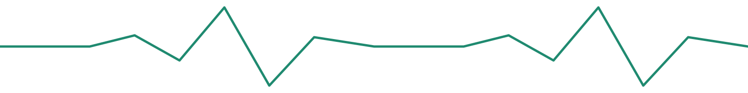



THE PROBLEM
What clinical trials never see
Trials can't catch everything
Clinical trials run on limited people for limited time — many side-effects surface only once a drug reaches the real world.
Patients report them anyway — informally
People post about their side-effects on health forums every day, in their own words. This data is rarely mined.
The goal of SafeSignal
Automatically detect Drug, Adverse Reaction, Disease, Symptom & Finding mentions in patient text — an NLP-based early warning system.
Pharmacovigilance = tracking drug safety after a drug is already on the market
Notes:
Clinical trials are small and short. Patients keep posting about side-effects on forums. SafeSignal reads those posts automatically.

Slide 3



HOW IT WORKS
From raw patient text to flagged risk
PATIENT POST
NER MODEL
TAGGED OUTPUT
Raw forum text
spaCy, trained on CADEC
Entities flagged
LIVE EXAMPLE
"I took Lipitor and started having severe muscle pain and memory problems."
Drug
Adverse Reaction
The model reads unstructured patient text and automatically labels drug names and side-effects, so a reviewer can scan flagged posts faster.
Notes:
Walk through the arrows: a post goes in, the NER model tags the drug and the side-effect words, and the output is flagged text. Use the Lipitor example.

Slide 4

THE APPROACH
Build: data, model, entities
DATASET
MODEL
CADEC
spaCy NER
CSIRO Adverse Drug Event Corpus
Named Entity Recognition model, trained from scratch
1,250 real patient forum posts
Entities detected:
12 different drugs
Drug
ADR
Symptom
Disease
Manually annotated: Drug, ADR, Disease, Symptom, Finding
Finding
1,000 train / 250 test split
20 training epochs • loss reduced 12,254 → 3,137
Notes:
Dataset: CADEC, 1,250 forum posts. 1,000 for training, 250 for testing. Model: spaCy NER trained from scratch for 20 epochs.

Slide 5
THE RESULTS
Strong on key entities, weaker on rare ones
0.91
0.65
0.18
Drug F1-score
ADR F1-score
Disease F1-score
Best-performing entity
Core detection target
Limited by class imbalance
Weaker scores on Disease, Symptom & Finding likely reflect fewer training examples for those labels (class imbalance).
Notes:
Drug 0.91 is strong. ADR 0.65 is okay. Disease 0.18 is weak, most likely because there are few Disease examples in the data.

Slide 6

KEY AUDIT FINDING
The model breaks down on informal language
FORMAL TEXT
INFORMAL TEXT
Clearly written posts
Casual, misspelled posts
0.26
0.00
Disease detection F1-score
Disease detection F1-score
Drug F1-score: 0.92
Drug F1-score: 0.84 (−8 points)
On informal, real-world patient language, Disease detection fell to zero. The informal test subset is small, so read this as a clear warning sign, not an exact number.
Notes:
This is my key audit finding. I split the test posts into formal and informal. Disease went from 0.26 to 0.00 and Drug dropped 8 points. The informal group is small, so treat it as a warning sign, not an exact number.

Slide 7
LIVE DEMO
Try it on any sentence
Type a patient post
Plain English, casual style or Hinglish, for example: "I took Lipitor and started having severe muscle pain and memory problems."
Click Detect Entities
The model highlights Drug, ADR, Disease, Symptom and Finding spans in colour and lists them in a table.
Check the limits too
Try a drug that is not in the training data (for example Dolo): it is missed. Hindi input is translated to English first.
The demo runs inside Google Colab, no separate web page needed

Slide 8
HONEST LIMITATION
Real patients don't write like textbooks
SafeSignal struggles most on informal, misspelled patient language — which is how many real forum posts are written. This is the gap between a clean benchmark and real-world deployment.
WHAT'S NEXT
Larger dataset + transformer models (BioBERT) for stronger informal-text robustness
Thank You
Questions?
Sanobar Latif Shaikh | PRN: 25030421039 | SafeSignal — CA3 NLP
Notes:
Main limitation: it struggles on informal language, and it misses drugs it never saw in training, like Dolo. Next steps: more data and a BioBERT model. Then ask for questions.

