Slide 1


Prototype Submission Phase

Slide 2
Sarc_engineers
Avantika Balaji
Charitha Uppalapati
Sanjay Balaji P
Sherwin Akshay J G
THEME:
Blue Sky Above

Slide 3
PROBLEM STATEMENT
The task is depicted in the schematic figure below. To aid you with the implementation, a code template with APIs is supplied. Two levels of data or picture processing are required for the answer. One includes extracting hyper-parameters or another suitable compressed representation/feature set from hyper-spectral satellite images/data. As data input, this compressed data should be supplied to the second regression machine learning (ML) model. To obtain the regression estimate of pollution (Nitrogen Dioxide) in the region for specific time instances, the regression machine learning model should process data from satellite imagery as well as map data from the open street map.

Slide 4
SOLUTION
According to the problem statement two levels of data or picture are being processed for the required calculation of pollutant_factor in the air.
The algorithm written goes in a way such that it draws out hyper-parameters or another suitable compressed representations from hyper-spectral satellite images and this is being used for the calculation of density of different kinds of particulate matters present in the hyper-spectral data provided.
Here, the algorithm efficiently works in the analysis of the density of the particulate matters present in the hyper-spectral input data feeded in. Different kinds of particulate matters are being analysed in accordance of their densities and their nature that tend to act against the human environment.
So, we feed in some input samples and some known kind of particulate matters for it being efficient to analyze the day-to-day real life hyper-spectral input data and performs with more accuracy and provides user the pollution rate across them with maximum accuracy as possible.
For that we totally rely on a single factor called the pollutant factor which is being calculated as given below.
Pollutant_factor = ((density_of_no2/(sum_of_all))*1/100)
As provided in the problem statement the estimation of air pollution around a given hyper-spectral sample goes with the calculation of the density of nitrogen dioxide in a specific time when the user provides with the hyper-spectral sample.
Pollutant_factor totally relies on the density of No2 in the provided hyper-spectral sample by the user as it is the main theme in establishing the pollutant rate around the user as provided in the problem statement.

Slide 5
Why No2 being the major?
Nitrogen dioxide levels above a specific point can affect the human respiratory system, making a person more susceptible to and worsening respiratory infections and asthma.
Long-term exposure to high quantities of nitrogen dioxide can induce chronic lung illness.
It may also have an influence on the senses, such as reducing a person's ability to detect odours
.High levels of nitrogen dioxide are also harmful to vegetation, causing leaf damage, stunting growth, and decreasing crop yields.
Nitrogen dioxide can fade and discolour furnishings and fabrics, as well as reduce visibility and react with surfaces.

Slide 6
Why No2 being the major?
The following are the approved nitrogen dioxide air quality levels:0.12 parts per million (ppm) is used for a one-hour exposure; 0.03ppm is used for an annual exposure time.
These recommendations are designed to protect vulnerable people including children and asthmatics.
Outdoor nitrogen dioxide concentrations are frequently much below the 1-hour limit, and exposure at these concentrations rarely causes respiratory difficulties.

Slide 7
Why this solution - so efficient?
There are 3 main reasons for which this solution works so efficiently and can be implemented as an effective solution :
The solution mainly targets in the calculation of density of No2 in the provided hyper-spectral data gives the solution more stronger base and avoid complications on not really concentrating on huge amount of entities or sample datas so that redundancy is avoided.
An user friendly interface is being deployed so that the pollutant factor can be calculated at any time using the proper device and good network connection. This interface provides user a very explanatory analysis of the quality of air and the compostion of particulate matter present in the hyper spectral input data provided.
The interface also provides the user some precautionary measures and some basic level analysis of day to day hyper-spectral data provided by the user,which help user in overcoming the heath complications \ if so caused by the particulate matters in hyper-spectral data that is the near the user.

Slide 8
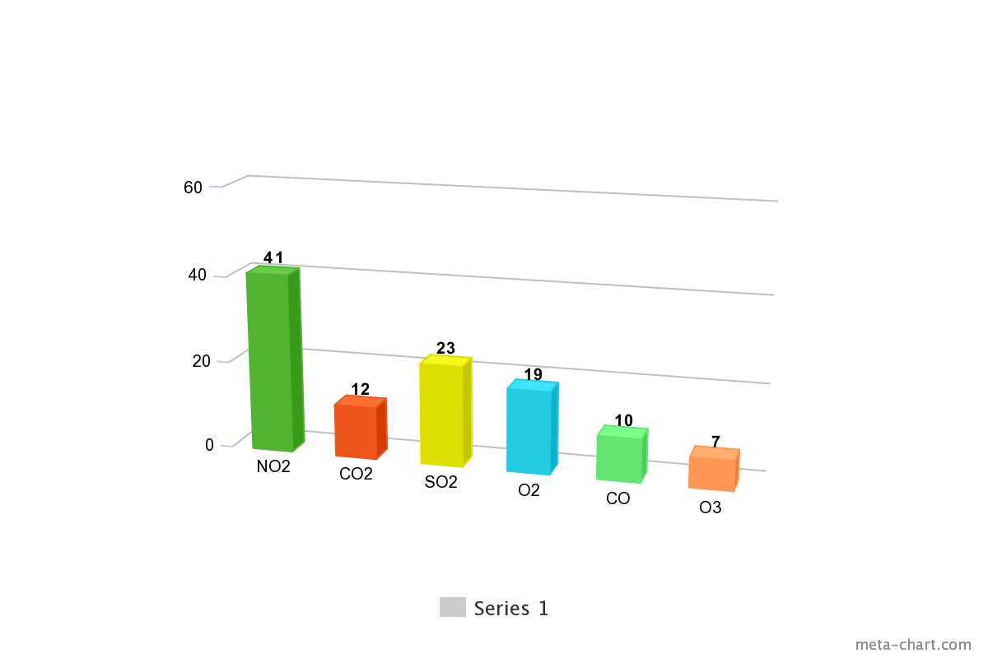
METHODOLOGY

Slide 9
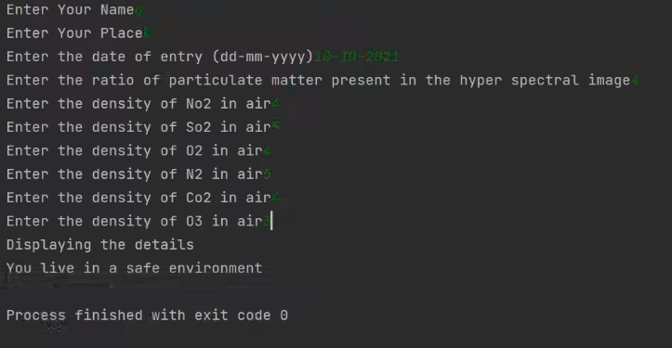
Sample Input

Slide 10
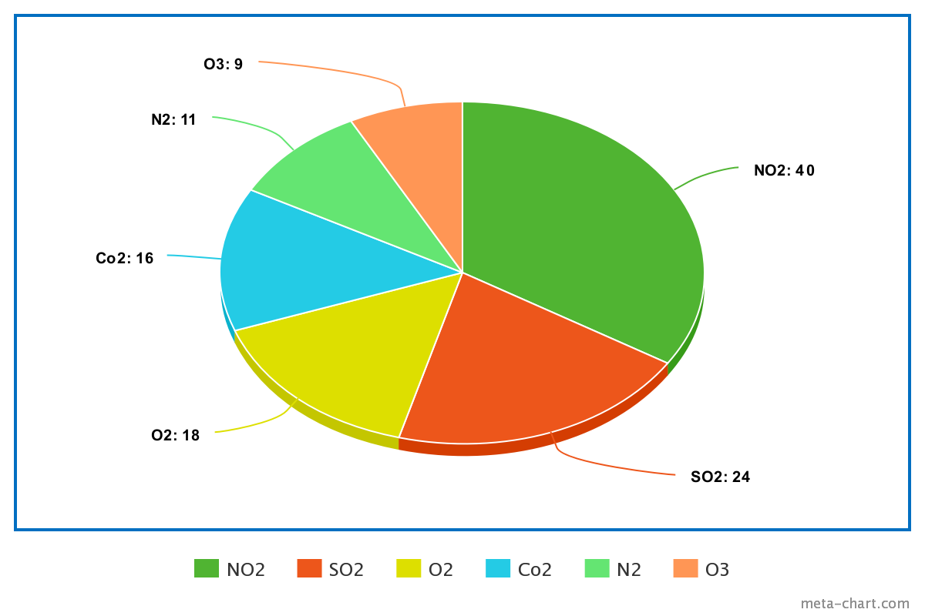
METHODOLOGY

Slide 11
WORKING PROTOTYPE
https://drive.google.com/file/d/13khLuuyJN0ZNbTv204soLLWhx6hEbASK/view? usp=sharing

Slide 12
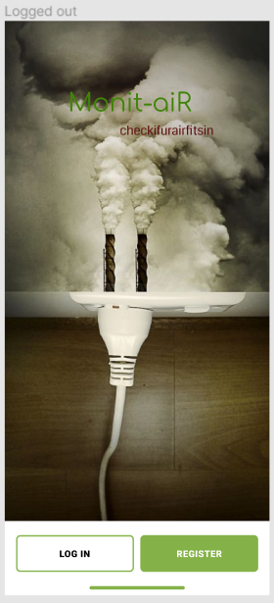

Slide 13


Slide 14


Slide 15


Slide 16


Slide 17


Slide 18
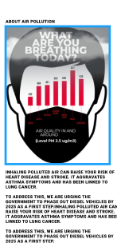

Slide 19


Slide 20
