Slide 1


PROJECT-2 DATA WRANGLING
BY: Sanskriti Sharma

Slide 2

Rows-610
Columns-10
Column Names
Instant, dteday ,season, yr,mnth ,hr, holiday, weekday,
Weathersit ,temp
Season
1-Spring
2.Summer
3-Fall
4-Winter
Dataset-1
Weather condition
1-Clear
2-Cloudy
3-Light rain/Snow
4-Heavy rain/snow

Slide 3
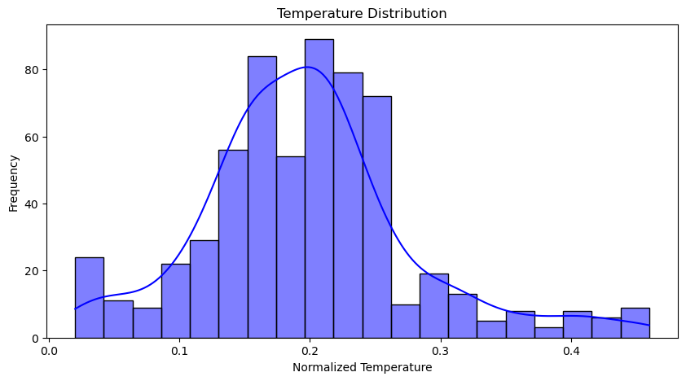
Graphical representation for data-1
Temperature follows normal distribution
Distribution is slightly skewed towards higher temperature showing warmer conditions might be slightly more frequent
extremely cold ones.

Slide 4
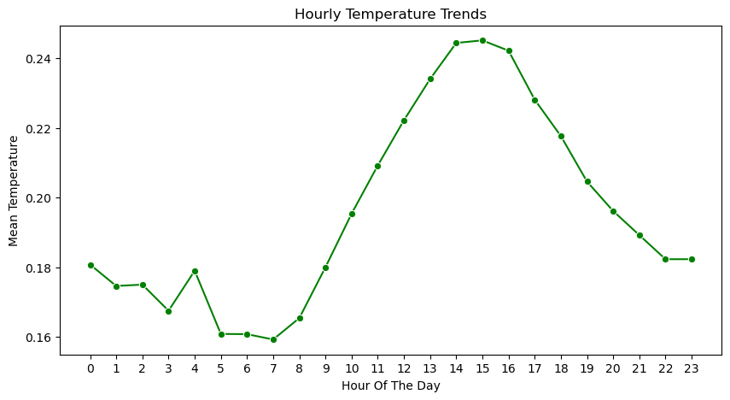

Another graph for dataset-1
This graph shows how temperature changes throghout the day
Temperature is lowest in early morning around 6 AM ,,rises during day and highest in the afternoon around 3 PM. before cooling in evening.

Slide 5
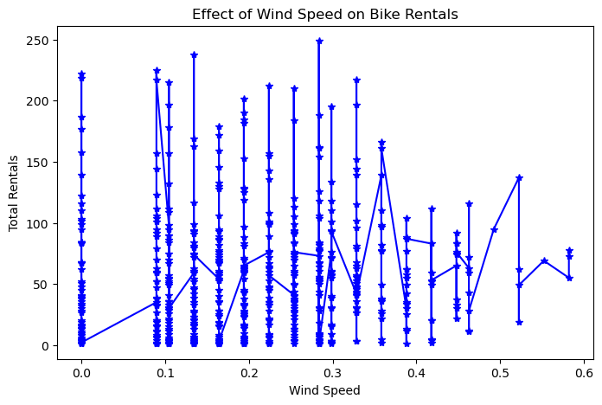
Few visuals of dataset-2
High windspeed is associated with lower bike rentals.
Rentals peak at lower wind speeds.
Suggests that strong winds discourage bike usage.

Slide 6
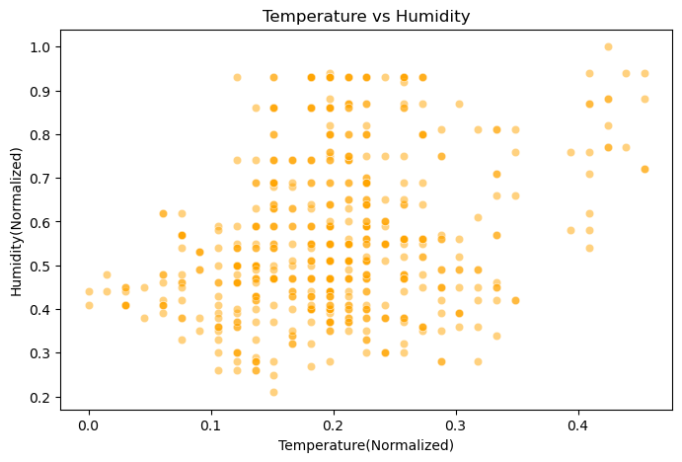

As temperature increases humidity tends to decrease.
Cluster indicates common weather conditions.
Outliers indicating unusual Weather(when high temperture and high humidity exist together and rare weather like heatwave,storms etc).

Slide 7
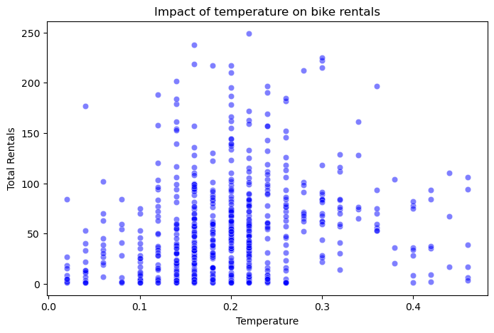
Merged Dataset 1 insights
Higher temperature leads to more bike rentals.
People prefer bike rentals when weather is clear ,warm.
Temperature strongly influence rentals.

Slide 8
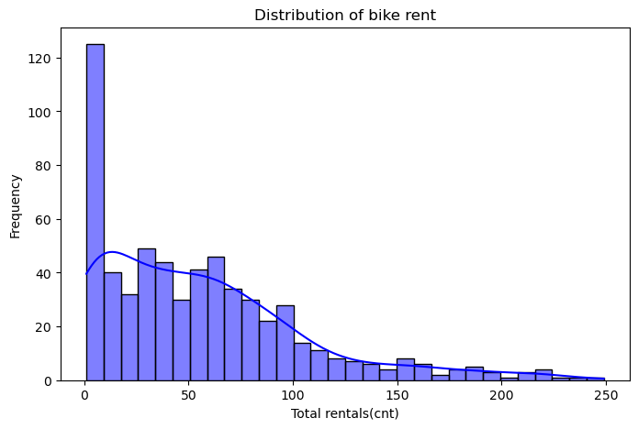
Long tail towards right indicates that most rentals are low to moderate.
There are some days with extreme rental spikes.
Spike could be due to seasonality,special events,or peak hours.

Slide 9
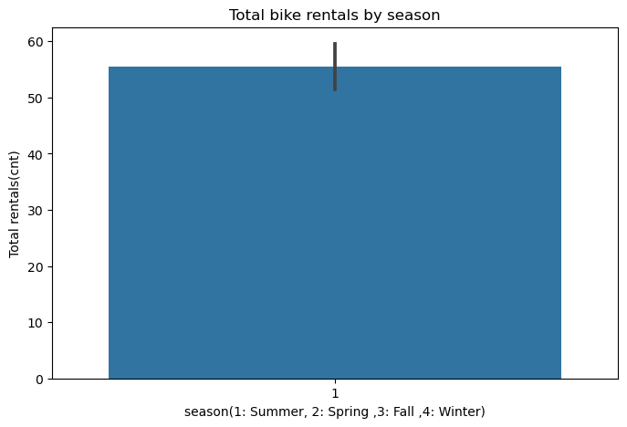
Above Graph indicates that bike rentals were highest in summer season may be due to clear weather and low humidity

Slide 10
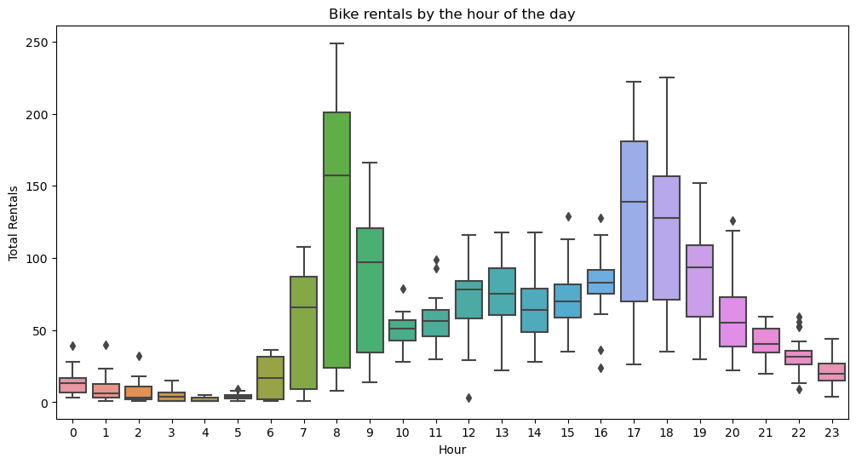
Dataset-3 insights
Above graph interprets that bike rental increased around
(7 AM-9 AM) and evening around (5 PM-7 PM).
Rentals decreased in afternoon.

Slide 11
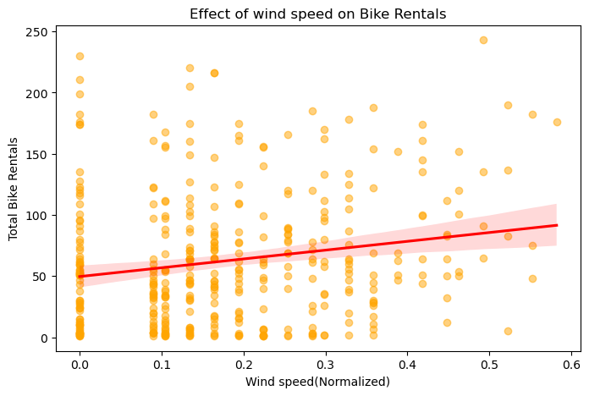
Second Insight
The regression line shows a slight positive correlation between wind speed and bike rentals as wind speed increases, bike rentals increase slightly, but not a strong effect other factors likely to play a more significant role in rental demand like weather conditions ,days of the week ,time of the day etc.

Slide 12
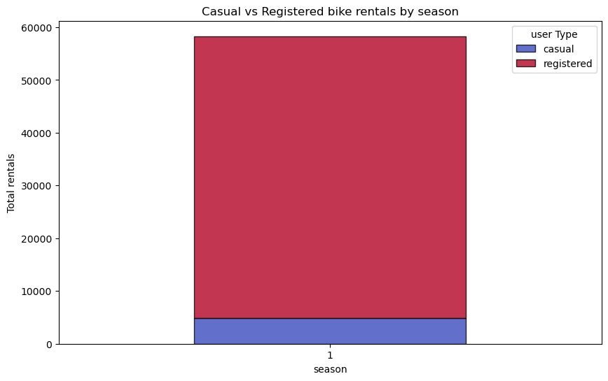
Merged Dataset 2 Graphical representation
1)Warmer months (spring & summer )drive higher demand for both casual and registered
2) Casual riders are more sensitive to weather changes,while registered users remain stable year round
3) Winter has lowest rentals,as bikibg conditions become less favourable

Slide 13
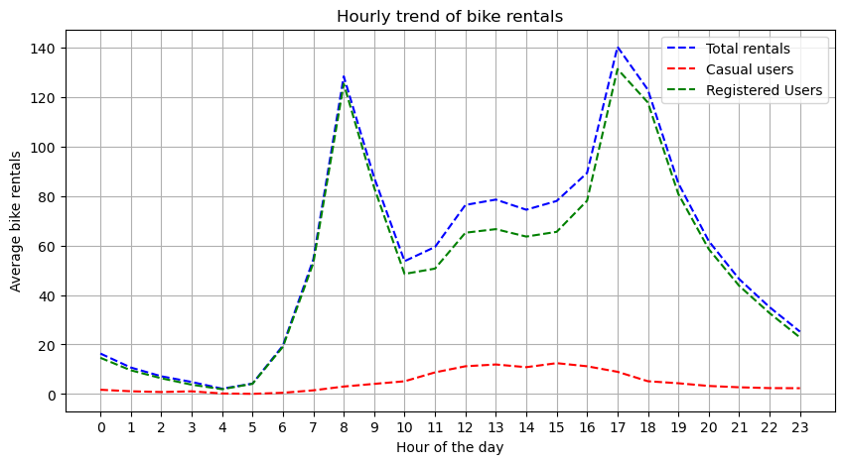
Hourly Trends
1)Morning peak(around 8 AM):due to commuters travelling to school or office
2) Evening Peak (around5-7 PM):due to people returning home from office
3)Rentals remain low during midday and late night
registered users are increasing in morning and evening
4) Casual riders are higher in the afternoon (10 AM -6PM),suggesting more leisure riders.
5) Rentals drop significantly after 9 PM, likely due to fewer people riding bikes late at night

Slide 14
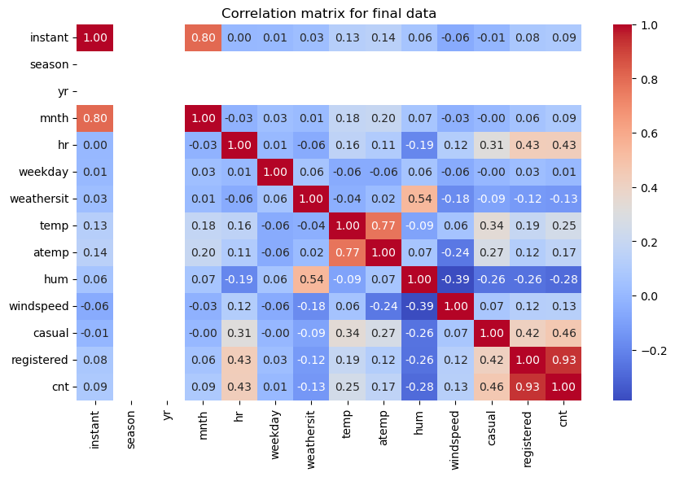
Corelation between columns

Slide 15
Interpretation of Heatmap
1 )Bike rentals highly corelated with registered (0.93) concluding that most rentals came from registered users than casual users
2) Moderate positive correlation with temp(0.25)and atemp(0.17)-means higher temperatured lead to more rentals.
3) Slight negative correlation with humidity (-0.28)-concludes that humid weather affects bike rental negatively
4) Other notable corelations -temp(0.77) and atemp (0.77) are almost identical.
5) Higher humidity is associated with bad weather condition
6) Hour and cnt are also positivly corelated concluding that certain hours see higher rentals i.e morning and evening hours and
it decreases in afternoon.
7) Month has a very low corelation concluding that seasonal changes may not drastically impact temperature.
8)Weekday has a very low correlation-meaning there is no clear wekday/weekend pattern.

Slide 16
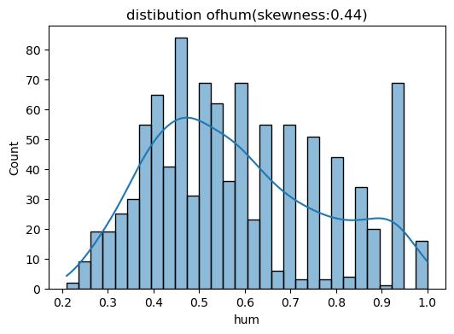
Skewness of data(showing few graphs)
1) Most rental counts are low,but there are some very high values.
2)Bike rentals are not eveny distributed showing sudden increase in rental some days(possible
cause weekend,holidays or specific weather conditions).
3) Most values indicate good weather,with very few instances of extreme weather conditions.
4)Columns(temp ,atemp, hum, windspeed, mnth) are moderately right skewd indicating that occasional ### extreme weather affects bike rentals .
5) Columns(hr, weekday, yr ) are evenly distributed making them more reliable for any prediction.¶

Slide 17
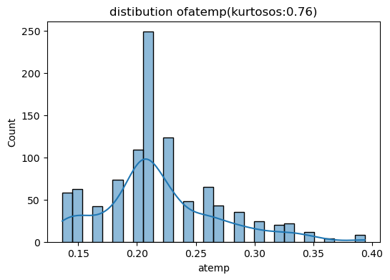

Kurtosis(few graphs)
1) High Kurtosis: Columns(casual, registered,cnt) indicate that many days
with very few casual rentals but some days have very high rentals.
* registered column indicating most rental counts are within normal range but some
extreme values exist (probably due to special events,weekends and holidays
2)Low Kurtosis: (columns-instant,mnth,hr,weekday,hum,windspeed)
*No specific month,hour,weekday dominate the datase.¶
*Rental demand does not concentrate ina single time frame but demand is different at different time.
3)Near Normal Kurtosis-Columns(weathersit, season, year) These variable does not have extreme values.
*Kurtosis of year suggests that both years (2011 and 2012) have balanced amount of data.
*this data set doesnot favour one year over the other.
*Different weather conditions appear in a balanced way.
*Rainy or stormy days are not excessively frequent compared to clear days.
In [ ]:

Slide 18



