Slide 1
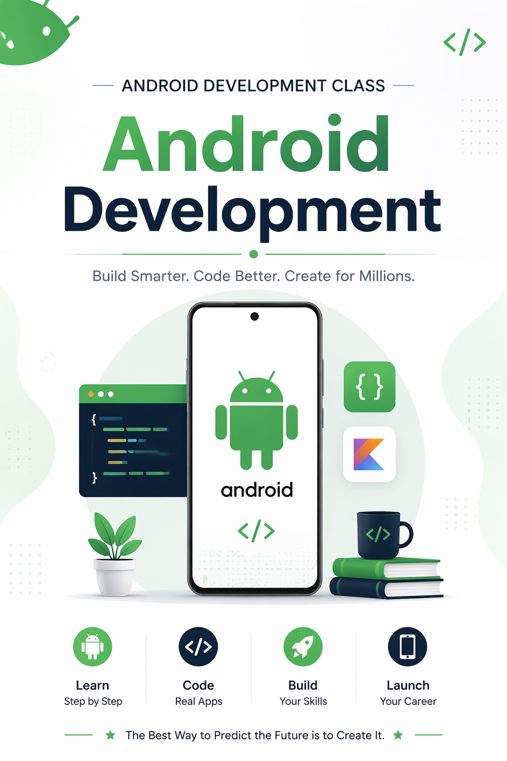

RecycleView
Week 2, Day 2, Session 1

Slide 2
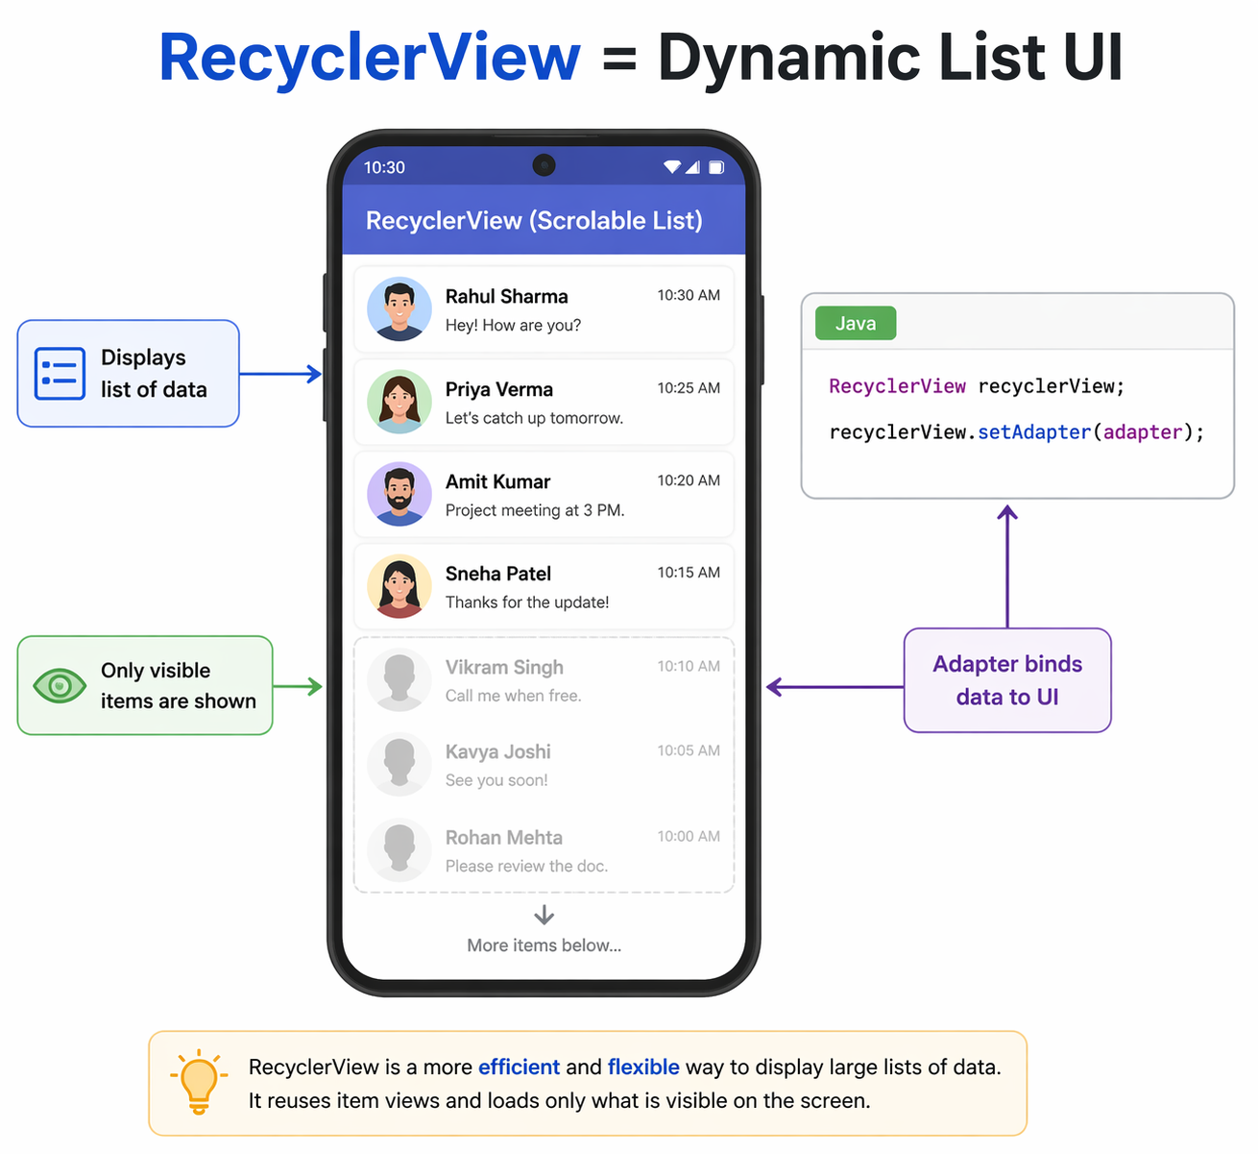
ANDROID DEVELOPMENT
RecyclerView in Android
A modern, efficient way to display scrolling lists of data in your Android apps. This presentation walks you through what RecyclerView is, why it replaced ListView, and how to use it to handle large datasets with ease.
What You'll Learn
What RecyclerView is and its core purpose
Why it replaced the older ListView component
How it handles large datasets efficiently
The basic components and how they work together

Slide 3
TOPIC 1
What is RecyclerView?
RecyclerView is a flexible Android widget for displaying large datasets in a scrollable list or grid. Introduced in Android 5.0 (API 21) as part of the androidx.recyclerview library, it is the go-to component for any app that needs to show repeating items — from contact lists to social media feeds.
Scrollable Container
Highly Customizable
Part of AndroidX
RecyclerView holds and manages a collection of item views, recycling them as the user scrolls to save memory and improve performance.
Supports linear lists, grids, and staggered grids through different LayoutManager options. You can also add animations and item decorations.
Available via the AndroidX library, meaning it works across all modern Android versions and receives regular updates from Google.

Slide 4
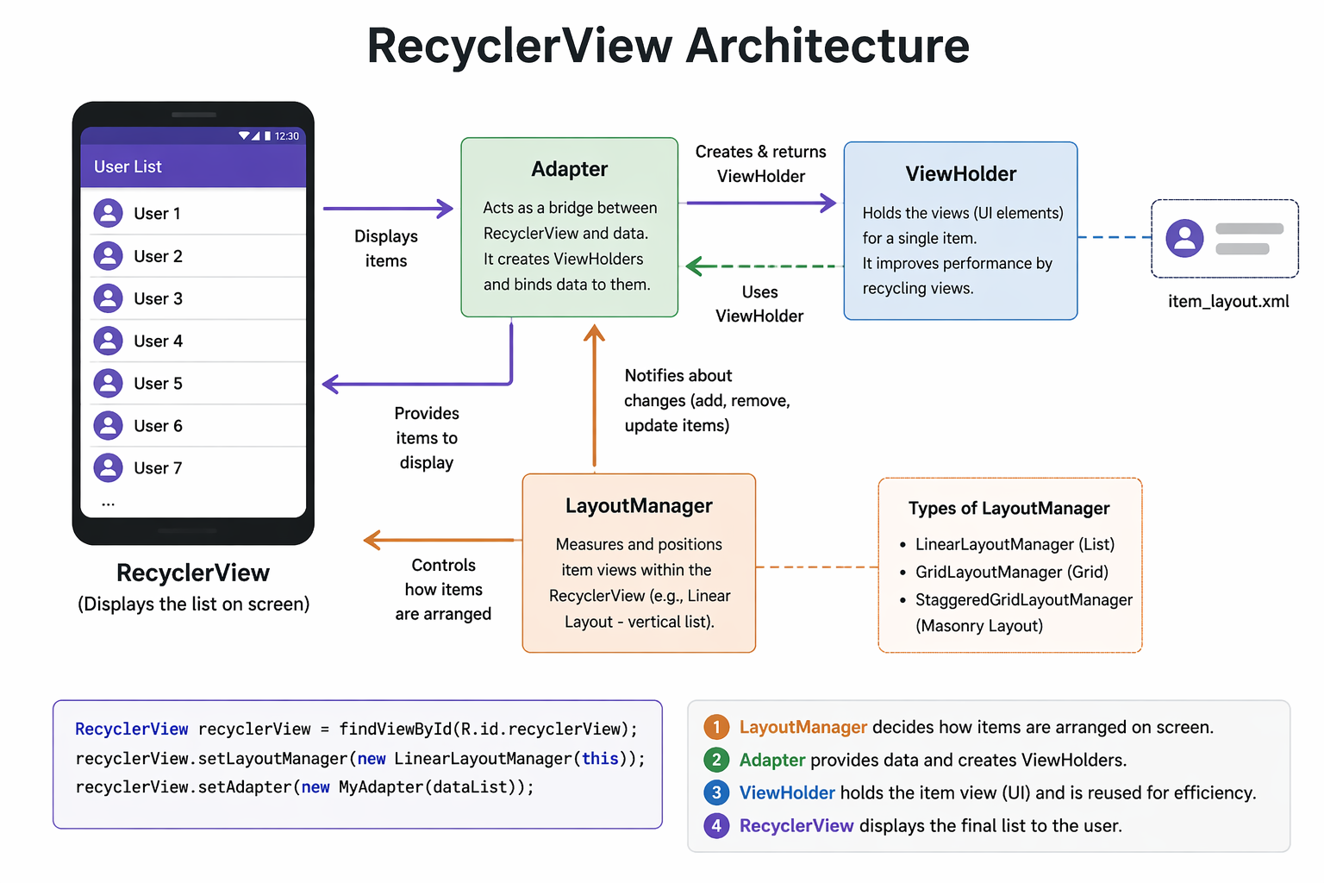
TOPIC 1 — CONTINUED
The Three Core Components
RecyclerView relies on three key classes working together. Understanding each one is essential to building your first list.
Adapter
ViewHolder
Binds your data to the item views. Tells RecyclerView how many items exist and what each one should display.
Holds references to the views inside each item layout. Reduces repeated calls to findViewById(), boosting performance.
LayoutManager
Controls how items are arranged — vertically, horizontally, in a grid, or staggered. You choose the layout style.

Slide 5

TOPIC 2
Why RecyclerView Instead of ListView?
ListView was the standard list component for years, but RecyclerView was designed to solve its limitations. Here's why RecyclerView is the better choice for modern Android development.
❌ ListView Limitations
✅ RecyclerView Advantages
No built-in ViewHolder pattern enforcement
Limited layout options (vertical list only)
No built-in support for item animations
Poor performance with very large datasets
Difficult to customize item decorations
Enforces ViewHolder pattern for better performance
Supports linear, grid, and staggered layouts
Built-in support for smooth item animations
Efficient view recycling out of the box
Flexible item decorations and touch handling
Key takeaway: RecyclerView isn't just an upgrade — it's a complete redesign that gives developers far more control and flexibility over list-based UIs.

Slide 6
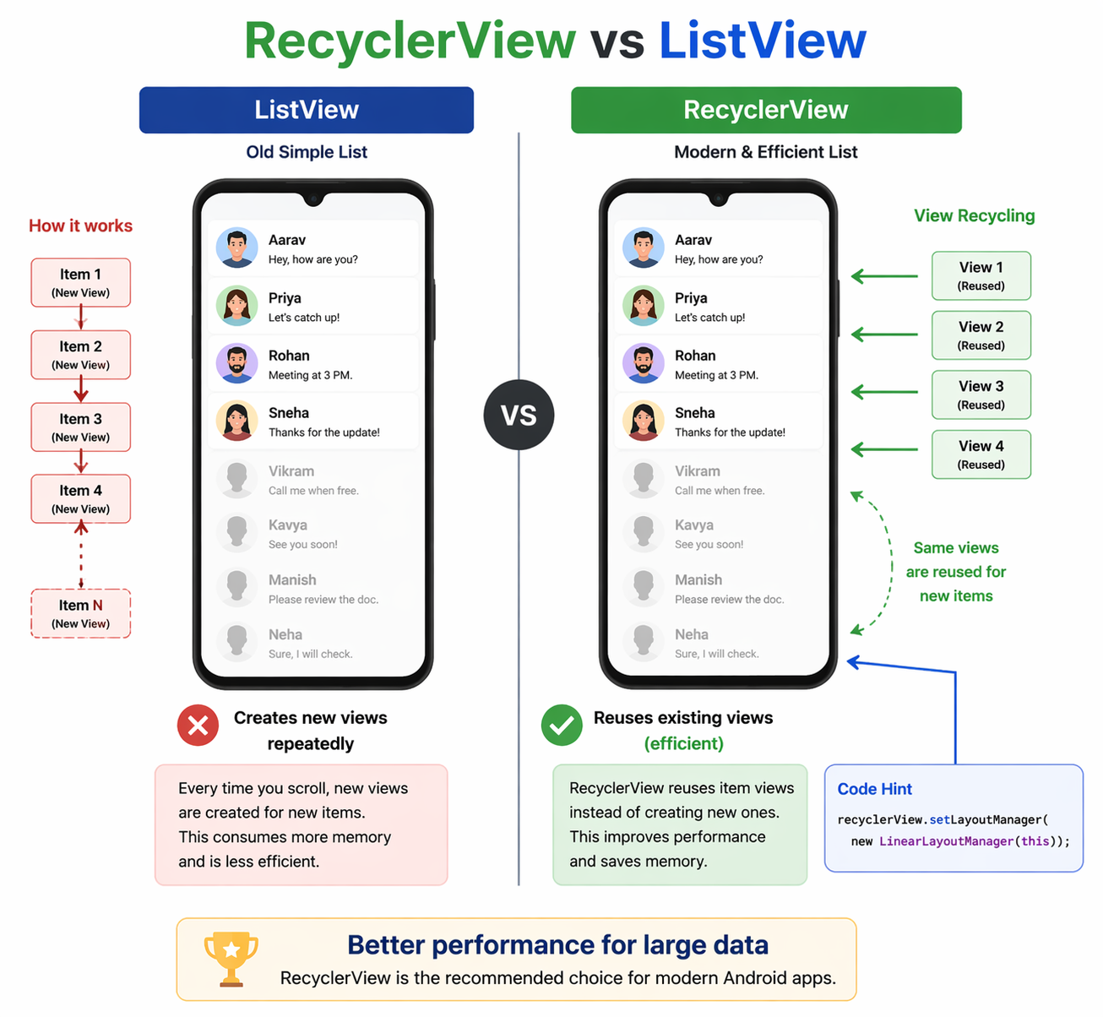
TOPIC 3
Displaying Large Datasets Efficiently
One of RecyclerView's greatest strengths is how it handles thousands of items without slowing down your app. The secret lies in view recycling.
📸 Image Placeholder
How View Recycling Works
Add an illustration showing how off-screen views are recycled and reused as the user scrolls through a long list.
Instead of creating a new view for every single item, RecyclerView creates only enough views to fill the screen. As items scroll off-screen, their views are reused (recycled) for newly visible items.
Only ~10–15 ViewHolder objects exist in memory at any time, regardless of dataset size
Off-screen views are passed to onBindViewHolder() to be updated with new data
This dramatically reduces memory usage and keeps scrolling smooth even with 10,000+ items

Slide 7
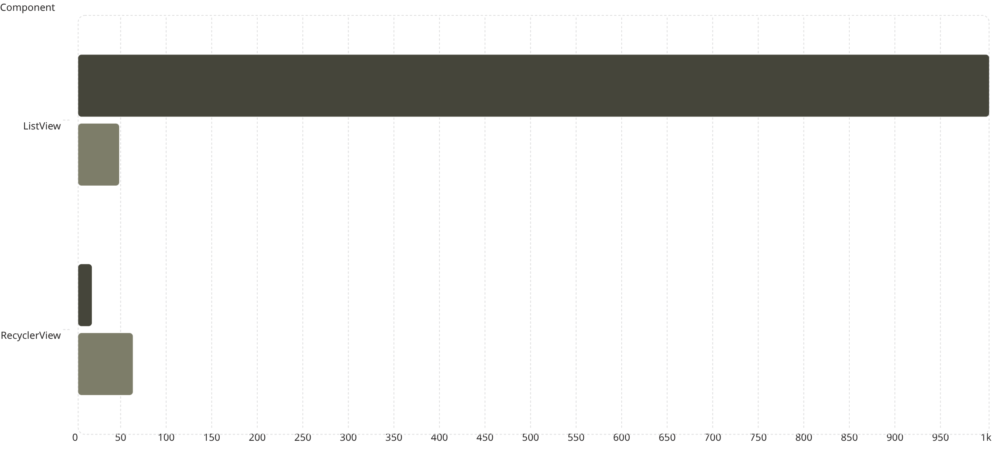
TOPIC 3 — CONTINUED
Performance in Practice: The Numbers
To understand just how much of a difference RecyclerView makes, consider this comparison of memory usage and frame rendering between ListView and RecyclerView when displaying a list of 1,000 items.
View Objects Created
Avg Frames Per Second
RecyclerView creates only ~15 view objects (one per visible item plus a small buffer) compared to ListView's 1,000. This results in consistently smooth 60 FPS scrolling, whereas ListView often drops below 45 FPS on mid-range devices. The recycling mechanism is what makes this possible.

Slide 8
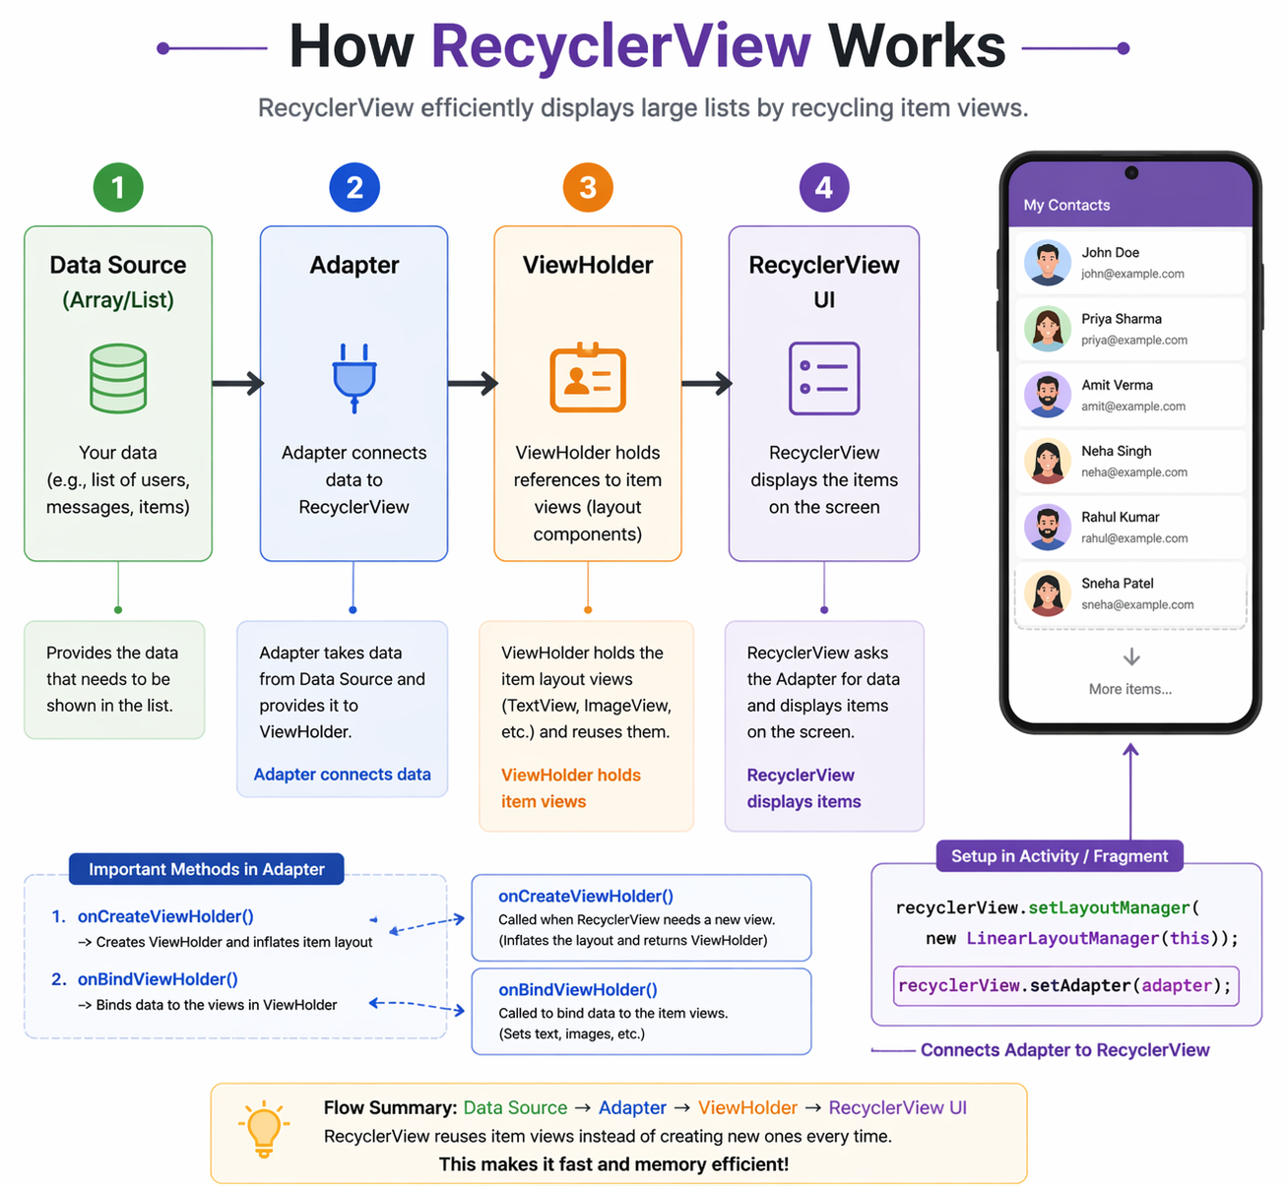
TOPIC 4
Basic Working: Setting Up a RecyclerView
Here's a minimal, working example of how to set up a RecyclerView in an Activity. This covers the essential steps — adding the dependency, defining the layout, and wiring up the adapter.
Step 1 — Add the Dependency
// build.gradle (app module)
dependencies {
implementation "androidx.recyclerview:recyclerview:1.3.2"
}
Step 2 — Add to Your Layout
<androidx.recyclerview.widget.RecyclerView
android:id="@+id/recyclerView"
android:layout_width="match_parent"
android:layout_height="match_parent" />
Step 3 — Set Up in Activity
val recyclerView = findViewById<RecyclerView>(R.id.recyclerView) recyclerView.layoutManager = LinearLayoutManager(this) recyclerView.adapter = MyAdapter(myDataList)

Slide 9
TOPIC 4 — CONTINUED
The Adapter & ViewHolder: Tying It All Together
The Adapter is the bridge between your data and the RecyclerView. The ViewHolder holds each item's views. Together, they power the recycling mechanism.
class MyAdapter(private val items: List<String>) : RecyclerView.Adapter<MyAdapter.MyViewHolder>() { class MyViewHolder(itemView: View) : RecyclerView.ViewHolder(itemView) { val textView: TextView = itemView.findViewById(R.id.textView) } override fun onCreateViewHolder(parent: ViewGroup, viewType: Int): MyViewHolder { val view = LayoutInflater.from(parent.context) .inflate(R.layout.item_layout, parent, false) return MyViewHolder(view) } override fun onBindViewHolder(holder: MyViewHolder, position: Int) { holder.textView.text = items[position] } override fun getItemCount() = items.size }
1
2
3
onCreateViewHolder
onBindViewHolder
getItemCount
Inflates the item layout and creates a new ViewHolder — called only when a new view is needed.
Binds data at a given position to the ViewHolder's views — called every time a view becomes visible.
Returns the total number of items in your dataset so RecyclerView knows how many rows to draw.

