Slide 1

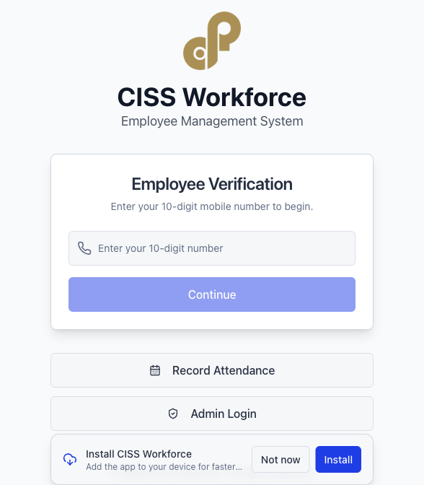
CISS Workforce
Regional rollout management overview
Live workforce operations platform
Region-ready backend isolation
What management can see in this session
What is already live and operational today
How Kerala stays protected while new regions get separate databases
How guard onboarding, attendance, and supervision work together
What the next HRM phases add: training, payroll, leave, and branch operations
Presented for senior management | March 2026

Slide 2
2
Why This Platform Matters
CISS Workforce is solving daily operational problems first, not just digitising forms.
1
QR
4
1:1
Single source of truth
Field-ready attendance
Role control
Region isolation
guards, sites, work orders, attendance
identity + location + photo proof
super admin, admin, FO, guard
one region, one backend
Problems being removed
Business value now
Management takeaway
Manual attendance proof and delayed reporting
No clean separation between regional operations
Paper-heavy onboarding of guards and site assignments
Low visibility for management on deployment and compliance
Faster region setup with a guided onboarding wizard
Verified attendance from the field with location context
District-level supervision for field officers
Operational data ready for later HRM and payroll expansion
Kerala remains protected
New regions can be started independently
The same codebase can scale without mixing live data
CISS Workforce | Management overview

Slide 3
3
What Is Live Today
This is already more than an attendance app. It is a workforce operations platform with region onboarding.
HQ / Super Admin
Regional Admin
Region onboarding, cross-region setup control, admin provisioning
Clients, field officers, employee records, duty sites, work orders, reports
Field Officer
Guard / Candidate
District-scoped view of attendance and site operations
Mobile-first enrollment, QR identity, attendance-facing flows
Attendance Control
Operations Masters
QR scan, location, geofence logic, photo proof, review metadata
Clients, client locations, duty sites, work orders, exports
Mobile first
PWA ready
Role based
Region isolated
CISS Workforce | Management overview

Slide 4
4
How A Region Goes Live
The model is intentionally simple for non-technical users: manual Firebase setup + guided app onboarding.
1
1. Create region
HQ creates a region record in the app with region code, name, project id, and web app details.
2
2. Finish three Firebase console steps
Create Firestore, enable Email/Password Auth, and initialize Storage once.
3
3. Recheck readiness
The wizard verifies Firestore, Auth, and Storage and explains what is still missing.
4
4. Seed defaults
The app seeds compliance and runtime defaults for that region backend.
5
5. Create first regional admin
HQ creates the first admin account for that region directly from the wizard.
6
6. Start operations
Regional admin can create clients, field officers, sites, work orders, employees, and attendance immediately.
CISS Workforce | Management overview

Slide 5
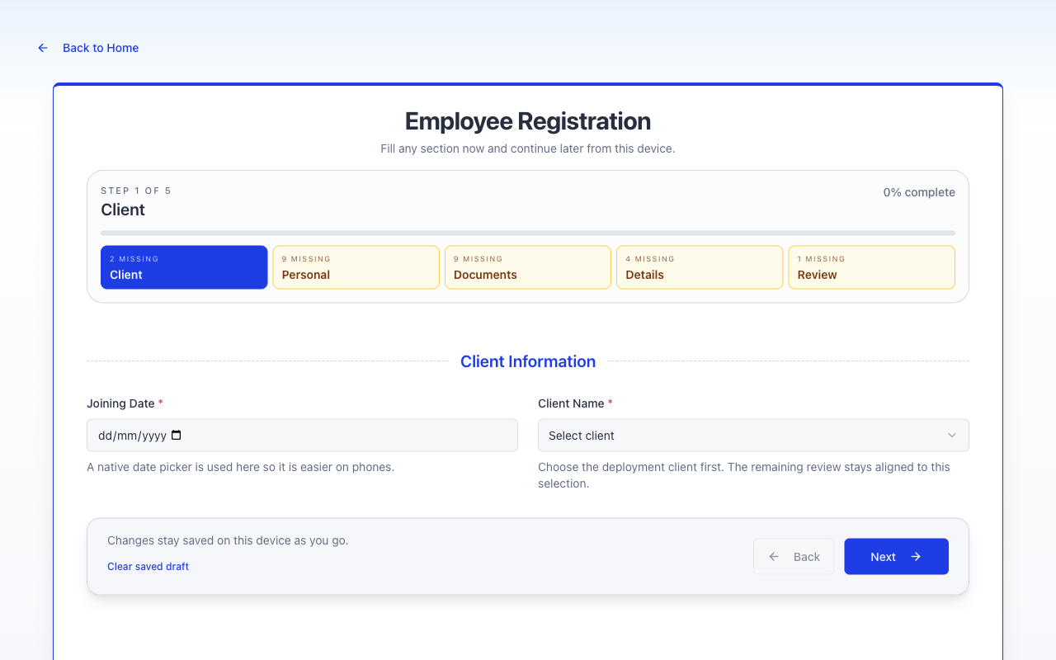
5
Enrollment And Employee Readiness
The guard onboarding flow is structured, mobile-friendly, and designed to improve data quality at entry time.
Why management should care
Enrollment quality drives better attendance, cleaner records, and fewer downstream HR errors.
Step-based registration reduces confusion on mobile
Separate document uploads improve clarity and traceability
Draft-safe flow helps staff finish long forms without losing progress
Client-linked onboarding keeps operations aligned from day one
Result
Guards can be enrolled faster with better document completeness and stronger operational records.
CISS Workforce | Management overview

Slide 6
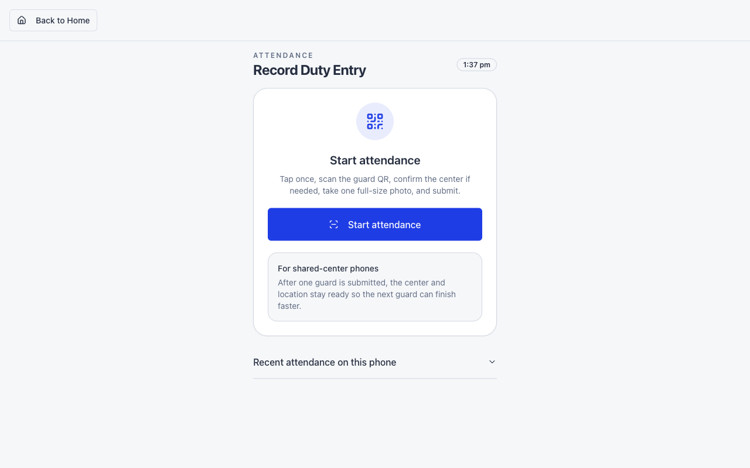
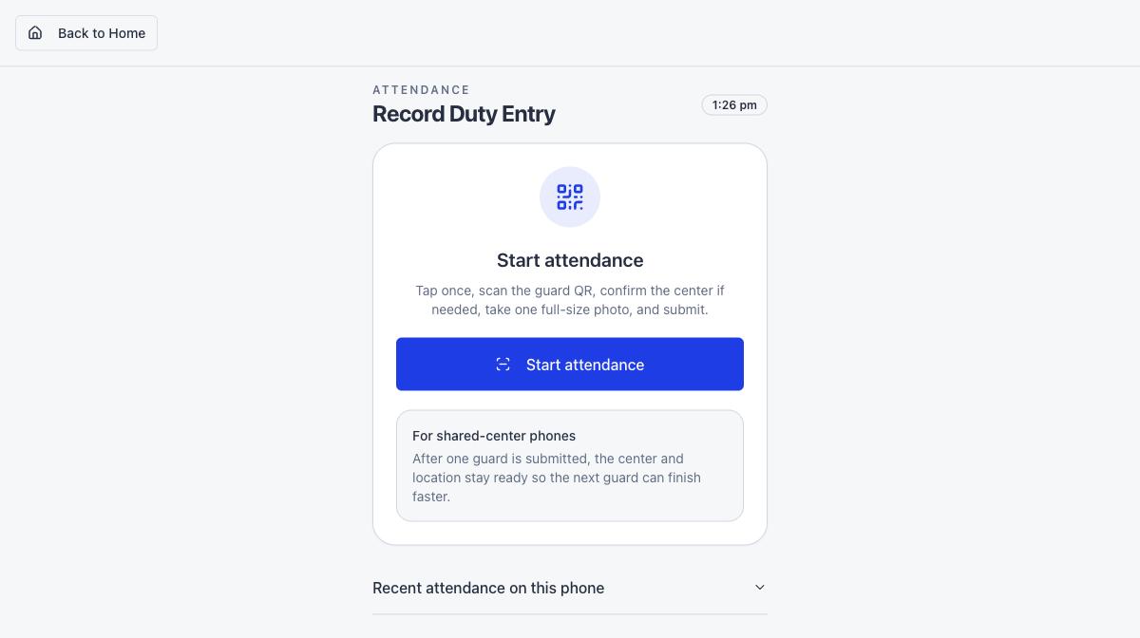
6
Attendance Built For Real Field Use
Attendance is designed for shared mobile devices at sites, not office desktops.
Attendance proof chain
Start attendance from a simple mobile-first screen
Scan guard QR code to identify the person quickly
Capture reporting location, date, and time
Apply geofence checks and site validation
Capture attendance photo and save review metadata
Show the record immediately in admin and field-officer monitoring
CISS Workforce | Management overview

Slide 7
7
How Operations Stay Under Control
Different users see the same operation from the right level of visibility.
Regional Admin
Field Officer
Guard
Sees full region operations
Creates field officers and clients
Monitors attendance logs and reports
Sees only assigned districts
Tracks local site coverage and attendance
Acts on operational gaps in the field
Uses simple mobile flows
Gets QR-based identification
Interacts with attendance and later self-service
What was proven in a real dummy-region test
HQ created a separate region backend and first admin
That region created field officers, clients, employees, duty sites, and work orders
Attendance was recorded and then seen correctly at both admin and district-scoped field-officer levels
CISS Workforce | Management overview

Slide 8
8
Architecture And Governance
The platform is already structured for operational discipline and scalable rollout.
Technology stack
Control model
What this means
Next.js 15.5 App Router
Firebase Auth, Firestore, and Storage
Vercel deployment model
Mobile-first PWA usage
Role-based access across admin, FO, client, and guard layers
Audit-oriented server routes
Geofence-aware attendance validation
Dedicated backend per region
No cross-region data mixing
Operational accountability
Stronger rollout confidence
Management assurance
Kerala remains the current live region database. New regions are onboarded without migrating or overwriting Kerala data. The setup model is now simple enough for HQ operations: finish 3 Firebase console actions, then let the wizard validate, seed, and create the first admin.
CISS Workforce | Management overview

Slide 9
9
What Comes Next
The current platform already supports operations. The next phases convert it into a full HRM and payroll system.
Phase 1-2
Phase 3
Phase 4-5
Phase 6
UI refinement
Training modules
Evaluations
Leaderboard
Awards
Payroll engine
Client wage configs
Payslips
Statutory compliance
Manual overrides
Leave management
Attendance hardening
Site review queue
Holiday and allowance logic
Branch operations
FO visit reports
Training reports
Expense tracking
Recommended management view
Approve rollout based on what is already live today for operations, then fund later phases as controlled business expansions rather than treating everything as one big risky transformation.
CISS Workforce | Management overview

Slide 10
10
Recommended Demonstration Flow
Use this sequence for a confident management presentation.
Live demo script
What to say in one sentence
1. Show Region Onboarding and explain separate backend per region
2. Show client and field-officer setup in a region
3. Show employee enrollment with the guided mobile-friendly flow
4. Record one attendance entry live if possible
5. Open attendance logs and show the same record immediately
6. Close with the roadmap: training, payroll, leave, branch operations
"CISS Workforce is now a region-ready workforce operations platform, with Kerala protected, new regions isolated, and field attendance controlled in real time."
Management decision ask
Approve rollout to the next region
Use operations first, then extend to payroll and HRM
Treat this as the company’s standard workforce platform
CISS Workforce | Management overview

