Slide 1
EU FUNDING
INTELLIGENCE
EIF Financial Intermediaries Research & Analysis
Prepared for CEO, COO & Management Team
European Commission // Your Europe Portal // Q1 2025

Slide 2
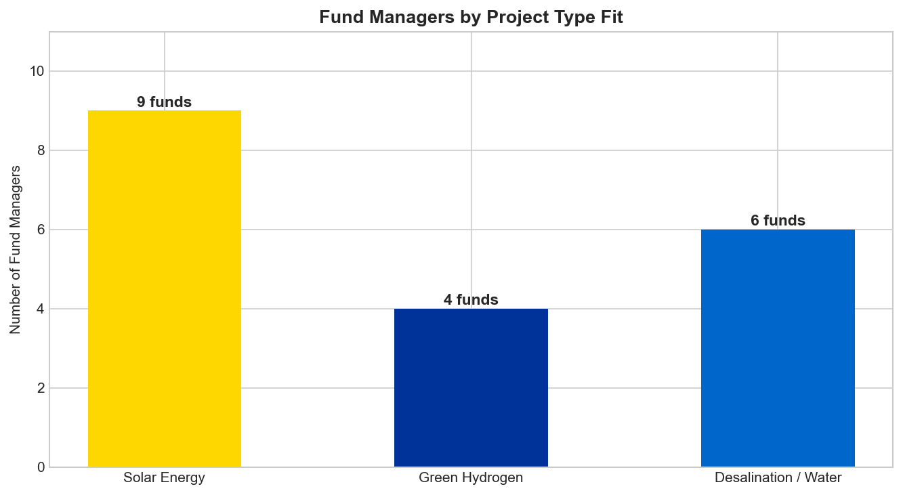
Key Metrics
Portfolio overview
12
Fund Managers
5
Countries
EUR 119M
Total EIF Capital
9
Solar Fit
4
Hydrogen Fit
6
Desalination

Slide 3
Fund Manager Rankings
Sorted by strategic fit score
FUND MANAGER | COUNTRY | TYPE | EIF COMMITMENT | SCORE | TIER
Suma Capital SGEIC SA leading manager in | Spain | Infrastructure | 41.2M | 8.0 | PRIORITY
Impact Bridge is a Spanish asset managem | Global | Debt | -- | 7.0 | PRIORITY
Impact Bridge Carlos de Abajo Co-Head Ag | Spain | VC | 0.0M | 6.0 | SECONDARY
Axon Partners Group Investment | Spain | PE | 21.0M | 6.0 | SECONDARY
OXY Capital Empowering small and midsize | Portugal | Debt | 10.5M | 5.5 | SECONDARY
Alantra Multi Asset SGIIC | Spain & Portugal | VC | 20.3M | 5.0 | SECONDARY
Impact Bridge Rebecca Eastmond Co-Founde | Global | Debt | -- | 4.5 | SECONDARY
NIAM Infrastructure invests in Nordic in | Sweden | Infrastructure | 5.2M | 4.0 | SECONDARY
Impact Bridge Cristina González Viu Gene | Spain & Portugal | Debt | -- | 3.5 | MONITOR
Impact Bridge Louisa Brassey Chair of th | Global | Debt | -- | 3.5 | MONITOR
Arta Capital Fund III | Spain | PE | 2.8M | 3.5 | MONITOR
Norrsken Impact Accelerator welcomes the | Sweden | VC | 17.5M | 3.2 | MONITOR

Slide 4
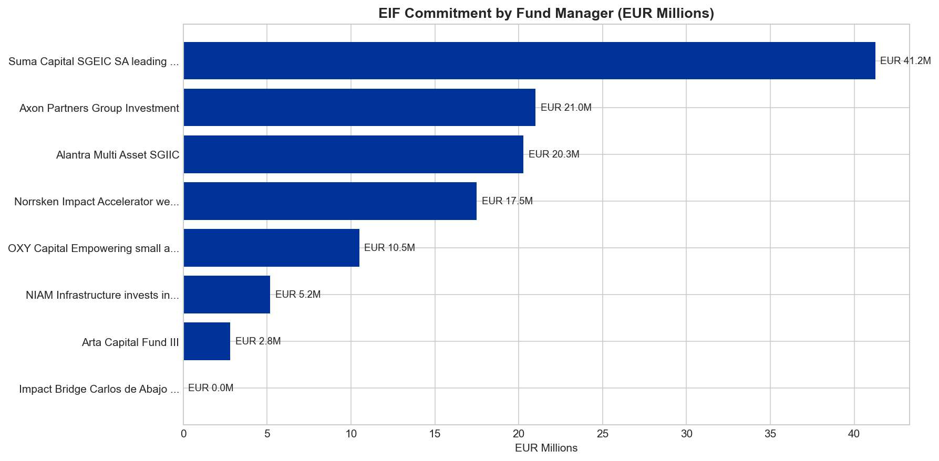
EIF Commitment
Capital allocated per intermediary

Slide 5
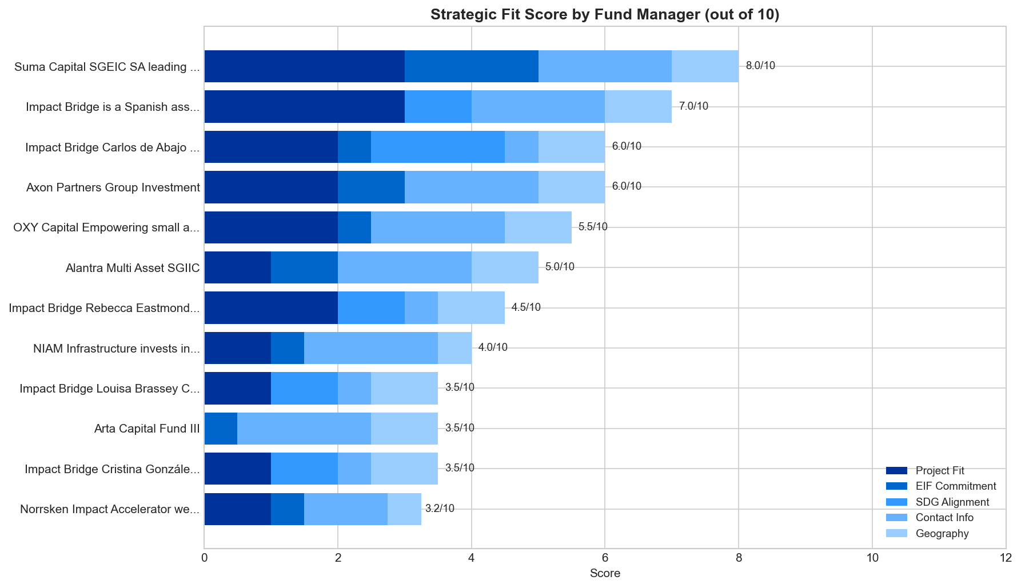
Strategic Fit Scoring
Project Fit // EIF Commitment // SDG // Contact // Geography

Slide 6
Key Findings
1
SPAIN HUB
Spain dominates with 7 of 12 fund managers - strongest entry point.
2
SOLAR COVERAGE
Broadest coverage of any project type, multiple funding options.
3
DESALINATION GAP
No fund targets it directly. Best route: SDG 6/14 via Impact Bridge.
4
HYDROGEN STRATEGY
Multi-fund: Suma Capital + Impact Bridge + Axon Partners.
5
NORDIC SCALE
NIAM at EUR 51.7M - largest commitment, infrastructure scale.
6
SDG READINESS
Impact funds require measurable metrics. Prepare data first.

Slide 7
Decision Framework
Does EU funding apply to your company?
01
LOCATION
>>
EU27, EEA, outermost regions, associated countries?
02
COMPANY
>>
Startup, SME, mid-cap, or infrastructure project?
03
FINANCE
>>
Loans, venture capital, microfinance, or grants?
04
PARTNER
>>
EIF, EIB, InvestEU, or national promotional banks?
05
AMOUNT
>>
From under EUR 500K to EUR 50M+?
06
SDG
>>
Which sustainable development goals apply?
07
OUTPUT
>>
Your filtered shortlist with direct portal link.

Slide 8
Recommended Actions
Prioritized by timeline
IMMEDIATE
Outreach to Tier 1: Suma Capital (8/10) and Impact Bridge Global (7/10).
Q2 2025
Prepare SDG-aligned pitch deck with measurable impact metrics.
Q2 2025
Develop Portugal strategy for OXY Capital: solar + green hydrogen.
Q3 2025
Apply to Norrsken Impact Accelerator 2026 cohort.
ONGOING
Expand intermediary research across all 27 EU member states.
European Commission // Your Europe Portal // Q1 2025

