Slide 1
Student Performance Prediction System
Machine Learning Capstone Project
Academic Analytics • Prediction • Dashboard • Recommendations

Slide 2
1. Problem Statement
Analyze academic data to understand factors affecting student performance.
Predict performance level: High, Average, or Low.
Generate actionable improvement recommendations.
Present insights through an interactive dashboard.

Slide 3
2. Project Objectives
Data analysis and preprocessing
Machine learning prediction
Factor identification and visualization
Performance insights
Dashboard-based student analytics

Slide 4
3. Dataset & Features
Self-created academic dataset: 1,003 raw rows → 1,000 cleaned rows.
Numeric: attendance, study hours, internal marks, participation, previous score, assignment completion, weak subjects.
Categorical: gender, study mode, subject.
Targets: final score and performance level.

Slide 5
4. Data Preprocessing
Missing values handled with imputation.
Duplicate records removed.
Categorical variables encoded using one-hot encoding.
Numeric features normalized using StandardScaler.
Reusable Scikit-learn preprocessing pipeline.

Slide 6
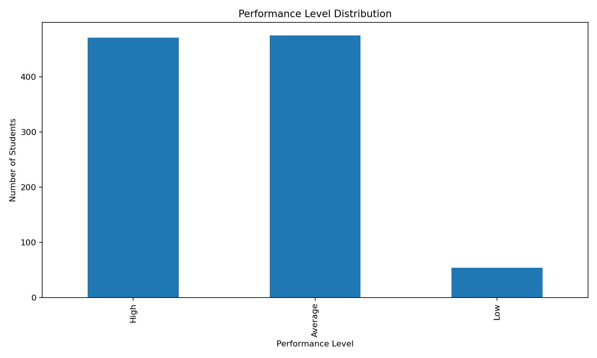
5. Exploratory Data Analysis

Slide 7
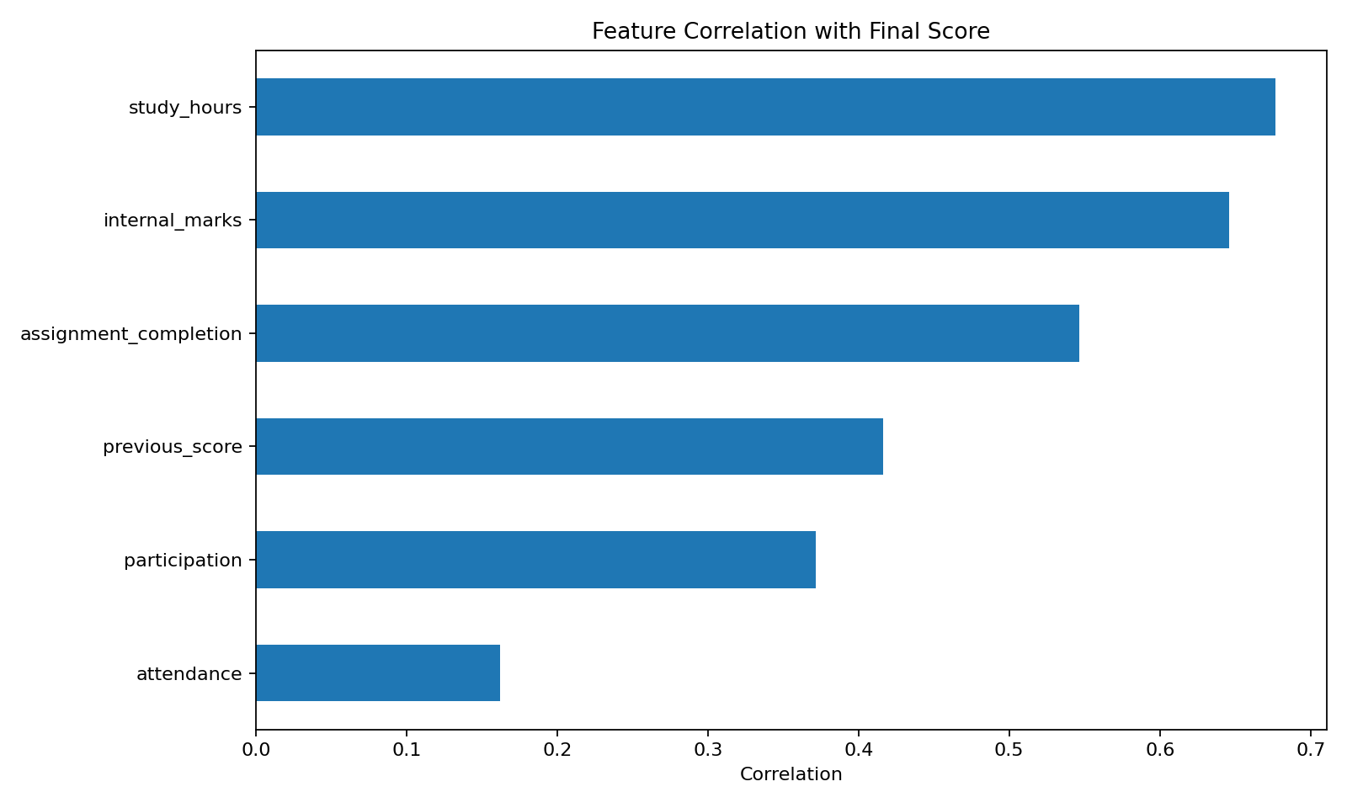
6. Feature Relationship Analysis

Slide 8
7. Machine Learning Models
Random Forest Classifier — accuracy 0.760.
Decision Tree Classifier — accuracy 0.675.
Linear Regression — MAE 4.46, R² 0.815.
Random Forest Regressor — MAE 5.05, R² 0.767.

Slide 9
8. Prediction Flow
Student inputs → preprocessing pipeline → trained classifier/regressor → predicted score + performance level.
Prediction → recommendation rules → personalized improvement suggestions.

Slide 10
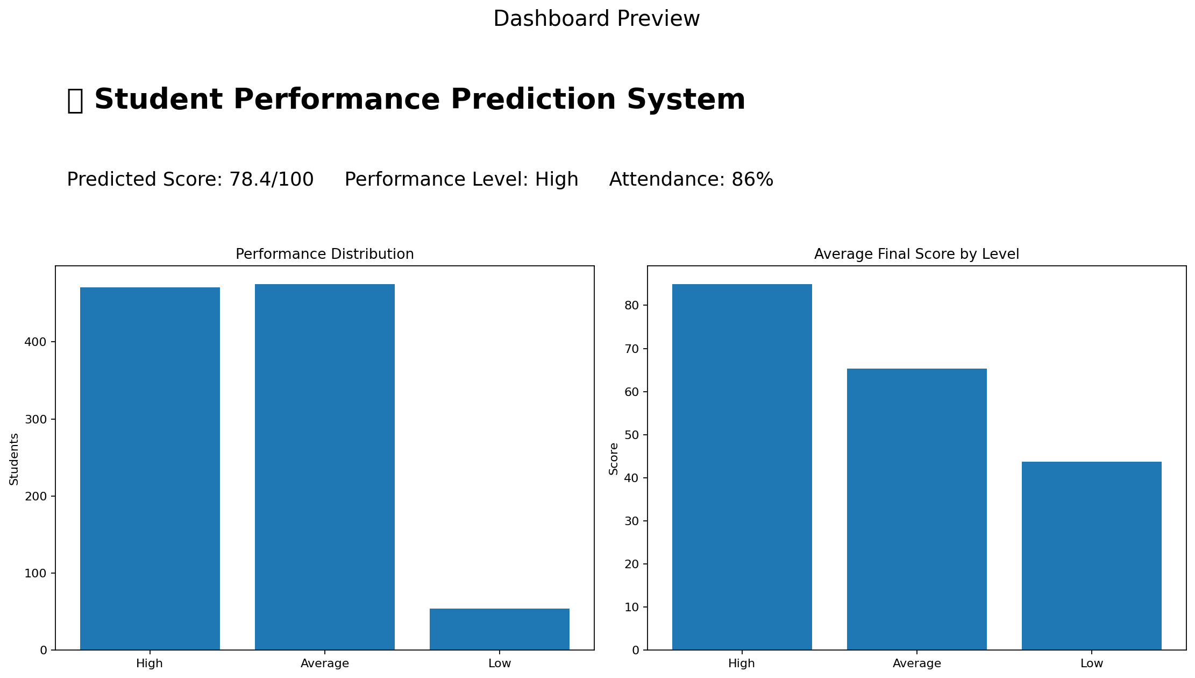
9. Dashboard

Slide 11
10. Recommendation System
Increase study hours when needed.
Improve attendance.
Focus on weak subjects.
Attend practice sessions and participate.
Improve assignment completion and internal assessment preparation.

Slide 12
11. Technology Stack
Python, Pandas, NumPy
Scikit-learn
Matplotlib, Seaborn
Streamlit
Joblib
Deployment-ready for Streamlit Cloud / Render

Slide 13
12. Scope & Limitations
No deep learning.
No real-time student monitoring.
No large-scale educational platform.
No complex AI architecture.
Focused on a clean, functional prediction system.

Slide 14
13. 25-Day Plan
Days 1–3: Requirements + dataset
Days 4–7: Cleaning + preprocessing
Days 8–12: EDA
Days 13–17: ML models
Days 18–21: Dashboard
Days 22–23: Recommendations
Day 24: Testing
Day 25: Deployment + presentation

Slide 15
14. Deliverables
Source code
Project report
PPT presentation
GitHub-ready repository structure
Dashboard screenshots
Deployment-ready application
Demo-video recording plan

Slide 16
15. Final Outcome
An end-to-end Student Performance Prediction platform.
Analyzes academic data.
Predicts student outcomes.
Visualizes performance analytics.
Generates improvement insights.
Matches the supplied capstone brief and evaluation structure.

