Slide 1

ASPNETCOREIDENTITY
Sit Dolor Amet

Slide 2
Implementing asp.net core identity from scratch

Slide 3
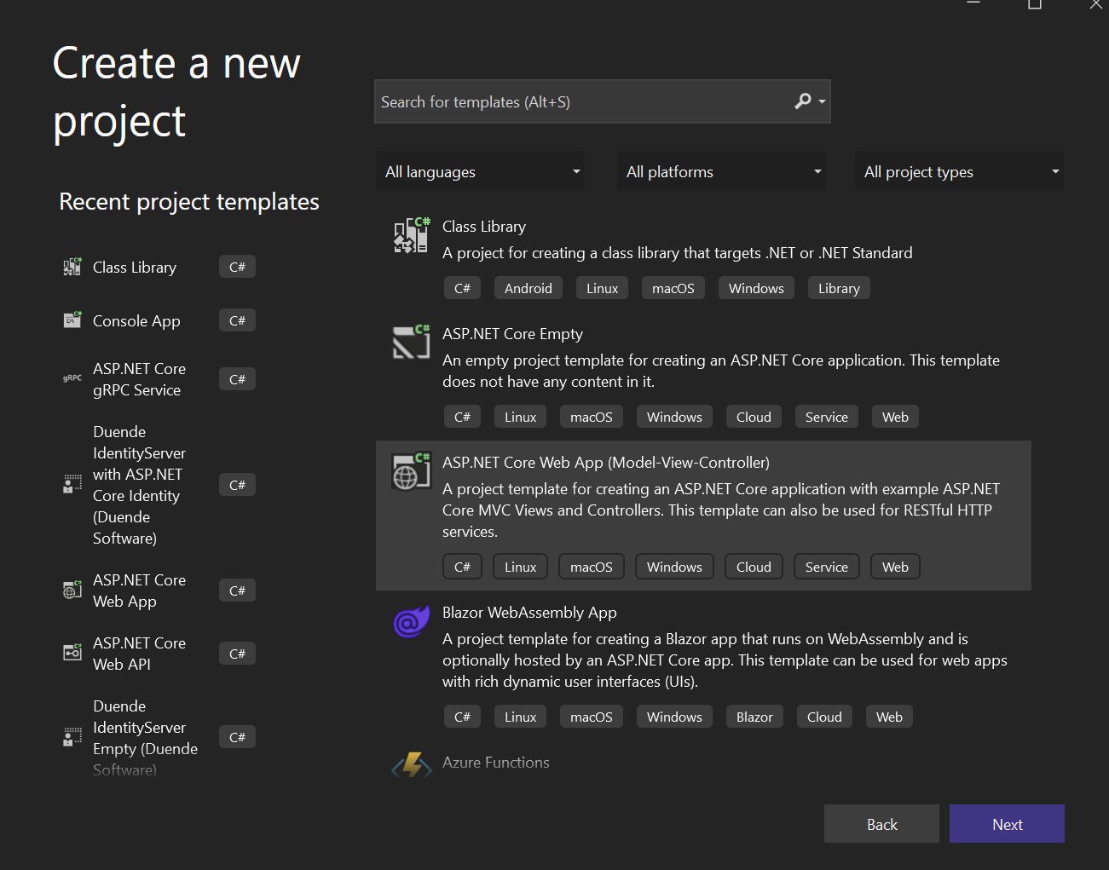
ASP.Net Core IDENTITY - 1

Slide 4
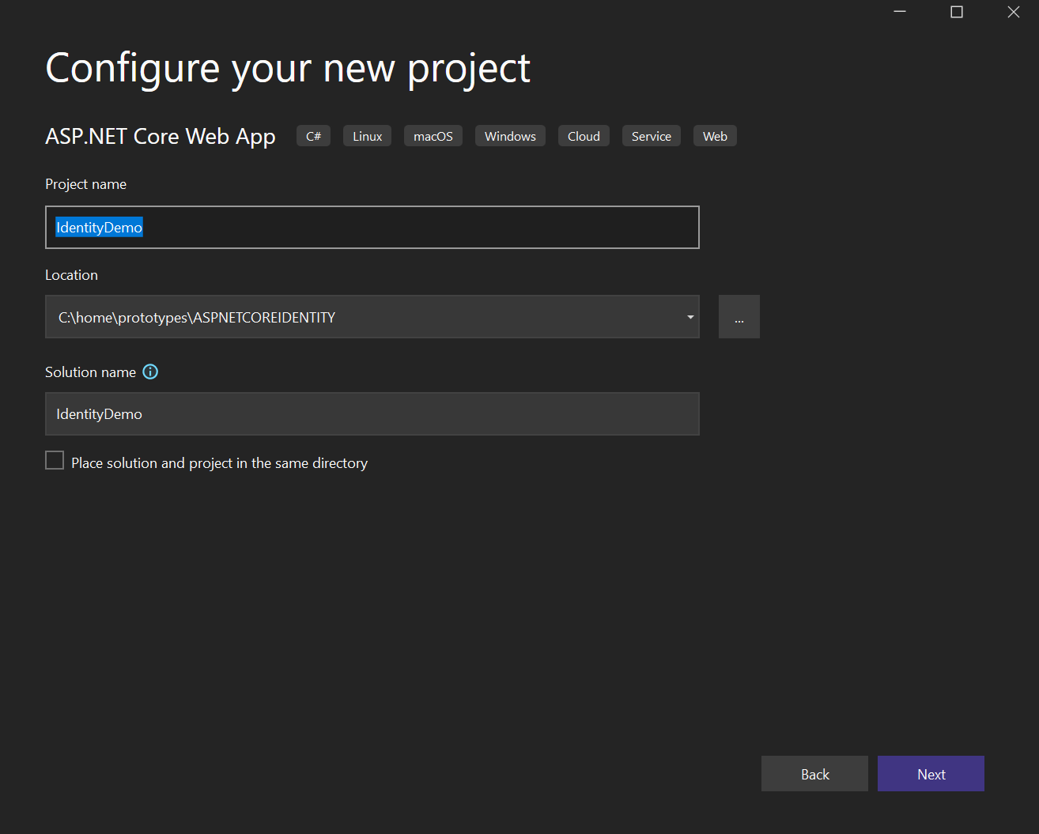
ASP.Net Core IDENTITY - 2

Slide 5
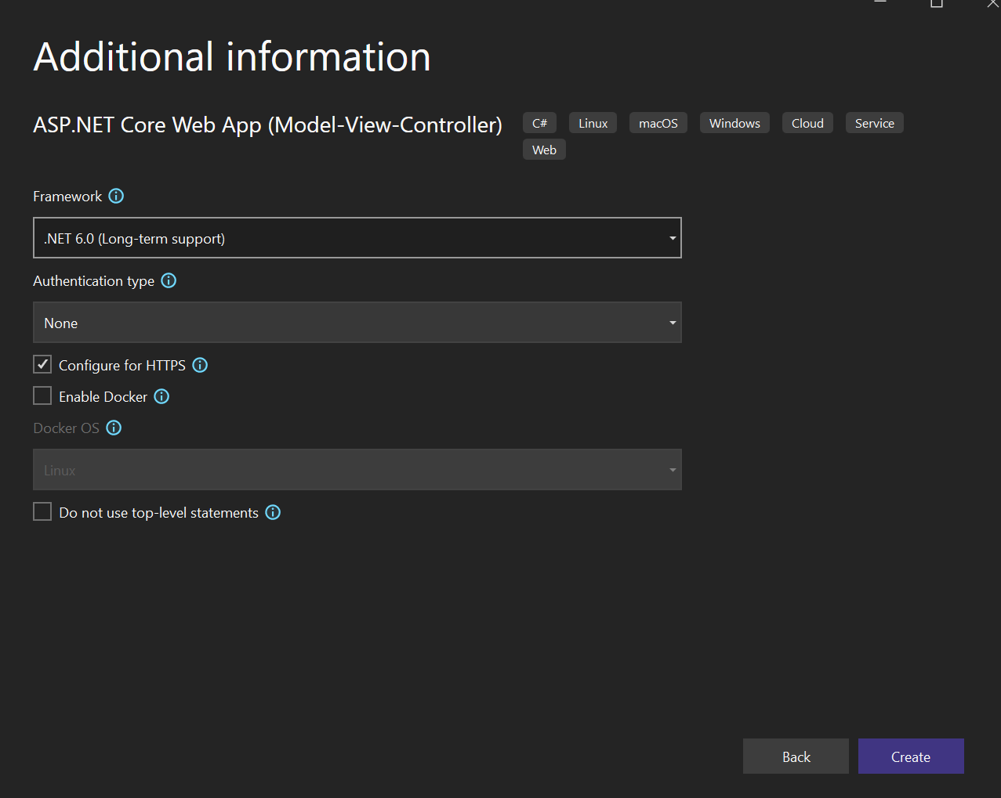
ASP.Net Core IDENTITY - 3

Slide 6
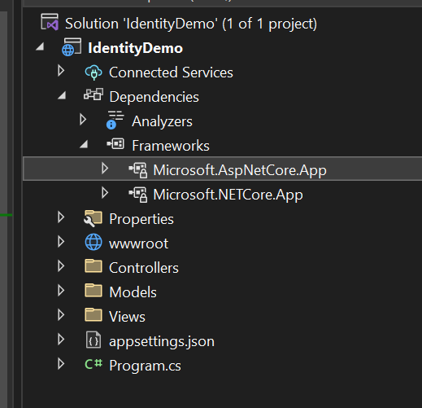
ASP.Net Core IDENTITY - 4
For demo :
Microsoft.AspNetCore
Microsoft.AspNetCore.Mvc
Microsoft.AspNetCore.StaticFiles
Microsoft.Extensions.Identity.Core

Slide 7
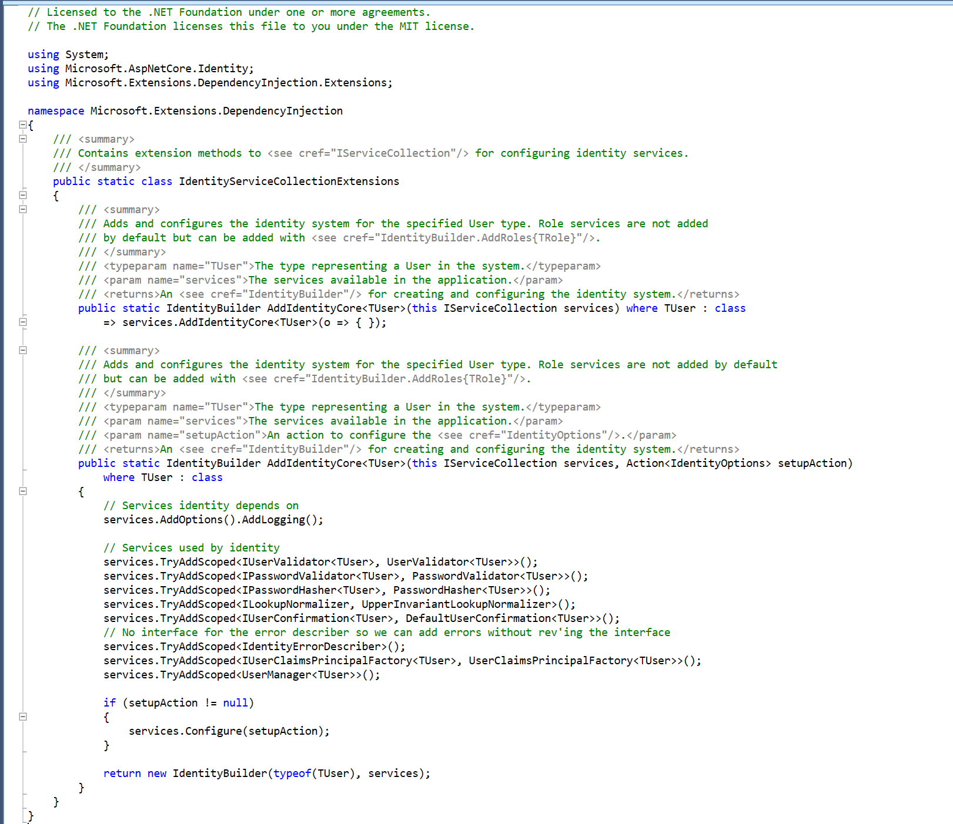
ASP.Net Core IDENTITY - 5

Slide 8
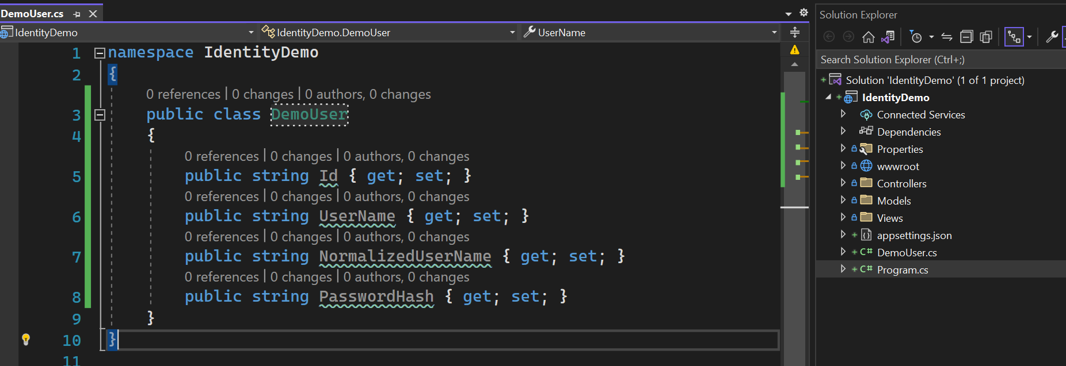
DemoUser

Slide 9
IDENTITY

Slide 10
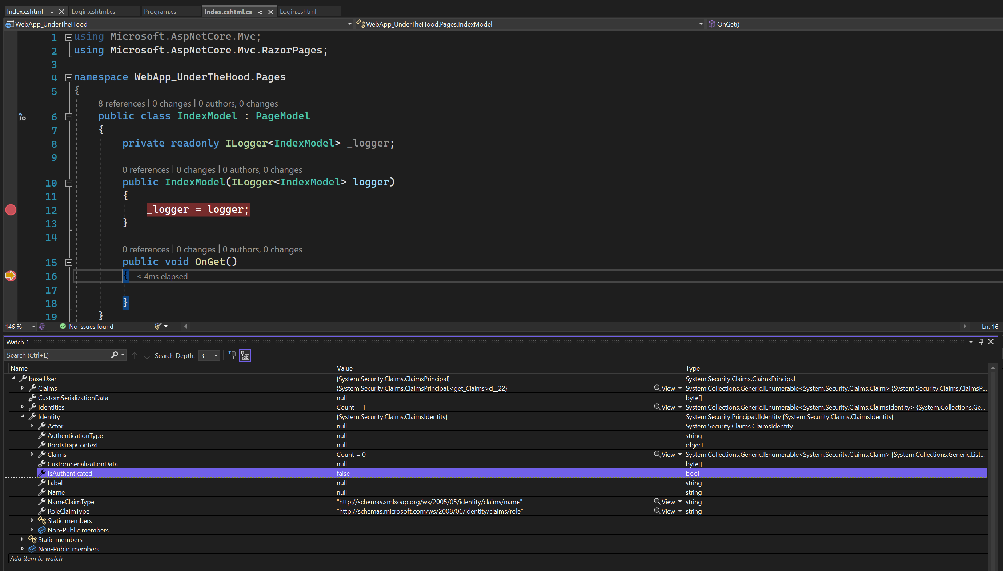
IDENTITY - 1

Slide 11
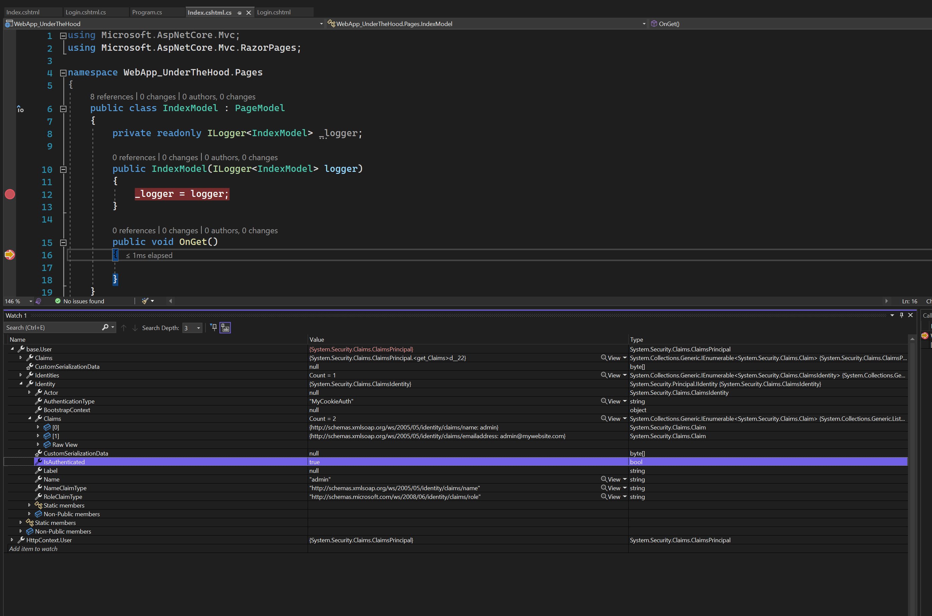
IDENTITY - 2

Slide 12
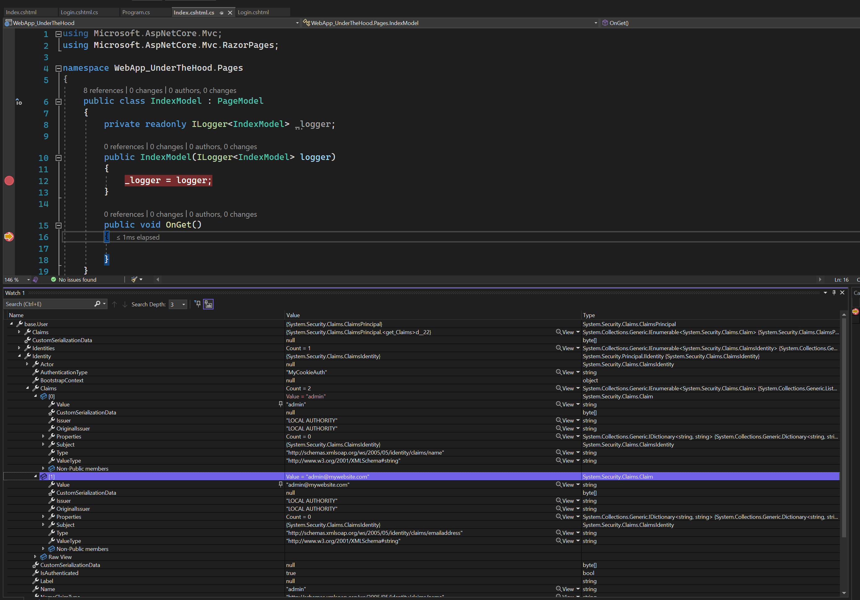
IDENTITY - 3

