Slide 1

ASPNETCORE6RESTAPI
Sit Dolor Amet

Slide 2
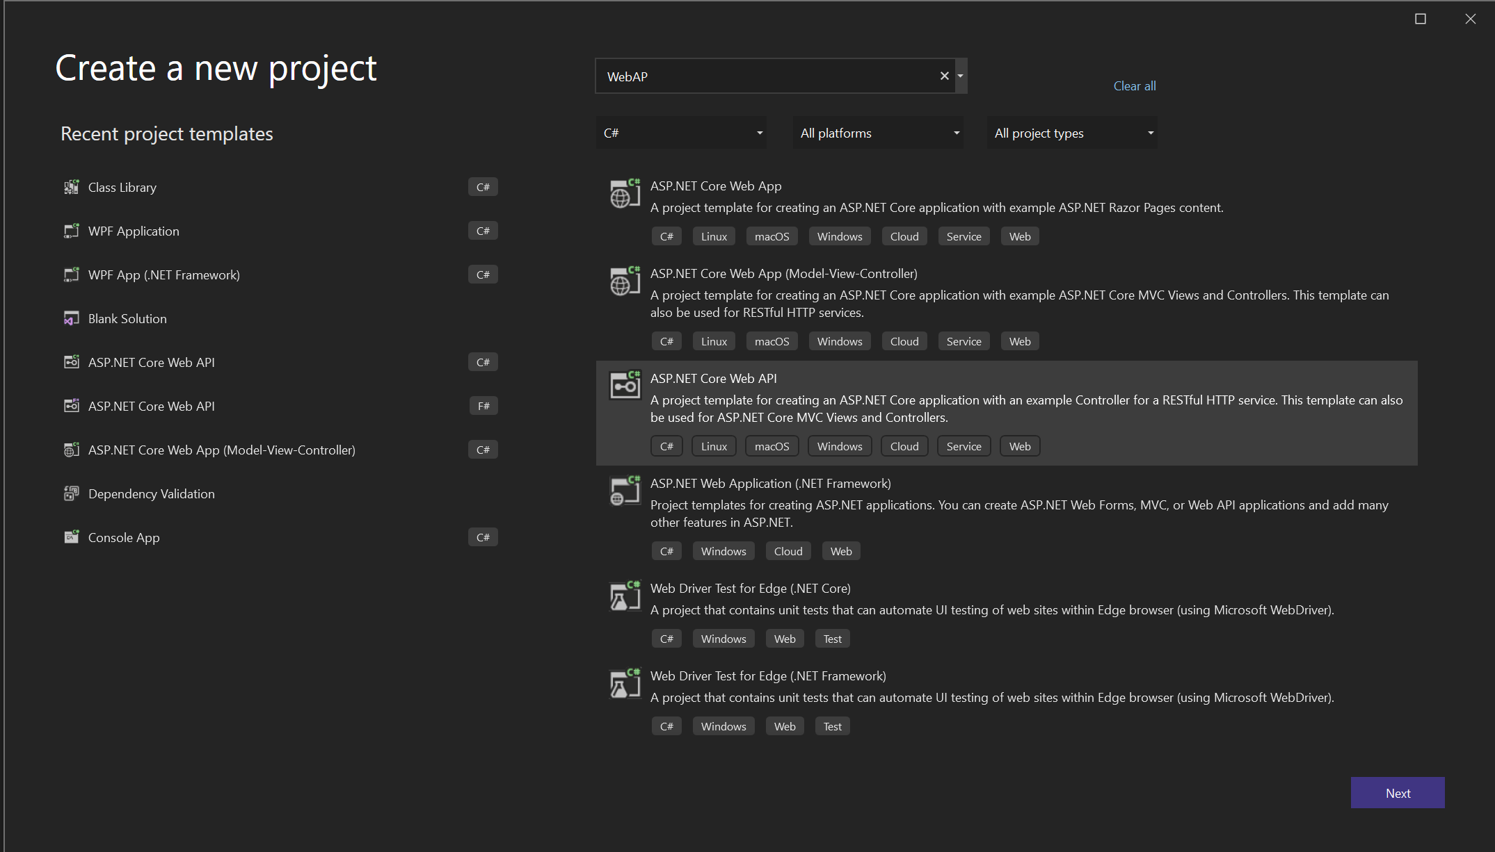
Project template

Slide 3
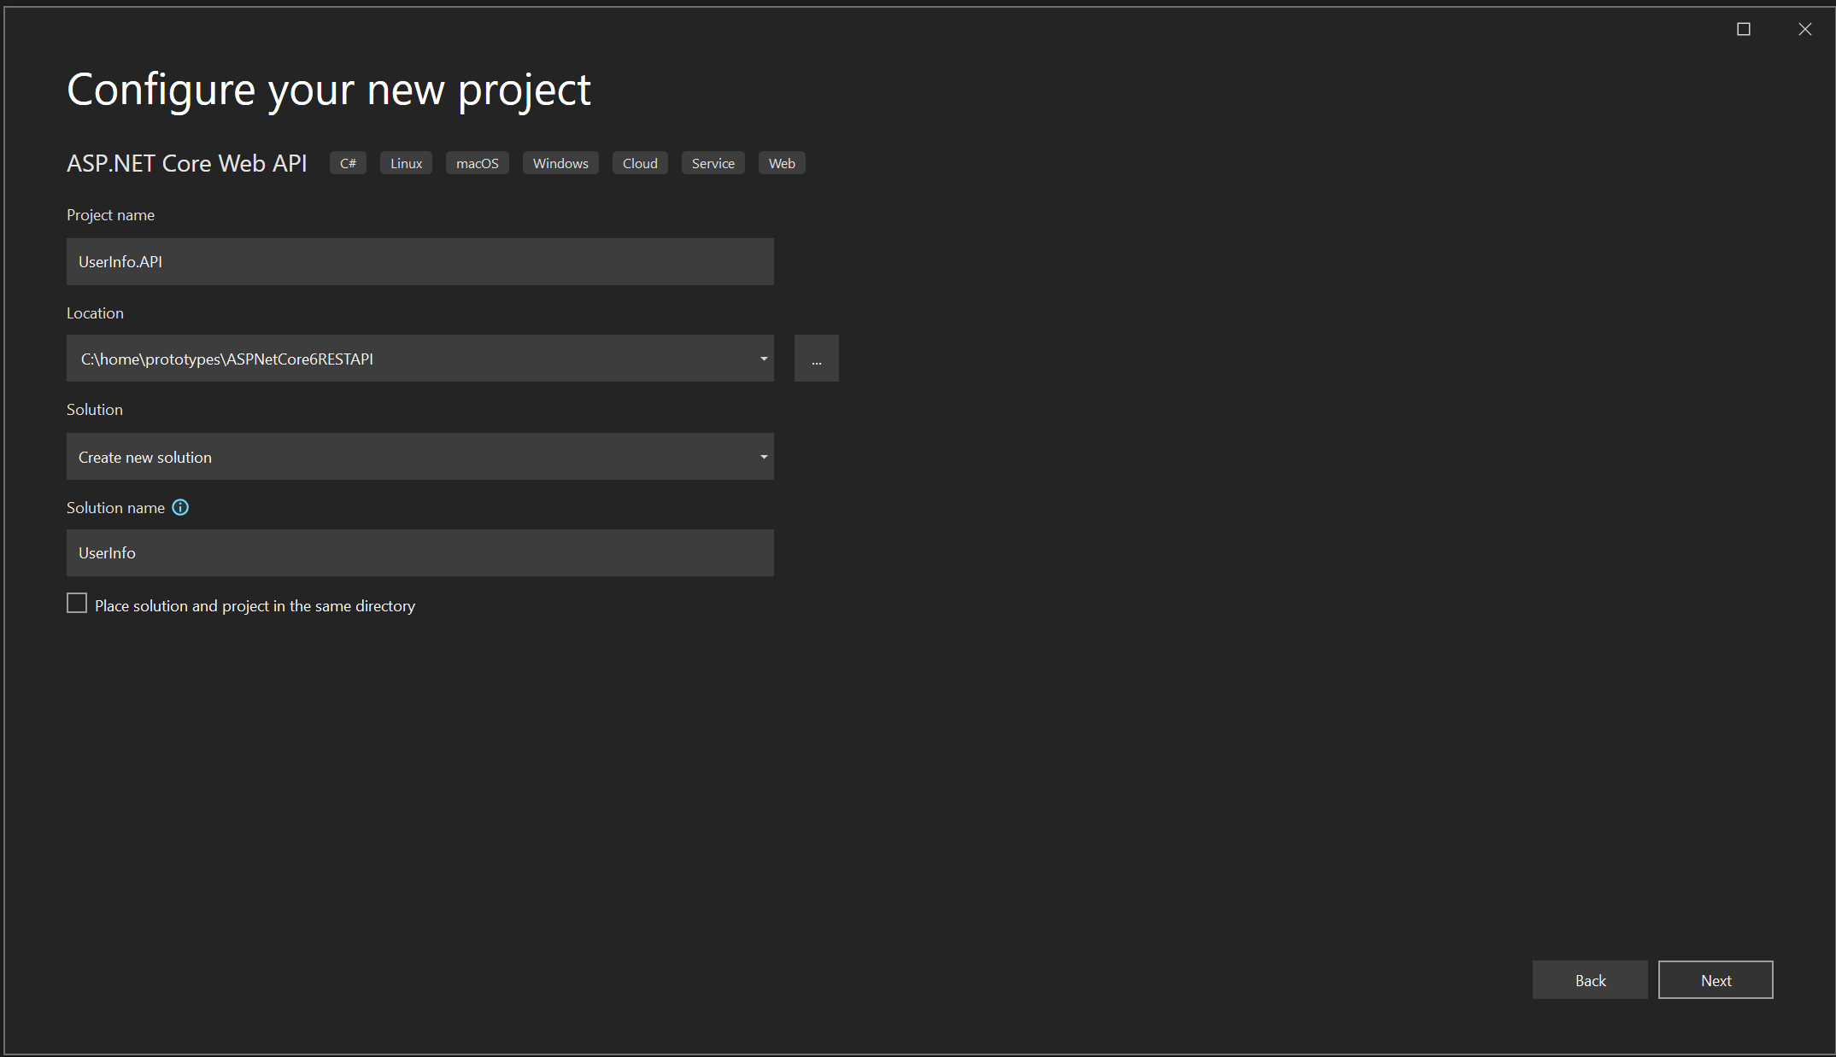
Create project

Slide 4
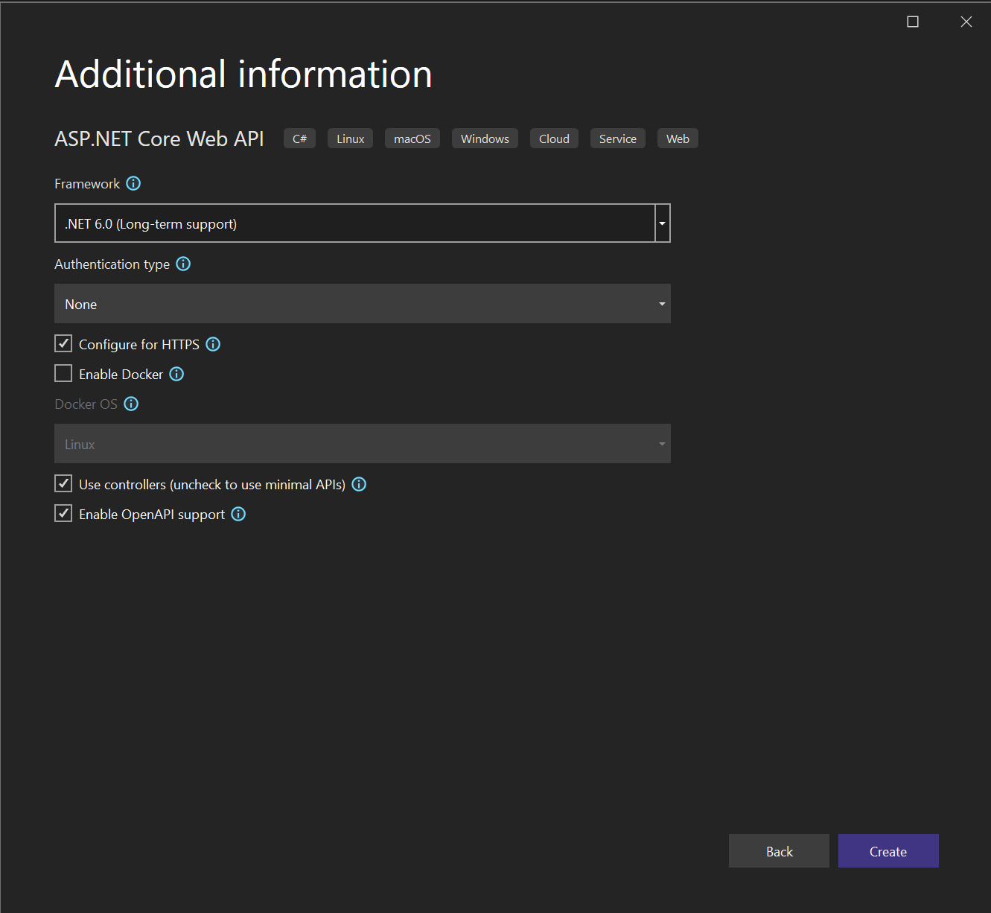
Enable open api support

Slide 5
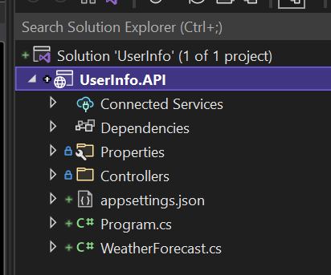
Userinfo.api

Slide 6
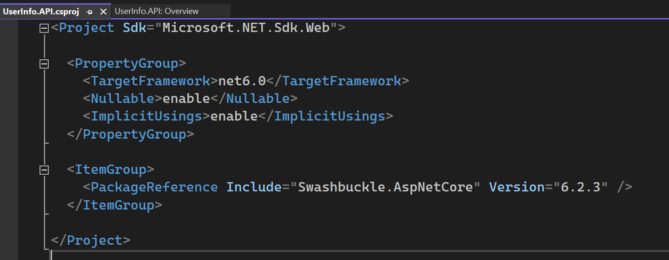
USER INFO API
Swashbuckle.AspNetCore is an implementation of OpenAPI or swagger as it used to be called for ASP.Net Core.

Slide 7
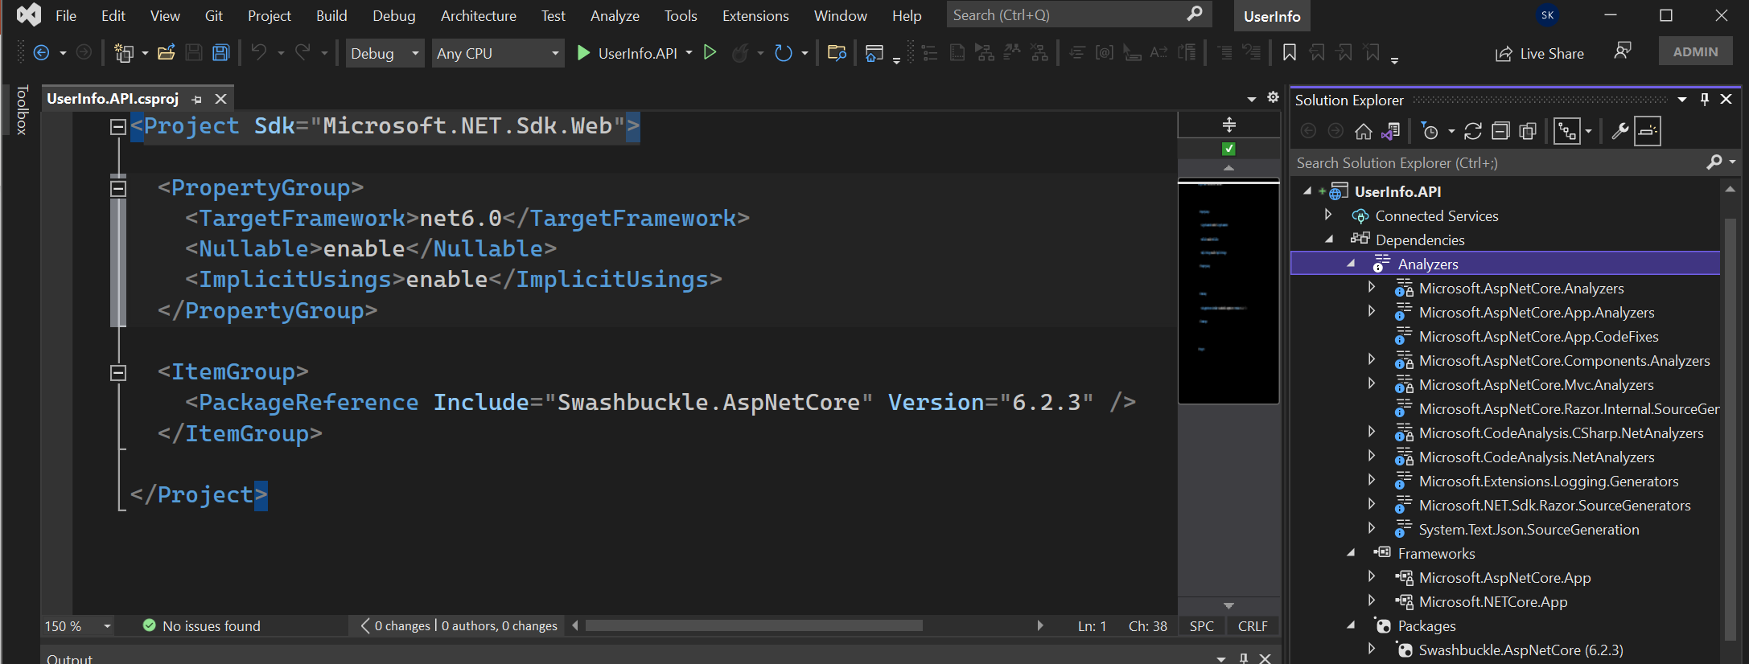
Project that target Microsoft.NET.Sdk.web implicitily target Microsoft.AspNetCore.App
It is also called as ASP.Net core shared framework.
Microsoft.NETCORE.APP are lower assemblies that make up the .NET Developer Platform.
Explicit reference packages Swashbuckle.AspNetCore for generating documentation.
Analyzers – These are packages that analyze your code while developing. It will also do code analysis.

Slide 8
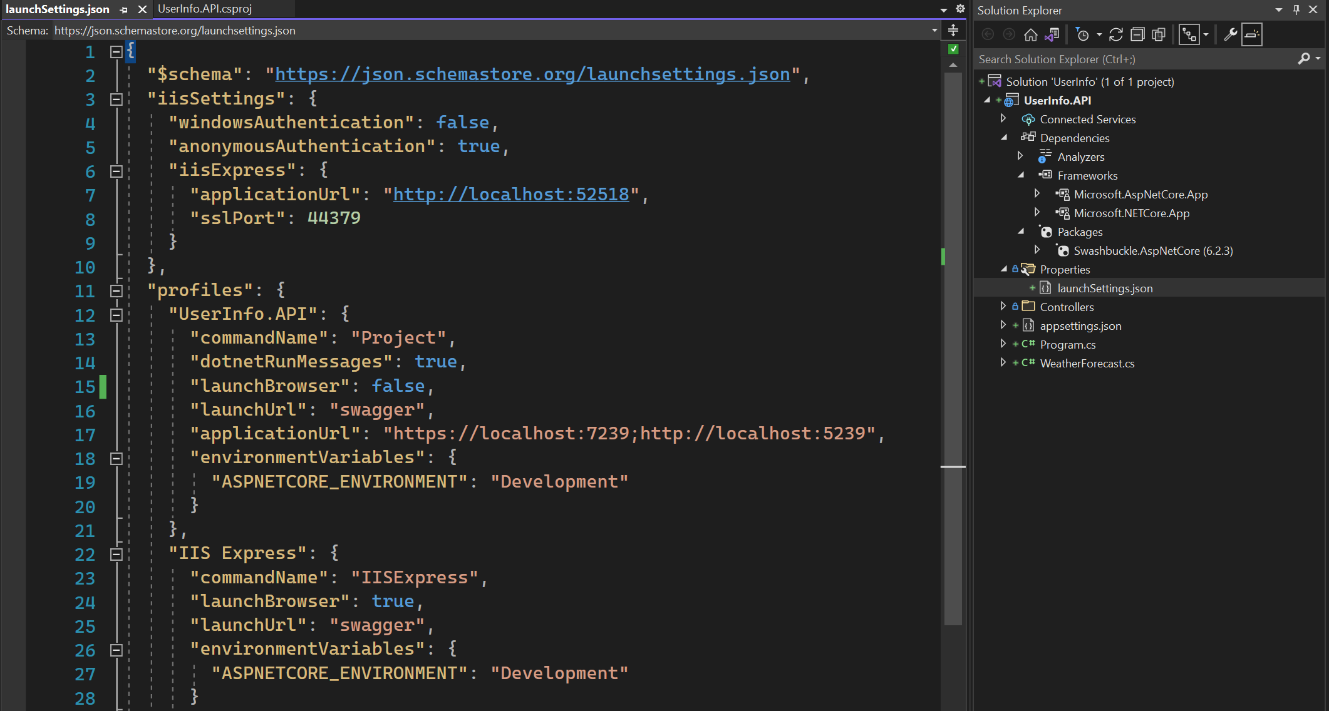
This file is used to setup the environment for local machine development. Not deployed.
The first profile contains the name “Project”. That means it use Kestrel Web Server to launch the project. It is more in line
with cross platform nature of .Net.
Change launchbrowser to false.

Slide 9
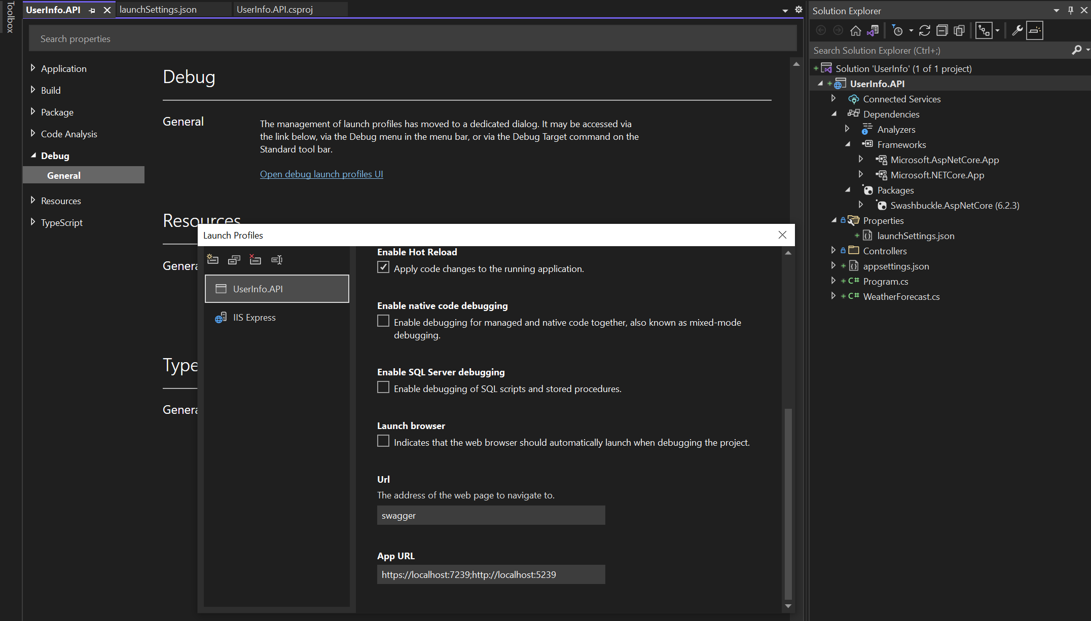
Open Launch Profiles

Slide 10
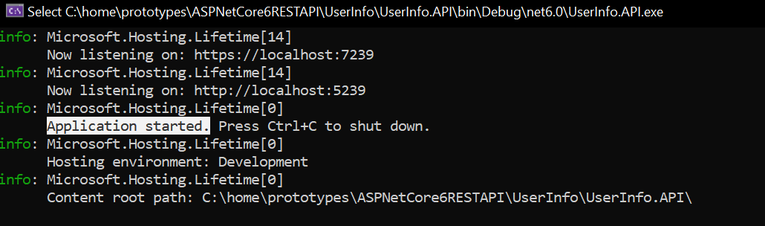
Application started

Slide 11
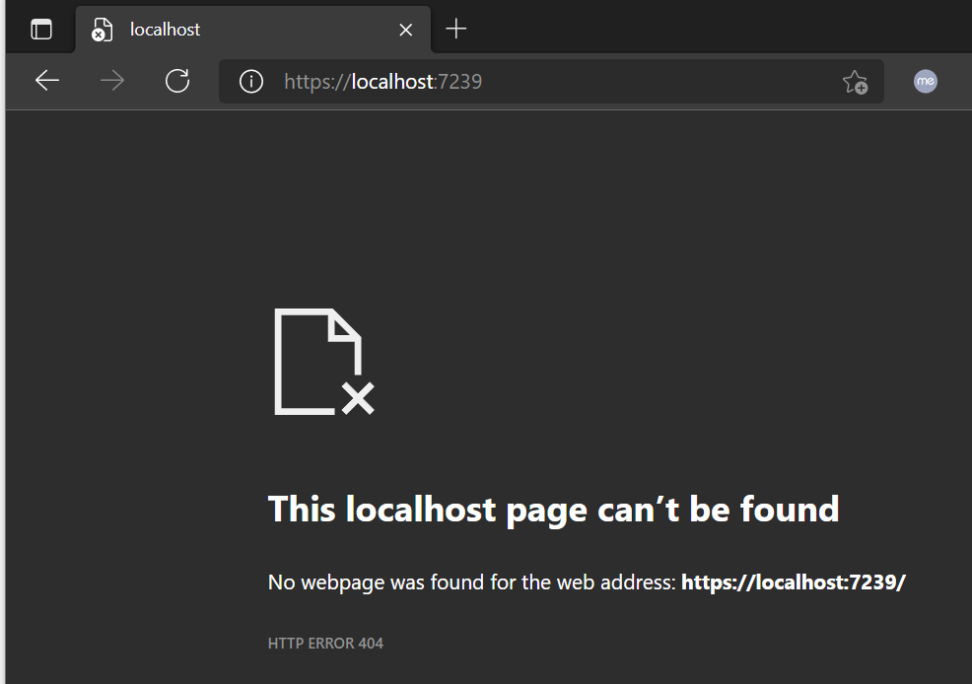
Navigate to the root

Slide 12
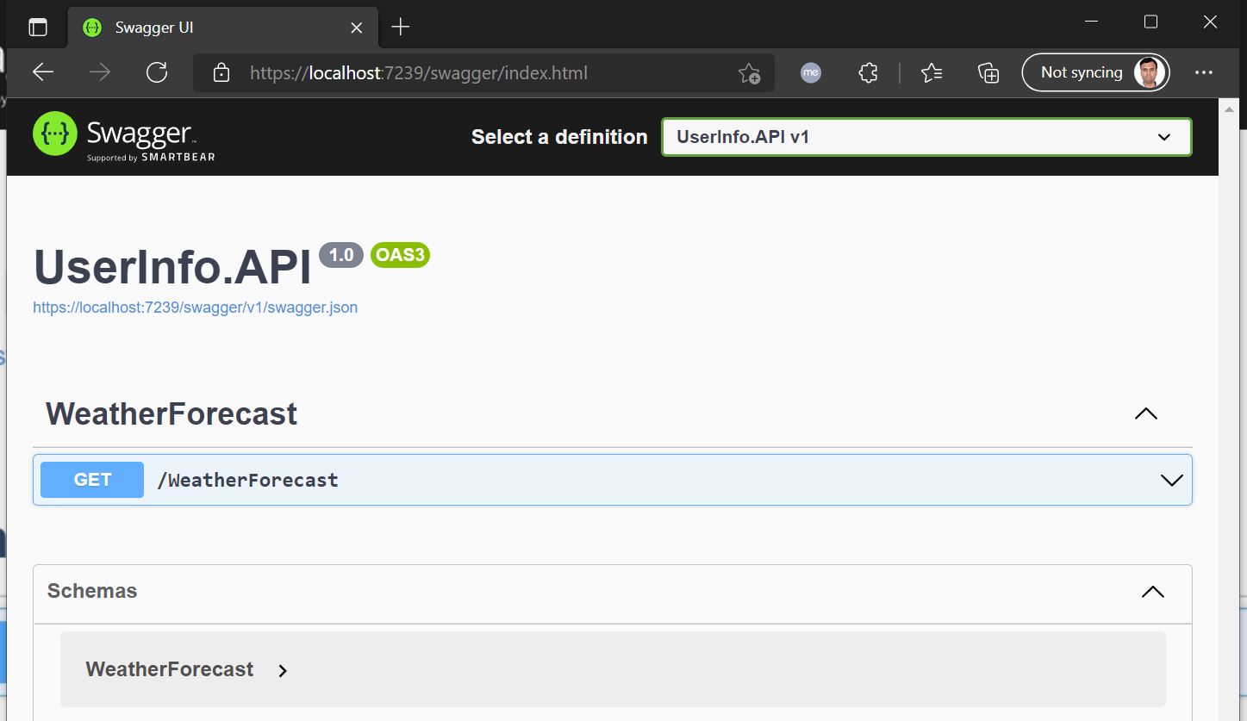
swagger

Slide 13
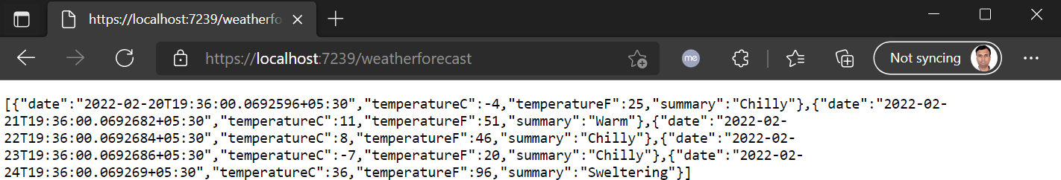
Navigate to weatherforecast

Slide 14
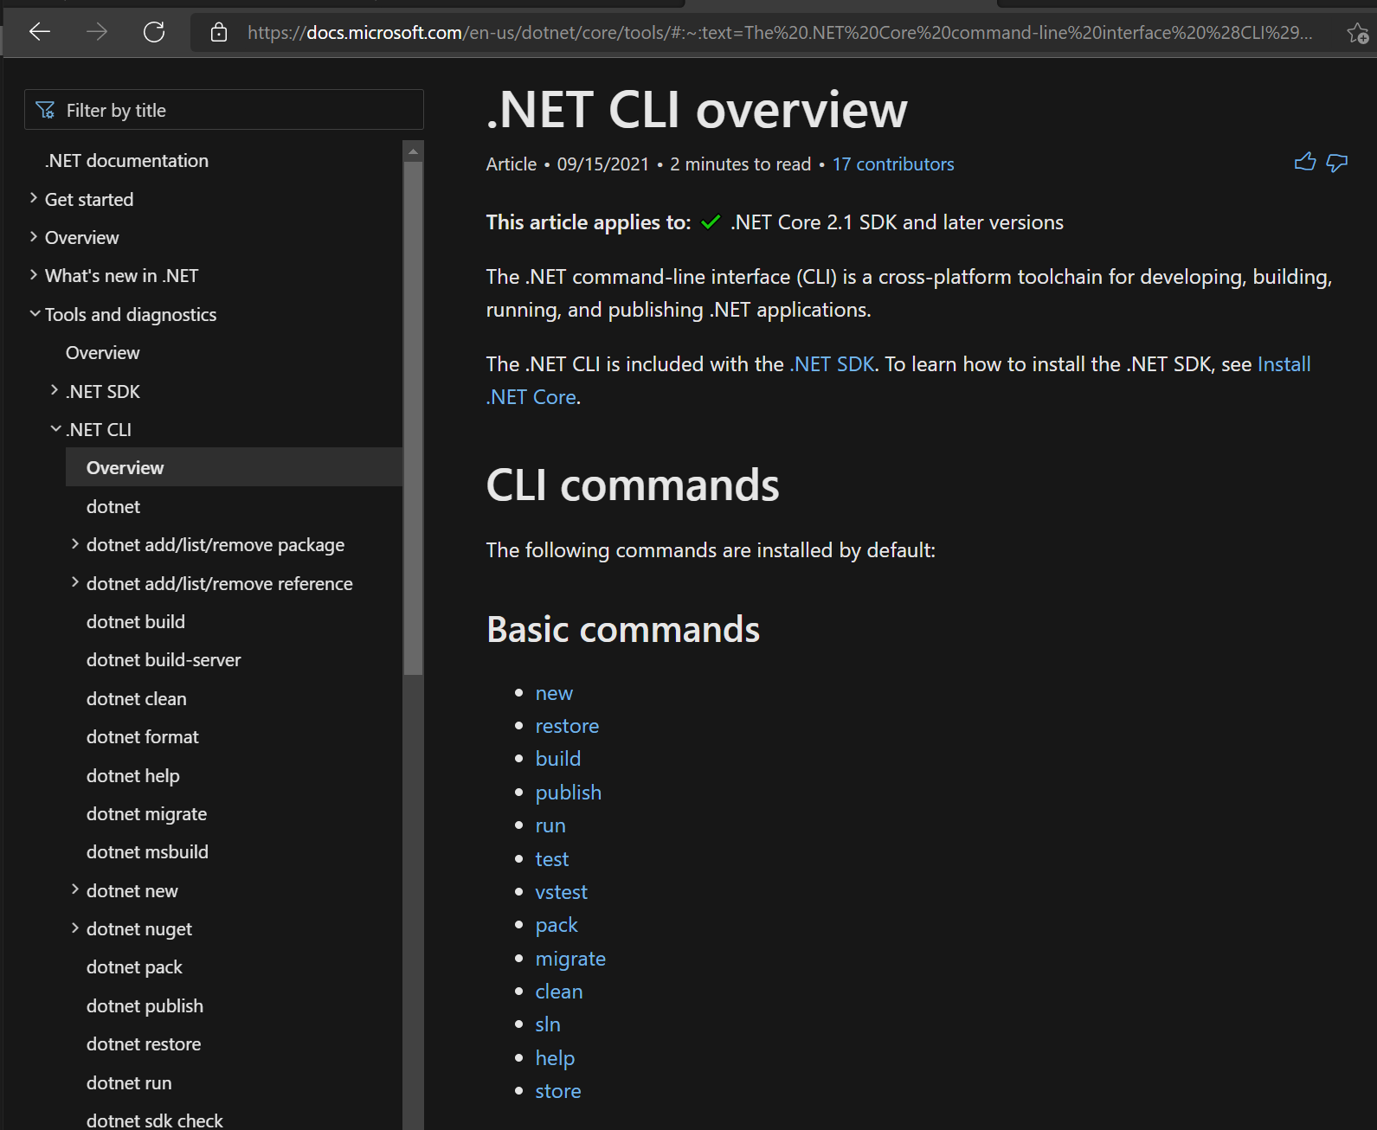
.Net CLI

Slide 15
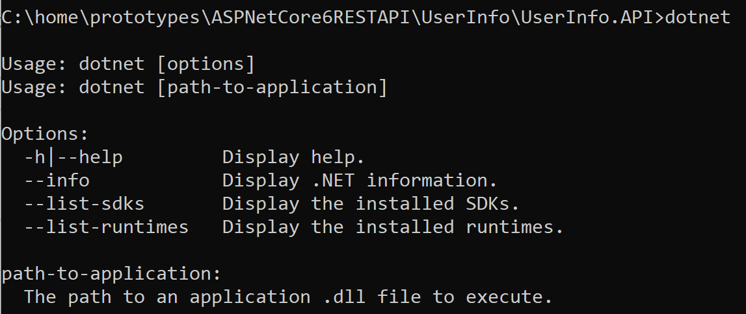
dotnet

Slide 16
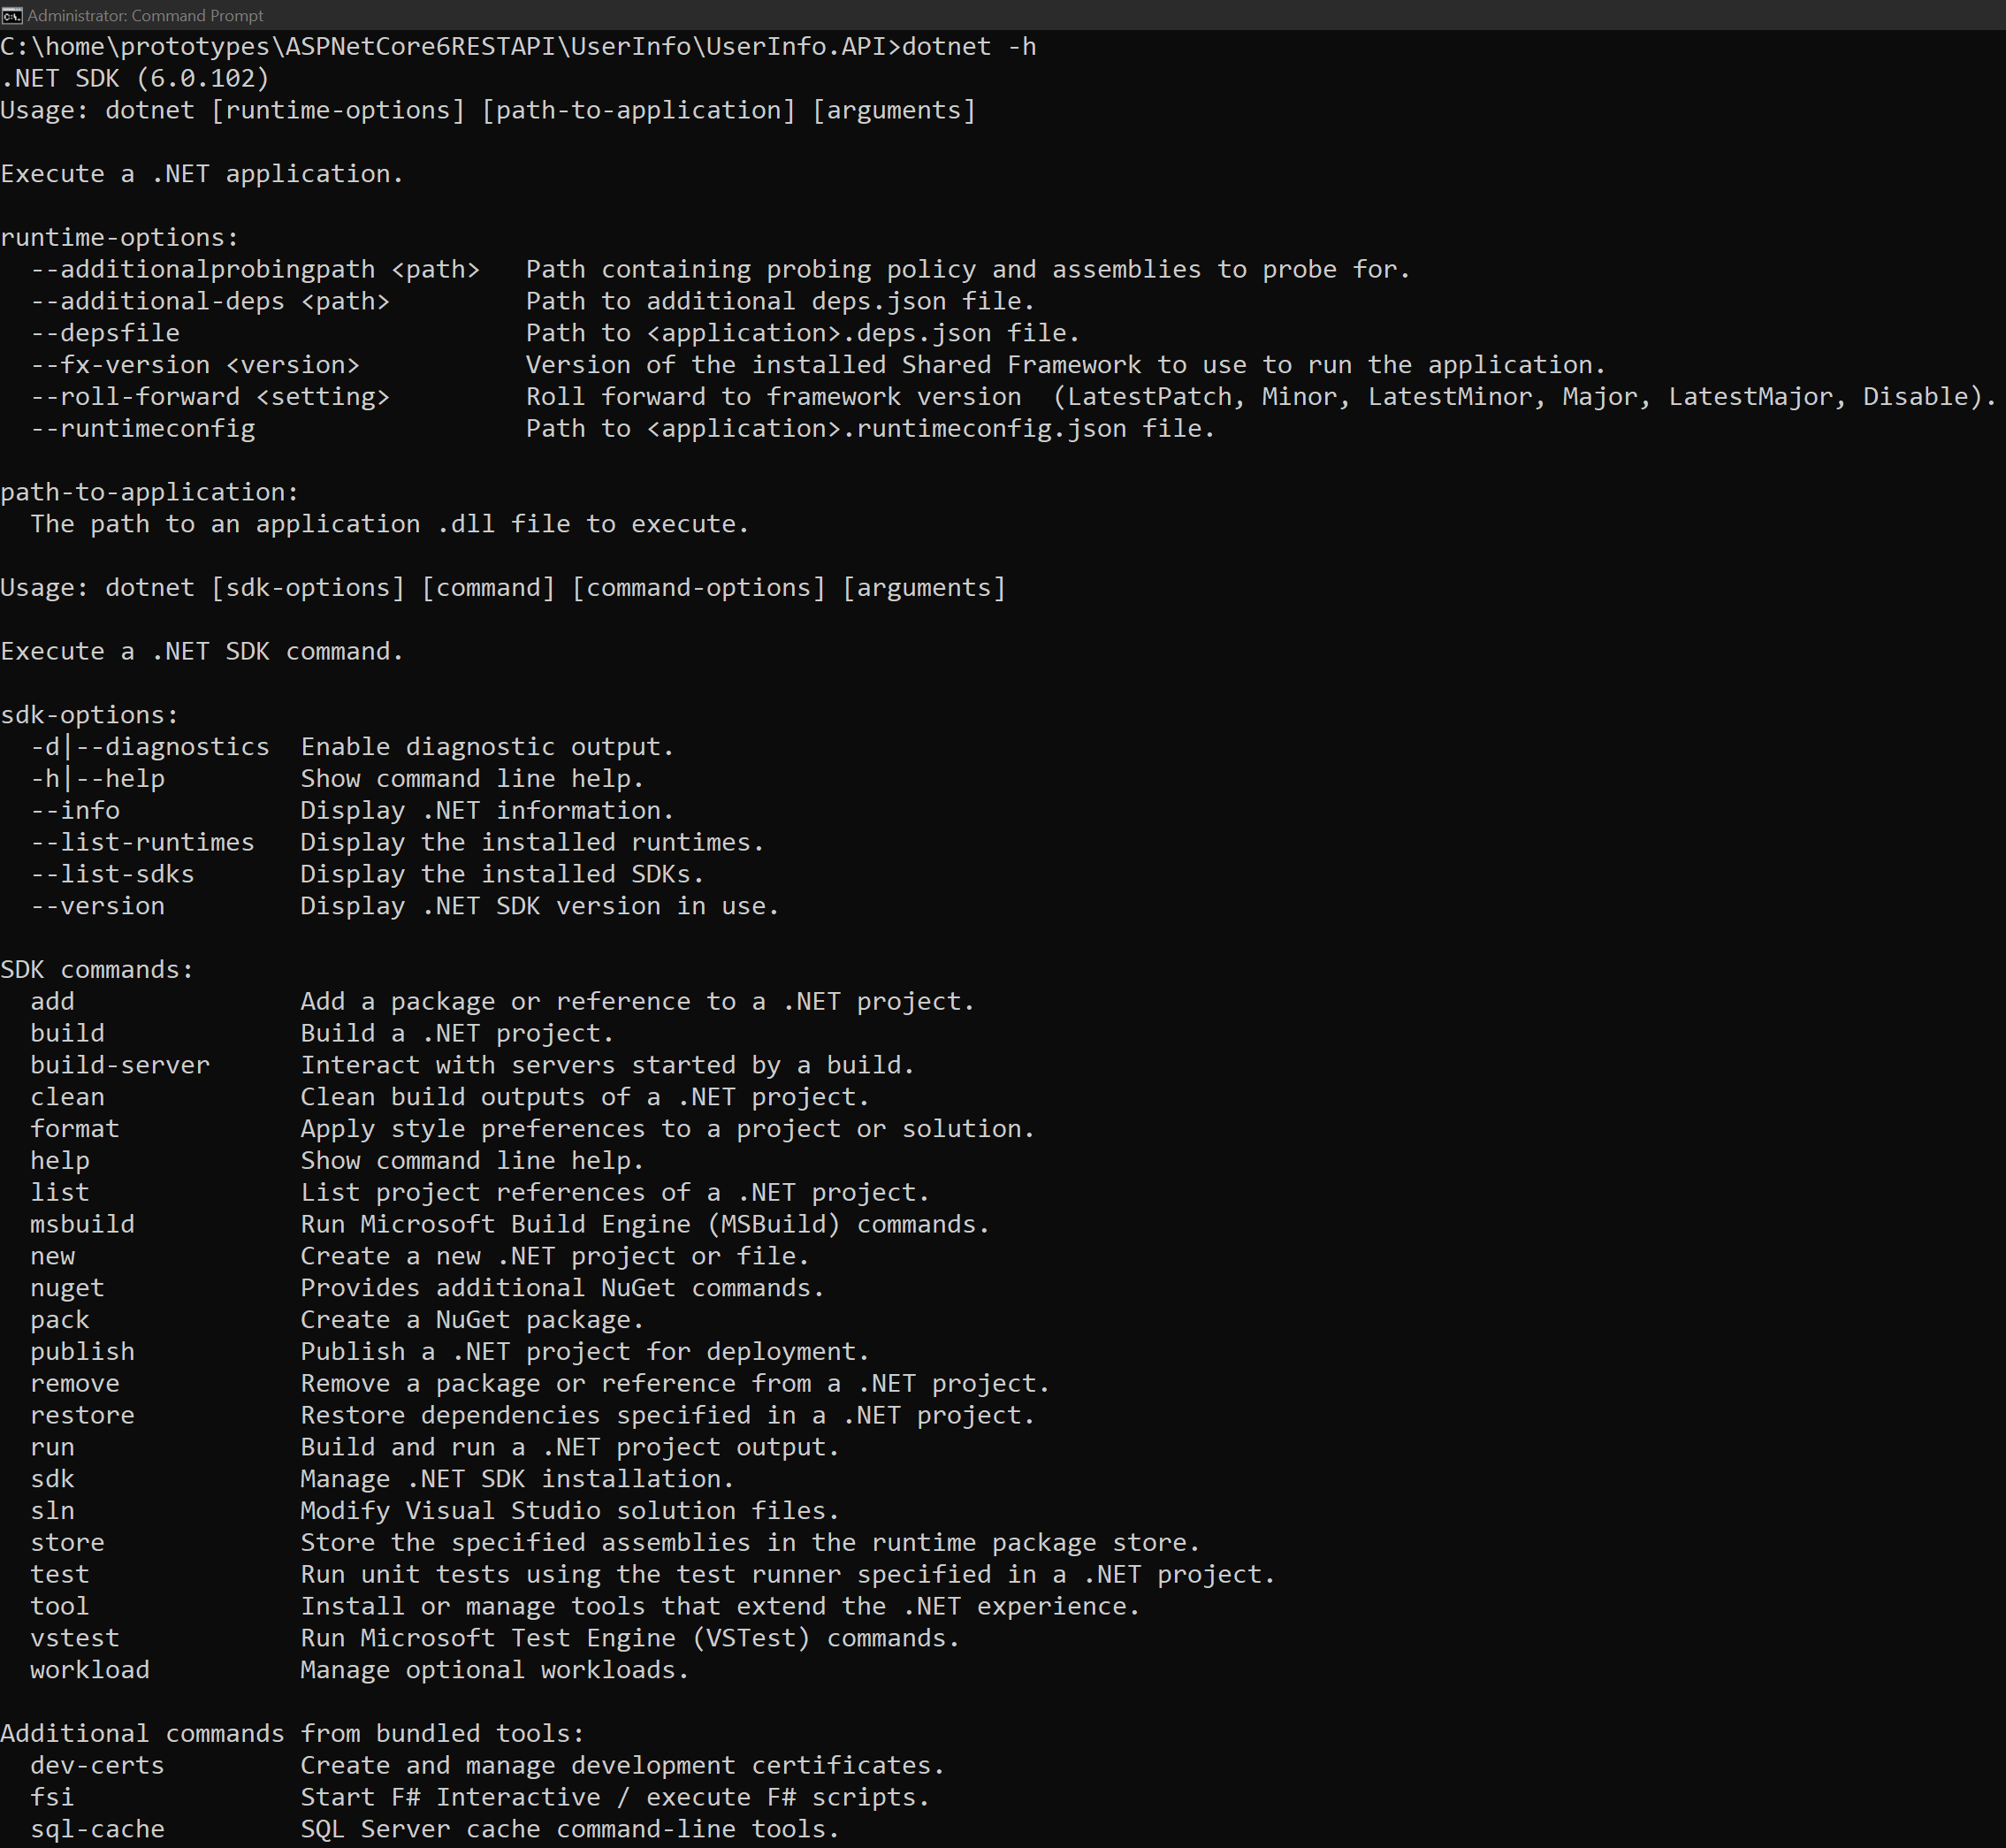
Dotnet -h

Slide 17
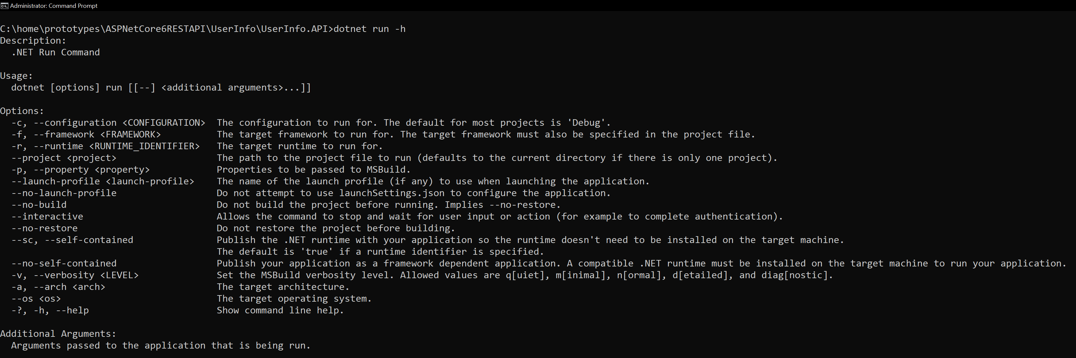
Dotnet run -h

Slide 18
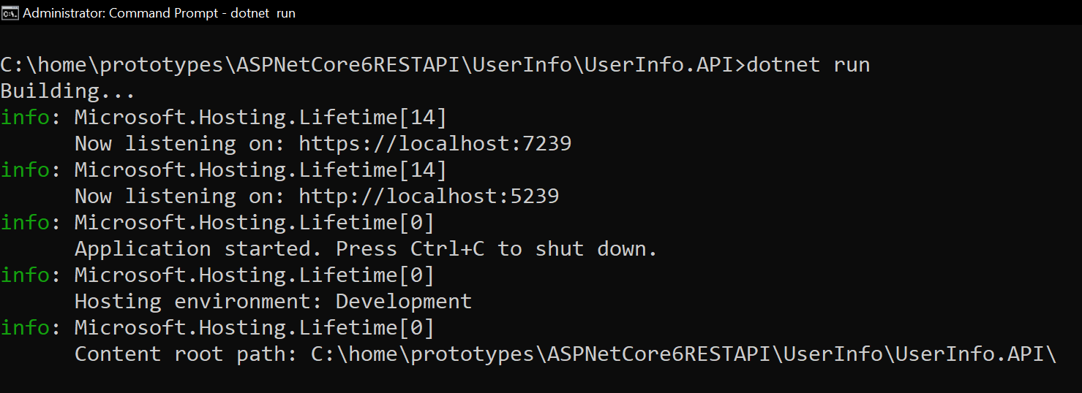
Dotnet run
Ctrl + c to shutdown the application.

Slide 19
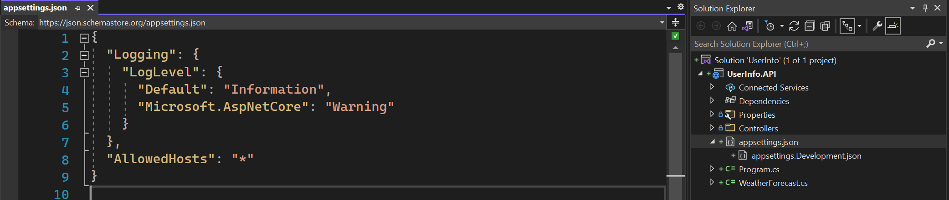
Appsettings.json
Default appsettings.json that allowed host.

Slide 20
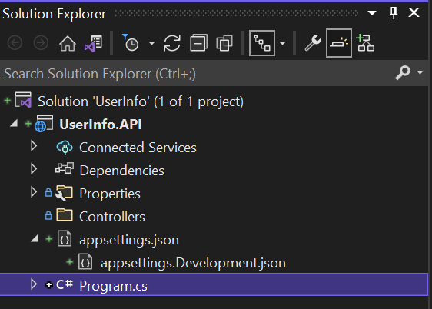
Delete weatherforecastcontroller and weatherforecast

Slide 21
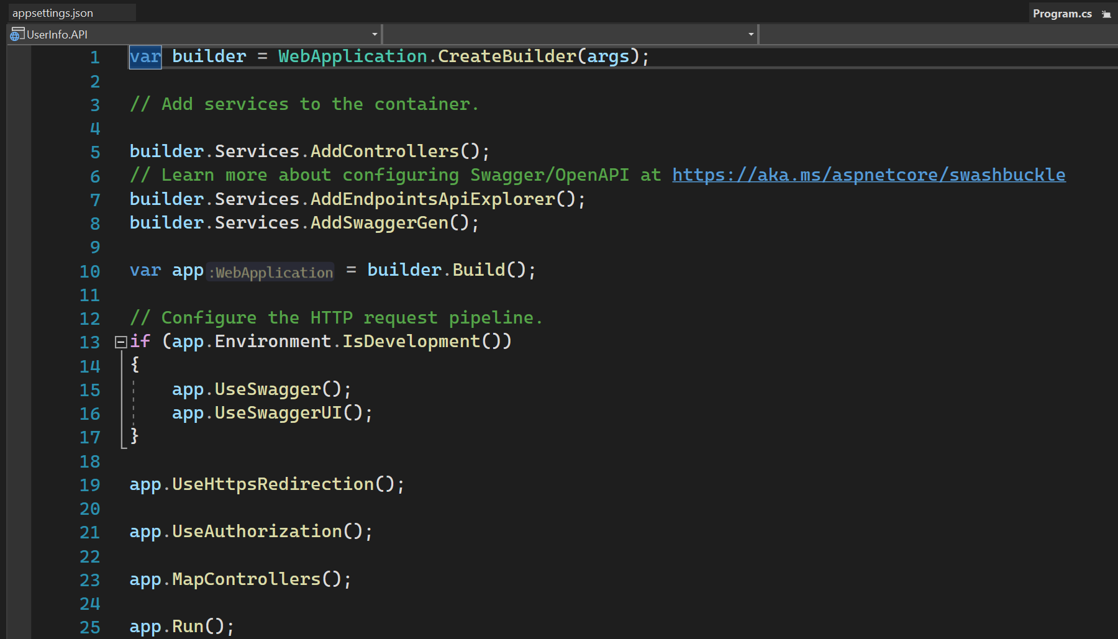
Top level statement feature

Slide 22
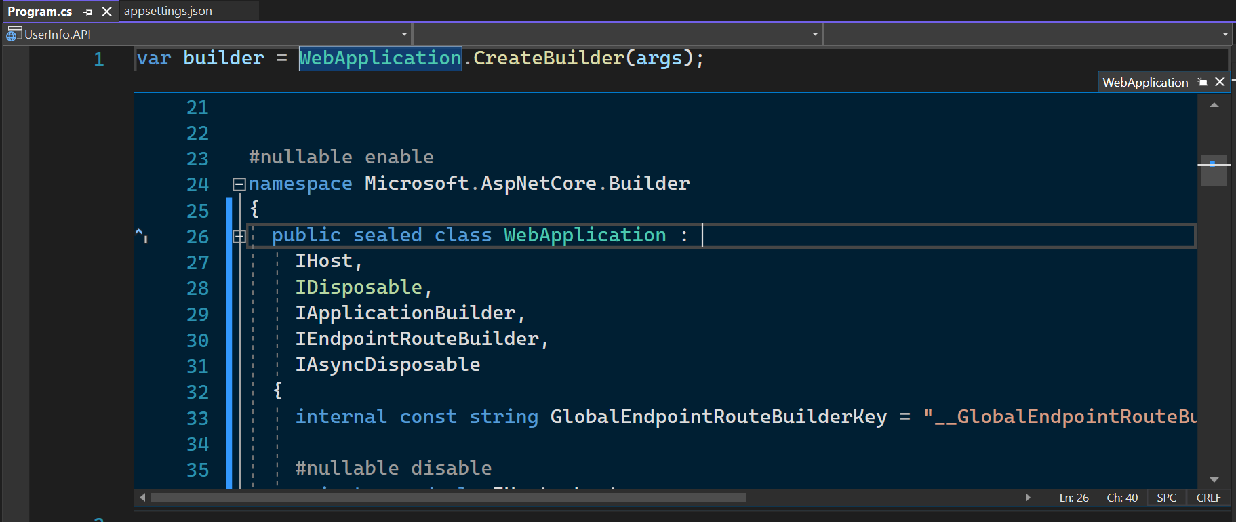
Iapplicationbuilder
IApplicationBuilder : Provides a mechanism to configure application request pipeline and that’s exactly what we do next.
By doing so, how ASP.Net Core will respond to individual HTTP requests. The components that potentially handle these
requests are called as MiddleWare.

Slide 23
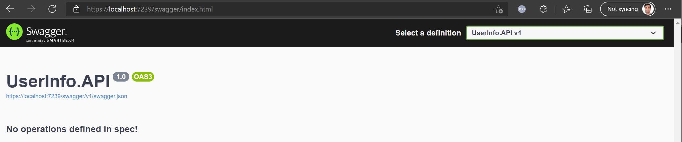
swagger

Slide 24
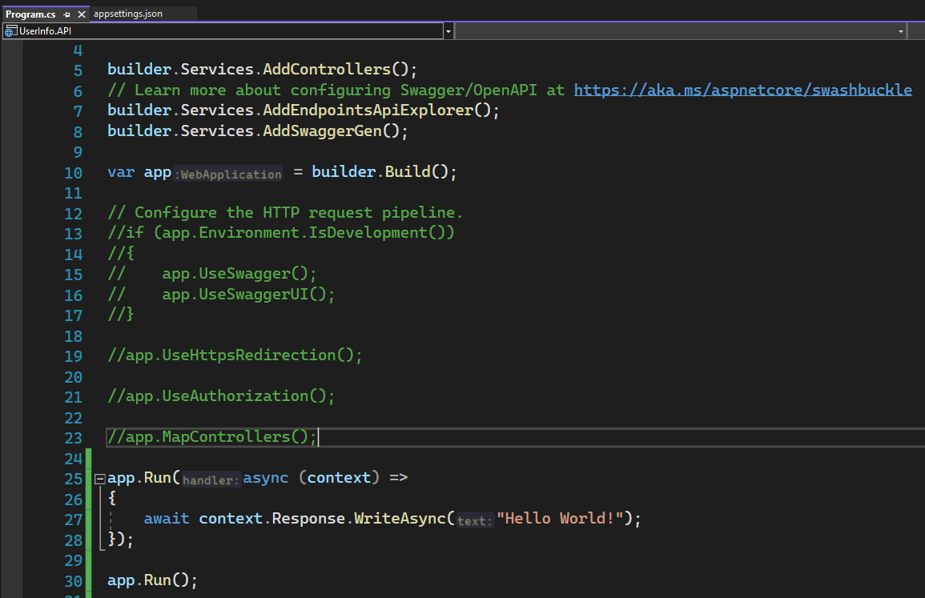
APP.Run

Slide 25

Run the application

Slide 26
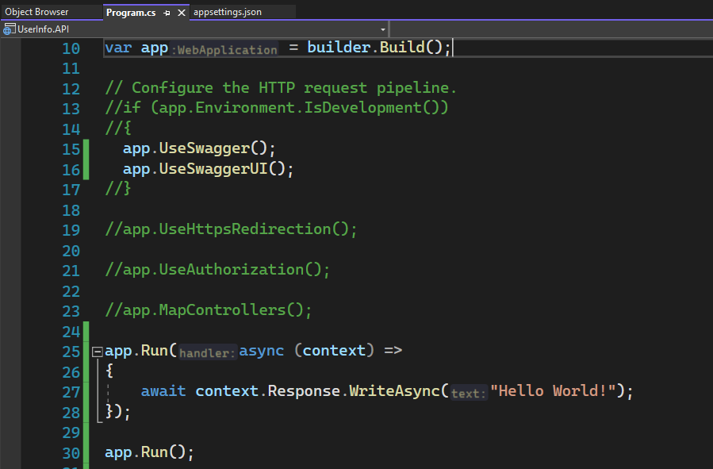
Enable swagger

Slide 27
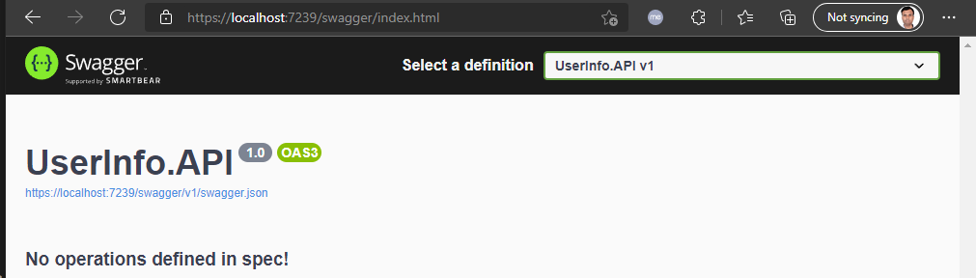
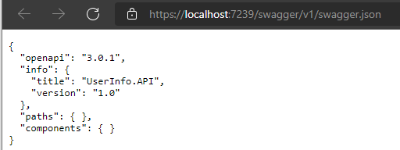
SWAGGER UI
<- This file being interpreted and transformed into UI.

Slide 28

Any other request

Slide 29
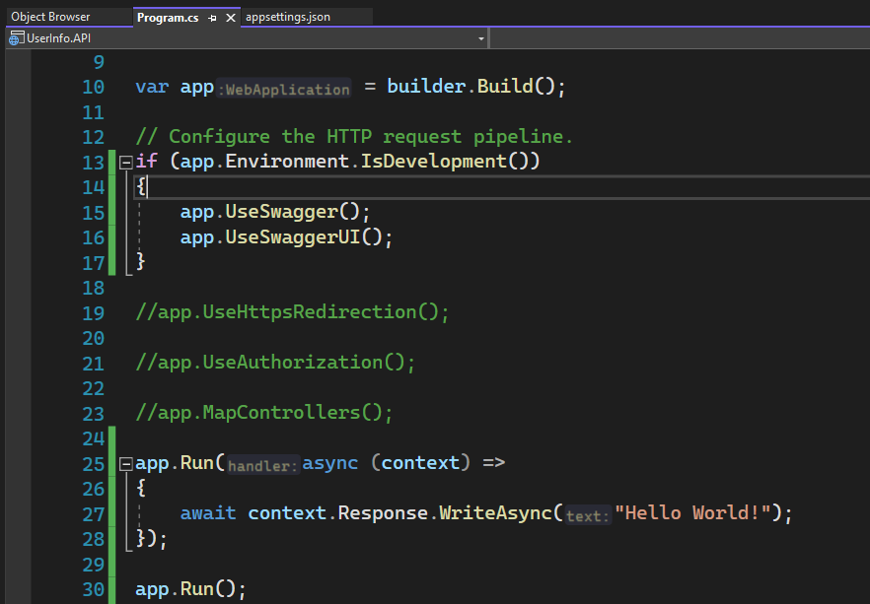
Enable development environment

Slide 30
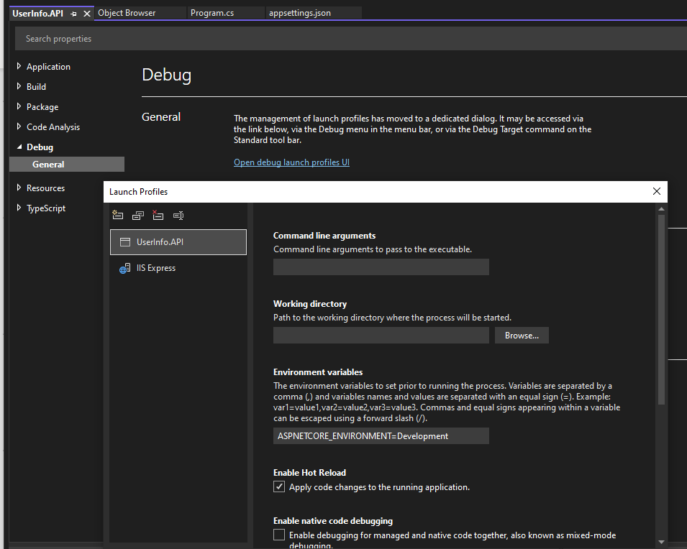
ASPNETCORE_ENVIRONMENT - development

Slide 31
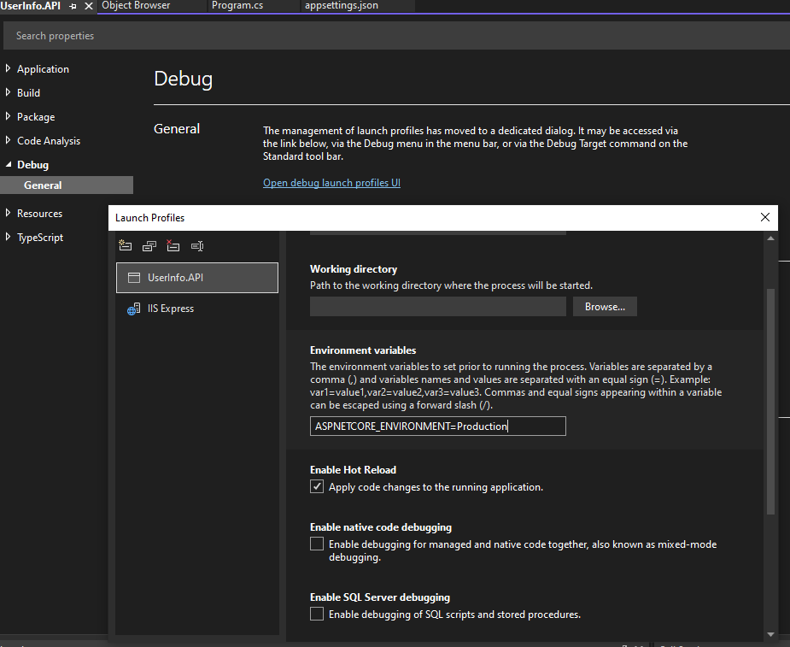
ASPNETCORE_ENVIRONMENT - production

Slide 32

Run the application

Slide 33
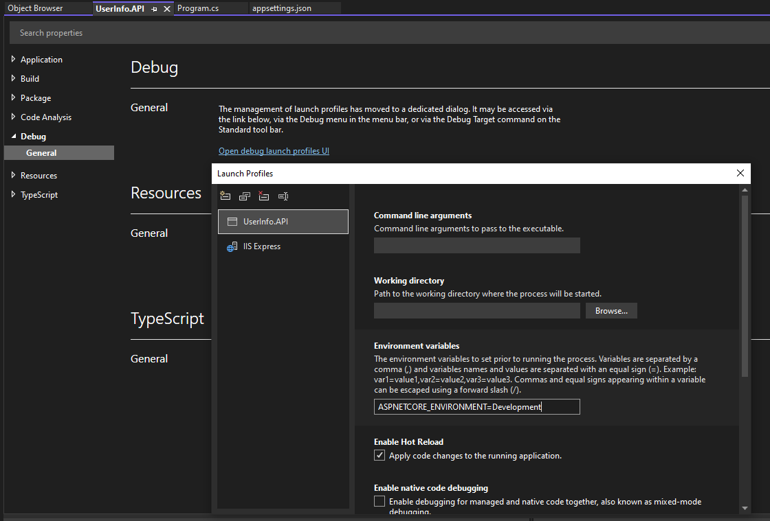
Aspnetcore_environment = development

