Slide 1

REST API Architectural constraints
Sit Dolor Amet

Slide 2
caching

Slide 3
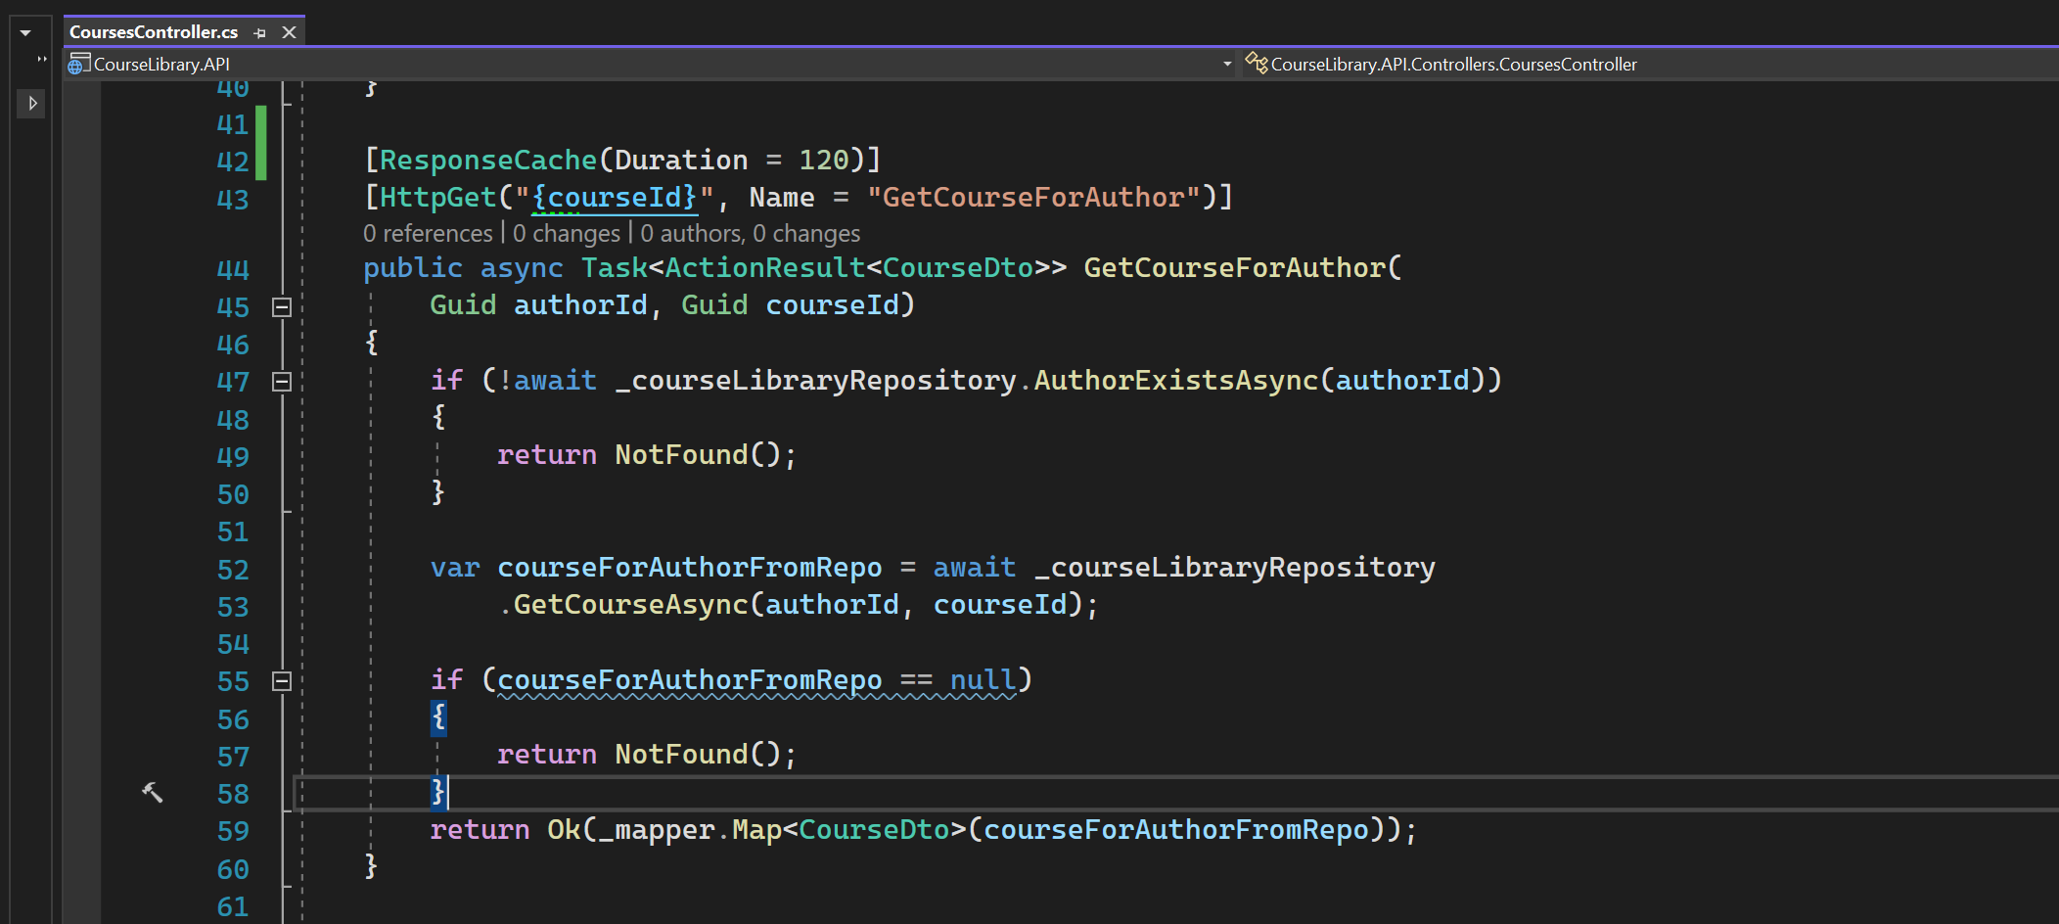
Adding cache headers

Slide 4
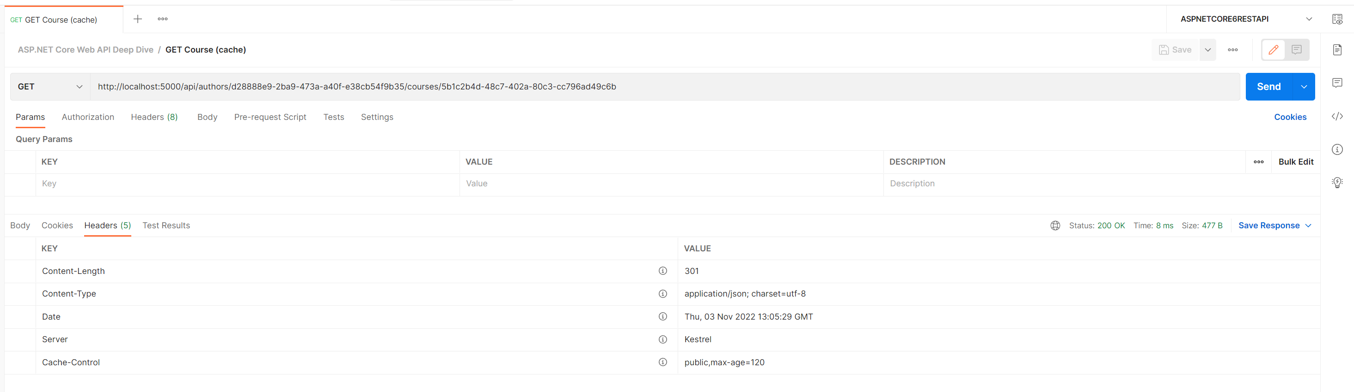
Cache-control
public means it can be used by both shared and private cache

Slide 5
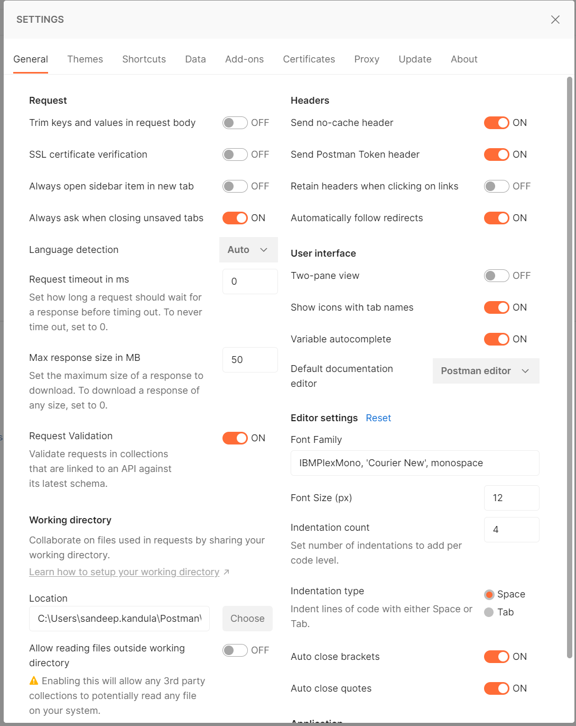
DEFAULT POST MAN SETTINGS

Slide 6
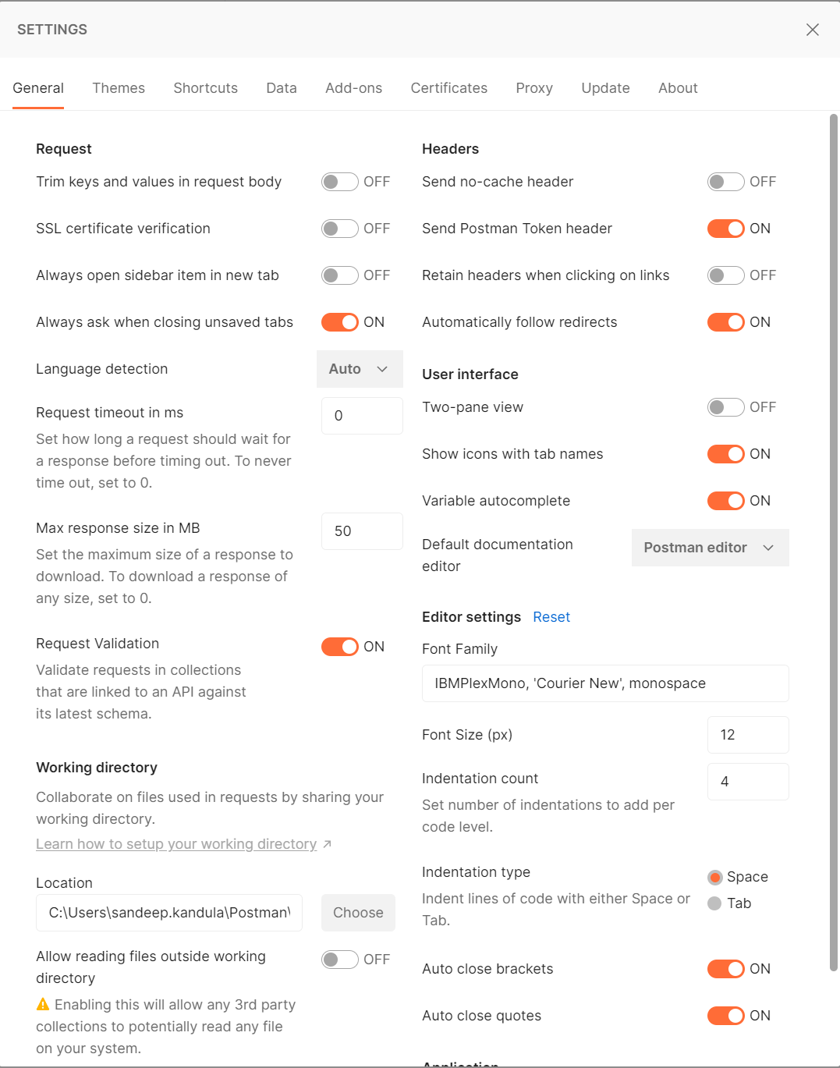
Send no cache header to off

Slide 7
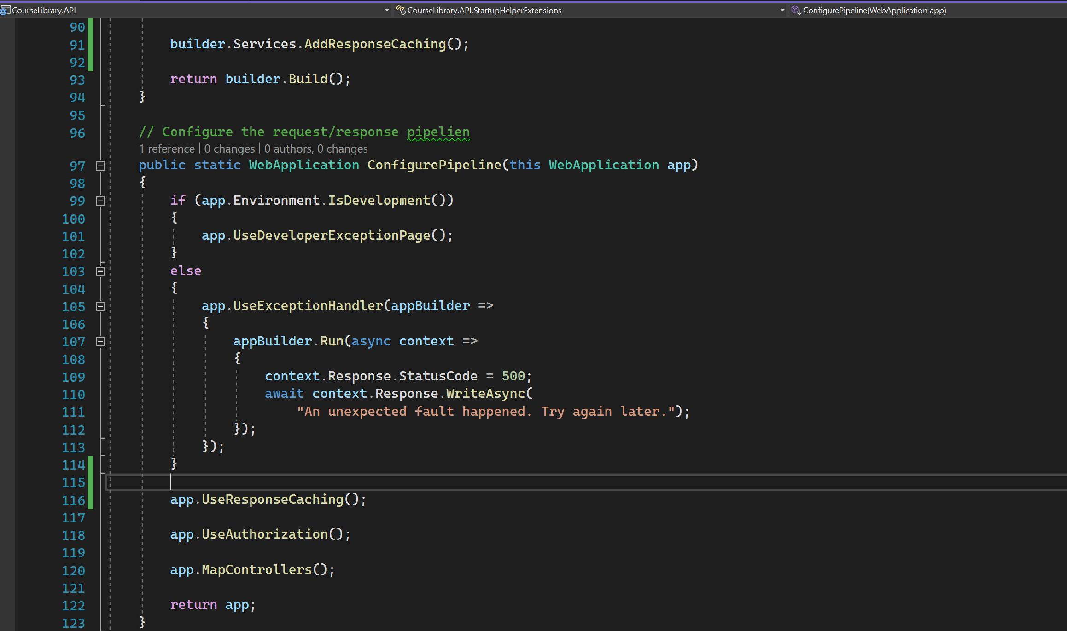
For cache to work, need to use cache store

Slide 8
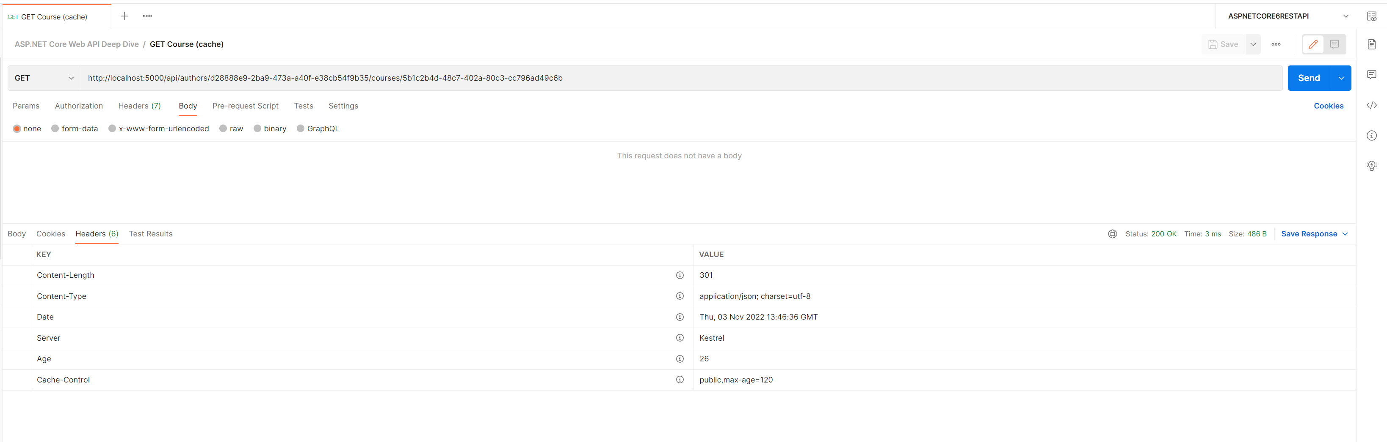
OBSERVE AGE
Will hit the backend after age expires.

Slide 9
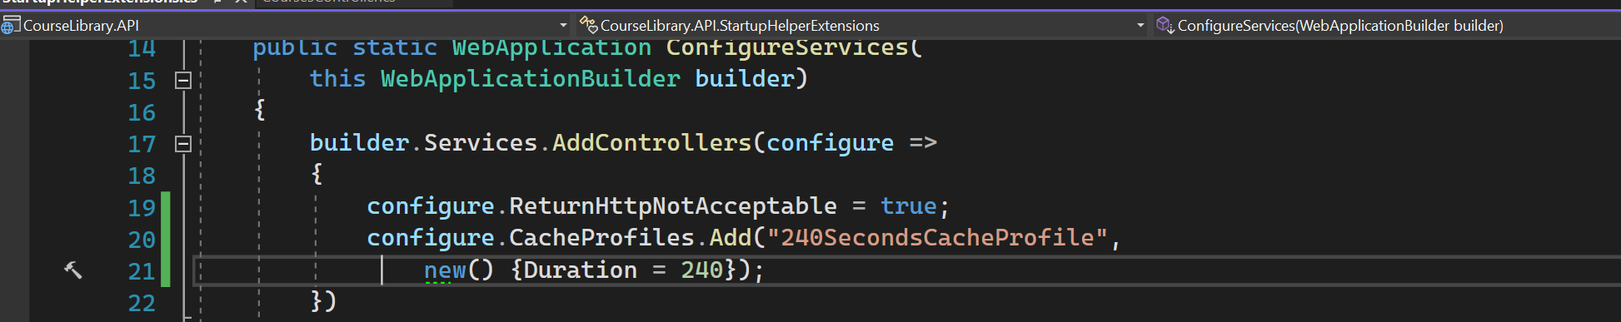
Cache profile - 1

Slide 10
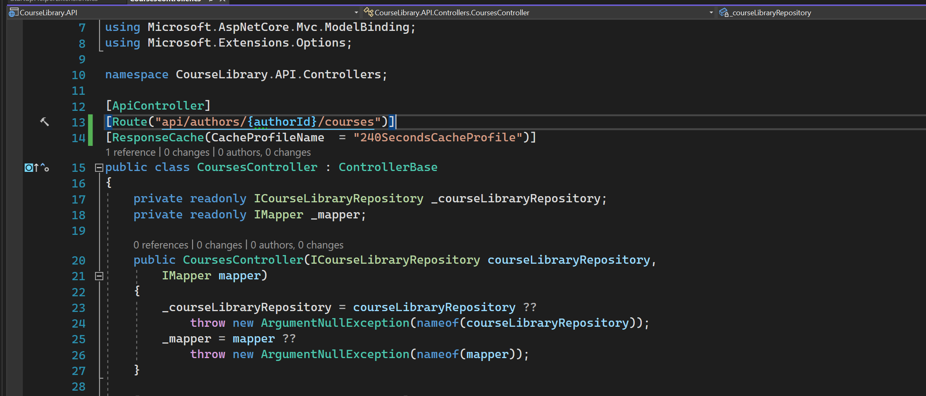
Cache profile - 2

Slide 11
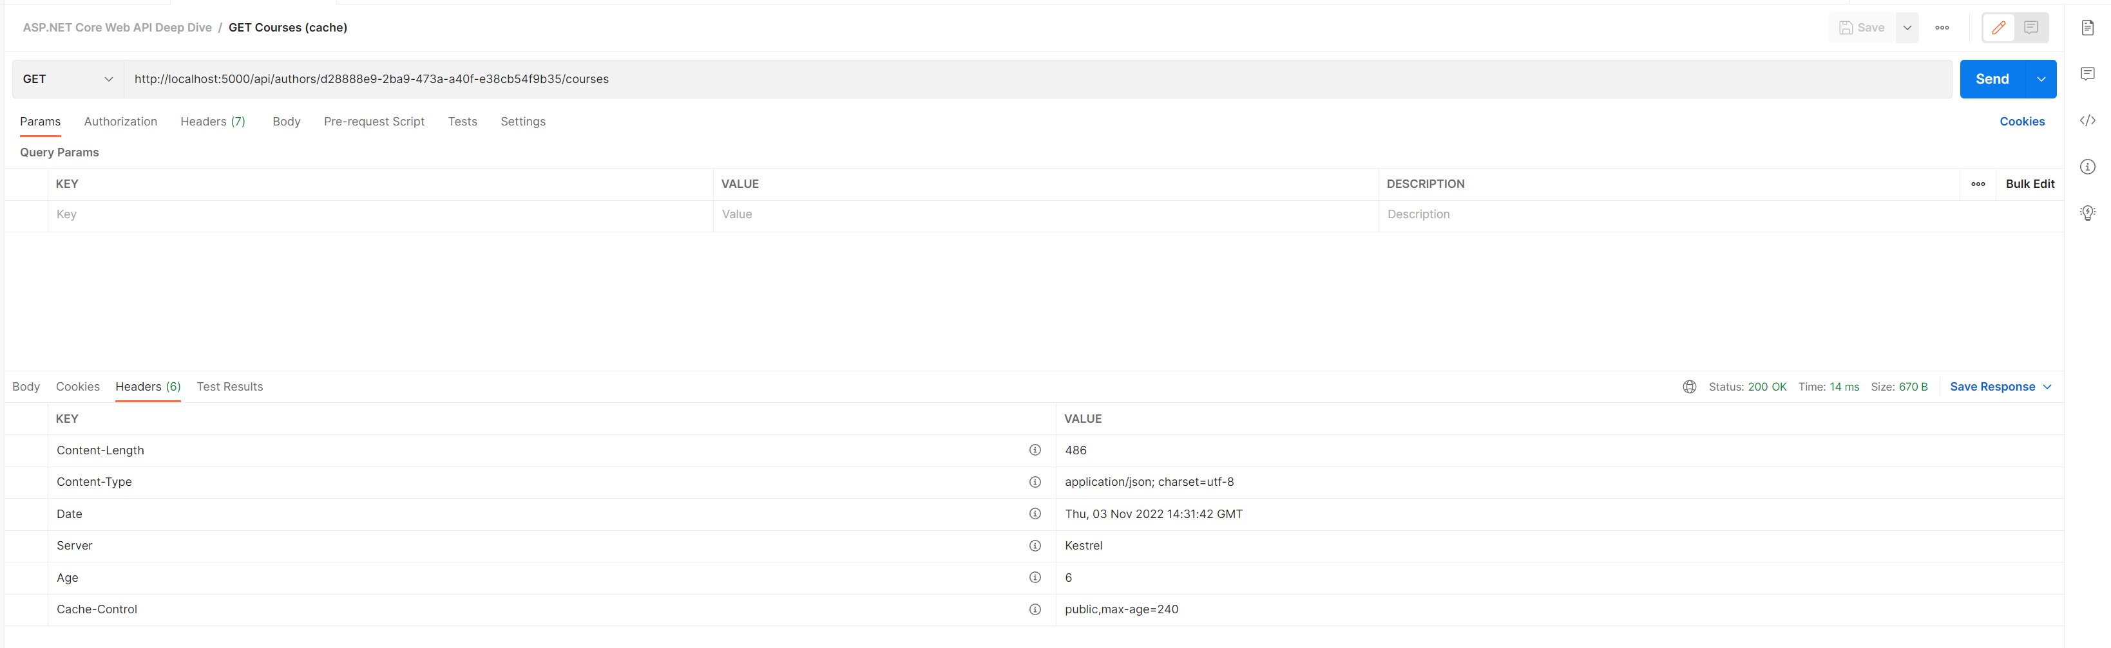
Cache profile - 3

